Slide 1

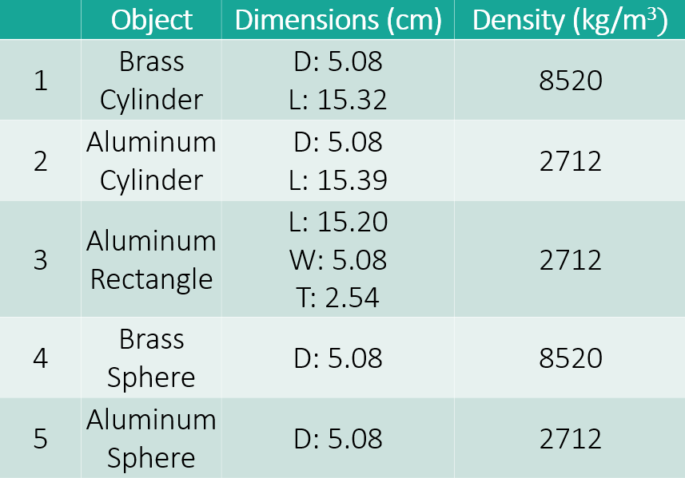
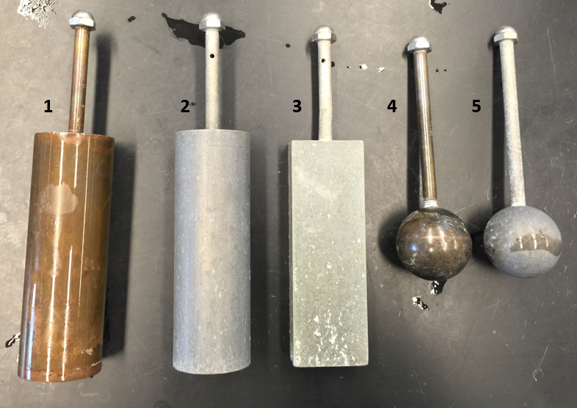
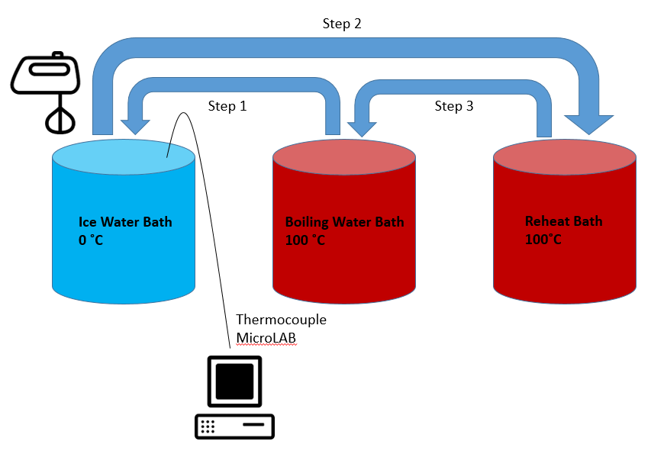
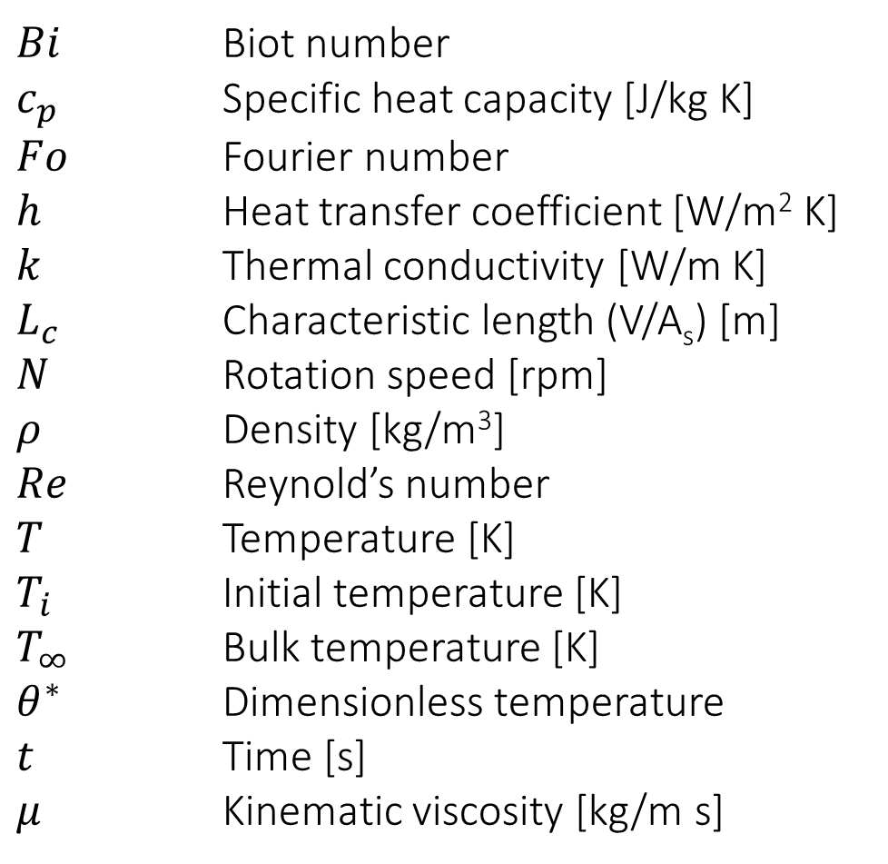
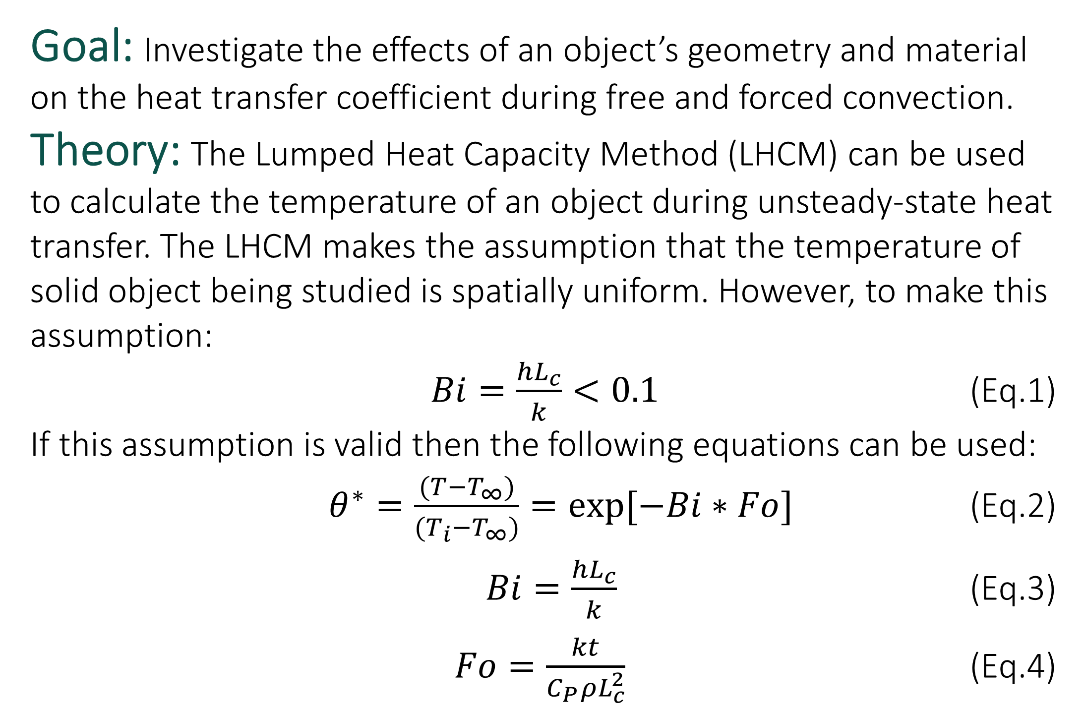
Unsteady-State Heat Transfer
The Best Group Ever
Beck, M., Estep, K., Fakhoury, M. & King, J.
Department of Chemical Engineering, University of New Hampshire
Introduction
Results
Results (cont.)
Goal: Investigate the effects of an object’s geometry and material on the heat transfer coefficient during free and forced convection.
Theory: The Lumped Heat Capacity Method (LHCM) can be used to calculate the temperature of an object during unsteady-state heat transfer.¹ The LHCM makes the assumption that the temperature of the solid object being studied is spatially uniform. However, to make this assumption:
$Bi=\frac{hL_{c}}{k}<0.1$ (Eq.1)
If this assumption is valid then the following equations can be used:
$θ^{∗}=\frac{(T−T_{∞})}{(T_{i}−T_{∞})}=exp[−Bi∗Fo]$ (Eq.2)
$Bi=\frac{hL_{c}}{k}$ (Eq.3)
$Fo=\frac{kt}{C_{P}ρL_{c}^{2}}$ (Eq.4)
As the density increased greatly from aluminum to brass, the heat transfer coefficient increased moderately by increments between 10-15 W/m²K.
As the cross sectional length increased slightly based on the geometry, the heat transfer coefficient increased by increments of 10-50 W/m²K.
There was a dramatic increase in the value of the heat transfer coefficient when operating under forced convection verses free convection.
.
Figure 4: Dimensionless temperature and time to reach steady state (0.1 Dimensionless Temperature) of trial 1 for free and forced convection of the aluminum sphere.
Design Solution
Design Problem: Find the time needed to cool an aluminum sphere with a 10 cm diameter from 120 °C to 10 °C in a 5 °C water bath for free and forced convection.
Using the calculated heat transfer coefficients for the aluminum sphere for free and forced convection the cooling times displayed in Figure (5) were determined.
Methods
Figure 2: Average heat transfer coefficients for free and forced convection for the five objects. The error bars displayed represent the standard deviation.
-45 %
-87 %
Figure 5: Time to reach design problem conditions for free convection from experimental and literature values and forced convection from experimental values¹.
Variables
$Bi$ Biot number
$c_{p}$ Specific heat capacity [J/kg K]
$Fo$ Fourier number
$h$ Heat transfer coefficient [W/m² K]
$k$ Thermal conductivity [W/m K]
$L_{c}$ Characteristic length (V/A_{s}) [m]
$N$ Rotation speed [rpm]
$ρ$ Density [kg/m³]
$Re$ Reynold’s number
$T$ Temperature [K]
$T_{i}$ Initial temperature [K]
$T_{∞}$ Bulk temperature [K]
$θ^{∗}$ Dimensionless temperature
$t$ Time [s]
$μ$ Kinematic viscosity [kg/m s]
Figure 3: Average time to steady state (0.1 dimensionless temperature) for free and forced convection for the five objects.
For conditions regarding free and forced convection, as the time increased the temperature of the object decreased.
As the time increased by increments of 100 seconds, the dimensionless temperature difference decreased only slightly.
At a certain time, the dimensionless temperature difference reached a steady state.
References
Figure 1: Diagram of methods and objects.
1. Bergman, Theodore L., Afrienne S. Lavine, David P. DeWitt, and Frank P. Incropera. Introduction to Heat Transfer. 6th ed. Hoboken, NJ: Wiley, 2011. Print.

