Slide 1

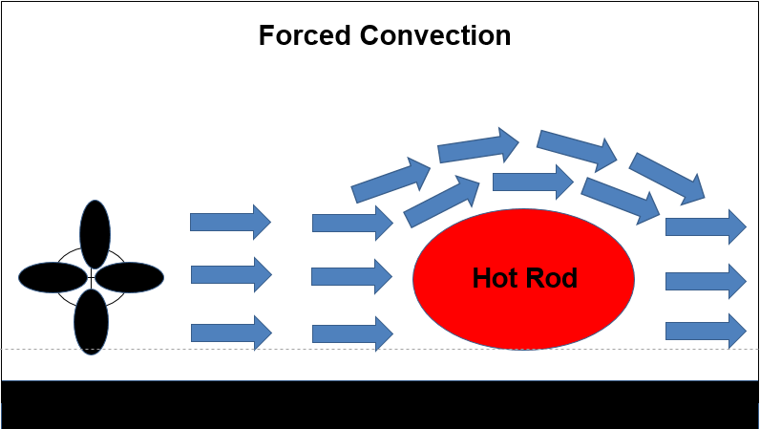
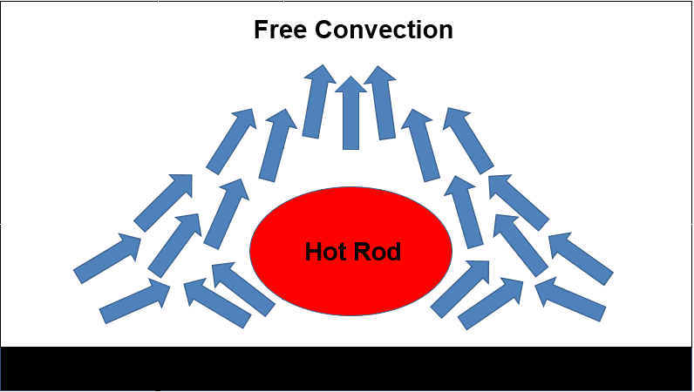
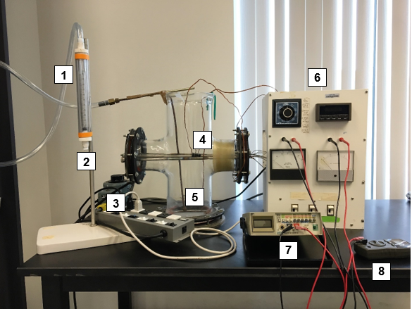
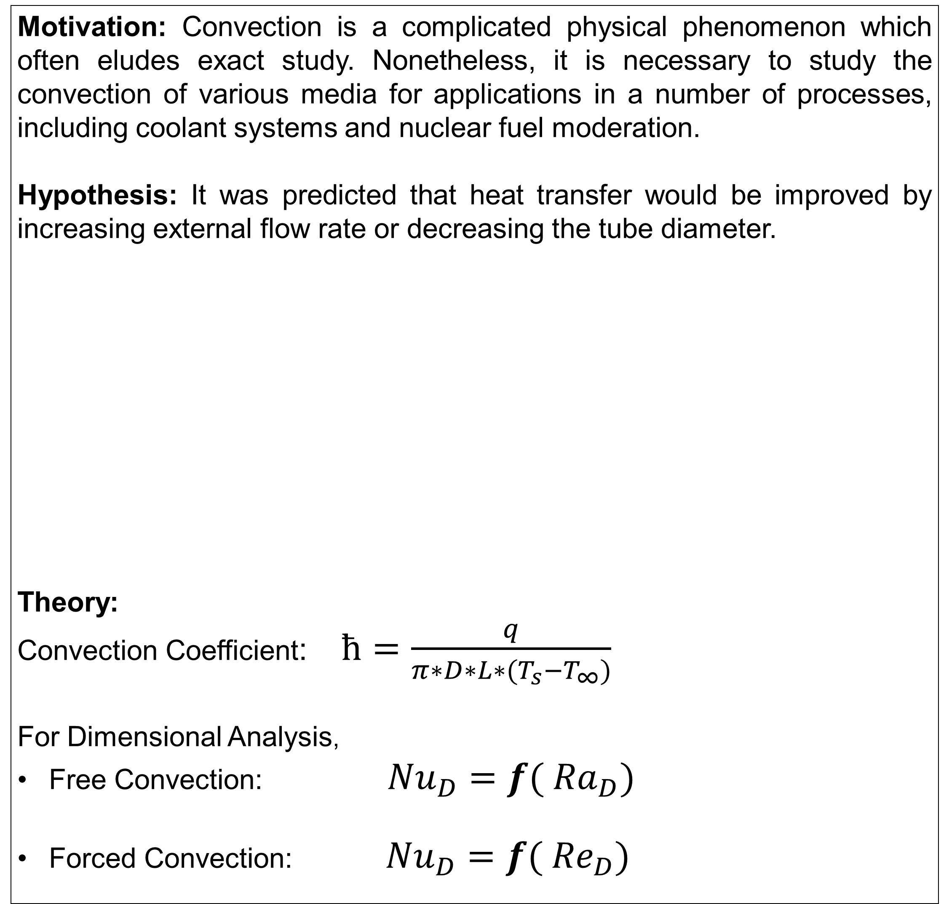
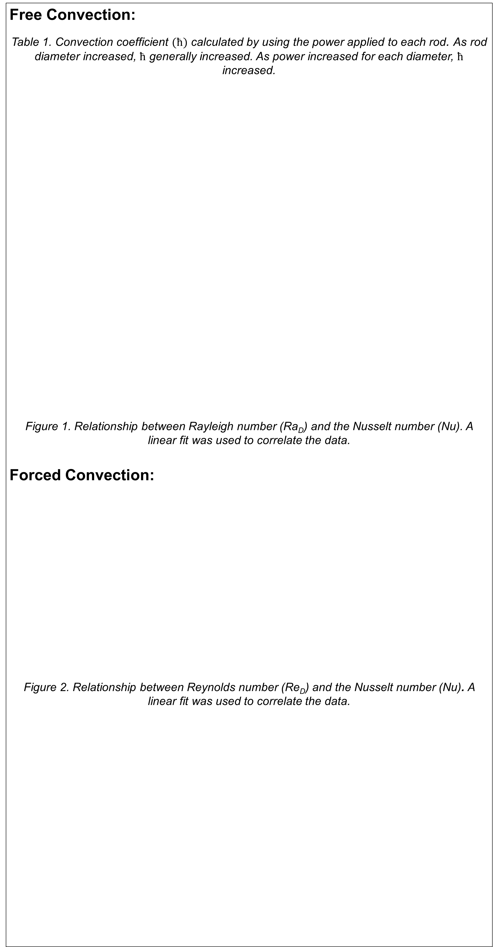
Free and Forced Convection over Horizontal Cylinders
Justin Cournoyer, Ami Humphrey, Cedric Masengere, Chris Reilly
Department of Chemical Engineering, University of New Hampshire
Introduction
Results and Discussion
Design Problem
Motivation: Convection is a complicated physical phenomenon which often eludes exact study. Nonetheless, it is necessary to study the convection of various media for applications in a number of processes, including coolant systems and nuclear fuel moderation.
Hypothesis: It was predicted that heat transfer would be improved by increasing external flow rate or decreasing the tube diameter.
Theory:
Convection Coefficient: $ħ=\frac{q}{π∗D∗L∗(T_{s}−T_{∞})}$
For Dimensional Analysis,
Free Convection: ${Nu}_{D}=f( {Ra}_{D})$
Forced Convection: ${Nu}_{D}=f( {Re}_{D})$
Free Convection:
Table 1. Convection coefficient $(ħ)$ calculated by using the power applied to each rod. As rod diameter increased, $ħ$ generally increased. As power increased for each diameter, $ħ$ increased.
Figure 1. Relationship between Rayleigh number (Ra_{D}) and the Nusselt number (Nu). A
linear fit was used to correlate the data.
Forced Convection:
Figure 2. Relationship between Reynolds number (Re_{D}) and the Nusselt number (Nu). A linear fit was used to correlate the data.
A cylindrical heating element is used in an endothermic reaction that takes place in air in a reaction vessel at 30°C. The volume of the vessel is 0.5 m³. Heat must be added at a rate of 100 J/min but the temperature of the heating element must not exceed 80°C. Determine the size of the heating element necessary to achieve the design objectives with natural convection. If the reaction medium is flowing through the vessel at a flow rate of 25 m/s, how is the size of the heating element affected?
Free Convection Solution:
D = 0.125 inches and L = 1.93 inches
Forced Convection Solution:
D = 0.047 inches and L= 5.75x10⁻⁵ inches
Diameter (in) | Power (W) | Convection Coefficient (W/m² K)
1/4 | 13.84 38.56 | 41.38 41.96
3/8 | 15.67 38.10 | 37.43 45.16
1/2 | 10.99 28.16 | 62.64 71.22
Forced Convection Air Flow
(v = 25 m/s)
Guess heating element diameter
Vessel (V = 0.5 m³)
T∞ = 30°C
Calculate Reynold’s number
Calculate Rayleigh number
Use experimental correlation to find Nusselt number
T_{S} = 80°C
Find convection coefficient
Heating Rod
(q = 100 J/min)
D
Find length of heating element
L
Find surface area of heating element
Find dimensions of reactor vessel
Methods
 | Free Convection | Forced Convection
Manipulated Variables | Diameter Voltage | Diameter Air flow rate
Constant Variables | Air Flow | Voltage
Figure 4. Free convection heat transfer coefficient versus rod diameter.
Figure 5. Forced convection heat transfer coefficient versus rod diameter.
Legend
Flow meter
2. Air Inlet
3. Power Source
4. Heating Rods
5. Air outlet
6. Thermocouple Reader
7. Voltmeter
8. Ammeter
References
C. Geankoplis, Transport Processes and Separation Process Principles, 4th ed. Pearson Education, Inc., 2003
Figure 3. Convection coefficient ($ħ$) versus velocity of air for various rod diameters. As the velocity increased, $ħ$ increased. Larger diameter produced higher $ħ$ values.
Acknowledgements: We would like to thank Dr. St. Jean for aiding in data collection and analysis in this experiment.

