Slide 1

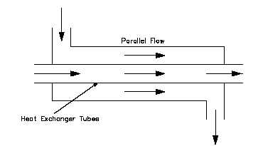
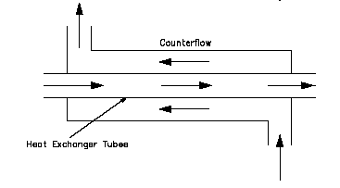

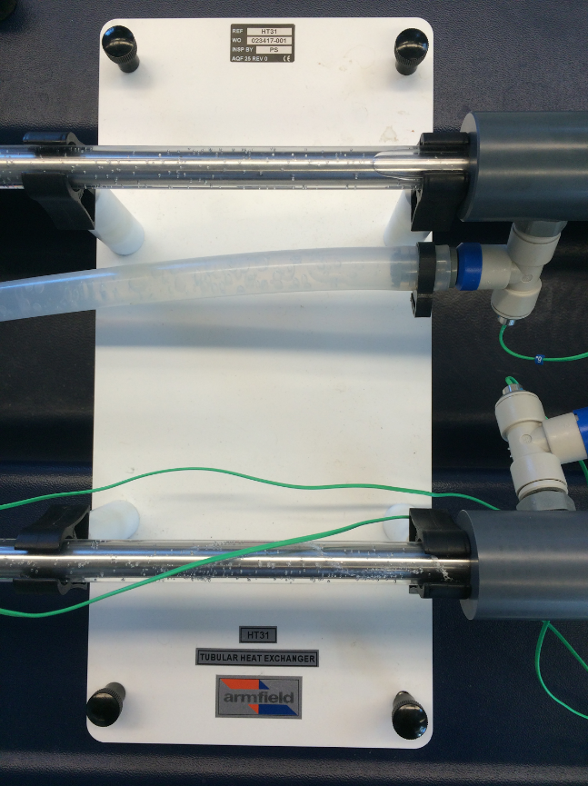
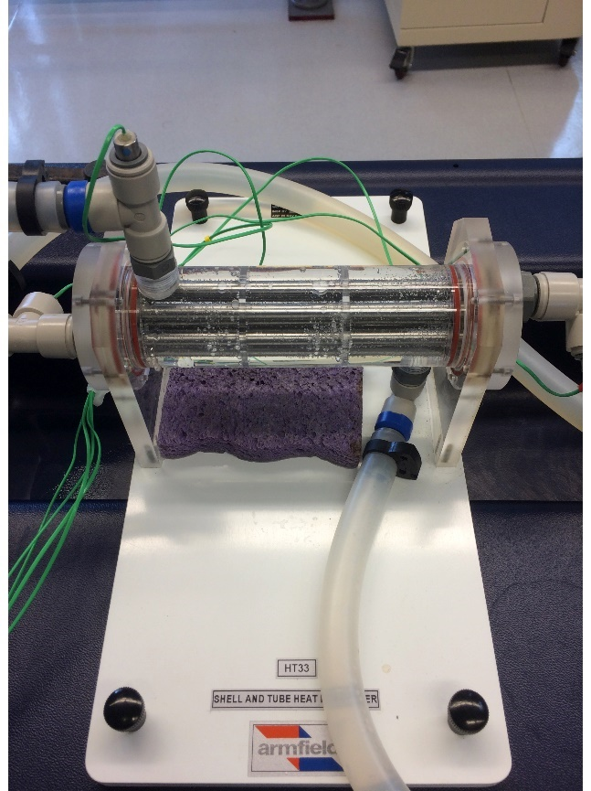
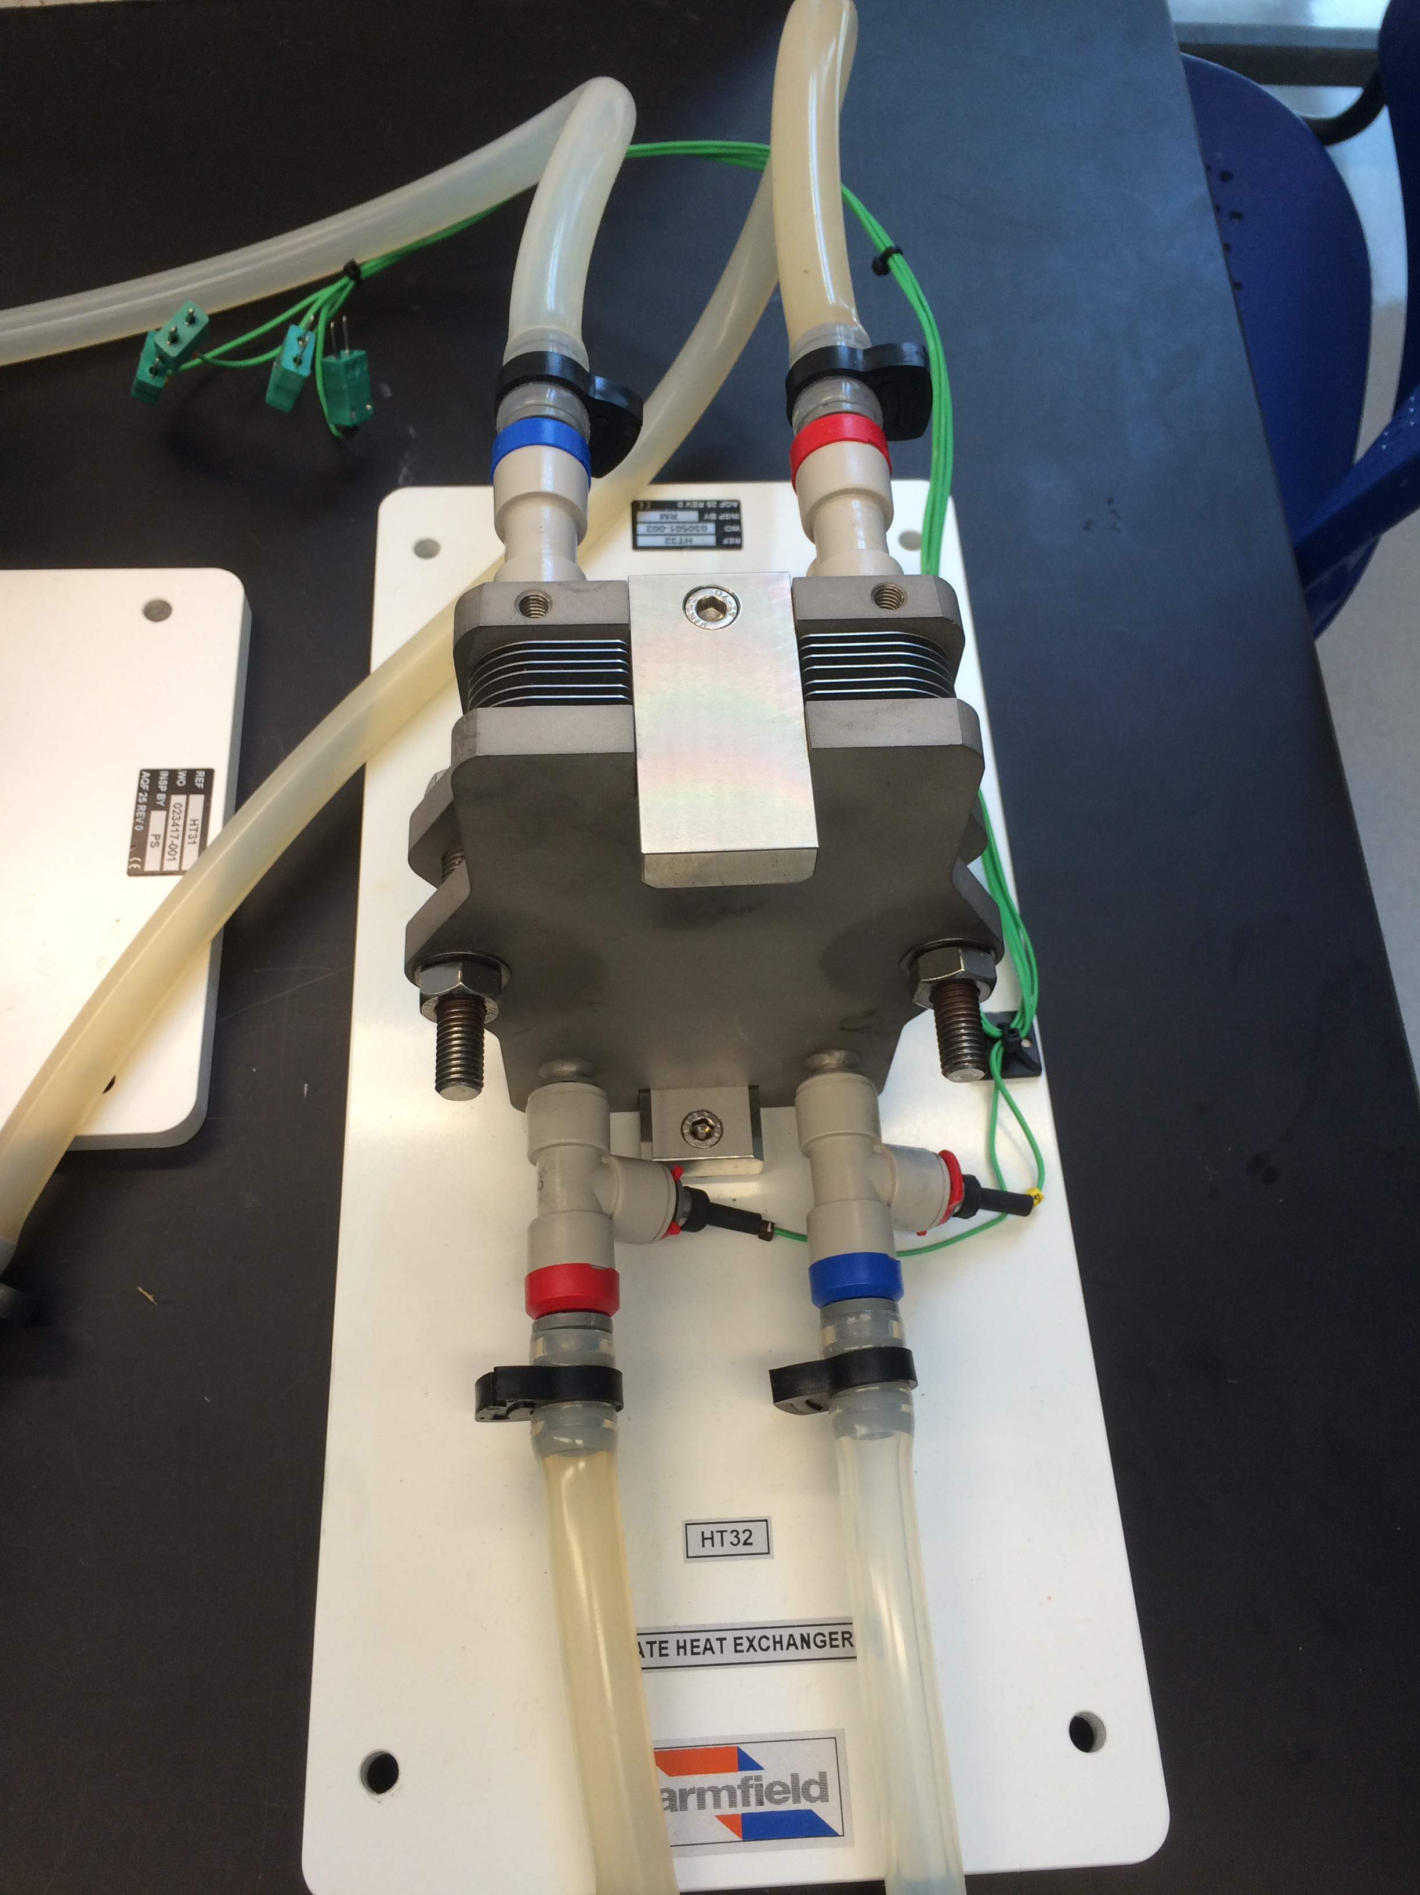
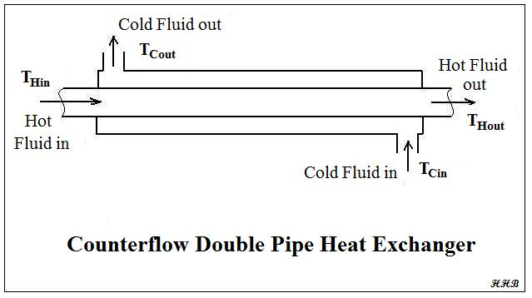
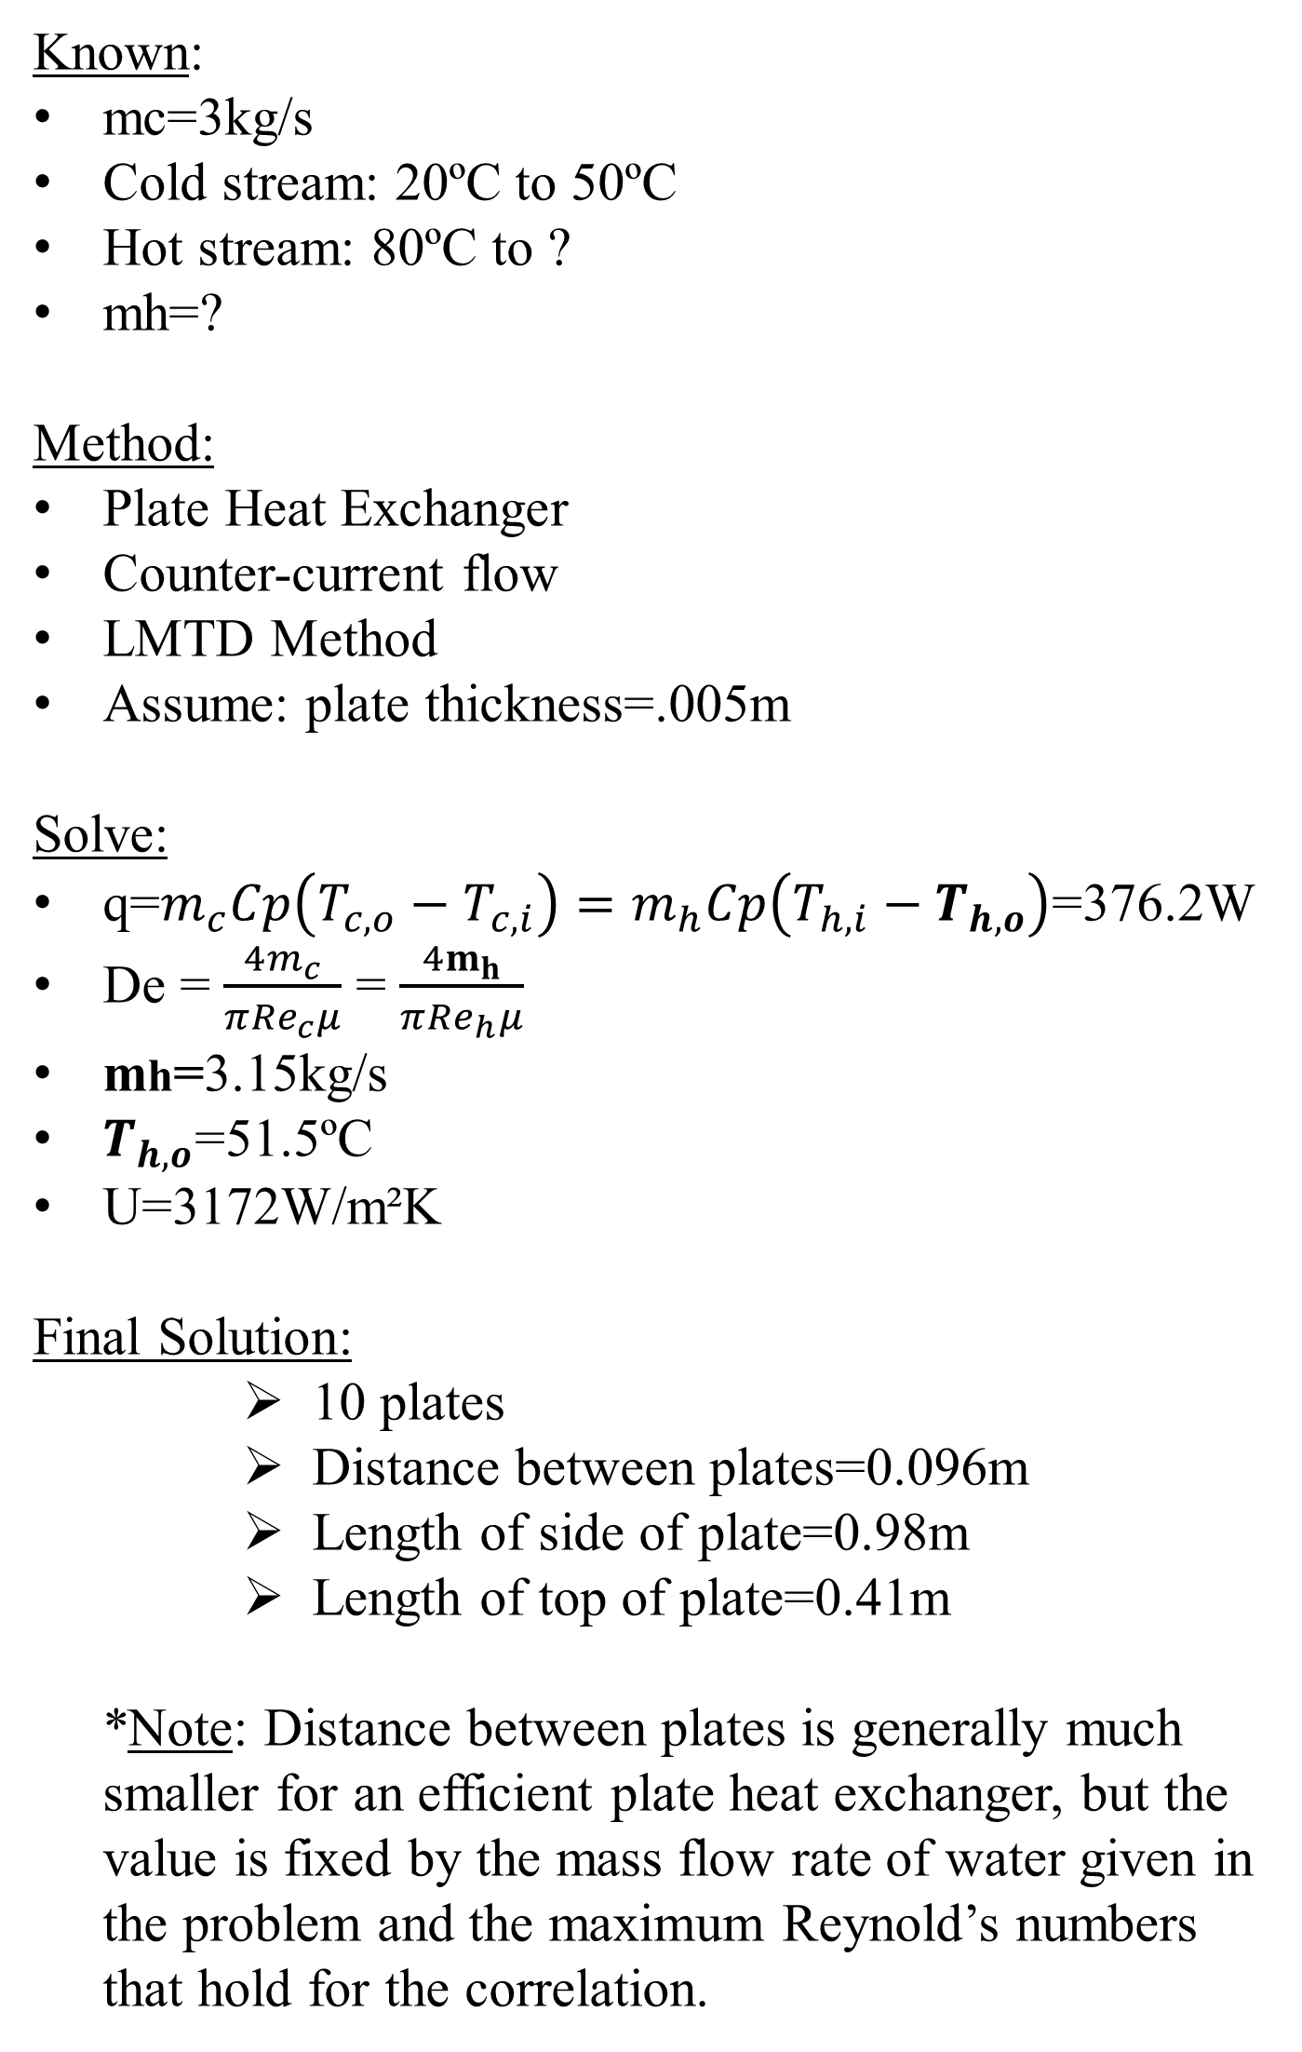
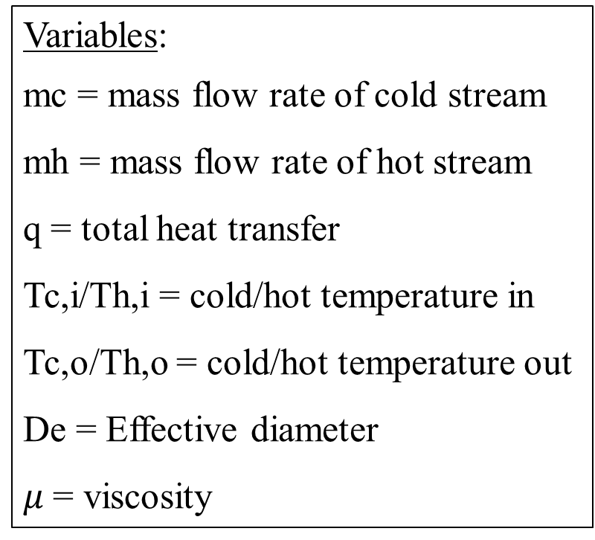
Comparison of Heat Exchangers
Courtney McLoud, Jojo Steiner, Meghan Moore, Department of Chemical Engineering, University of New Hampshire
Introduction
Figure 3. Cross method of varying flow rates (CFR=cold flow rate, HFR=hot flow rate)
This was performed for co-current and countercurrent flow by changing the direction of the hot water inlet (Figure 1).
Statistical Methods
A Multilinear Regression was performed on the hot and cold stream data versus the calculated heat transfer coefficient to determine any potential relationship.
Design Problem
HFR
Test the effects that a Plate, Tubular, and Shell and Tube Heat Exchangers had on the overall heat transfer coefficient (U) and Reynolds Number (Re).
Determine if Co-current or Countercurrent flow affected U or Re.
Main variables observed were the rate of heat transfer (q), surface area (As), and log mean temperature difference (ΔTlm ,LMTD method. )
Calculation of Re determined relationship between flow rate and U
Re=ρVD/μ Equation 2
The overall heat transfer coefficient was solved using the LMTD Method.
q=UAΔTlm Equation 1
1
3
1 2 3
CFR
Variables:
mc = mass flow rate of cold stream
mh = mass flow rate of hot stream
q = total heat transfer
Tc,i/Th,i = cold/hot temperature in
Tc,o/Th,o = cold/hot temperature out
De = Effective diameter
$μ$= viscosity
Known:
mc=3kg/s
Cold stream: 20ºC to 50ºC
Hot stream: 80ºC to ?
mh=?
Method:
Plate Heat Exchanger
Counter-current flow
LMTD Method
Assume: plate thickness=.005m
Solve:
q=$m_{c}Cp\left(T_{c,o}−T_{c,i}\right)=m_{h}Cp\left(T_{h,i}−T_{h,o}\right)$=376.2W
De = $\frac{4m_{c}}{π{Re}_{c}μ}$ = $\frac{4m_{h}}{π{Re}_{h}μ}$
mh=3.15kg/s
$T_{h,o}$=51.5ºC
U=3172W/m²K
Final Solution:
      10 plates
      Distance between plates=0.096m
      Length of side of plate=0.98m
      Length of top of plate=0.41m
  *Note: Distance between plates is generally much smaller for an efficient plate heat exchanger, but the value is fixed by the mass flow rate of water given in the problem and the maximum Reynold’s numbers that hold for the correlation.
Figure 5. Plate Heat Exchanger correlation, R²=0.880, Adjusted R²=0.871
Figure 1. Co-current (parallel) flow (left) and countercurrent flow (right) [3].
Results
Figure 6. Tubular Heat Exchanger correlation, R²=0.877, Adjusted R²=0.868
Figure 7. Shell and Tube Exchanger correlation, R²=0.816, Adjusted R²=0.803
Methods
Materials
Tubular Heat Exchanger (Armfield)
Shell and Tube Heat Exchanger (Armfield)
Plate Heat Exchanger (Armfield)
Computer (Labworks II)
The most common arrangement for flow patterns within a heat exchanger are co-current (parallel) and countercurrent flow (Figure 1). The average U values for the co-current arrangement for the flat plate, tubular, and shell and tube heat exchangers were very similar to those in the countercurrent arrangements.
  Therefore the flow direction had little effect on the resulting U.
Due to the difference in surface area of the exchangers, the flat plate exchanger had a higher value of U than both the shell and tube and tubular exchangers for co and counter flow arrangements.
The compact design of the flat plate exchanger allowed for more area of heat transfer.
  This factor allows for the flat plate exchanger to have the same thermal capacity as a tubular heat exchanger as much as five times its size [2].
Increased flow rate from the cold stream while maintaining a constant flow rate from the hot stream also resulted in a higher U value for each exchanger at both flow arrangements.
  This was due to the increased temperature difference that was observed for higher cold stream flow rates.
Conclusions
A
B
C
The Plate Heat Exchanger had the largest U for both co and countercurrent arrangements.
The shell and tube and tubular exchangers had similar U values for both co and counter current.
Co-current and Countercurrent flow had little to no effect on U.
Higher flow rates resulted in higher U values.
Regression correlations accurately depict experimental data.
Figure 4. High similarity in correlation between the Reynold’s number of the hot stream and the overall heat transfer coefficient for each exchanger for counter-current and co-current flow type. Error bars represent standard deviation from multiple trials.
Figure 2. Tubular Heat Exchanger (A), Shell and Tube Heat Exchanger (B), and Plate Heat Exchanger (C).
Table 1. Correlations for each Heat Exchanger Type
Procedure
Varied flow rates in a cross technique for each heat exchanger and recorded temperature at both inlets and outlets.
Heat Exchanger Type | Correlation
Plate | 653.2+0.06016(Rec)+0.0622(Reh)
Tubular | 274.0+0.06816(Rec)+0.2416(Reh)
Shell and Tube | 358+0.6329(Rec)+0.3851(Reh)
References
[1] C. Geankoplis, Transport processes and unit operations. Engelwood Cliffs, N.J.: PTR Prentice Hall, 1993.
[2] Inc, B.H. (2010) The flat plate heat exchanger in comparison with other types of heat exchangers. (Accessed: 25 April 2016).
[3] Edge, E. (2000) Parallel and counter flow designs heat exchangers. (Accessed: 25 April 2016).
Notes:
mw=3kg/s
Cold stream: 20ºC to 50ºC
Hot stream: 80ºC to ?
mh=?
Method
Plate Heat Exchanger, counter-current flow
LMTD Method
Assume: plate thickness=.005m
SOLVE
q=$m_{c}Cp\left(T_{c,o}−T_{c,i}\right)=m_{h}Cp\left(T_{h,i}−T_{h,o}\right)$

