Slide 1

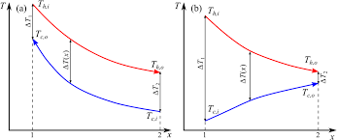
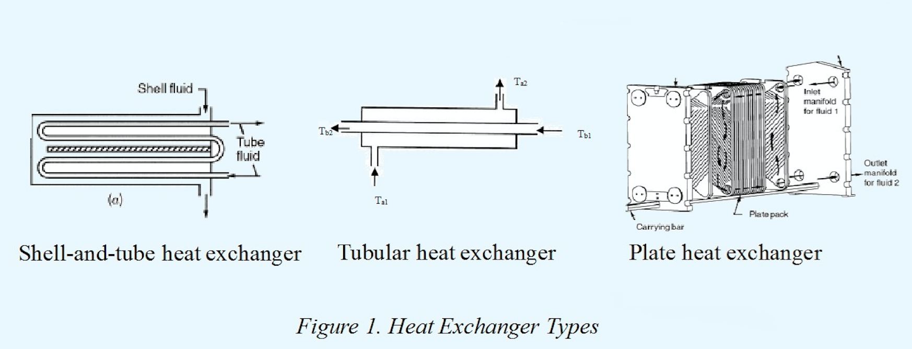
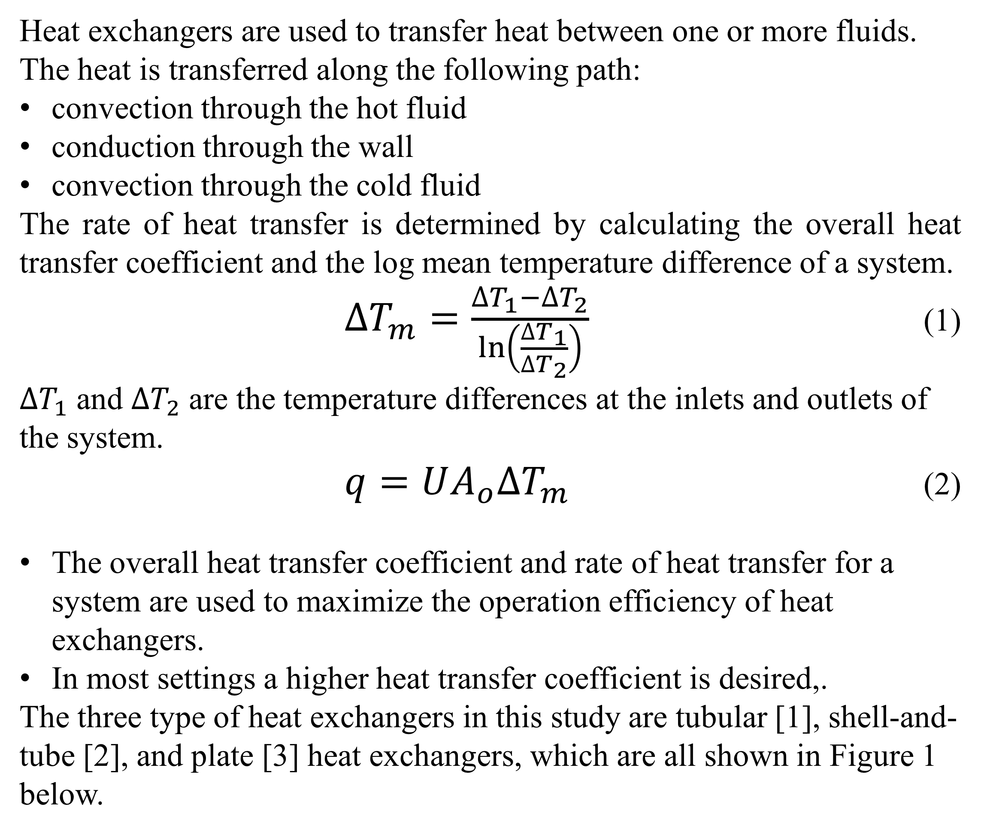
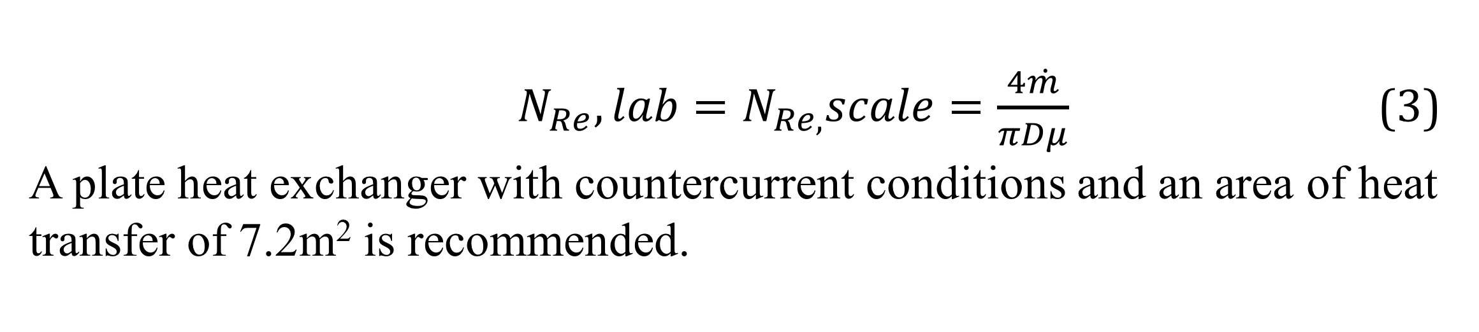
Comparison of Heat Exchanger Types
Shannon Murphy, Conor Sandin, Erin Tiedemann
Department of Chemical Engineering, University of New Hampshire
Introduction
A
B
 | Hot Flow Rate
Cold Flow Rate | 1 | 2 | 3
 | 2
 | 3
Discussion
Heat exchangers are used to transfer heat between one or more fluids.
The heat is transferred along the following path:
convection through the hot fluid
conduction through the wall
convection through the cold fluid
The rate of heat transfer is determined by calculating the overall heat transfer coefficient and the log mean temperature difference of a system.
$∆T_{m}=\frac{∆T_{1}−∆T_{2}}{\ln\left(\frac{∆T_{1}}{∆T_{2}}\right)}$ (1)
$∆T_{1}$ and $∆T_{2}$ are the temperature differences at the inlets and outlets of the system.
$q=UA_{o}∆T_{m}$ (2)
The overall heat transfer coefficient and rate of heat transfer for a system are used to maximize the operation efficiency of heat exchangers.
In most settings a higher heat transfer coefficient is desired,.
The three type of heat exchangers in this study are tubular [1], shell-and-tube [2], and plate [3] heat exchangers, which are all shown in Figure 1 below.
Countercurrent flow increased the overall heat transfer coefficient of a system for all exchanger types
The plate heat exchanger tested had the largest U, which is due to the large surface area of heat transfer available
The tubular heat exchanger and shell heat exchanger had similar heat transfer coefficients due to their lower surface area to volume ratios
Figure 2. Flow types and data collection. Countercurrent (A) and co-current (B) flow types. On the right is a matrix describing data collection: one inlet flow is varied while the other is held constant.
Results
The overall heat transfer coefficient for each flow pattern and heat exchanger type are shown in Table 1. For all types tested, increasing flow rates increased the overall heat transfer coefficient of the system.
Design Problem
Design problem: Identify the heat exchanger design required to heat a 3kg/s liquid reactant stream from 20°C to 50°C with available hot water at 80°C.
Based on the data collected in this study, conditions producing the highest U are:
Plate heat exchanger
Countercurrent conditions
U (W/m²K)
The Reynolds number for the experimental cold flow rate was calculated, and was scaled up to determine the design specifications.
Flow Rate (L/min)
Table 3. Design Problem Data
N_{Re} | Diameter (m) | A_{s} (m²)
983.18 | 0.54 | 7.20
Figure 3. Effect of hot and cold flow rates on the overall heat transfer coefficient, U. The exchanger types are represented by circles (plate), squares (tubular), and diamonds (shell-and-tube). Flow types are represented by dark (countercurrent) and light (co-current) shades. Blue represents varying hot flow rates at a constant cold flow rate, and red represents varying cold flow rates at a constant hot flow rate.
This study investigated the effects of flow pattern and flow rate on the overall heat transfer coefficient for the three types of heat exchangers.
$N_{Re},lab=N_{Re,}scale=\frac{4\dot{m}}{πDμ}$ (3)
A plate heat exchanger with countercurrent conditions and an area of heat transfer of 7.2m² is recommended.
Table 1. Average U values for various heat exchangers
Heat Exchanger Type | U (W/m²K)
 | Co-Current | Countercurrent
Plate | 1638.8 | 4029.3
Tubular | 419.2 | 949.7
Shell and Tube | 494.7 | 840.9
Methods
References
Each heat exchanger was operated using Armfield software, which regulated:
Inlet temperature of hot fluid (35˚C)
Flow rates of both fluids
Flow patterns (cocurrent vs countercurrent)
Thermocouples monitored temperature changes at every inlet and outlet
Each trial was collected in triplicate for both flow patterns.
Statistical analysis showed that flow type did not significantly effect U, and yielded regression models for each exchanger type.
[1] MIT, Concentric tube heat exchangers. 2012.
[2] Indian Institute of Technology Delh, Two Shell Pass- Four Tube Pass Heat Exchanger. 2016.
[3] Indian Institute of Technology Delhi, Gasketed Plate and Frame Heat Exchanger. 1988
[4]Heat Exchanger Theory, 1st ed. 2016
[5]C. Geankoplis, Transport processes and unit operations. Engelwood Cliffs, N.J.: PTR Prentice Hall, 1993.
Table 2. Regression model coefficients.
Heat Exchanger Type | Cold | Hot
Plate | 1366.3 | 1568.0
Tube | 568.9 | 233.5
Shell | 286.6 | 303.8

