Slide 1

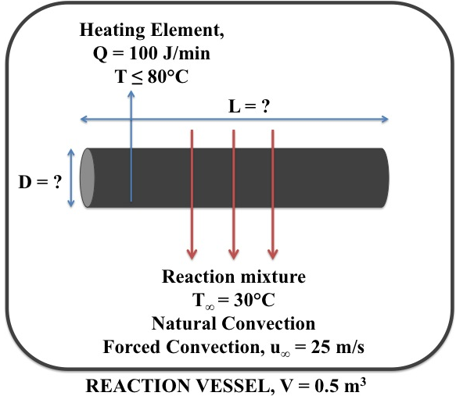
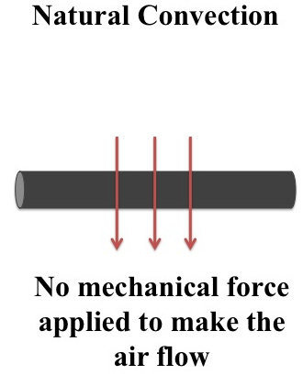
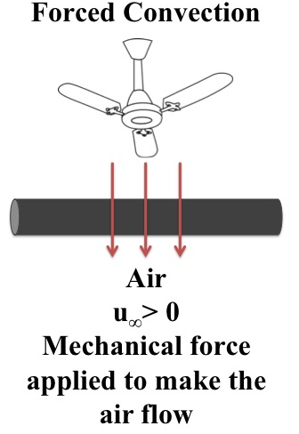
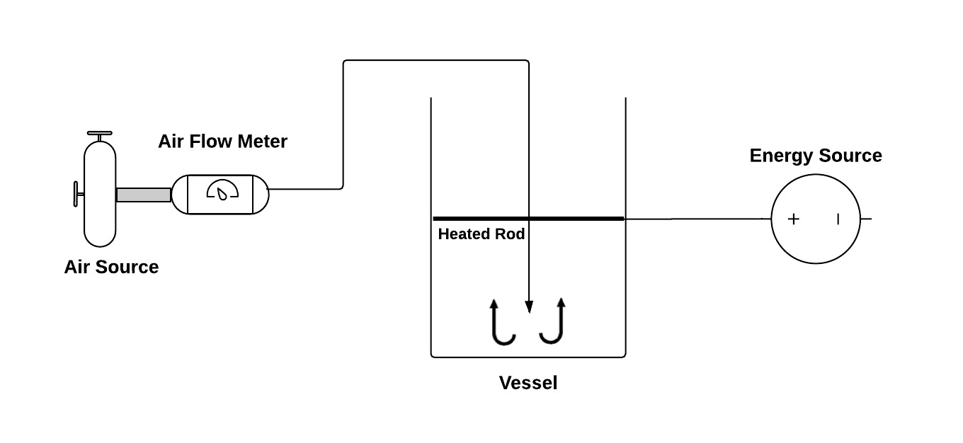
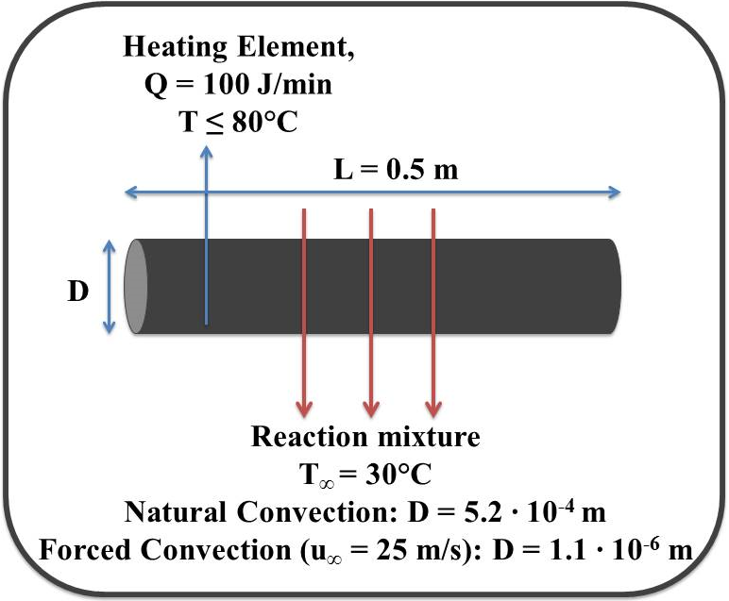
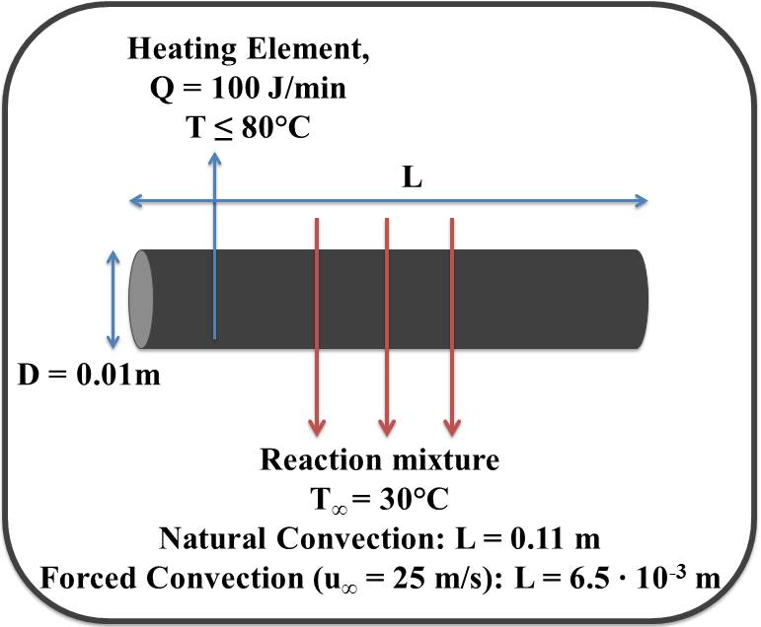
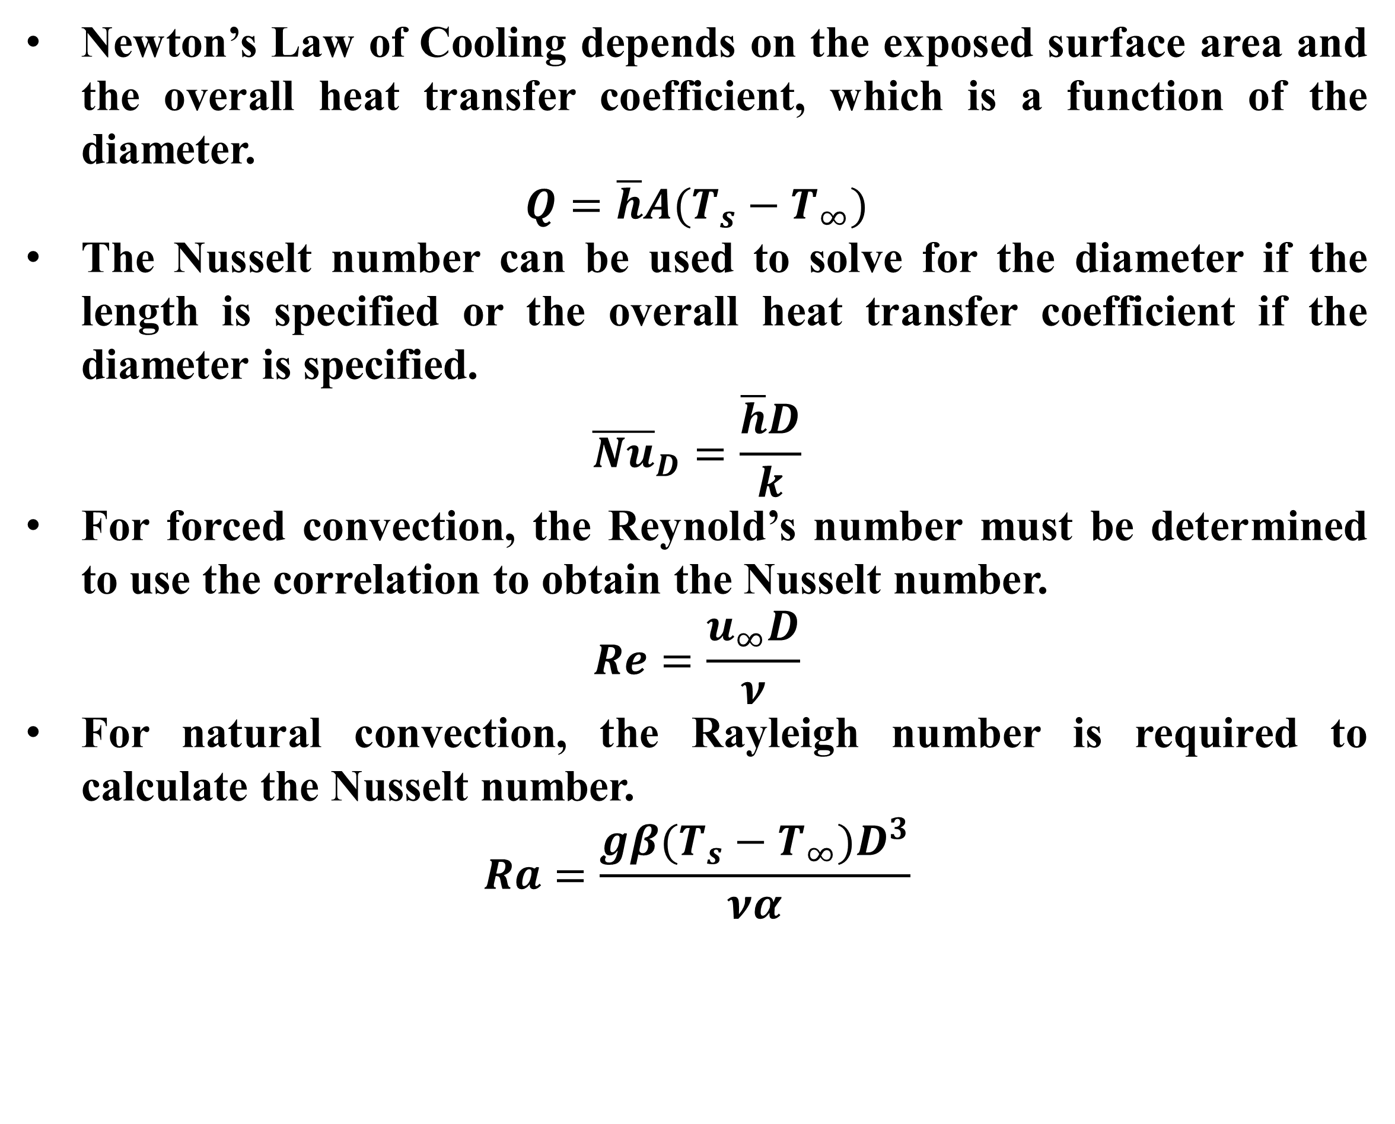
Convection from Horizontal Cylinders
Thanh Dinh, Meho Kamaric, and Alec Maddaus
Department of Chemical Engineering, University of New Hampshire, Durham, N.H.
Introduction
Results & Discussion
Design Problem
Convection – Heat exchange between a solid surface and a fluid.
Examples of convection:
  A fan used to cool electronic circuitry
  Air being circulated in a car radiator
  Heating food over a stove
  Cooling off coffee by blowing air on the surface
Natural Convection vs. Forced Convection
Overall Heat Transfer Coefficients Under Natural and Forced Convection
Rayleigh Number (Ra) - Accounts for the buoyancy forces and the viscous forces of the air in natural convection.
Reynolds Number (Re) - Accounts for the inertial forces and viscous forces of the air in forced convection.
In both natural convection and forced convection, the overall heat transfer coefficients decreased as the diameter increased.
In forced convection, the Reynold’s numbers increased linearly with higher air flow rates, resulting in an increase in overall heat transfer coefficient.
  As the air flow rate increased, more heat from the rod was dissipated to the surroundings, which corresponds with higher overall heat transfer coefficients.
Dimensionless Correlations
The Nusselt Number (Nu) represents the ratio of convective heat transfer to conductive heat transfer in a fluid.
In both natural convection and forced convection, a strong linear relationship between ln(Ra) and ln(Nu) was observed.
Under a logarithmic scale, the Nusselt number did not show any variation with diameter.
Natural Convection
Forced Convection
Newton’s Law of Cooling depends on the exposed surface area and the overall heat transfer coefficient, which is a function of the diameter.
$$Q=\overline{h}A(T_{s}−T_{∞})$$
The Nusselt number can be used to solve for the diameter if the length is specified or the overall heat transfer coefficient if the diameter is specified.
$${\overline{Nu}}_{D}=\frac{\overline{h}D}{k}$$
For forced convection, the Reynold’s number must be determined to use the correlation to obtain the Nusselt number.
$$Re=\frac{u_{∞}D}{ν}$$
For natural convection, the Rayleigh number is required to calculate the Nusselt number.
$$Ra=\frac{gβ(T_{s}−T_{∞})D^{3}}{να}$$
tumor
Methods
Natural Convection
Forced Convection
Design Solution
If the length of the reaction vessel is specified, the diameter can be determined using the correlation and vice versa.
For natural convection, different voltages were applied to heat rods (1/4”, 3/8”, 1/2”) without mechanical air flow present.
For forced convection, alternate air flows were introduced perpendicularly over the rods at a constant voltage.
The inner and surface temperatures of the heated rods were recorded at steady state for each trial using thermocouples.
Surface temperatures were used to calculate the overall heat transfer coefficients and the corresponding dimensionless numbers.
References
Bergman, T. L., Adrienne, L. S., Incropera, F. P., & Dewitt, D. P. (2011). Introduction to Heat Transfer (6th ed.). John Wiley & Sons.
Geankoplis, C.J.J. (2003) Transport Processes and Separation Process Principles: (includes unit operations) (4th ed). New Delhi: Prentice-Hall of India Pvt.

