Slide 1

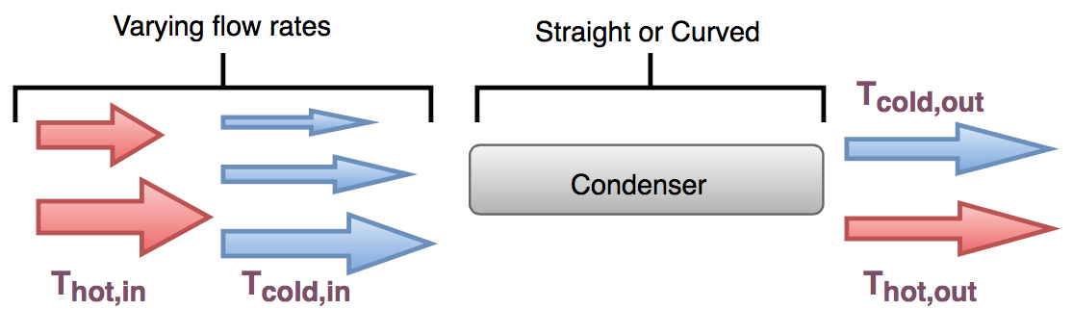
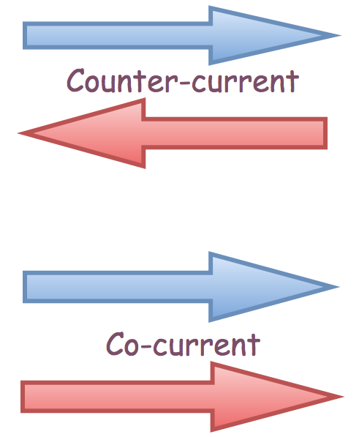
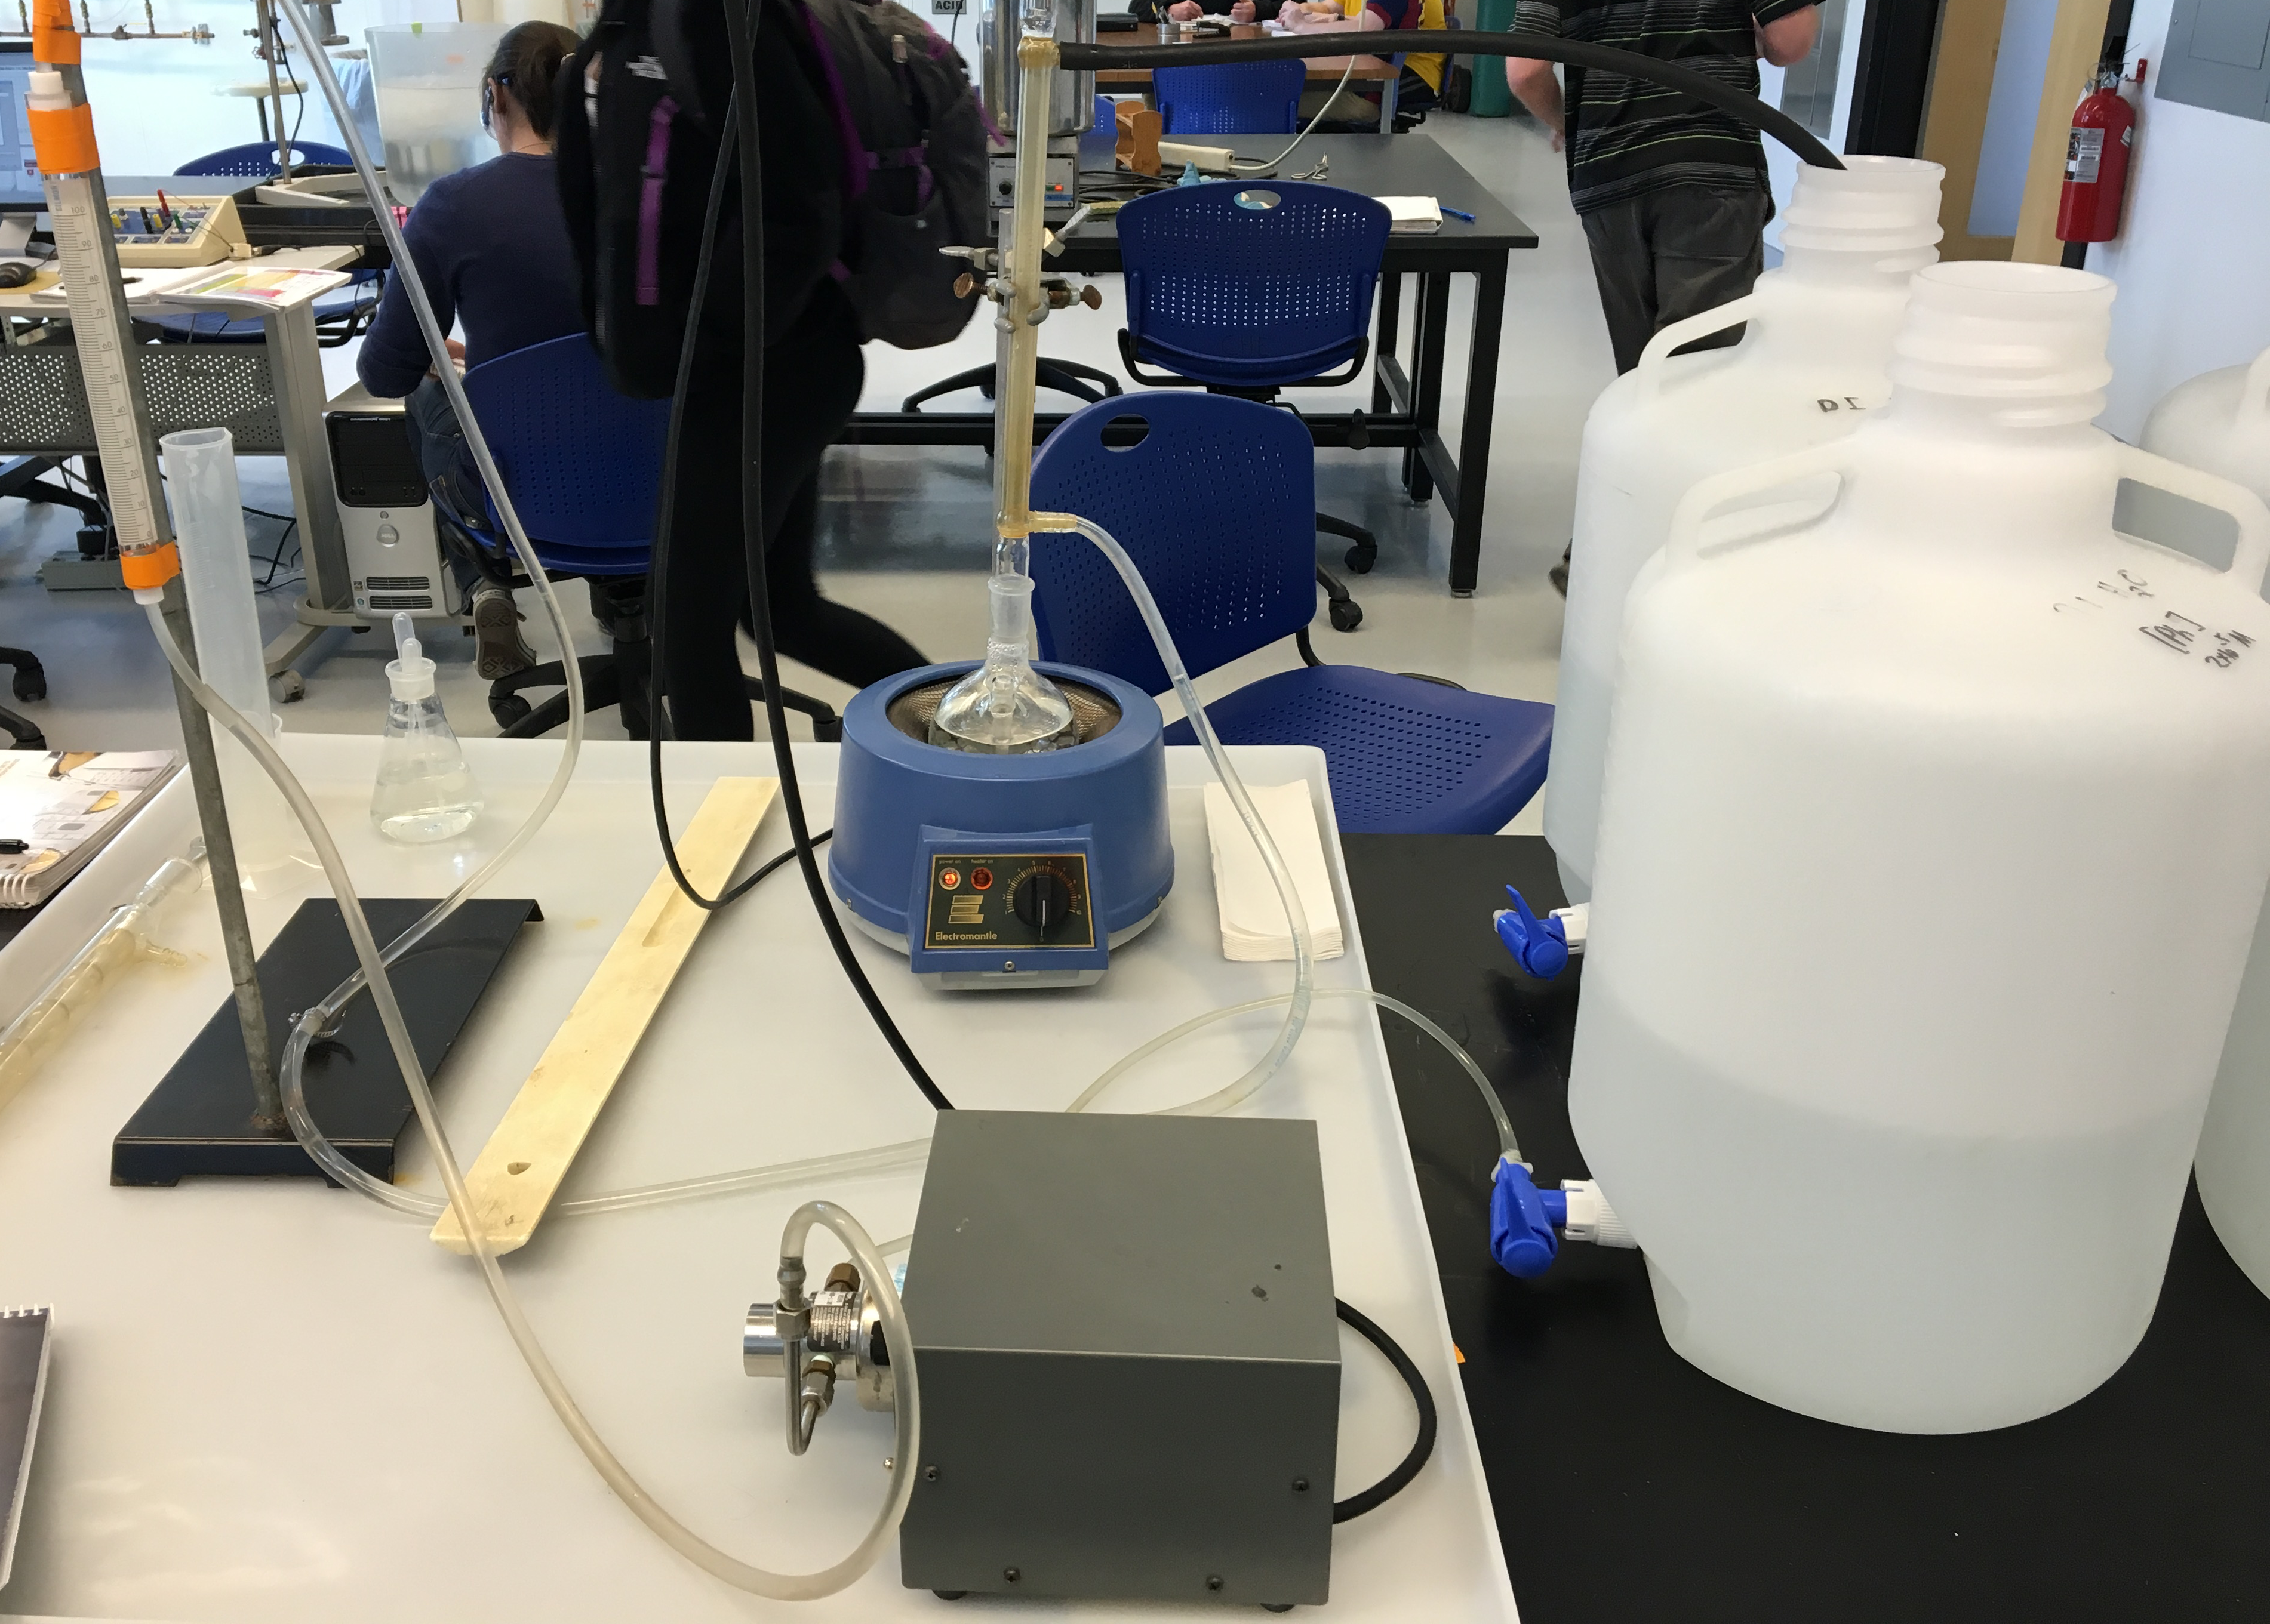
Heat Exchange in Condensing Systems
Sofia Diaco, Zachary Lee, Samantha Nadeau
Department of Chemical Engineering, University of New Hampshire
Introduction
Results and Discussion
Design Problem Solution
The purpose of this experiment was to determine the overall heat transfer coefficient for the different condensers in order to solve the design problem. The relationship is shown below, where T∞ is the condensation temperature.
Water
15°C
Steam
100°C
600 SCFM
Steam
100°C
600 SCFM
Methods
Water
T=?
Find: Type of Condenser, Orientation, Outlet Temperature, Area of Condensation
Figure 1. Heat transfer coefficients increase as cold flow rate increases.
The overall heat transfer coefficient increases as the hot flow rate decreases
Counter-current flow results in higher overall heat transfer coefficients
Chose the straight condenser because it achieves higher heat transfer coefficients at higher flow rates
Chose counter current flow at heat setting 1 since this orientation led to the highest heat transfer coefficients
Assumed an outlet water temperature of 95 °C
Found diameter of condenser to be 15 cm
Found length of condenser to be 3.5 cm
Concluded that more testing would be needed
Found mass flow rate by counting the drops that condensed in a given time frame and then massing a certain number of drops
Kept T_{c,in} relatively constant
T_{in}-T_{out} was similar with both counter current and co-current heat exchange
T_{out}-T_{in} decreased as cold stream flow rate increased
Water outlet
Condenser
Water inlet
Water Flowmeter
References
Heating Mantle
.
T. Bergman et al, “Heat Exchangers” in Introduction to Heat Transfer, 6th ed. New Jersey: Wiley, 2011. pp. 671-713.
C. Geankoplis, “Heat Exchangers” in Transport Processes and Separation Process Principles, 4th ed. New Jersey: Pearson Education, 2003. pp. 291-300.
Water pump
Figure 2. The straight condenser was observed to achieve higher heat transfer coefficients.

