Slide 1

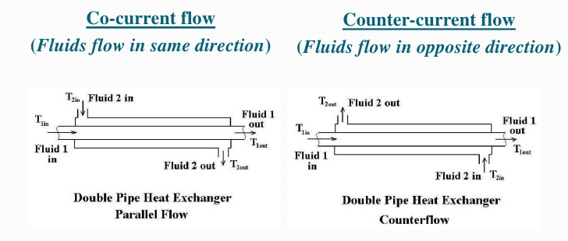
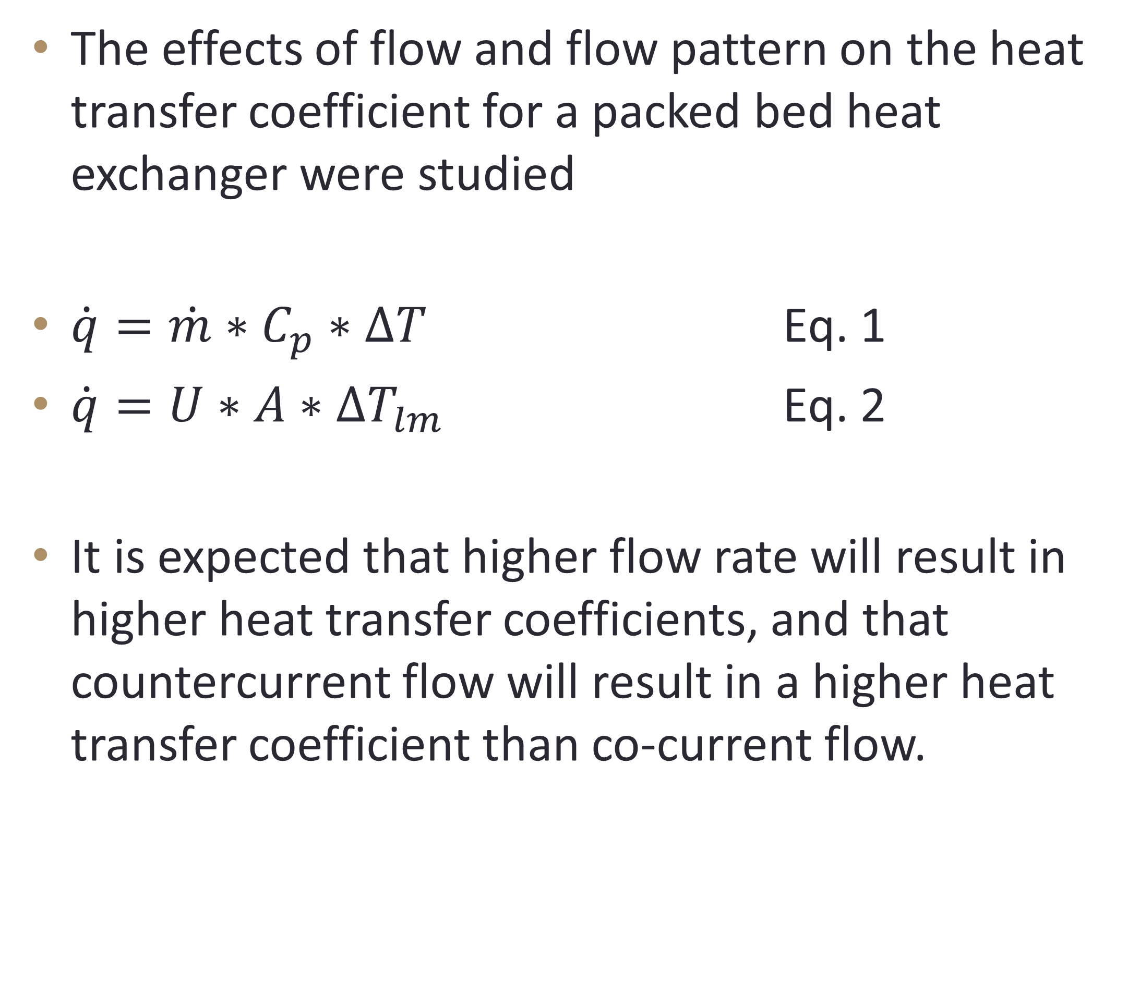
Heat Exchange in Packed Bed Reactors
Trevor LaBrie, Joseph Costa, Stephen Spiro, Chemical Engineering, University of New Hampshire
Introduction
Results and Discussion
The effects of flow and flow pattern on the heat transfer coefficient for a packed bed heat exchanger were studied
$\dot{q}=\dot{m}∗C_{p}∗∆T$ Eq. 1
$\dot{q}=U∗A∗{∆T}_{lm}$ Eq. 2
It is expected that higher flow rate will result in higher heat transfer coefficients, and that countercurrent flow will result in a higher heat transfer coefficient than co-current flow.
Co-current
Heat transfer coefficient increased with increased air and water Reynolds number
Heat transfer coefficients for a given air Reynolds number are less impacted by water flow rate than for countercurrent
Time required to reach steady state increased with both increased flow rate, and with countercurrent over co-current
Countercurrent
Heat transfer coefficient increased with increased air Reynolds number
Displayed greater variance and produced typically higher heat transfer coefficients than co-current
Did not increase with increased water Reynolds number. Likely due to an equipment error, resulting in “0” temperature change for water
Figure 1. Shows average heat transfer coefficient versus average Reynolds number for co-current flow. Error bars represent standard deviation.
Figure 2. Shows average heat transfer coefficient versus average Reynolds number for countercurrent flow. Error bars represent standard deviation.
P. Das, “Heat Exchangers design and construction,” Slide Share . [Online]. Available at: http://www.slideshare.net/rijumoniboro/heat-exchangers-12606868. [Accessed: 02-May-2016].
Methods
Design problem
Conclusions/Future works
Four different air flow rates of air were run through a single-pass packed bed heat exchanger with a set flow rate of water.
The temperatures at the inlet and outlet streams and the bed temperature were recorded.
Two additional water flow rates were tested under these conditions.
Gas enters a packed bed heat exchanger (75°C) and exits at 30°C with a flow rate of 100 SCFM. Determine the inner and outer radius, as well as the length of the heat exchanger
Assumptions: Counterflow, steady-state, no heat loss to surroundings, water enters at 20°C with a flow rate of 57 mL/s.
The inner radius of the heat exchanger should be 1.58 m.
The outer radius of the exchanger should be 2.91 m.
The overall length of the heat exchanger is 0.0023 m.
The overall heat transfer coefficient increased with increased flow rate for air.
Countercurrent yielded higher overall heat transfer coefficients than co-current for 2 of 3 water flow rates. The third is likely the result of error.
For future trials, more experimentation on higher flow rates would be needed. Data could be improved with more precise thermocouples

