Slide 1



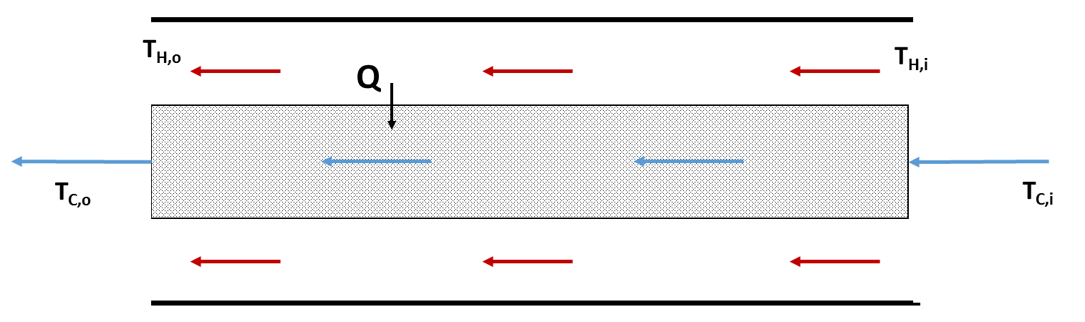

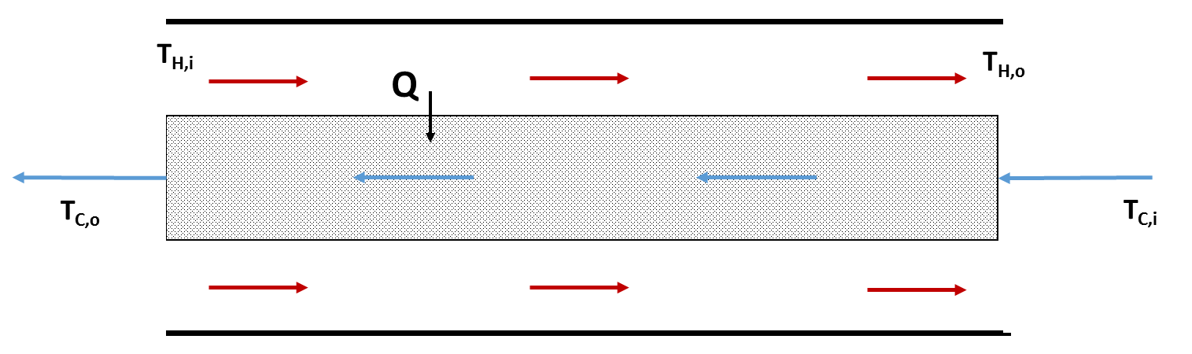

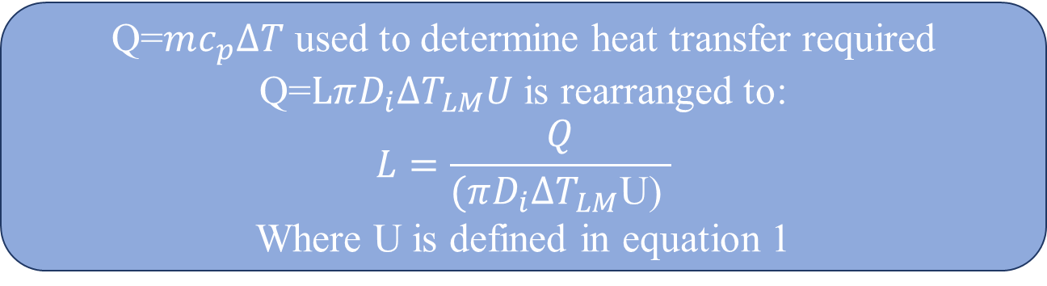
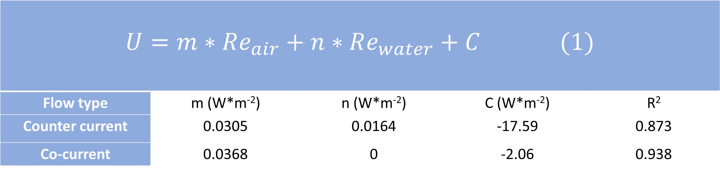
Heat Exchange through a Packed Bed
Alison Deyett, Kevin LaSalle, Alexander Redfearn
Chemical Engineering, University of New Hampshire, Durham, NH 03824
Introduction
U vs Re
Design Problem
Packed beds are essential for several chemical processes such as stripping, distillation, catalytic reactors and absorption.
Optimizing the heat transfer through a packed bed is essential for keeping the cost of operation of the equipment low.
A model of a packed bed heat exchanger can be used to optimize the parameters of a production packed bed heat exchanger
Parameters to be optimized include the area of the heat exchanger and the working fluids temperature and flow rates.
Co-Current Heat Transfer
Counter- Current Heat transfer
Given Variables
Assumed variables
Unknowns
L
T_{C,i}=10°C
Q
T_{C,o}
D₀
D_{i}
$\dot{V}=$100SCFM
T_{H,o}=30°C
T_{H,I} =75°C
m_{w}=60kg/s
Solution
As the Reynolds number or the air increases the overall heat transfer rate also increases.
Changing the Reynolds number of the water does not show a clear affect on the heat transfer coefficient
As the Reynolds number of the air and water increase the overall heat transfer rate also increases.
As the air Reynolds number increases the effect of the water Reynolds number also increases
Air Reynolds number is the dominant feature in the model
Assumptions:
Steady state
1-D Radial heat transfer
Negligible conduction resistance
No heat loss to surroundings
Assumed values:
m_{w} = 60 kg/s
T_{C,i} = 10 °C
Properties of water taken at 10 °C
Properties of Air taken at 52.5 °C
Q=$mc_{p}∆T$ used to determine heat transfer required
Q=$LπD_{i}∆T_{LM}U$ is rearranged to:
$$L=\frac{Q}{(πD_{i}∆T_{LM}\text{U}\text{) }}$$
Where U is defined in equation 1
Methodology
Generating a Model
Co-Current Heat Transfer
$$U=m∗Re_{air}+n∗Re_{water}+C (1)$$
Flow type | m (W*m⁻²) | n (W*m⁻²) | C (W*m⁻²) | R²
Counter current | 0.0305 | 0.0164 | -17.59 | 0.873
Co-current | 0.0368 | 0 | -2.06 | 0.938
Create a solution landscape by
Select a range of Di
For each Di use a range of Do
Using the combined equation solve for L at each combination
Inspect the solution landscape to find the most feasible solution
Counter- Current Heat transfer
L= 40.9m
Di=5.76m
Do=6m
Multiple linear regression was performed under the assumption that U would depend on both Re’s
A linear relationship of Reynolds numbers were used as a model for calculating U
• Co-current flow U is only a function of the Re of air
• Countercurrent flow U is a function of both the Re of air and water
The model is for Reynolds numbers which fall into the laminar flow region
Conclusion
A packed bed heat exchanger of inner Diameter 5.76 m, Outer Diameter 6 m and Length of 40.9 m is necessary to perform the desired cooling process
The air Reynolds number had a much larger effect on the overall heat transfer coefficient than the water Reynolds number had
Trial Parameters
At each water flow rate four air flow rates were tested at 20,40, 60, and 80 SCFH
Inlet and outlet temperatures were taken for each trial
All trials run in triplicate
Co-Current Heat Transfer
Counter-Current Heat Transfer
Water Flow Rate (mL/s)
Co-current | Counter Current
7.13 | 8.5
24.5 | 25.6
63.2 | 61.8
Future Work
Extend the range of Reynolds numbers calculated
Change the packing material of the beds and determine the effect of bed type on heat transfer
The Co-current data appears to fit the model more precisely than the Counter-Current Model
Note the water Reynold’s number appears to be insignificant in Co-Current model, so there are less data points that have to be taken into account making it easier to fit.
References
[1] Geankoplis CJ. “Heat Exchangers” in Transport Processes and Separation Process Principles (4 th edition). New York: Prentice Hall, 2003, ch 4 sec. 9, pp. 291-300.

