Slide 1

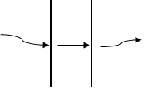
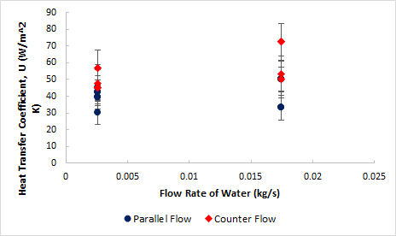
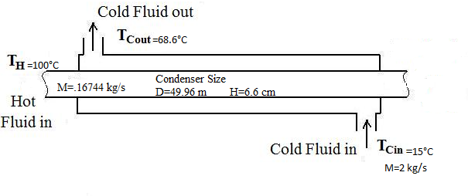
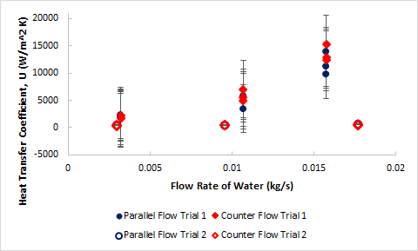
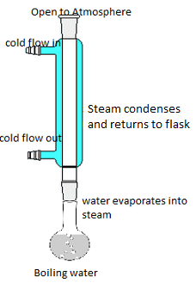
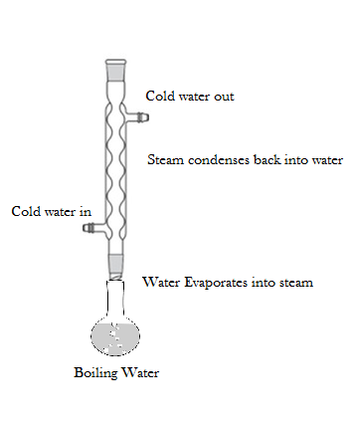
Heat Exchange in Condensing Systems
James DiLiegro, Donatus Obot-Etiebet, Katherine Pavlik
Department of Chemical Engineering, University of New Hampshire
Introduction
Results
Design Problem
Heat Exchangers: transfer heat between two or more substances (gas or liquid)
Condensation: gas phase liquid phase
Steam enters condenser; reaches latent heat of vaporization at certain distance along condenser; condenses at constant temperature
Qlost from hot stream (Steam) = Qgained from cold stream (Water)
Q=mH_{vap} Q=mCPΔT Q=UAΔT_{LM}
Counter flow produced 25% greater heat transfer coefficient than parallel flow using the Allihn condenser
In the concentric tube condenser, the heat transfer coefficient increased as the flow rate of water increased
The heat transfer coefficient was over 100% greater in the concentric tube condenser than the Allihn condenser
Steam from a pilot-scale power generating turbine (100°C, 1 atm) is to be condensed in a small scale condensing unit
Steam = 600 SCFM Water = 15 °C; water cannot boil
Specify the type and dimensions of the required condenser
Calculate the exit temperature of the water stream
Convection Conduction Convection
Hot Stream
Tube Wall
Cold Stream
Solution: (highlighted in yellow)
ALLIHN CONDENSER
Methods
Materials & Equipment
Electrothermal hot plate
Condenser (Concentric and Allihn)
Micropump
Flow meter
Corning 310 thermocouple
Experiment
Three flow rates for cold water ( ~3 mL/s, ~10 mL/s, ~16 mL/s)
Steam flow rate constant
Parallel and counter flow
Triplicates
Used a Reynolds number relationship to scale the condenser to full size
Set the heat loss from the hot stream equal to the heat gain from the cold stream
Assumed a cold stream flow rate of 2 kg/s to find the exit temp
Data does not give a feasible answer
Most likely cause is an ineffective method of measuring mass flow rate
CONCENTRIC TUBE CONDENSER
Conclusion
More experimentation is needed
The larger expanse of heat transfer coefficients in trial one compared to trial two, suggests possible error in one of the trials
Devise a more accurate way to measure steam flow rate
Heat transfer coefficients were 5 to 30 times larger in the first trial
Trial one had a larger variance of U, from about 2,000 to as large as 15,000
Trial two had a range of U, from about 400 to 500
The concentric condenser was found to be more efficient than the Allihn condenser
References
Geankoplis, Christie J. "16." Transport Processes and Separation Process Principles (Includes Unit Operations). Engelwood Cliffs, NJ: PTR Prentice Hall, 1993. N. pag. Print.

