Slide 1

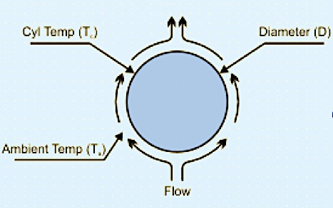
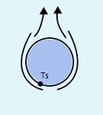
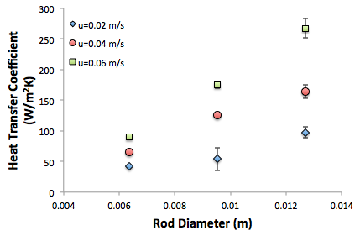
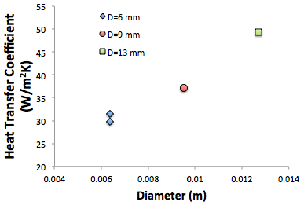



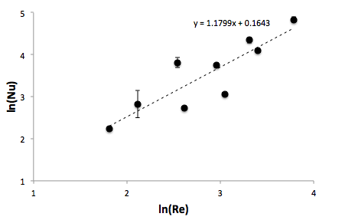
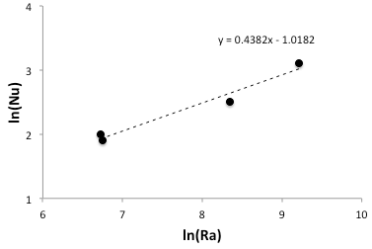
Convection from Horizontal Cylinders
Madeline Frattaroli, Curtis Lalonde, Darrell Orozco
Department of Chemical Engineering, University of New Hampshire
Introduction
Methods
Derived Correlations
Independent variables: Cylinder diameter, velocity of air flow, power into the cylinder
Dependent variables: Rod surface temperature
Calculated variables: Heat transfer coefficient, Reynolds number, Nusselt number, Grashof number
Free Convection:
Free Convection: Nu=0.3612Ra^{0.4382}
Forced Convection: Nu=1.1754Re^{1.1809}
Applications of Forced Convection: Fertilizer industry, computer processors, food making and storage systems
Applications of Free Convection: Cooling molten metals, fluid flows around heat dissipation fins, ocean currents, sea wind formation [1]
The magnitude of the heat transfer coefficient is affected by geometry, flow rate, flow condition, and fluid type.
By utilizing dimensionless numbers, relationships can be developed between geometrically similar surfaces operating under different conditions [2].
Discussion
Heat transfer can be increased by:
Increasing heat transfer area
Increasing air flow velocity over a heated body
Maintaining a larger temperature gradient
Literature Correlations:
Hilper/Knudsen and Katz correlation (forced) and the Churchill and Chu correlation (free) follow similar trends and yield error of about 20-30% of the experimental data.
1. Specify power input into cylinder
2. Allow the system to reach steady state
3. Record temperature of ambient air and cylinder surface
Forced Convection:
1. Specify power input into cylinder
2. Set air flow velocity
3. Allow the system to reach steady state
4. Record the temperature reading of the air and cylinder surface
Results
Design Problem
      Free Convection:
      Forced Convection (u_{A}=25 m/s):
Design Parameters:
      h=Qin[πDL(T_{S}-T∞)]⁻¹
Air Velocity
Experimental Correlation:
Figure 1: Cross sectional image of forced convection (left) and
free convection (right) over a cylinder.
Diameter
Diameter
Nu=0.3612(Pr*ΒgD³(T_{s}-T∞)ν⁻²)^{0.4382}
Nu=(hD)k_{f}⁻¹
Calculations
Diameter: 6 mm
Length: 72 mm
Figure 2: The graph of forced convection data (left) shows that heat transfer coefficient increases as air velocity and diameter increase. The free convection data (right) suggests that heat transfer coefficient increases as diameter increases.
Design Parameters:
Surface balance to find heat transfer coefficient: Q_{in}=hπDL(T_{S}-T∞)
Reynolds number: Re=(uD)ν⁻¹
Nusselt number: Nu=(hD)k_{f}⁻¹
Rayleigh number: Ra=GrPr
Grashof number: Gr=ΒgD³(T_{s}-T∞)ν⁻²
      h=Qin[πDL(T_{S}-T∞)]⁻¹
Experimental Correlation:
Nu=(hD)k_{f}⁻¹
Nu=1.1754((u_{A}D)ν⁻¹)^{1.1809}
Diameter: 1 mm
Length: 12 mm
References
      Figure 3: A linear relationship exists between ln(Nu) vs. ln(Re) and ln(Nu) vs. ln(Ra) that yields the experimental forced convection and free convection correlations respectively.
“Applications of convection,” Applications of convection ya[Online]. Available at: http://www.slideshare.net/chourasiarakesh/what-is-convection-and-what-are-some-applications-of-convection-yahoo-uk-ireland-answers. [Accessed: 27-Apr-2016].
F. P. Incropera and D. P. DeWitt, Introduction to heat transfer. New York: Wiley, 1996.

Slide 2

This poster template provided courtesy of
UNH ESRC Poster Printing Services
Trust us to make your poster look GREAT!
Website: http://posters.unh.edu
Poster Guide: http://goo.gl/1E7TJY
DELETE THIS SLIDE BEFORE PRINTING

