Slide 1


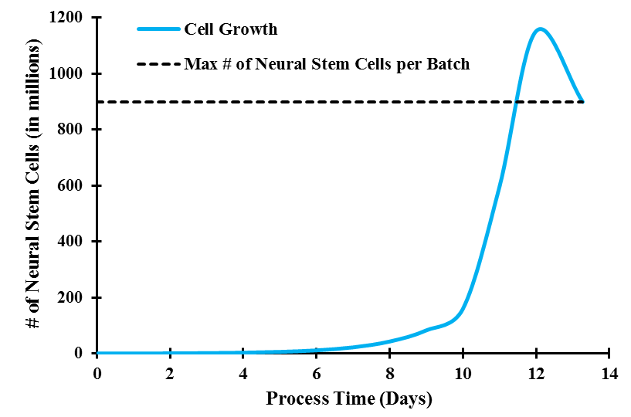
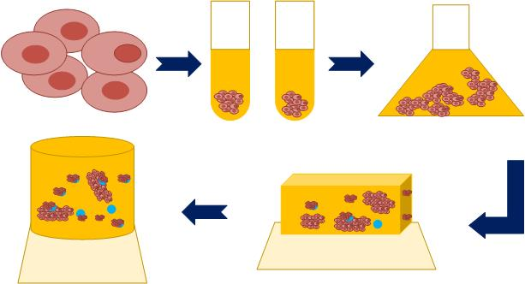
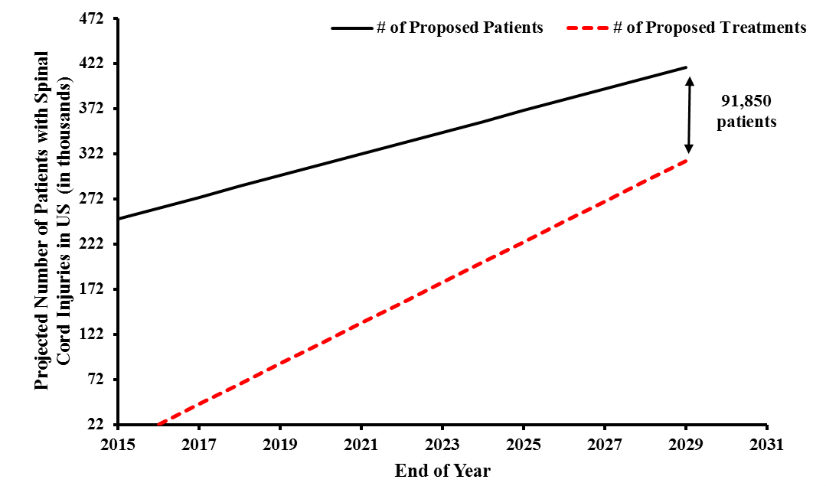
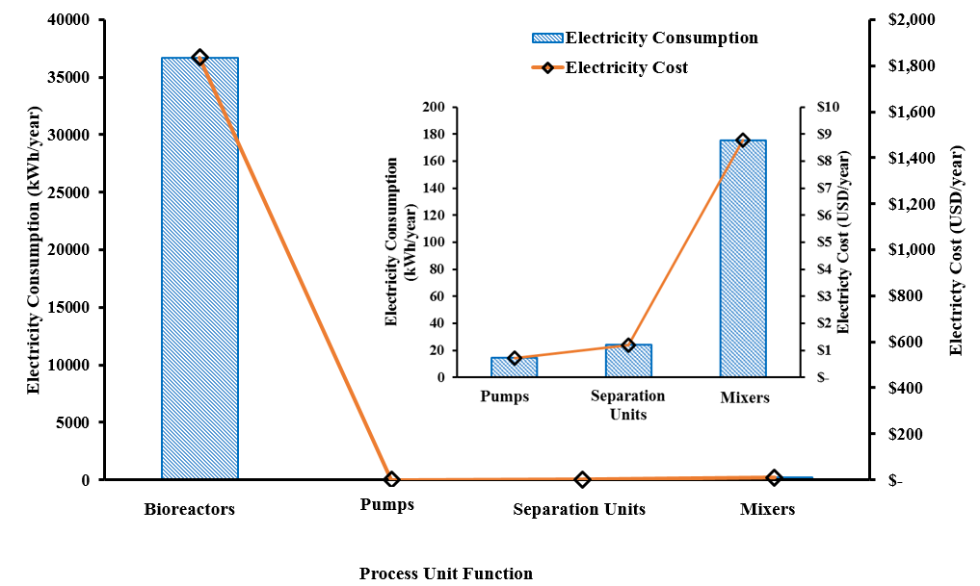
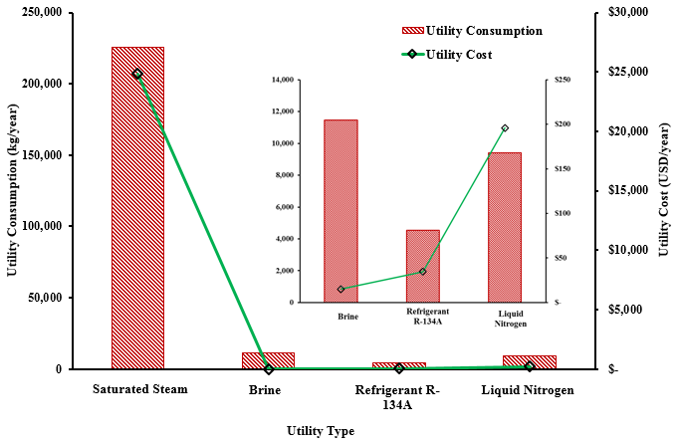
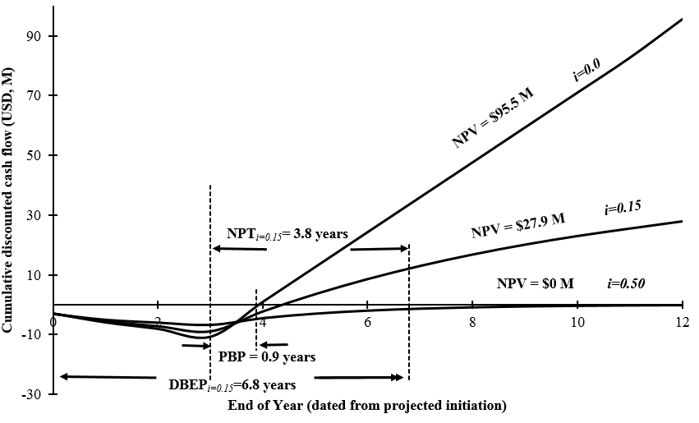
Production of Adult Neural Stem Cells as a Cell Therapy for the Treatment of Spinal Cord Injuries
Terrapins Design Group: Rhiannon Jacobs, Zachary Smith, Denys Tymchenko
Objective
Process Flow Diagram
Design a manufacturing facility to produce adult neural stem cells for the treatment of spinal cord injuries
Introduction
250,000 spinal cord injuries in US
12,000 new injuries each year in US
Living cells are injected into a patient as a treatment for a disease
Neural stem cells can treat spinal cord injuries
Average dose: 1,000,000 cells (10 injections of 100,000 cells)
Cell Scale Up
Critical to Quality Variables
Market Analysis
Selected Material Balances
Conclusions
Successful proliferation of MSC’s depends on media & microcarriers.
FACS Separator must separate 100% of viable and nonviable cells.
MSC’s must differentiate to NSC’s.
Refrigeration must occur at 1°C/min.
Capacity: 2*10¹⁰ neural stem cells/year → 20,440 doses/year
Yearly Sales Revenue: $35.8 M
Net Present Value: $95.5 M
Net Payout Time: 3.8 years
Total Capital Investment: $9.35 M
Discounted Cash Flow Rate of Return: 50%
After Tax Rate of Return: 122%
55% of US Market Share
Sale Price of $1,753 per 10⁶ cells
Utility and Electricity Requirements
Economic Analysis
Recommendations
The Terrapins Design Group recommends proceeding based on a DCFRR of 50% and a NPV of $95.5 M.
Acknowledgements
The Terrapins Design Group would like to thank:
UNH Department of Chemical Engineering especially Dr. Vashisth, Dr. Barkey, Dr. Teng, and Dr. Carr
Professor Halpern and Brian Zukas
The Smith Family: Christopher, Lori, Bradley, Gram, Jaju, and Uncle Bob
The Jacobs Family: John, Carole, and Ian
The Tymchenko Family: Vyacheslav, Olena, and Sophia

