Slide 1

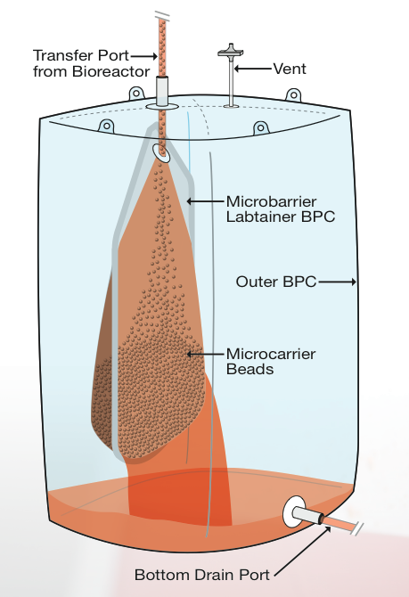
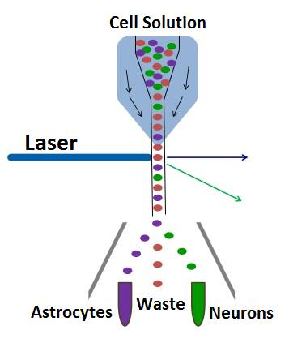
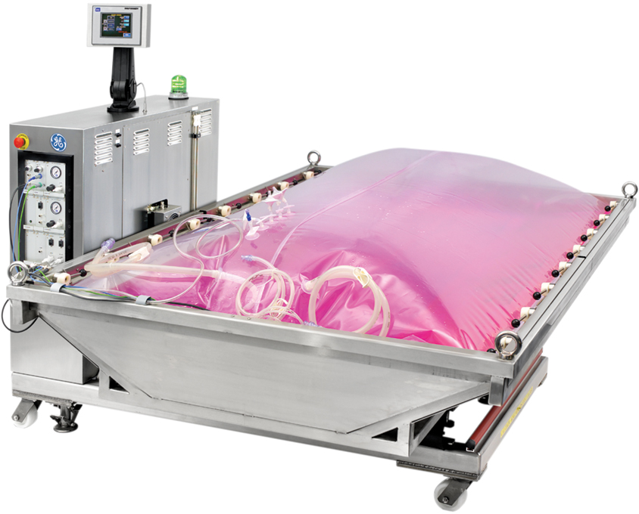
Cell Therapy for Spinal Cord Injuries
PlusOne
Engineering
Logan Almquist, Holly Eliades, and Ryan McEachern
BACKGROUND
PROCESS FLOW DIAGRAM
PURIFICATION
250,000 people suffer from spinal cord injuries (SCI) in the US, with 12,000 new cases each year. There is a growing need for treatment.
OBJECTIVE
From a starting vial of 100,000 adult mesenchymal stem cells, we aim to manufacture a neural cell therapy to treat 12,500 SCI patients each year. Our neural cell therapy consists of 70% neurons and 30% astrocytes to replenish damaged cells within the patient.
HARVESTAINER
FLOW CYTOMETRY
Separates cells from microcarriers while staining cells for flow cytometry
Separates neural cells from undifferentiated mesenchymal stem cells
WAVE BIOREACTOR
ECONOMIC ANALYSIS
CONCLUSIONS
Selling price is $210/dose
Annual revenue of $2,600,000 is
achieved by selling 12,500 doses
Yearly operating cost is $1,700,000
$580,000 net annual profit is accumulated after taxes
Total capital cost of facility is $2,400,000
Each batch is completed in 31 days
11 batches are run per year
2.3x10¹¹ neural cells are produced per year
Enough cells are produced to treat 12,500 patients, obtaining 5% of the market share
Used to expand and differentiate cells
Low shear rocking system prevents cell damage
Disposable bags prevent contamination
Bag sizes range from 2 to 50 liters during scale-up
RECOMMENDATIONS
Through a class 4 analysis, PlusOne Engineering recommends a “GO” and suggests the company moves forward with the neural cell production facility.
ACKNOWLEDGMENTS
We would like to acknowledge and thank Brian Zukas, our teaching assistant, for all the help he has provided us. Further, we thank Dr. Jeffrey Halpern for adequately preparing us to tackle a project of this magnitude.
Mesenchymal stem cells are anchorage-dependent and require a large surface area for expansion
Cytodex 1 microcarriers provide surface area for cell expansion and differentiation
The DCFRR value of 31% is significantly higher than the current cost of investment in the United States, proving that this project is a good investment. NRR is also a great measure of profitability and the value of 13% indicates a successful venture. Based on these values and the low break-even times shown by PBP, NPT, and DBEP, this project demonstrates excellent profitability potential.

