Slide 1
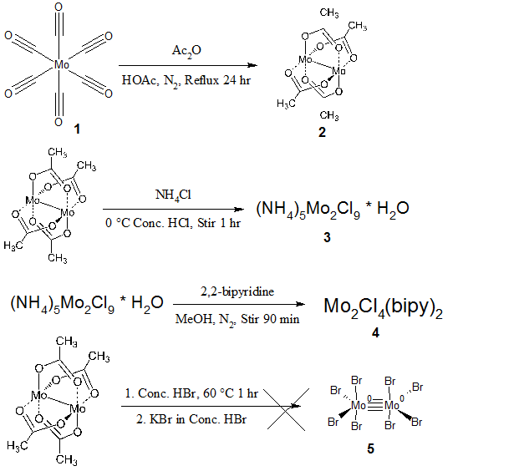
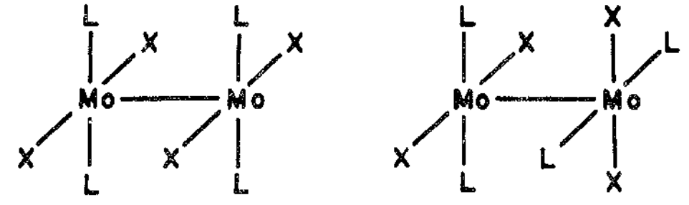

UNH Chemistry 775: Synthesis of Two Tetrahalodimolybdenum(II) Complexes
Anthony Jennings, Luke Fulton, Dr. Roy Planalp
asu54@wildcats.unh.edu; Parsons Hall, 23 Academic Way, Durham NH 03824
Introduction
Tetrahalodimolybdenum(II) complexes are a class of molybdenum coordination complexes which contain a Mo-Mo quadruple bond. Dimolybdenum tetraacetate can be synthesized from molybdenum hexacarbonyl, and was used as a precursor in the synthesis of two other complexes. The goal of this study was to synthesize three of these complexes and study the effects of different ligands on the energy of this bond by observing its Raman scattering. Raman spectroscopy was chosen over FTIR because the Mo-Mo quadruple bond is both IR and Raman active. The bond is very weakly IR active and is difficult to detect by that method, but is strongly Raman active. It was also planned to investigate other parts of the complexes, such as the halogen-molybdenum bond stretches and the coordinate covalent bonds.
Results and Discussion
Figure 3. FTIR spectrum for dimolybdenum tetraacetate
Figure 4. FTIR spectrum for tetrachlorobis(bipy)dimolybdenum(II)
Two peaks near 1500 cm⁻¹ and a strong peak at 671 cm⁻¹ in figure 3. matched up well with literature values, confirming the formation of dimolybdenum tetraacetate.
Bipyridine complex formation confirmed by position and magnitude of four peaks at 957, 897, 772 and 726 cm⁻¹ closely matching literature values. Mo-Cl stretch expected at 304 cm⁻¹.
Mo-Mo stretching bands were expected to appear in the Raman spectra at 403 cm⁻¹ for dimolybdenum tetraacetate and 338 cm⁻¹ for the bipyridine complex. This makes sense as the acetato ligand is weaker field than the 2,2-bipyridine ligand.
Consistent yields of around 50% were significantly lower than in literature, likely caused mostly by transfer loss and dissolution during high-volume wash steps.
Quality of hydrobromic acid was suspect in octabromomolybdate synthesis, and KBr was used in place of CsBr, causing the failure of the synthesis.
Future Work
Further analysis of the complexes would consist of collecting quality Raman spectra of dimolybdenum tetraacetate and Tetrachlorobis(bipy)dimolybdenum(II). The results would be compared with literature values and any trends in the Mo-Mo stretches would be determined.
3-
Conclusions
Both dimolybdenum tetraacetate and tetrachlorobis(bipy)dimolybdenum(II) were successfully synthesized as confirmed by FTIR analysis. Potassium octabromodimolybdate(II) could not be synthesized, which was the expected result due to deviations from the procedure. FTIR analysis using the spectrometer in the CHEM 775 lab is inadequate to study the characteristics of Mo-Mo quadruple bonds.
Figure 1. Synthetic scheme for tetrachlorobis(bipy)dimolybdenum(II) and the octachloromolybdate ion.
Figure 2. General structure for dimolybdenum complexes. In the bipyridine complex, 2,2-bipyridine ligands may bridge the Mo-Mo bond or simply coordinate with one Mo atom. X = Cl.
Experimental
2 was synthesized from 1 using excess acetic anhydride, bright yellow product was collected on glass frit, washed with ethanol and diethyl ether(55.2% yield)
2(1 eq.) was dissolved in concentrated HCl and cooled to 0°C, NH₄Cl(8 eq.) was added, stirred for 1 hour at room temperature. Violet precipitate was collected on glass frit, washed with ethanol. (0.514g, 52.3% yield)
3 was converted to 4 using 2,2-bipyridine in excess. Black crystals were collected by vacuum filtration, washed with methanol, water and ether. (250 mg, 49.4% yield)
In attempt to synthesize 5, 2 was dissolved in HBr, heated for 1 hr. Solution of KBr (5 eq.) in HBr was added. No reaction appeared to occur.
Acknowledgments
Thanks to the UNH Chemistry Department for providing funding for this project as part of the CHEM 775 course, and to Luke Fulton for assisting with much of the procedure.
References
Brencic, J. V. and F. A. Cotton. Stoichiometric and Structural Characterization of the Compound (NH4)5Mo2Cl9 ● H2O. Inorganic Chemistry. 1970. 9. 346-351..
San Filippo, J. Jr., H. J. Sniadoch and R. L. Grayson. Preparation and Characterization of Some Tetrahalodimolybdenum(II) Complexes. Inorganic Chemistry. 1974. 9.
Planalp, R. Metal-Metal Quadruple Bonds. CHEM 775 Lab Handout. 2016.
Clark, R. J., A. J. Hempleman and M. Kurmoo. Infrared, Raman, and Resonance-Raman Spectra of [Mo2(O2CCH3)4] and [Mo2(O2CCD3)4]. Journal of the Chemical Society, Dalton Transactions. 1988. 4. 973-981.

