Slide 1


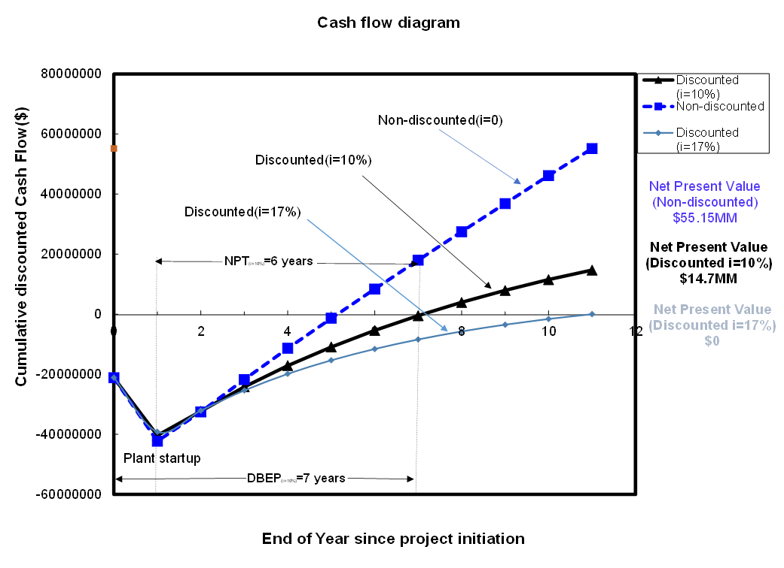
The Design of a New Phthalic Anhydride Production Facility
Ram Subedi, Lev Levintov, Nick Tancrede
Introduction
Process Flow Diagram and Material Balance
Production of Phthalic Anhydride
100,000 metric tons per year
6.90 billion dollar market
The reaction must occur between 300ºC and 400ºC
55% of volume of market share is used for phthalate plasticizer
Reactor Design
Economic Analysis
Conclusions and Recommendations
Net annual profit of $8.46MM
DBEP: 7 years
NPT: 6 years
Phthalic anhydride= $2 per kg
Suggesting a GO for this project
Acknowledgements
ROI: 23%
DCFRR: 17%
We express our deep sense of gratitude to Brian Zukas for being available to answer all our questions and concerns. We sincerely thank Dr. Halpern for his guidance and encouragement in carrying out this project.
Volume: 170m³

