Slide 1

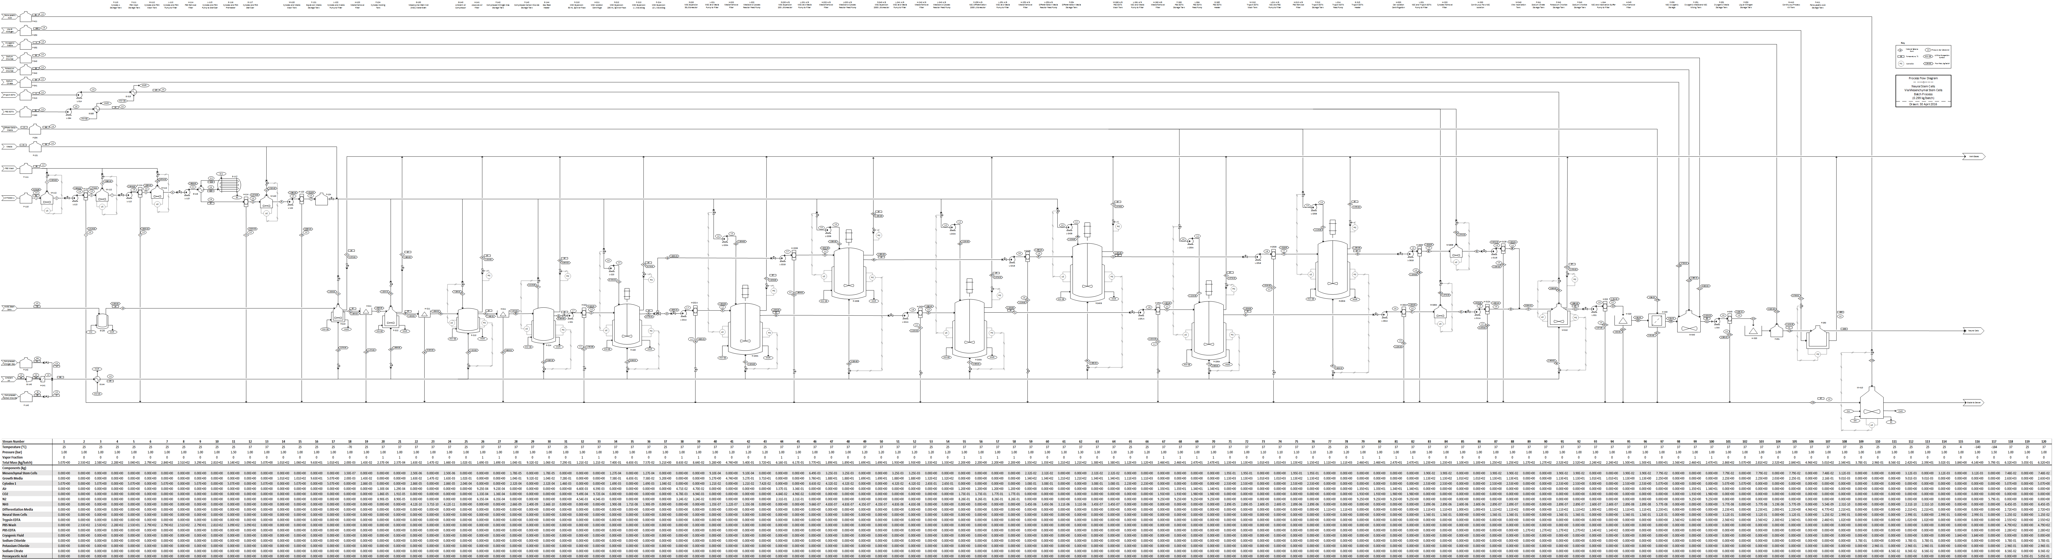
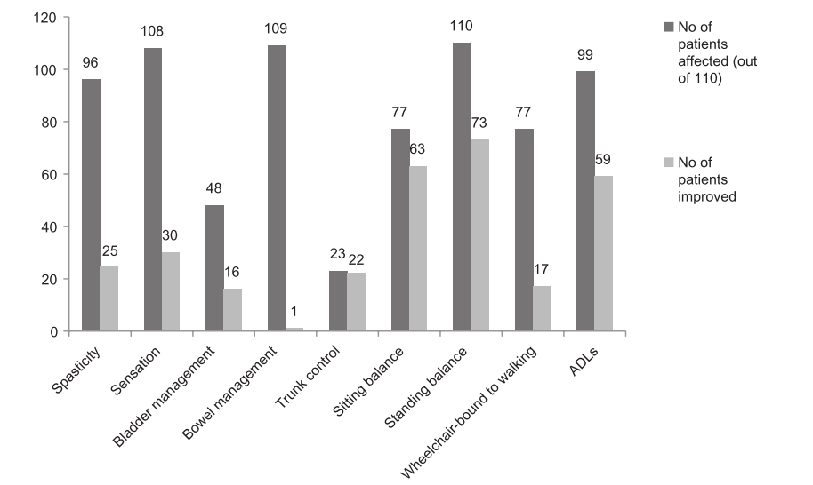
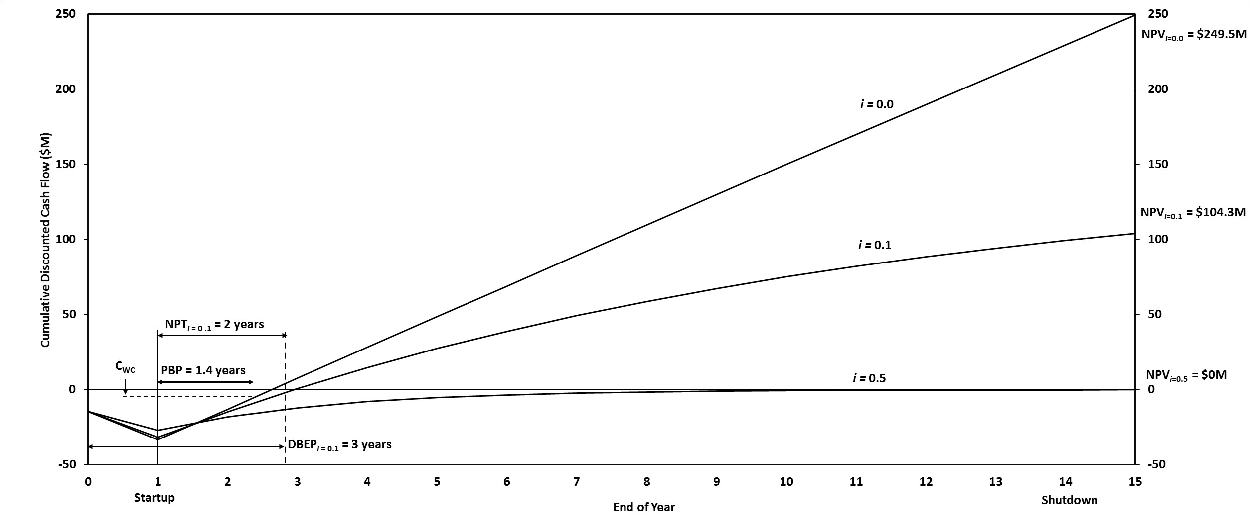
Cell Therapy for Spinal Cord Injuries:
Commercial Manufacturing Facility
A Class 4 Study on the Feasibility of Industrial Scale Production
Shear Stress
Chris Redus
Jessica Verbisky
Hannah Pinard
Department of Chemical Engineering
Conclusions:
    Plant produces 170,946 doses/year (42,750 treatments)
    To achieve a internal rate of return of 50%, the price of a dose is set to be $905
    The plant lifetime is 15 years with a 1 year startup period
Recommendations:
  Our team recommends continuing with the construction of this facility
# of Neural Stem Cells Produced/ Year | 3.42 x 10¹²
# of Neural Cells/Dose | 20 x 10⁶
Doses/ Year | 170,946
Price Per Dose | $905
Revenue Per Year | $155 M
Acknowledgements:
Connie Sutton (Sartorius Group North America)
Paul Todd (IKOTECH)
Gale Ulrich and P.T. Vasu for creating Econ Expert
Adam Steinberg (STERIS)
References:
Sharma, A., Gokulchandran, N., Sane, H., Badhe, P., Kulkarni, P., Lohia, M., . . . Thomas, N. (2013). Detailed Analysis of the Clinical Effects of Cell Therapy for Thoracolumbar Spinal Cord Injury: An Orginal Study. Journal of Neurorestoratology, 1(13), 22nd ser., 13-22. Retrieved May 4, 2016.

