Slide 1

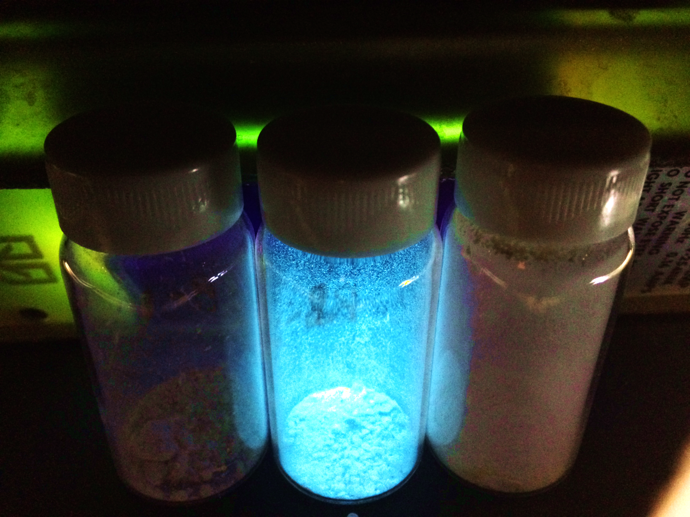
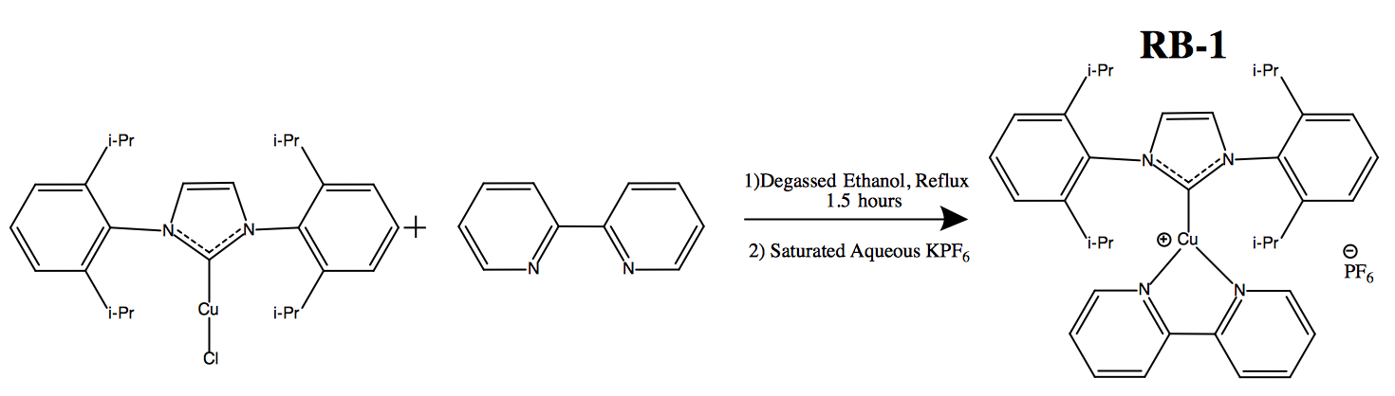
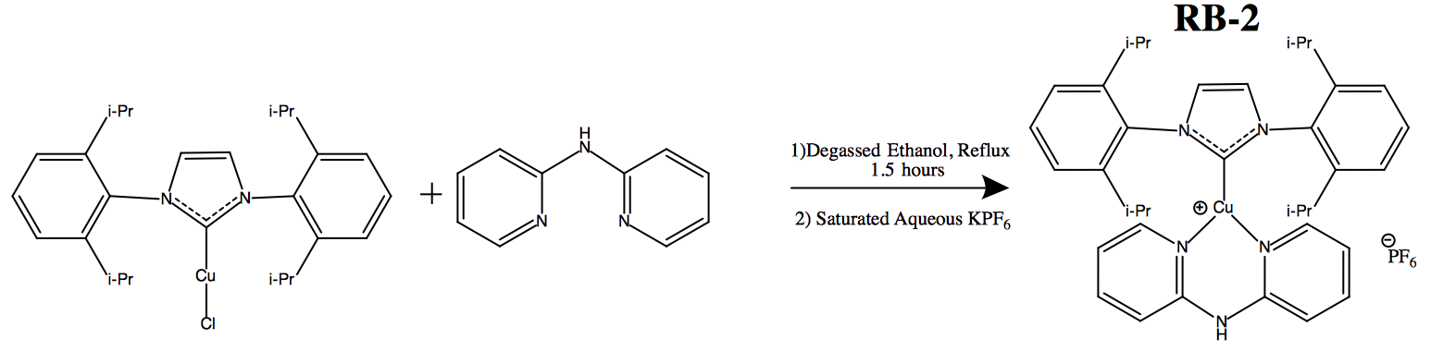
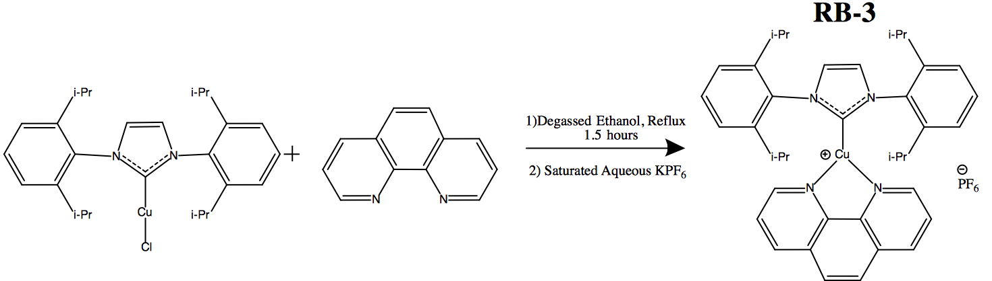
A Photoluminescent Study of Copper (I) Complexes Containing NHC and Bis(N-heterocyclic) Ligands
Robert Biro, Timur McArdle, Luke Fulton, Roy Planalp*
rah285@wildcats.unh.edu, Department of Chemistry, University of New Hampshire, Durham, NH
May 5th, 2016
Introduction
The synthesis of copper (I) organometallic complexes containing N-heterocyclic carbene (NHC) and bis(N-heterocyclic) ligands are described herein. As precious metals are too expensive for broad applications, copper (I) is used to create stable complexes with NHC ligands used for further stabilization of the organometallic species before functionalization.
By changing and fine tuning various bis(N-heterocyclic) ligands, the photo-physical properties of each complex are altered. This has already opened a broad range of applications in supported catalysis, ion detection, and organic light emitting diodes (OLEDs⁾¹. Furthermore, the phosphorescence of the synthesized compounds was studied as these [Cu(iPr)(N^N)]PF₆ compounds are air-stable blue-emitting copper complexes are potential anchoring points for bis(N-heterocyclic) ligands which can make them good candidates for OLED applications¹.
Results
Discussion
Using FTIR spectroscopy to characterize products, RB-1, RB-2, and RB-3 were successfully synthesized. The alkyl C-H stretching frequencies are weakly absorbing at 2960 cm⁻¹ and 1500 cm⁻¹. The C-H bending vibrations are seen at 835 cm⁻¹ with respective in each product, lower than predicted and seen in the starting material, however this is expected due to stabilization by the NHC ligand and the increased steric environment. The IR spectrum of RB-2 has a broad band at 3400 cm⁻¹ indicative of a secondary amine.
UV-Vis and phosphorescence spectroscopy were used to characterize and probe photoluminescent properties of the complexes. UV-Vis spectroscopy often record two bands of absorbance, the stronger due to π−π* ligand transitions, the weaker due to dπ−π* metal-to-ligand transitions. The λ_{max} for each compound followed with literature further confirming the synthesis of the products.
In the phosphorescence experiment, RB-1 and RB-3 were expected not to have strong emission, and this was seen^{1,2}. Yet RB-2, [Cu(iPr)(bipy)]PF₆, had a strong emission at 428nm, blue light. This was confirmed by literature as well^{1,2}.
RB-1
RB-2
RB-3
[Cu(iPr)]Cl
Synthesis
General Procedure: 0.25 grams (0.5mmol) of [Cu(iPr)]Cl was added to a dried round bottom flask under an argon atmosphere with 0.55mmol of a bis(N-heterocyclic) ligand. 10mL of degassed ethanol was added and the system was stirred at reflux for 1-2 hours. After cooling, a saturated aqueous solution of KPF₆ was added (~5mL) affording a white precipitate. The solid product was filtered and washed with 10mL water and 10mL of diethyl ether twice before drying under vacuum. Products were characterized by FTIR, UV-Vis, and Phosphorescent spectroscopy.
RB-1
RB-2
RB-3
Exposed to a UV-light source, RB-2’s phosphorescent emission was visibly blue and much stronger than RB-1 and RB-3.
Conclusion
The synthesis of three Copper (I) organomettalic complexes containing an NHC and each a unique bis(N-heterocyclic) ligand was successful. FTIR spectroscopy and phosphorescent spectroscopy was used to characterize each product. RB-1 and RB-3 had weak phosphorescent emissions while RB-2 had high phosphorescent emission, all of which were expected when comparing to literature. Future work with other bis(N-heterocyclic) ligands can be done to find other blue-emitting copper complexes; this may lead to a good candidate for OLEDs.
RB-1
Sample | λ (excit.) (nm) | λ (emis.) (nm)
RB-1 | 250 | 522, 326
Bipy. | 282 | -
[Cu(iPr)]Cl | 257 | 521, 353
73%
RB-2
Sample | λ (excit.) (nm) | λ (emission)
RB-2 | 281 | 428, (500)
Dipy-NH | 312 | 347
[Cu(iPr)]Cl | 257 | 521, 353
Acknowledgements
I’d like to thank Luke Fulton for his instrument help and data collection. I’d also like to thank Timur McArdle for his help on the project.
dipyrilamine
82%
RB-3
References
Marion, Ronan, Sguerra, Fabien, Di Meo Florent, Sauvageot, Elodie, Hamel Matthieu, Gaillard, Sylvian. NHC Copper (I) Complexes Bearing Dipyridylamine Ligands: Synthesis, Structural, and Photolumincscent Studies. Inorganic Chem. 2014, 53, 9181-91
(2) Krylova, Valentina, Djurovich, Peter, Whited, Matthew, Thompson, Mark.
Synthesis and characterization of phosphorescent three-coordinate Cu(I)-
NHC complexes. Chemical Communications. 46 6696-98.
1,10-phenanthroline
Sample | λ (excit.) (nm) | λ (emission)
RB-3 | 272 | 368
1,10-Phen | 265 | 361
[Cu(iPr)]Cl | 257 | 521, 353
61%

