Slide 1



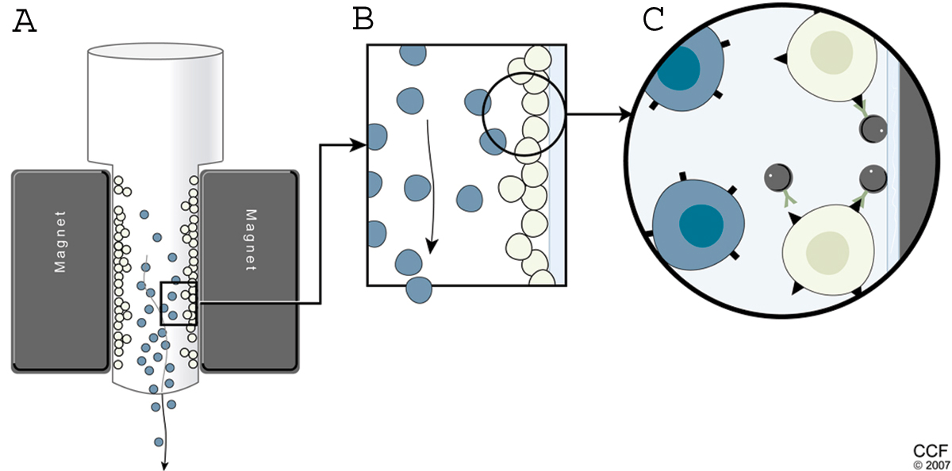

A Practical Approach to Neural-Progenitor Cell Manufacturing
Manlet: Jon Silva, Nick Sweeney Cook, Aguedo De Los Santos
Objectives:
Design a practical process for the production of 100% pure Neural Progenitor cells for cellular therapy
Produce a cost-effective treatment option for Americans suffering from spinal cord injuries (SCI’s)
Process Flow Diagram and Material Balances
Neural Cell Purification:
Immunomagnetic Cell Sorting
Conclusions & Recommendations
Stem cell therapies are budding technologies that are still in development, but appear to be profitable.
Cutting-edge technologies like MACS may be used to produce high-purity cells for injury treatment.
We highly recommend this process, or elements of this process, for the large-scale manufacture of neural progenitor cells for cellular therapies.
Pricing Contributions:
Economic Analysis
https://www.clevelandclinic.org/reproductiveresearchcenter/imglarge/innomale07_1.jpg
$1,775/dose
100% Patient Acquisition
cGMP Compliant
R&D Focused
Notes:
This is only a template. You may chose to use or not use this format. I highly recommend you use a format that works for your group.

