Slide 1

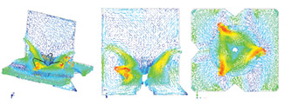
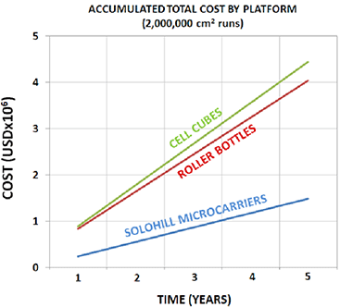
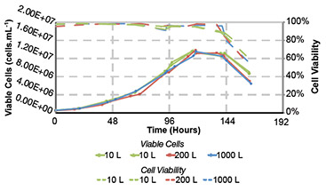
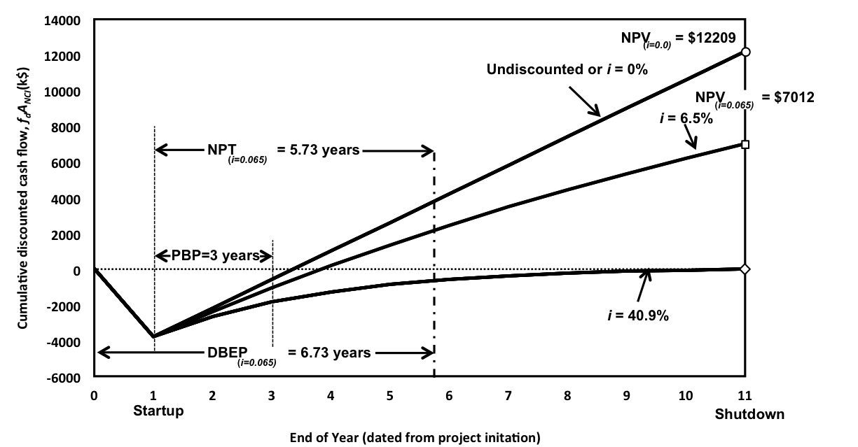
Manufacturing of Neural Stem Cells
The Atoms Family
Michael Pappas, Sean Towler, and Halie White
Introduction
Process Flow Diagram and Material Balance
Currently 250,000 victims of spinal cord injury with 12,000 new victims every year.
Treatment only available through patient derived bone marrow or donated umbilical cords.
Large scale production facility will sustain increasing demands for treatment
Single-use biocontainers/centrifuge and gamma-irradiated microcarriers prevent contamination
The homogenous mixing profile of the 1000 liter bioreactor is shown above. Adult stem cells are extremely delicate and are difficult to grow in traditional suspension cultures. It is critical to minimize shear stress applied to the cells during proliferation all while keeping homogeneity.
Microcarriers are a cost effective option to protect adult stem cells during proliferation.
Viability is maintained during scale up
Economic Analysis
Conclusions and Recommendations
Acknowledgments
Batch process will take 81.2 days with 4 batches produced annually
12,400 treatments per batch with 12,000,000 neural stem cells per treatments
The cost per treatment $91.00
Using Class IV analysis we recommend proceeding with this process
  Low breakeven and payback periods
  NPV = $7,012,000
  NRR = 28%
  DCFRR = 41%
Pall Corporation customer service
Charles Golightly, PhD of Pall Life Sciences
Friends, classmates, and family for their moral support
UNH Department of Chemical Engineering
References
"SoloHill® Microcarriers – Animal Product Free." Pall Corporation. Pall Corporation, 2016. Web. Apr. 2016.
"Allegro STR Single-use Stirred Tank Bioreactors." Pall Corporation. Pall Corporation, 2016. Web. Apr. 2016.
"California's Stem Cell Agency." California's Stem Cell Agency. California Institute for Regenerative Medicine, 2015. Web. 01 May 2016.
Notes:
This is only a template. You may chose to use or not use this format. I highly recommend you use a format that works for your group.

