Slide 1

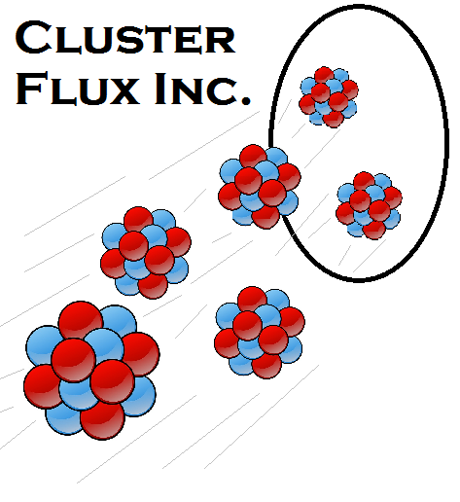
Production of Neural Stem Cells for the Treatment of Spinal Cord Injuries
Cluster Flux
Jennifer Godin, Sean Curtin, Christian Fuller
Introduction
Objectives
Design a production plant for the production of neural stem cells
Produce enough cells to provide for the entire market
Market
In 15 years, 430,000 patients will be in need of neural stem cell treatment
Treatment = 1 million cells a week for 4 weeks
Human Mesenchymal Stem Cell Growth Curve in PADReactor (1200L)
Bench-Top Analysis
Explore effect of large scale, low shear environments on hMSC doubling times
Explore effect of large pressure gradients on hMSC viability
Further define O₂ and CO₂ gas requirements
Explore inefficiencies in differentiation process
Process Flow Diagram
Cash Flow Analysis
PBP = 1.2 years
DCFRR = 50%
NPV at 10% discount rate = $27.5MM
NRR = 36%
Sale price = $1824 per treatment
Conclusions
Process is profitable
DCFRR and NPV are positive
Further reactor trains can be added to meet increases in market demand
Recommendations
Project is a go
Acknowledgments
Dr. Carr, Dr. Wu, Dr. Barkey, and Dr. Gupta for giving us the knowledge to complete this project. The Godin Family, Curtin Family, Fuller Family, and our friends for keeping us sane.
Block Flow Diagram
Cash Flow Analysis
Citations: Ulrich, Gael and Palligarnai Vasudevan, Chemical Engineering: Process Design and Economics a Practical Guide. Durham: Gael D. Ulrich, 2004. Print; Rafiq, Q. A., Brosnan, K. M., Coopman, K., Nienow, A. W., & Hewitt, C. J. (2013). Culture of human mesenchymal stem cells on microcarriers in a 5 l stirred-tank bioreactor. Biotechnology Letters Biotechnol Lett,35(8), 1233-1245. doi:10.1007/s10529-013-1211-9
Notes:
This is only a template. You may chose to use or not use this format. I highly recommend you use a format that works for your group.

