Slide 1


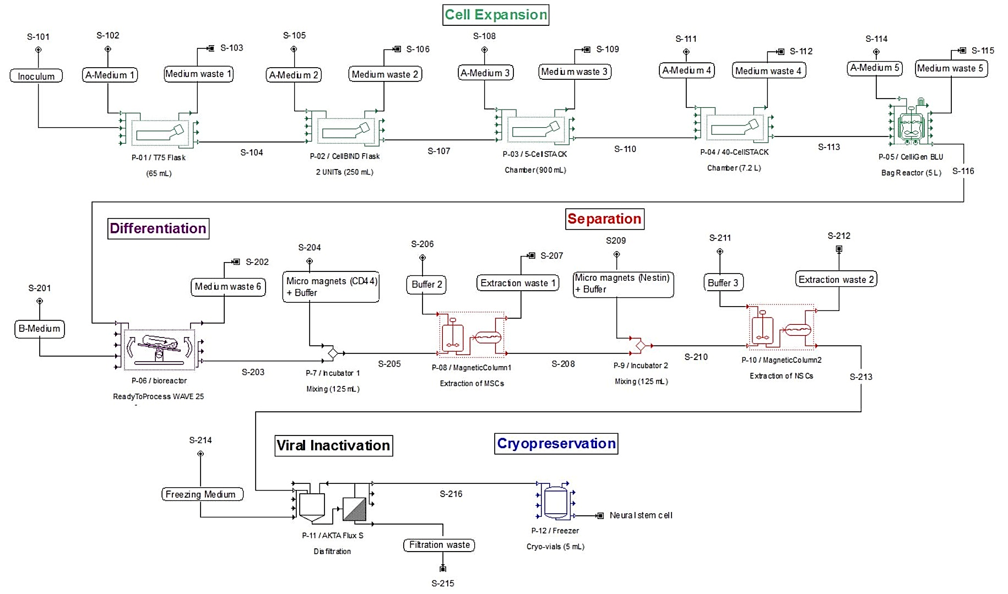
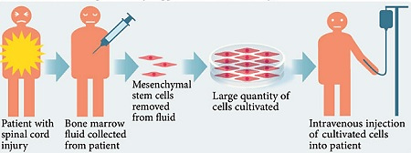
Cell Therapy for Spinal Cord Injuries:
Commercial Manufacturing Facility
Chem Corps: Curty Pinheiro, Jack Scippa & Masakazu Takaki Neto
Objectives
Process Flow Diagram & Material Balance
Conclusion & Recommendation
Design a manufacturing process to produce Stem Cell therapy for Spinal Cord Injuries (SCI).
The production of Stem Cell therapy for SCI is profitable and can be scaled up.
The expansion can be optimized and doubled, and the other sections can be done for bigger quantities of cells.
The process conditions for cell culture, media composition and cryopreservation protocol should be improved.
We recommend the manufacturing facility to be built.
Introduction
Figure 1: Stem Cell therapy (Stem Cell Worx).
Adult Stem Cells can be obtained from several parts of the human body.
These cells can be expanded and differentiated into any kind of cell or tissue.
Neural Stem Cells are used to treat SCI.
Stem Cell clinical trials of this therapyuse 4 injections of NSC in the patients spine, with a total of 20 million cells.
Acknowledgements
AIChE
ISPE
GE Health Care Life Sciences
UNH
Dr. Jeffrey Halpern
Brian Zukas
Gantt Chart
Economic Analysis
Figure 3: Gantt Chart for Stem Cell manufacturing process.
Nearly 40 days per batch
300 treatments per batch
17 batches a year
Total treatments expected: 5,100/yr
a
Figure 3: Discounted Cash Flow Diagram.
Income Tax Considered: 40%
Discount Rate Considered: 10%
Net Present Value: $8,717,984.62
Price for 50% IRR: $982.60
a
References
Stem Cell Worx StemCellWorx.com [Online] // Adult Stem Cell Therapy for Spinal Cord Injuries. - January 10, 2014. - May 3, 2016.
United Nations esa.un.org [Online] // Department of Economic and Social Affairs. - May 3, 2016. - http://esa.un.org/unpd/wpp/Download/Standard/Population/.
Spinal Cord Injury Zone TheSCIZone [Online]. - May 3, 2016. - http://www.spinalcordinjuryzone.com/info/11498/the-race-to-cure-spinal-cord-injuries.
Market Analysis
Figure 2: Spinal Cord Inuries in U.S.
Approximately 75% of SCI patients are treatable with Stem Cell therapy
a
Notes:
This is only a template. You may chose to use or not use this format. I highly recommend you use a format that works for your group.

