Slide 1
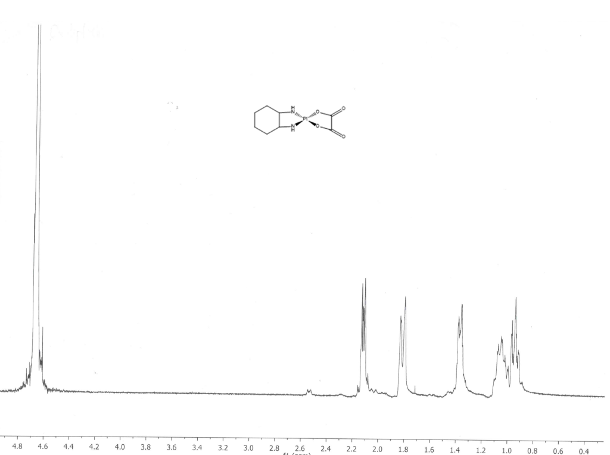
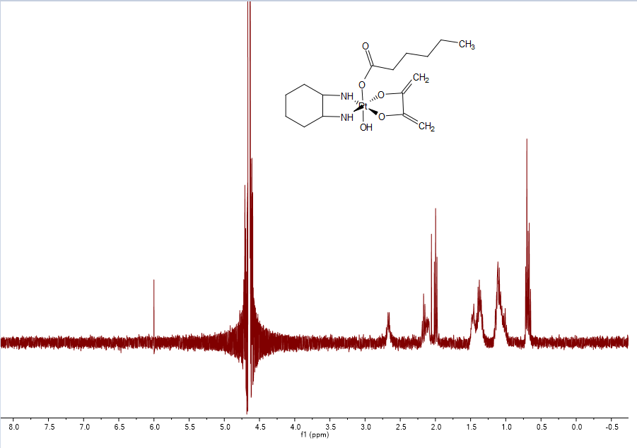
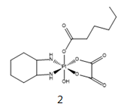
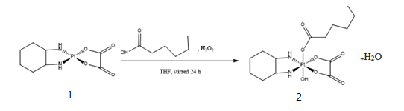
Towards the Synthesis of Pt(IV) Analogs of Oxaliplatin
Anyu Gao, Lea Nyiranshuti and Dr. Roy Planalp
aay55@wildcats.unh.edu; Parsons Hall, 23 Academic Way, Durham NH 03824
Background
The oxidation of Pt(II) precursor:
Platinum(IV)-based anticancer compounds have enormous potential for overcoming the limitations of platinum(II)-based chemotherapies. Platinum(IV)-based compounds have two axial ligands, which are able to influence the reduction kinetics, lipophilicity, cellular accumulation and activity of the platinum species. So, Platinum (IV) can have prolonged stability in the bloodstream and lower toxicity. Due to their increased stability platinum (IV) complexes may be furthermore suitable for oral application. A further orally applicable platinum(IV) anticancer drug currently under development is cis, trans, cis -diammine-dihydroxido-dichlorido-platinum(IV) (oxoplatin) which was synthesized by Chugaev and Khlopin for the first time in the Russian Federation in 1927. During the reduction, the axial ligands are released, this makes platinum(IV)-base compounds have more potential usage to be exploited in drug design.
In order to synthesize platinum (IV) complex, a platinum (II) precursor (oxaliplatin) 1 was oxidized to the platinum (IV) complex using a large excess of a carboxylic acid to dissolve in a polar solvent THF, and 30% hydrogen peroxide as the oxidizing agent, to generate a monocarboxylato platinum (IV) complex 2.
Results and Discussion
Figuer 2.NMR of oxaliplatin
Figuer 3.NMR of the oxidation of oxaliplatin
According to the literature NMR data of trans-[Pt(OCOC₅H₁₁)(OH)(ox)(R,R-chxn)] 2 ,it indicates that the final product 2 was not successfully made. Also, the yield of the final product 2 was 12.5%, and it was really low. There is two reasons to explain it. First, the difficulty in the isolation might cause the lower overall yield and final product lost during the isolation because the low solubility of the oxaliplatin in the reaction mixtures and higher lipophilicity of the product cause more difficult isolation. After diethyl ether added to the crude product, there were lots of white precipitates. However, the crude product can not be isolated completely during the centrifugation. It was supposed to be white solid, but the final product was in a yellow oil form. So, the final product 2 might be lost during the isolation. Second, during the first try in the experiment, the product was heated during the rotating evaporation. However, the heat causes the formation of the di-substituted product. So, the heat should be avoided at all times.
Figure 1. The Pt (IV) analogs of oxaliplatin synthesized in this lab.
Experimental
The synthesis of trans-[Pt(OCOC₅H₁₁)(OH)(ox)(R,R-chxn)]:
The oxidation of oxaliplatin 1 in hexanoic acid and THF was converted into trans-[Pt(OCOC₅H₁₁)(OH)(ox)(R,R-chxn)] 2 under nitrogen gas. 30% hydrogen peroxide was used as the oxidizing agent. The pure product 2 was precipitated out by adding diethyl ether and isolated using the centrifugation.
Conclusions and future work
Overall, the NMR of the oxidation of oxaliplatin shows that the final product 2 was not successfully made. Moreover, the yield for the final product was really low. The low solubility of starting material in the reaction mixture and higher lipophilicity of the product cause more difficult isolation and lower overall yield. In order to solve this problem, experimenters can use more polar and acidic solvent to dissolve starting materials. For example, experimenters can use 2-bromoacetic acid to replace hexanoic acid to give more solubility for starting materials. Also, the higher solubility of starting material can give higher yield. The heat should be avoided all times to avoid the formation of the di-substituted product.
References and Acknowledgments
1. Zhang JZ, Bonnitcha P, Wexselblatt E, Klein AV, Najajreh Y, Gibson D, et al. Chemistry A European Journal. Facile preparation of Mono-, Di- and Mixed-Carboxylato Platinum(IV) Complexes for Versatile Anticancer Prodrug Design . 2013;1–7.
The author gratefully acknowledge Lea Nyiranshuti, Dr. Roy Planalp and the University of New Hampshire Department of Chemistry
Scheme 1. The synthesis of trans-[Pt(OCOC₅H₁₁)(OH)(ox)(R,R-chxn)].

