Slide 1

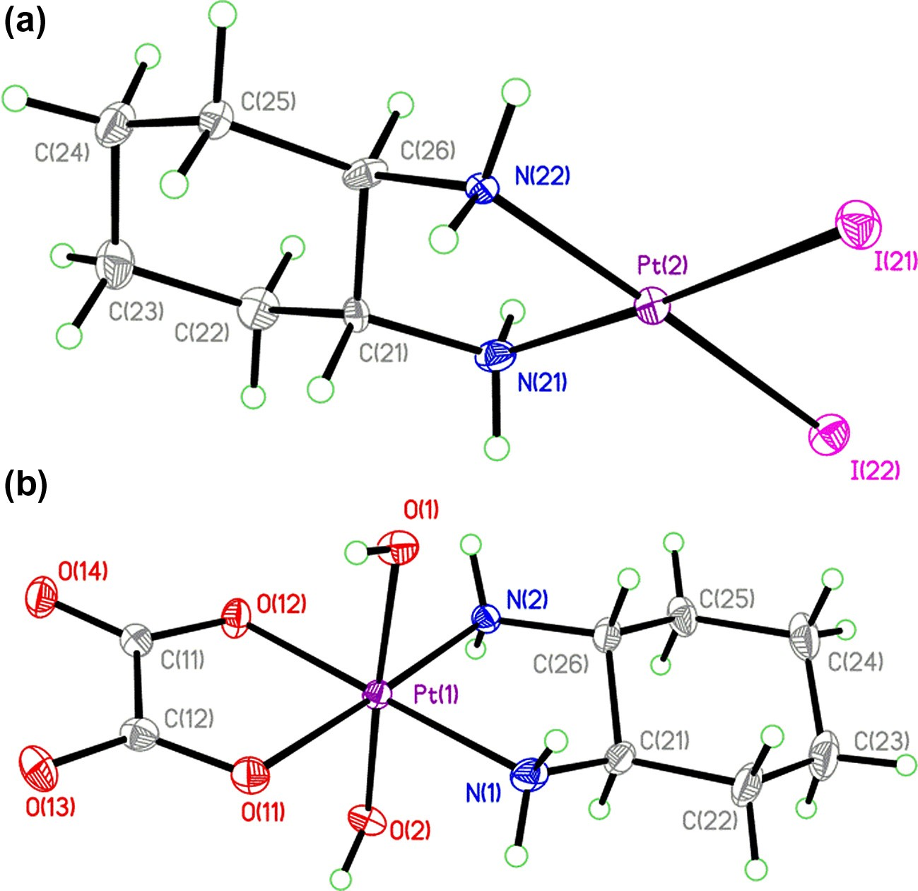
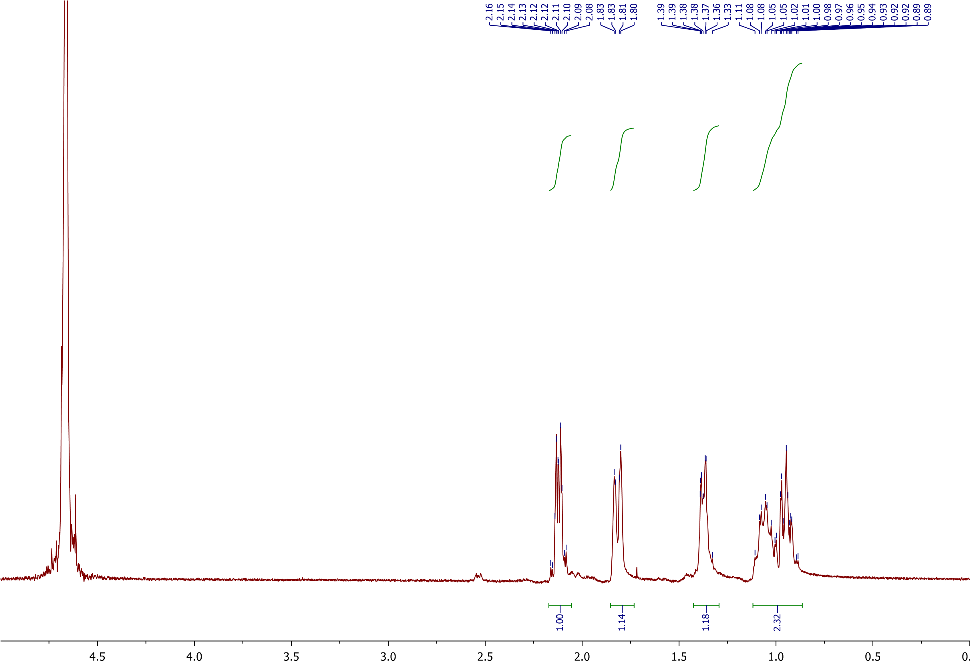
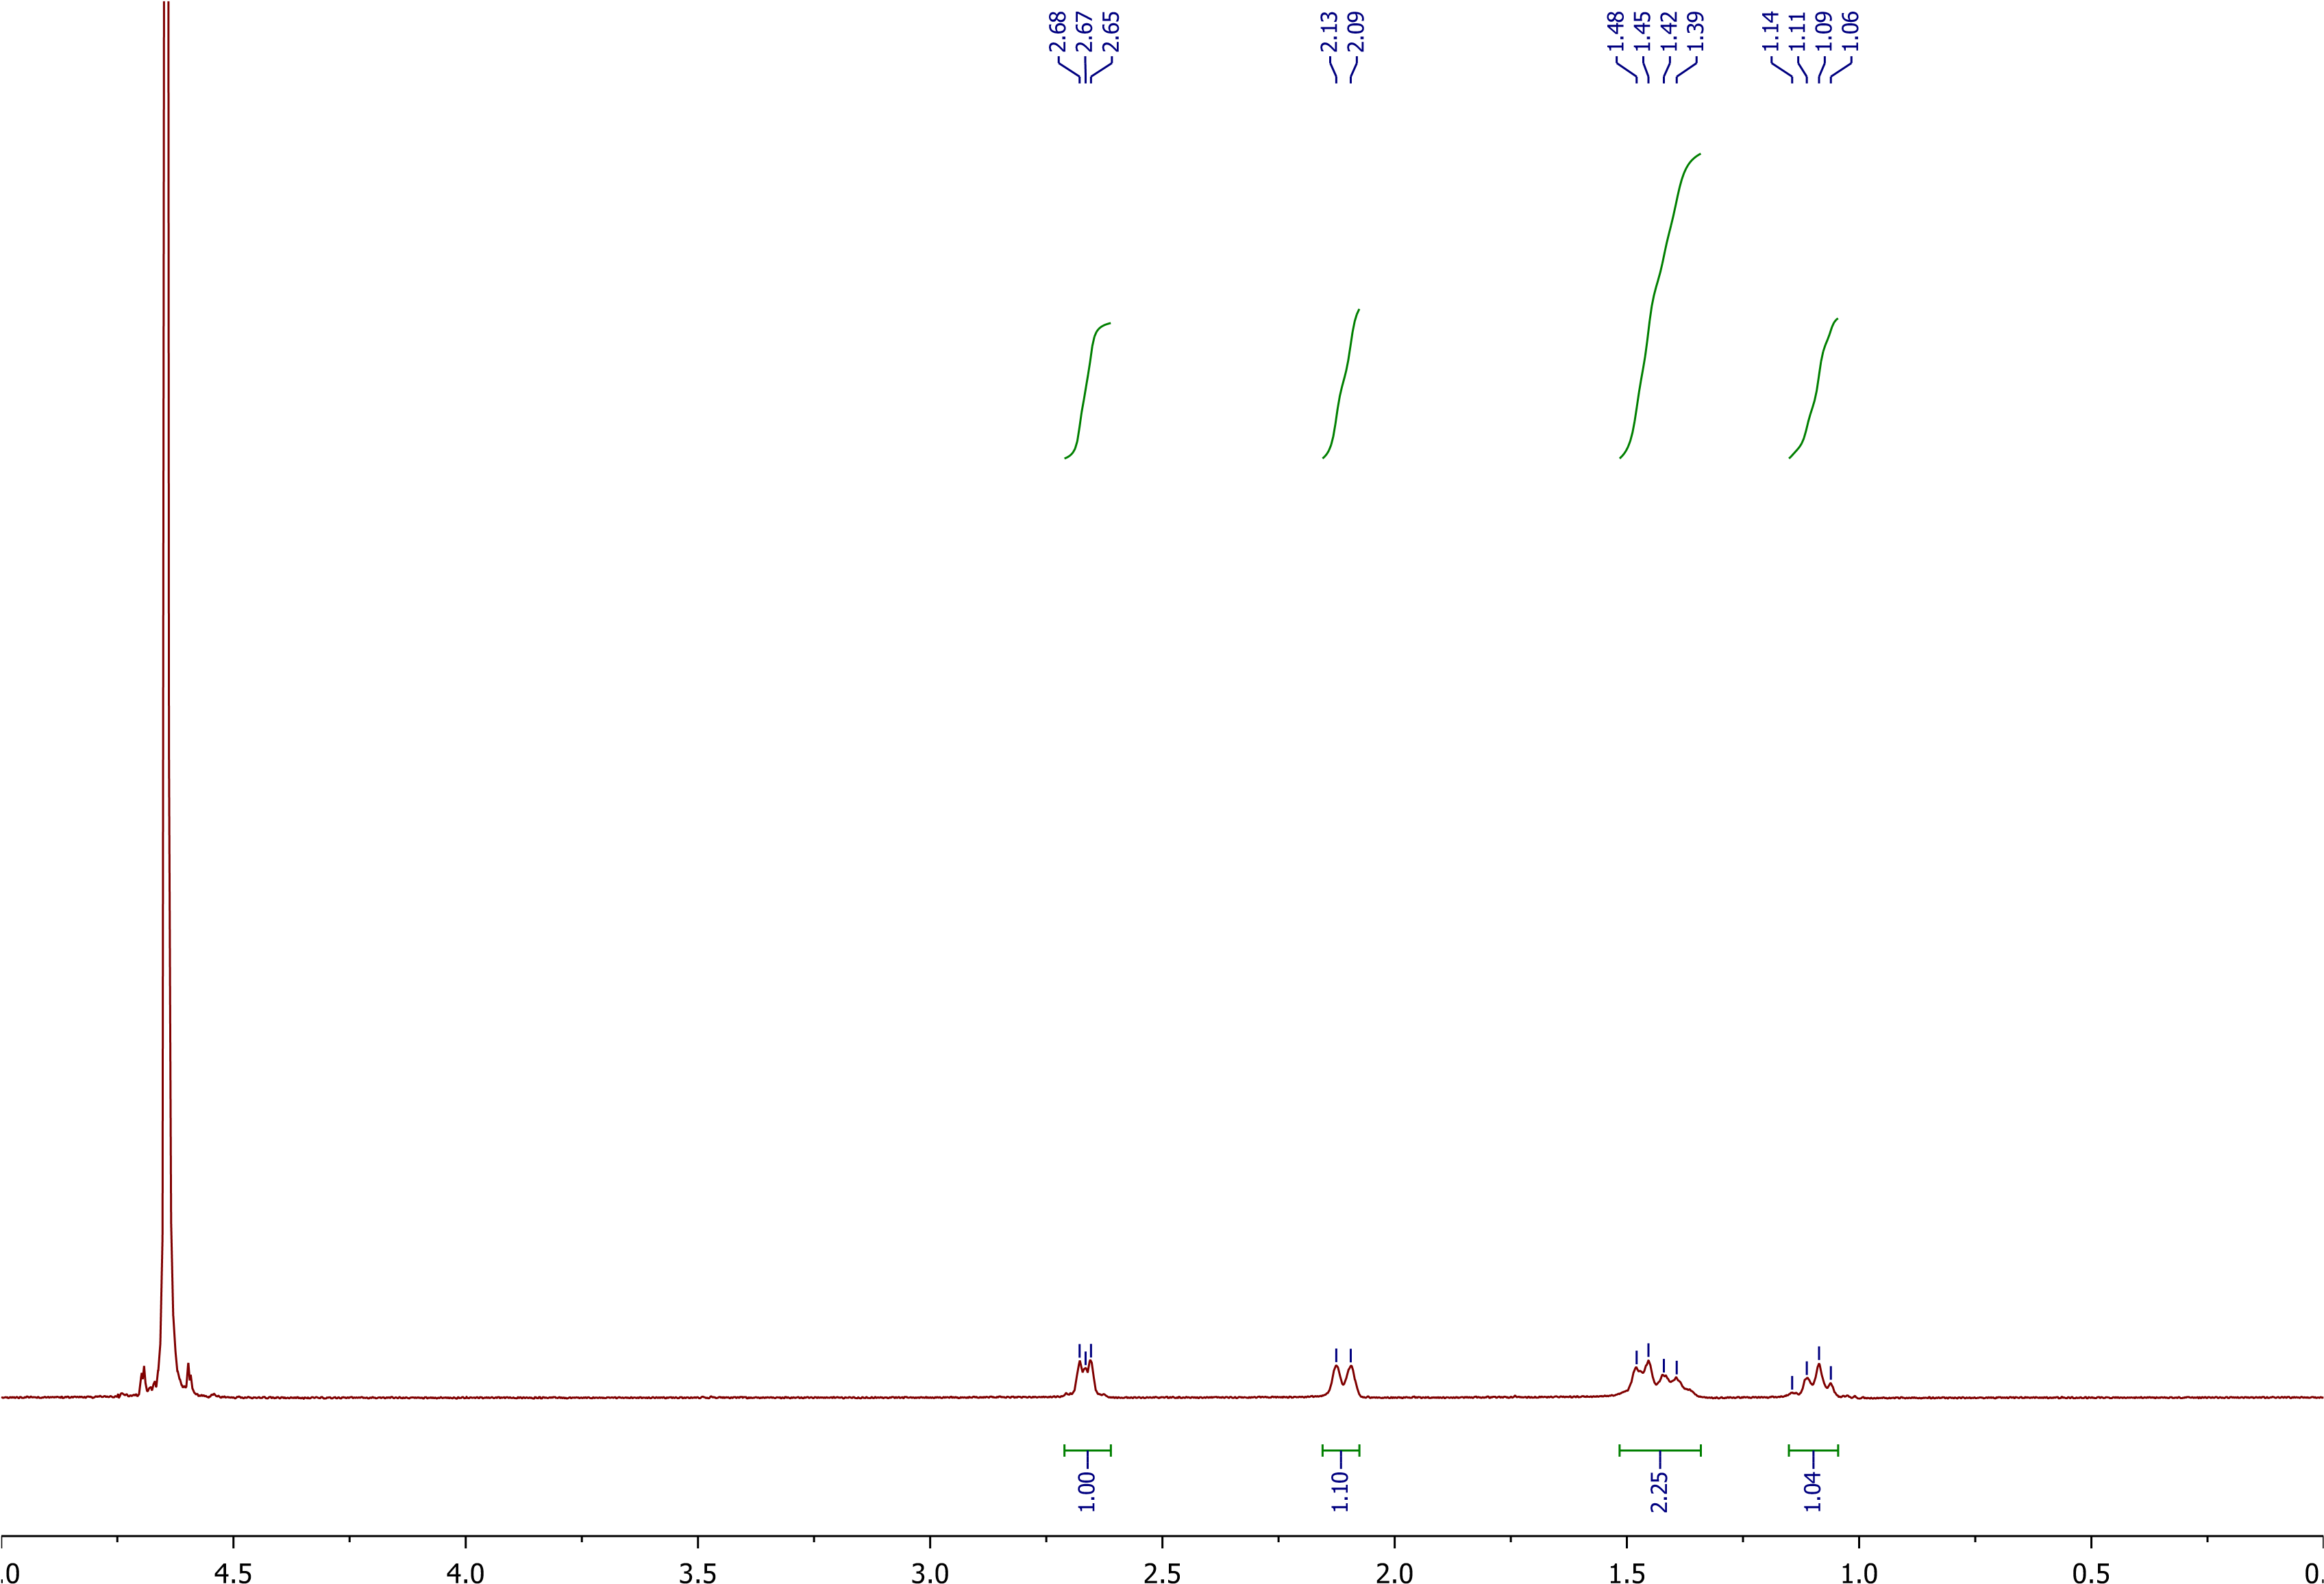
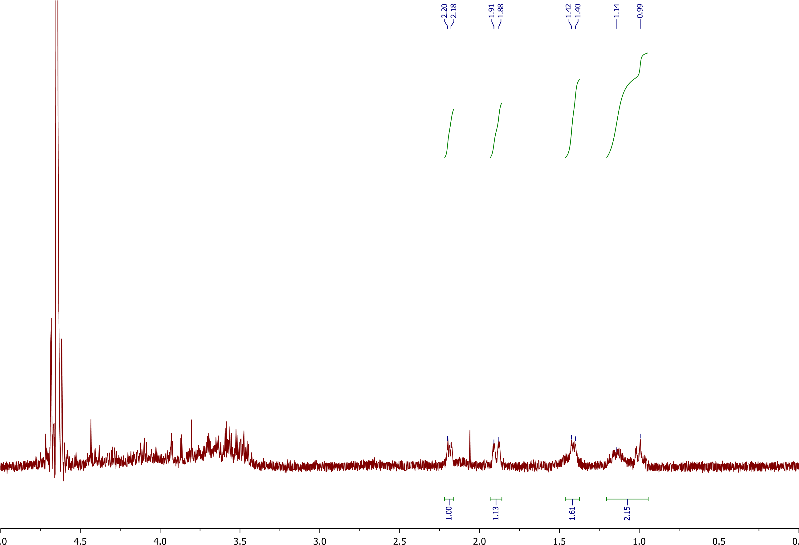
Trans-[Pt(OH)₂(ox)(R,R-chxn)] and the fight against cancer: a common monomer of Oxaliplatin
Ian Smith, Lea Nyiranshuti, Luke Fulton, Roy Planalp
imw8@wildcats.unh.edu, Department of Chemistry, University of New Hampshire, Durham, NH
5/1/2016
Introduction:
This lab was used to create one of the Pt(IV) compounds that reduces into oxaliplatin in order to use it for fighting cancer cells. The uses of oxaliplatin are as one of the compounds used to fight colon and rectal cancer, and advanced cancers of the same type. However, these cancers are not susceptibile from the outside of the cancer cells. So in order to combat these cancers the compounds are modified into Pt(IV) variety of the compounds, which are used in order to be taken in by the cancer cells. The axial ligands of the Pt(IV) compounds are lost in the transition through the membrane of the cancer cell and the oxaliplatin destroys the cancer cell from the inside out. This is because the cancer cell sees the Pt(IV) complex as safe to eat for nourishment, instead of as a danger. This transition happens as the cancer cell envelops the Pt(IV) complex which then proceeds to attack the cancer cell from the inside.
A multiday synthesis was performed starting with the oxaliplatin 1 to get the trans-[Pt(OH)₂(ox)(R,R-chxn)] 2. The suggested synthesis is shown in Scheme 1. This synthesis goes through a 24hr reaction contained in darkness, which was achieved by wrapped tinfoil around the reaction flask. This allows the Hydrogen Peroxide to react to the oxaliplatin in the axial positions. Any excess hydrogen peroxide is deactivated through applying heat after the 24hr period and a wash would then be applied to only get the trans-isomer of the product. Each step of the synthesis was purified and analyzed by proton NMR multiple times to verify purity and whether the compound has been achieved^{1,3,7}
Scheme 1. Synthetic Pathway to
Trans-[Pt(OH)₂(ox)(R,R-chxn)]
This reaction is a way to create one of the oxaliplatin compounds that penetrates and fights cancer. The original process, seen in the supporting information given to us, states a yield of 89% of the product. Obtained was a 19% yield, however this experiment was done to determine a working pathway and good product, not for yield. The product through proton NMR and IR has shown to be the appropriate complex at both Pt(IV) and Pt(II) (after reduction) complexes. X-ray crystallography was known and compared to the one taken for structural composition reference. The cyclic voltammetry was done on the compound in order to find the reduction potentials, however the expected results came back negative because the concentration was very low. Though the reduction potential of the compound used didn’t show confirmed results for the compound created, the compound is the desired compound sought after.
¹H NMR was used to characterize crude and pure products.
Figure 1. ¹H NMR of Oxaliplatin, [Pt(OH)₂(ox)(R,R-chxn)], and the reduced Pt(II) complex from the product.
The analysis of the reduction potentials of the compound are a key factor in the determination of the compound and the solutions used to figure these happened to be too weak in order to find the actual potentials. Additional work would be to confirm the reaction potentials of the compound through a different solution or concentration of the same solution and also to continue work on the pathway to increase percent yield.
Figure 2. X-ray crystallography structure of the original (a) and desired compounds (b).
The synthesis of trans-[Pt(OH)₂(ox)(R,R-chxn)] was completed and confirmed through proton NMR and x-ray crystallography. This compound was purified and with the process being known to work, efforts made to increase output yield and on the cyclic voltammetry concentrations can be made. There were no major problems and the reaction takes relatively no time to make. With the current yield making such a compound in bulk will require additional trials.
Lea Nyiranshuti and Luke Fulton and Professor Planalp and UNH chemistry department are gratefully acknowledged.
C.M. Giadomenico, M.J. Abrams, B.A. Murrer, J.F. Vollano, M.I. Rheinheimer, S.B. Wyer, G.E. Bossard, and J.D. Higgins, Inorganic Chemistry, 1995, 34, 1015-1021.
Khazanov, E., Barenholz, Y., Gibson, D., and Najajreh, Y. Novel apoptosis-inducing trans-platinum piperidine derivatives: synthesis and biological characterization. Journal of Medicinal Chemistry 45, 5196-5204, doi: 10.1021/jm020817y (2002)
K.R. Barnes, A. Kutikov, and S.J. Lippard, Chemistry and Biology, 2004, 11, 557-564.
Morley, C.P. Inorganic Experiments, 2nd ed.; Wiley-VCH: Weinheim, 2003; pp 146-148
Oxaliplatin. (2012, November 26). Retrieved March 29, 2016, from http://www.netdoctor.co.uk/medicines/cancer/a7993/oxaliplatin/
Johnstone, T. C. (2014). The crystal structure of oxaliplatin: A case of overlooked pseudo symmetry.Polyhedron, 67. Retrieved May 4, 2016.
Results and Discussion:
Future Work:
Conclusions:
Experimental Work:
Acknowledgements:
References:

