Slide 1
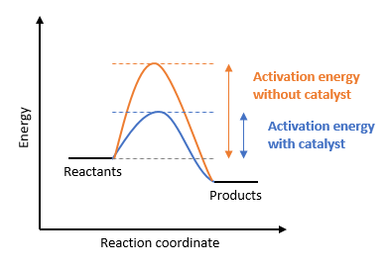
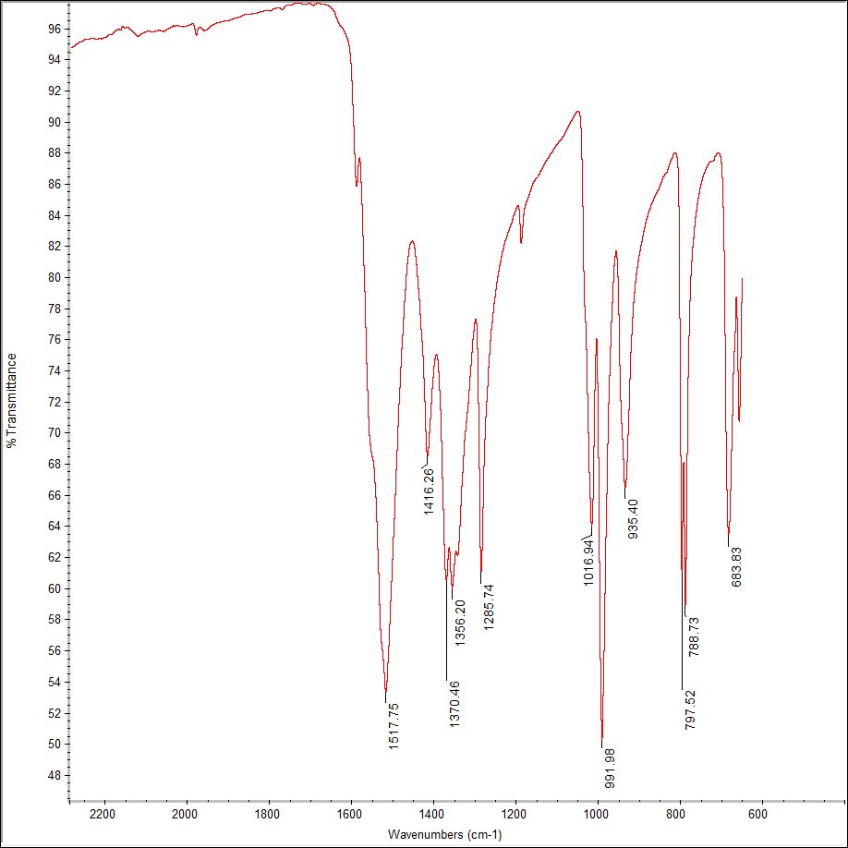
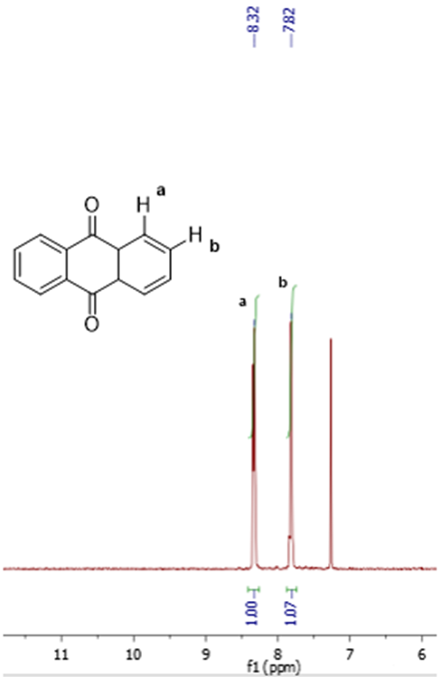
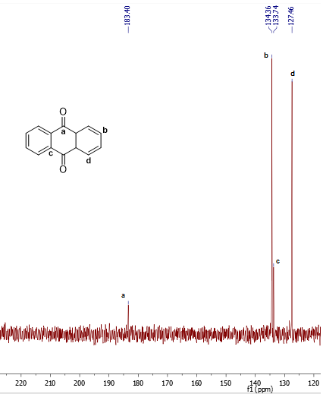
Effect of Reaction Conditions on Oxidation of Anthracene with a Vanadium Catalyst
Cynthia R. Gerber, Ian J. Martin, Lea Nyiranshuti*, Luke Fulton*, Roy P. Planalp*
cry85@wildcats.unh.edu; ijx4@wildcats.unh.edu; Parsons Hall, 23 Academic Way, Durham NH 03824
May 5th, 2016
Introduction
Catalysts are used to accelerate reactions by providing an alternate pathway and lowering the energy of activation (Figure 1). Vanadyl acetylacetonate has been chosen as a catalyst in the oxidation of anthracene to anthraquinone as it can be easily synthesized.
The effects of the reaction conditions on the turnover number (TON) of the catalyst and percent yield of anthraquinone in the oxidation of anthracene were explored. This was done by performing the reaction several times under various conditions.
Catalyst Synthesis
The procedure for the synthesis of the vanadyl acetylacetonate catalyst was adapted from literature¹ and involved first dissolving vanadyl sulfate in water, followed by the addition 2,4-pentanedione and a solution of saturated sodium carbonate (Figure 2).
Anthracene Oxidation
The procedure for the oxidation of anthracene was adapted from literature², however the reaction time was decreased. Anthracene and the vanadium catalyst were dissolved in ethyl acetate followed by the addition of hydrogen peroxide (Figure 4).
Figure 2. Synthesis of vanadyl acetylacetonate.
Figure 4. Synthesis of anthraquinone.
Figure 1. Schematic showing the effect of a catalyst on the energy of activation.
Figure 5. ¹H NMR spectrum. Figure 6. ¹³C NMR spectrum.
Figure 3. IR (ATR) spectrum of the vanadyl catalyst.
Future Work
TLC was used to roughly estimate the purity of the product, but instrumental methods could be used to quantitatively determine the composition of the product. This would allow the percent conversion of anthracene to also be analyzed.
Vanadyl acetylacetonate could also be used in qualitative experiments to illustrate the difference between coordinating and noncoordinating solvents and demonstrate how coordination affects solubility.
Results
Acknowledgments
Special thanks to Lea Nyiranshuti as well as Luke Fulton, Prof. Roy Planalp, and the Department of Chemistry at UNH for funding.
Conditions | TON | Yield (%)
Normal* | 12 | 40
Half H₂O₂** | 8 | 26
Double catalyst | 7 | 46
1 h** | 2 | 6
1.5 h | 12 | 41
*Normal conditions are 500 mg anthracene, 25 mg catalyst, 20 mL ethyl acetate, 15 mL 30% of hydrogen peroxide solution at reflux for 2 h. **Performed by Martin.
References
1. Charleton, K. D. M.; Prokopchuk, E. M. J. Chem. Educ. 2011, 88, 1155–1157.
2. Men’shikov, S. Y.; Vurasko, A. V.; Petrov, L. A.; Molochnikov, L.S.; Novoseiova, A. A.; Skryabina, Z. E.; Saloutin, V. I. Russ. Chem. Bull. 1992, 41, 619–622.
Conclusions
The data agreed with what was described in the literature¹, except for the half H₂O₂ reaction which showed a decrease in TON and percent yield compared to normal conditions where an increase was expected.
Table 1. Turnover number and percent yield for the oxidation of anthracene with varying reaction conditions.

