Slide 1

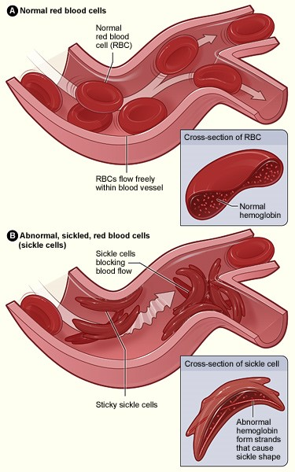
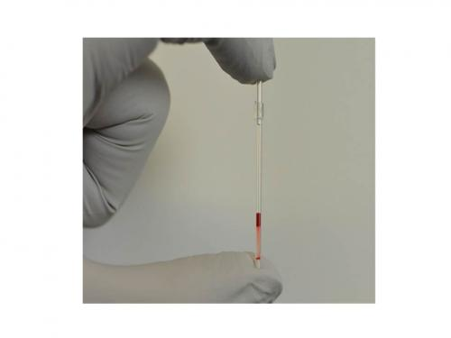
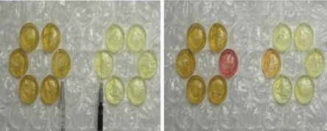
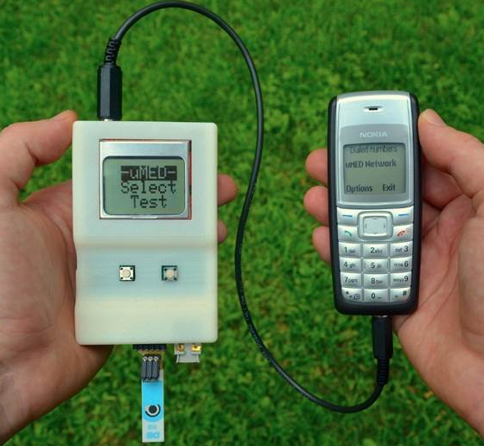
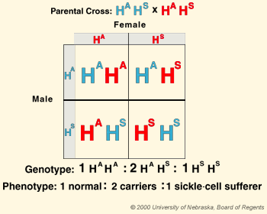
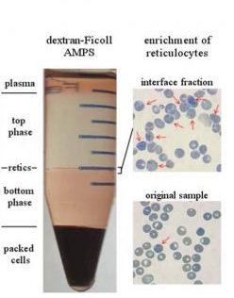
Density Diagnostics in Sickle Cell Disease
Julianna Raffa. Department of Chemistry, University of New Hampshire.
Introduction
Cell Function
Research in Zambia
Sickle Cell Disease (SCD) is a gene-inherited blood disorder that effects roughly 300,000 children every year. People with SCD have an abnormal hemoglobin. Hemoglobin is a protein that carries oxygen through the body by transport of the red blood cells. SCD patients inherit one abnormal hemoglobin gene from each of their biological parents creating hemoglobin SS. Hemoglobin SS is the gene for Sickle Cell Anemia, the most common and most severe kind of Sickle Cell Disease. Life expectancy for SCD patients has increased to 40-60 years old due to advancements in technology and the increasing opportunity for early diagnosis. The Whitesides Research Group at Harvard University is contributing to the advancements in technology with their research in healthcare for developing economies. The Whitesides Research Group is looking for low-cost alternatives to diagnostic medicine. The ability to detect sickle cells using density diagnostics is a product of the Whitesides Group research.
Red blood cells need oxygen to function. Hemoglobin carries oxygen through the blood stream by way of the red blood cells. Sickle shaped cells are flat as pictured in Figure 2.
Sickled cells are not flexible and stick to vessel walls. When the cells stick to the vessel walls they cause a blockage that can slow or even stop the flow of blood. Oxygen restriction is caused when the blood flow is slowed or stopped. In patients with SCD this oxygen restriction causes pain crises. These pain crises occur randomly and often need to be treated by medical professionals
The Whitesides Research Group has conducted research in Zambia. Zambia is a country in Southern Africa. It is a growing country in population but also a developing country that sees about 6,000 sickle cell disease births per year. Figure 4 shows an actual test done by the Whitesides Group of a blood sample from a person with SCD.
Figure 4
Hematopoietic Stem Cell Transplantation (HSCT) is a potential cure for SCD. It is very expensive and can only be done between family members of a genetic match.
Hydroxyurea is an oral medication taken by SCD patients to help control the number of pain crises that occur. Hydroxyurea produces another hemoglobin called hemoglobin F or fetal hemoglobin. Hemoglobin F makes red blood cells less likely to sickle.
Other Whitesides Research
The Whitesides Group performs other types of research concerning finding alternative cost and time efficient ways to practice medicine in developing countries.
Sickle Cell Disease
Sickle Cell Disease is passed from parents to children. Figure 1 demonstrates how the gene is passed from parents to children. The H^{s}H^{s} is the sickle cell genotype for a sickle cell patient.
Figure 5: Bubble wrap as use for transport and analysis of samples.
Figure 2
Figure 6: uMED device created by the Whitesides Research Group as a form of electrochemical testing
AMPS
The Whitesides Research Group has created a simple way to detect sickle cell presence in blood samples. Using an aqueous multiphase system created from Aqueous Multiphase Polymers (AMPS) they are able to separate the normal and sickle cells. Figure 3 shows a dextran and Ficoll AMPS system. The solutions separate by density.
The AMPS system is thermodynamically stable, biocompatible, and can be tuned for specific densities. As normal red blood cells change into sickle cells they change their shape and their density. The cells become very dense erythrocytes. They are the most dense part of the system and therefore sink to the bottom of the tube as seen in Figure 3.
Acknowledgements
UNH Chemistry Department
Whitesides Research Group
Pat Wilkinson and Arthur Greenburg
References
Figure 1
“Erythrocyte.” TheFreeDictionary.com. Farlex, Inc., 2016. Web. 02 May 2016
Global Burden of Sickle Cell Anemia in Childen Under Five, 2010-2050: Modeling Based on Demographics, Excess Mortality and Interventions. Piel FB, Hay SI, Grupta S, Weatherall TN. PLOS Medicine. July 2013
“George Whitesides.” Whitesides Research Group: Gwhitesides. Whitesides Research Group, 2011. Web. 02 May 2016.
“How Is Sickle Cell Disease Treated?” –NHLBI, NIH. National Institute of Health, June 2015. Web. 02 May 2016.
“Whitesides Research Group: Research Low-Cost Diagnostics and Tools for Global Health.” Low-Cost Diagnostics and Tools for Global Health. Whitesides Research Group, 2011. Web. 02 May 2016.
“What is Sickle Cell Disease?” –NHLBI, NIH. National Institute of Health, June 2015. Web. 02 May 2016.
SCD is a life long illness and there is no determined cure. Patients can be treated for pain and symptoms as necessary. Patients are more prone to infections and strokes so multiple trips to the doctor are required. In this type of Sickle Cell Disease that patient is anemic because because they carry the H^{S}H^{s} genotype.
Figure 3

