Slide 1

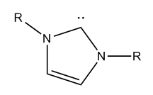
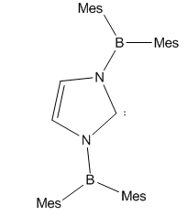
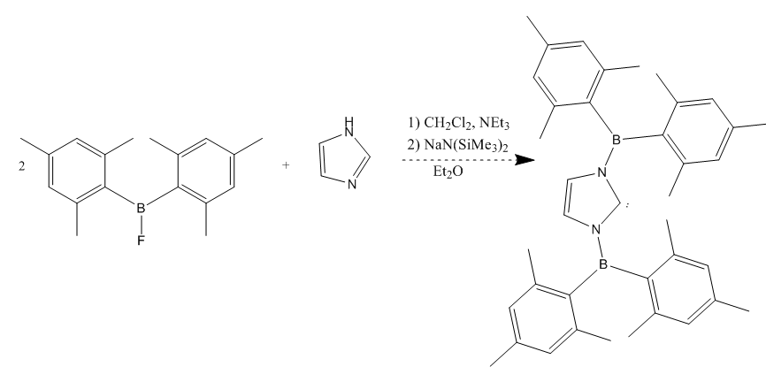
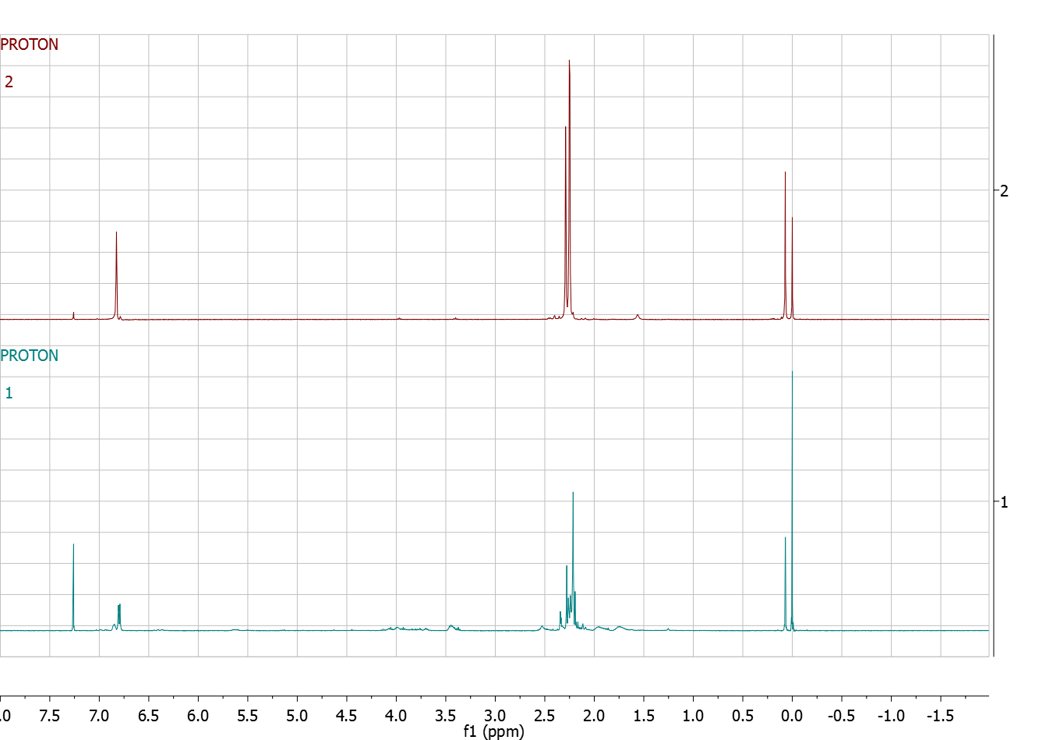
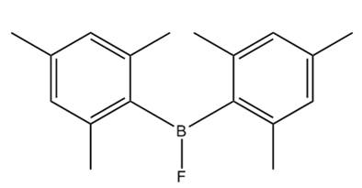
Synthesis and Characterization of a
“Confused” N-Heterocyclic Carbene Ligand
Kirsten Enegren, Christine Caputo
kem243@wildcats.unh.edu; Parsons Hall, 23 Academic Way, Durham NH 03824
Introduction
N-Heterocyclic Carbenes are carbon containing compounds that have divalent carbon atoms. They contain a carbon and a nitrogen in the ring structure and their arrangement ends up being bent because of the cyclic nature of the compound. The lone pair on the compound makes them nucleophilic σ-donor so that they are able to bind to metallic as well as non-metallic species. N-Heterocyclic Carbenes are used as ligands for transition metals and the Caputo group is interested in using them for CO₂ reduction.
Future Work
In the future the effectiveness and purification of boron trichloride versus boron trifluoride will be checked to see which is more effective and gives better results. After the syntheses have been performed boron NMR’s will be taken of the products to characterize the compounds and to clarify if the product has been made.
After these steps, the bismesityl boron fluoride will be added to imadazole. Once it has been established that this step has worked, another addition step will be carried out and from this the desired synthetic product will be created. From this product we can check the electron donation properties of the ligand and try to use it for CO₂ reduction.
Figure 1. Structure of a generalized N-Heterocyclic Carbene and the desired N-Heterocyclic species of the synthetic process.
Results and Discussion
The original synthesis of bismesityl boron fluoride produced a 46.9 % yield after three sublimations. This process was repeated and the boron NMR came back showing no trace of boron signifying that the product was not made. The proton NMR showed traces of impurities and it is assumed that the product was lost in the filtration step of the synthesis. Different solvents were used in the grignard synthesis to begin the reactions but the only solvent that proved to work was THF.
Figure 3. The proposed synthetic route for this project.
Experimental
This experiment was run under a schlenk line under constant nitrogen pressure due to chemicals being hygroscopic and moisture sensitive.
Conclusions
The synthesis that was carried out has only been synthesized halfway through the overall reaction. The future work on this product should provide a reliable ligand metal complex that can do CO₂ reduction. We will also characterize the electron donation properties of the ligand.
Acknowledgments
Thank you to Christine Caputo and the Caputo Research Group and thank you to the Department of Chemistry, UNH, for funding.
References
Hopkinson Matthew N., Richter Christian, Schedler Michael, Glorius Frank. 2014. An overview of N-heterocyclic carbenes. Nature Vol 510. 485-496
Figure 2. NMR results of two different synthesis experiments with the structure of the desired project.

