Slide 1


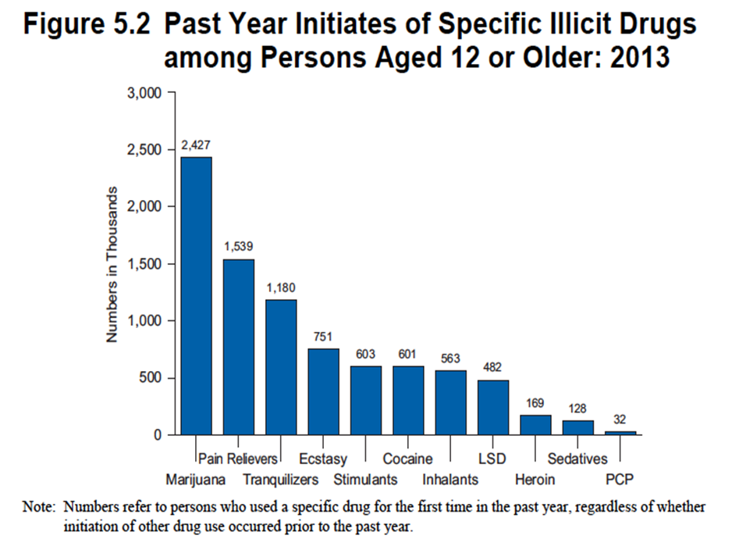
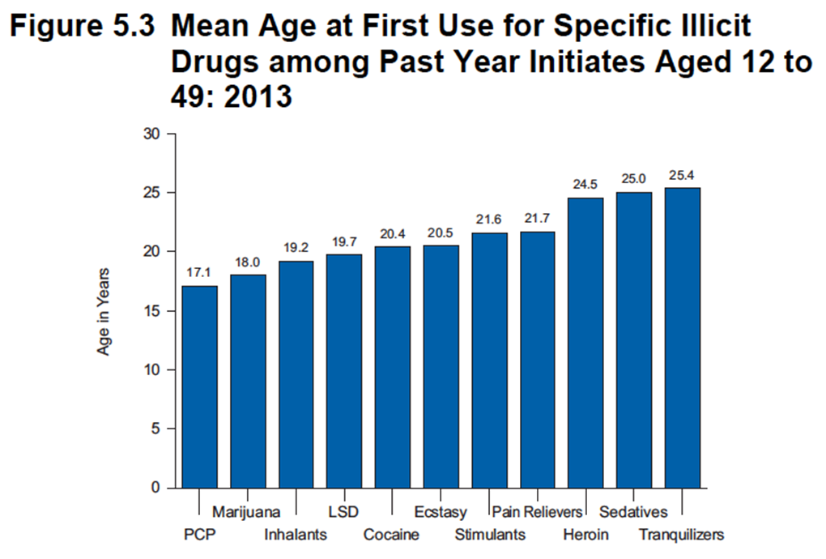
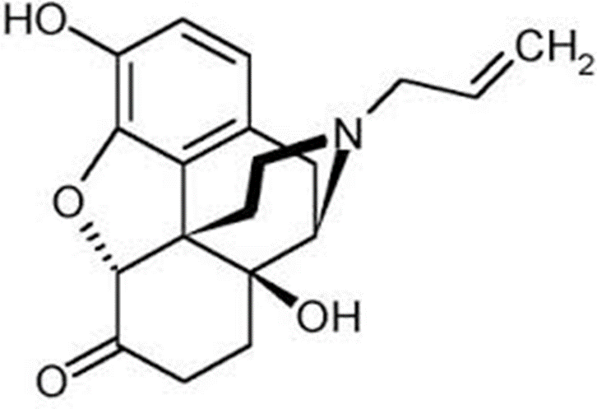
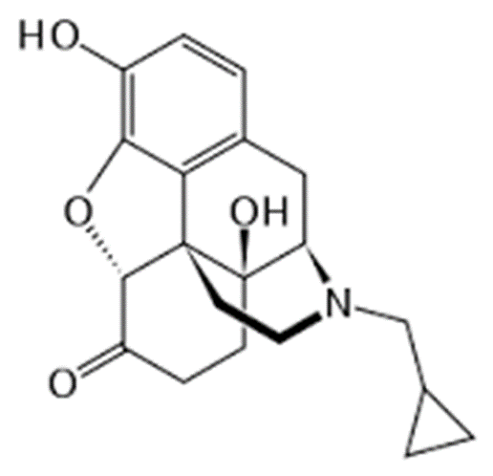
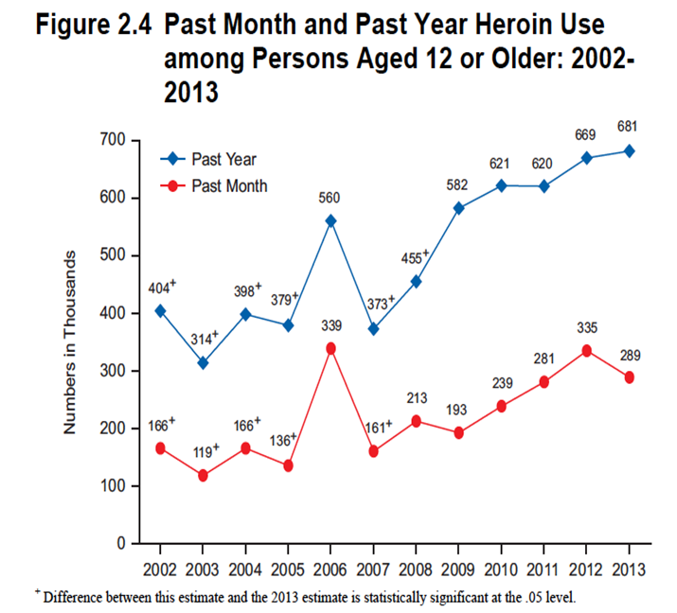
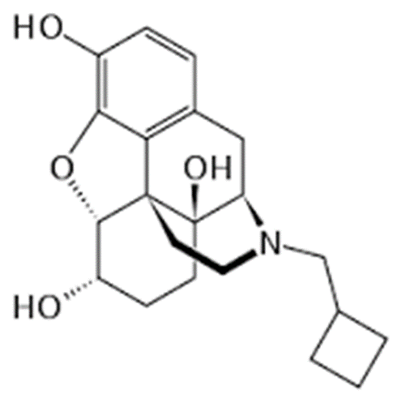
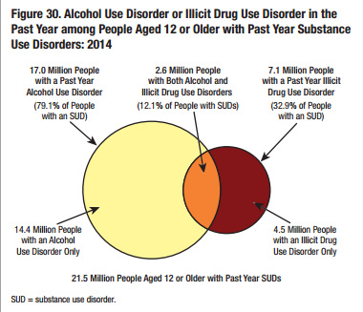
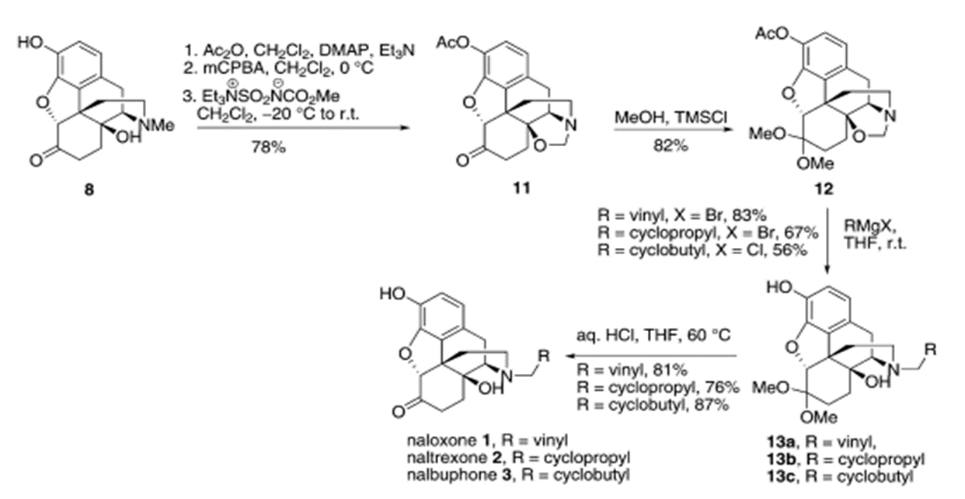

Naloxone: How and Why it is Being Produced and How the Government is Mandating It
Catherine Borella Chemistry BA Class of 2016
Senior Chemistry Seminar University of New Hampshire, Durham, NH, USA
Objective
Discussions
How the Government is Mandating Naloxone
Monte-Carlo (MC) Simulation Approach is well suited for simulation of free-radical polymerization reactions even when there is significant chain-length dependence. The simulation is done for a small control volume which is considered as the representative sample of the whole reaction system. In this simulation approach, for each simulation step, the next reaction is decided by using random numbers and the reaction probability of every possible reaction at that point in time.
The sequential nature of MC simulations make this approach processor intensive and time consuming which is a drawback of this approach. Here we demonstrate an Hybrid Simulation Approach which utilizes a combination of the stochastic MC simulation with deterministic Ordinary Differential Equation (ODE) solvers. This approach allows for significant reduction in simulation time while maintaining the features of complete MC methods.
Monitoring the usage of opioids such as heroin is important to why the use of naloxone became in such high demand.
Heroin, a once thought of as non-addictive version of morphine has become a highly addictive substance. Once in the body, heroin biochemically reverts back to morphine, but has larger euphoric effects.
Its use is at an all time high.
Average age of beginning use is 25
Naloxone is a full µ antagonist that blocks the opioid receptor from receiving opioids, masking their euphoric effects.
Naloxone can be administered a number of ways to stop a heroin user from overdosing, but nasal route is encouraged, as it does not require training.
Narcan is being administered by intranasal route upon signs of overdose. The three signs of overdose are:
Unusual sleepiness and inability to wake the person
Slow, difficult breathing patterns
Black circle in center of colored part of the eye
Narcan is safe to use in any persons who are not using opioids.
Whenever administered, ambulatory care should be contacted, as it is still a medical emergency.
Typically when prescribed, there are two devices given with the element of administration and the part containing the medicine. This is for the event that there needs to be a follow up dosage given if signs and symptoms return after the 2 to 3 minutes from the first dose. Narcan can only be used once.
It stays in the persons system for up to 2 hours, but with extremely large dosage of opioids, the overdose may last longer than 2 hours which is also why a second device is given.
In the US currently, there are only 17 states that allow for dispensing of Narcan without a prescription. In New Hampshire, you are recommended to see your doctor if you believe you know someone who is using opioids, and they will write a prescription.
Some of the precautions when allowing a drug like Narcan to be on the market is availability. If those using know it will be available to them in the event of an overdose, they tend to take overdosing less seriously, as now it may not always lead to death. It is of the utmost importance to medical professionals everywhere that the number of deaths decrease, but also that the number of users decreases as well, which is why the federal government and local governments are being precautious with this product.
This figure is from the national health survey in 2013, and illustrated the first time users aged 12 and older, in organization of illicit drug. This graph does not rule out first time users for more than one drug. Heroin places in the lowest three illicit drug use.
Compounds
Figure 1: Naloxone
Conclusions
Naloxone is a full opioid antagonist and is used in addictive therapy for patients who have developed a dependence on narcotics, or heroin.
This epidemic of narcotics being addictive and being taken to the point of overdosing is ongoing. The trends do not appear to be stabilizing, rather they appear to be forever increasing. Without drastic measures being put into place immediately, there will be serious repercussions. Addiction is not visibly detectable, but it is a disease. It is a mental disorder that takes over thousands of new lives every day. Once you are being treated by these medications, there is no true evidence or studies available that detail that substance abuse is eventually terminated in any patients. Rather, it can be found to reappear after decades of abstinence. It is important to our future generations that we as a society and a scientific community come up with a real solution to this problem.
Figure 2: Naltrexone
This figure shows the average age at which illicit drugs were first used, based on the type of illicit drug. The overall trend is irrelevant, but it is important to particularly notice the age at which heroin is used, 24.5 years of age.
Naltrexone is additionally a full antagonist and is used in clinical settings for alcohol addiction.
Figure 3: Nalbuphine
Nalbuphine is used in combination with drugs such as morphine to decrease the side effects of opioids that can range from addiction to nausea and vomiting.
References
It is important to notice their unique R-groups off the tertiary Nitrogen group when composing these compounds.
The trends in the first two figures above are not indicative of heroin being as much of a crisis as it seems. But this figure, labelled 2.4, shows the steady rise of heroin use in persons aged 12 and older since 2002. The number as nearly doubled across the time span, and does not show any signs of decreasing.
Mary Ann Endoma-Arias; Cox, D; Hudlicky, T General Method of synthesis for naloxone, naltrexone, nalbuphone, and nalbuphine by the reaction of grignard reagents with an oxazolidine derived from oxymorphone 2013 Advanced Synthesis and Catalysis 355 p 1869-1873
SAMHSA Behavioral Health Trends in the United States: Results from the 2014 National Survey on Drugs Use and Health 2015 U.S Department of Health and Human Services Publication number SMA 15-4927
Monitoring the Future 2016 University of Michigan Ann Arbor, Michigan USA
Figure 1: http://opioids.com/naloxone/naloxone.jpg
Figure 2: https://upload.wikimedia.org/wikipedia/commons/thumb/4/4d/Naltrexone_skeletal.svg/220px-Naltrexone_skeletal.svg.png
Figure 3: https://upload.wikimedia.org/wikipedia/commons/thumb/1/12/Nalbuphine.svg/220px-Nalbuphine.svg.png
Robert Mair Drugs and Behavior Lecture 11: Opioids
Narcan Nasal Spray 4mg 2015 Adapt Pharma
Derivation
The rise of overdoses comes from the rise in addiction. Opioids have addictive properties, by raising the amount of dopamine when using. Dopamine is a natural neurotransmitter that creates positive feeling and euphoria, and once coming into contact with opioids, the neurons in our brain are permanently detached, and set to a new path, one that includes dependence and cravings. Everyday activity that usually increases dopamine levels will never return to the same level once addicted to opioids, thus the reason an individual can be clean for years and somehow fall back into the pattern of using and abusing drugs.
Figure 11 is oxazolidine and can be made in a one pot sequence . Oxazolidine can be added with methanol and trimethylsulfide to produce ketal. Ketal, then using the Grignard Reagents and vinyl and bromide can produce an alkylated version of the compound. This then is added to an aqueous mixture of HCl, THF and vinyl at 60 degrees Celsius to produce naloxone in an 81% yield.
Acknowledgements
UNH Chemistry Department
UNH Psychology Department

