Slide 1
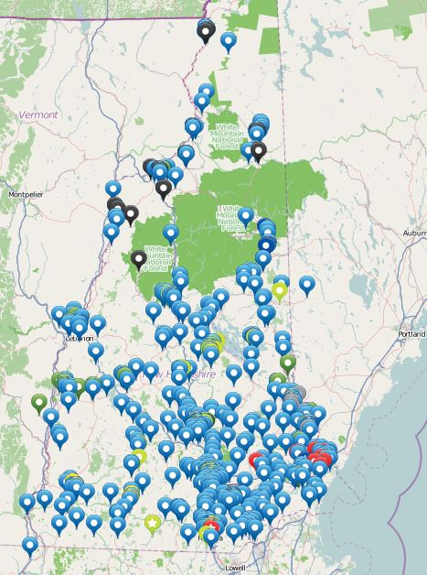
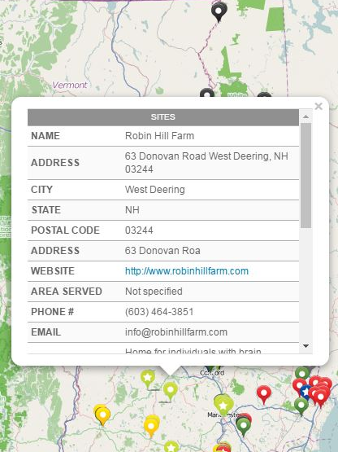
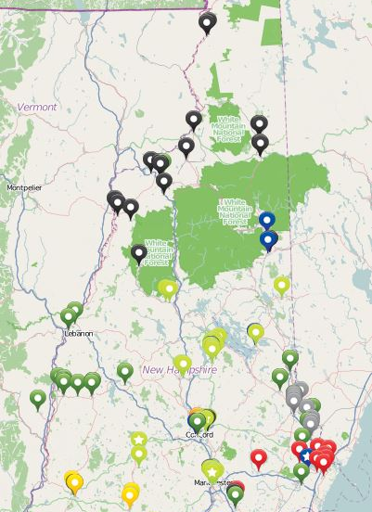


Maternal Infant and Early Childhood Home Visiting Evaluation
Rachel Korb, B.A., SLP
Leadership Insights
True leaders are not silent observers; they challenge and critique in order to optimize outcomes.
Both qualitative and quantitative research are useful in determining the success of existing systems.
It is not always safe to assume quality; it is more productive to evaluate, then help provide the tools to improve.
I will continue to utilize these insights in my future as a Speech Language Pathologist.
Background Information
Healthy Families America Home Visiting Program (HFA) is an evidence-based practice; when implemented with fidelity, it is shown to improve health outcomes for mothers and children.
This program is monitoring the fidelity of implementation of HFA to ensure the quality of health care and family support.
The Institute on Disability, the Department of Nursing, and the Carsey Graduate School of Public Policy are collaborating on this project.
This project directly relates to the mission of the LEND program in that it aims to “improve health care delivery systems for children with developmental disabilities”.
This project has also “emphasized the integration of services from state to local agencies and organizations, private providers”; once the sites get assess to the mapping software, they will have the tools to enable them to integrate services with other providers, agencies, and organizations.
Project Description
HFA sites in NH shared their community partners by means of network surveys.
Missing information about each community partner was added to a spreadsheet.
Other potentially relevant community partners throughout the state were added, using NH 2-1-1.
I embedded all of the information from the spreadsheet into a mapping software, to be shared with the sites so that they can feel better networked.
Left: All of the sites included on the spreadsheet and mapping software.
Center: The sites that at least one HFA site in New Hampshire refers to. A filter enables users to see how many potential sites there are in the state compared to how many they are networked with.
Above: Users are able to see the Name, Address, Website, Area Served, Populations Served, Services Provided, Payment Methods, and E-mail addresses for each site.
For more information, contact Eleanor Jaffee, Ph.D.
at Eleanor.jaffee@unh.edu

