Slide 1
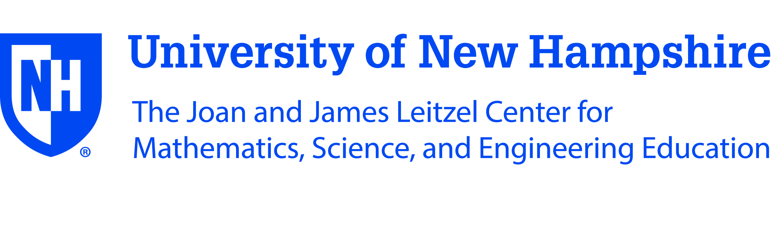
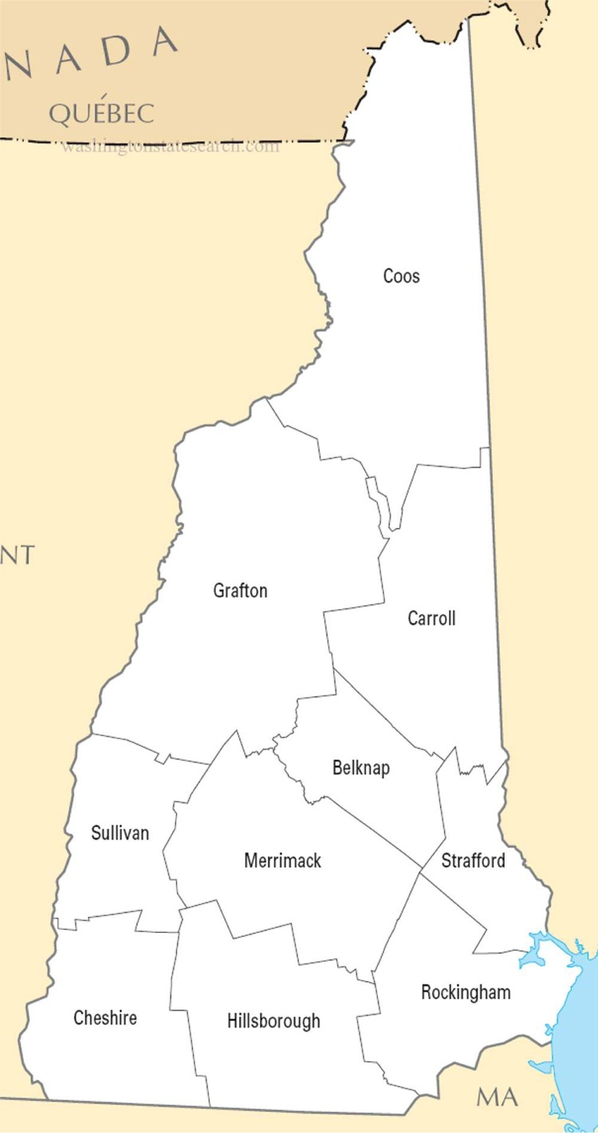
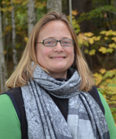
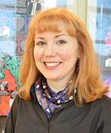
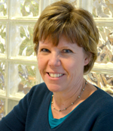
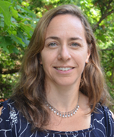
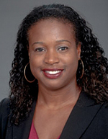
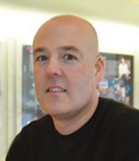
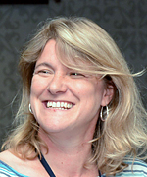
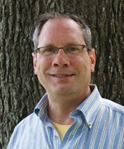
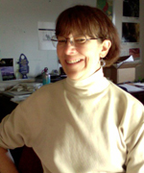
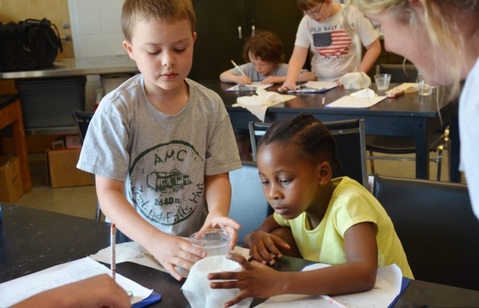
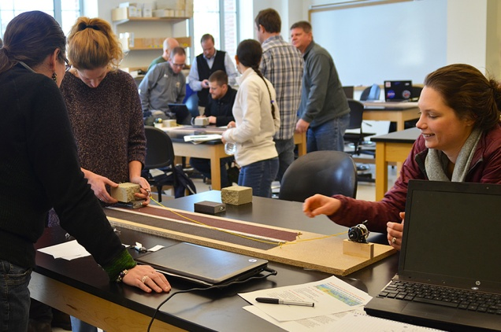
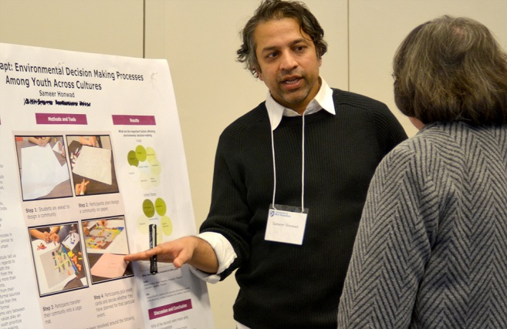
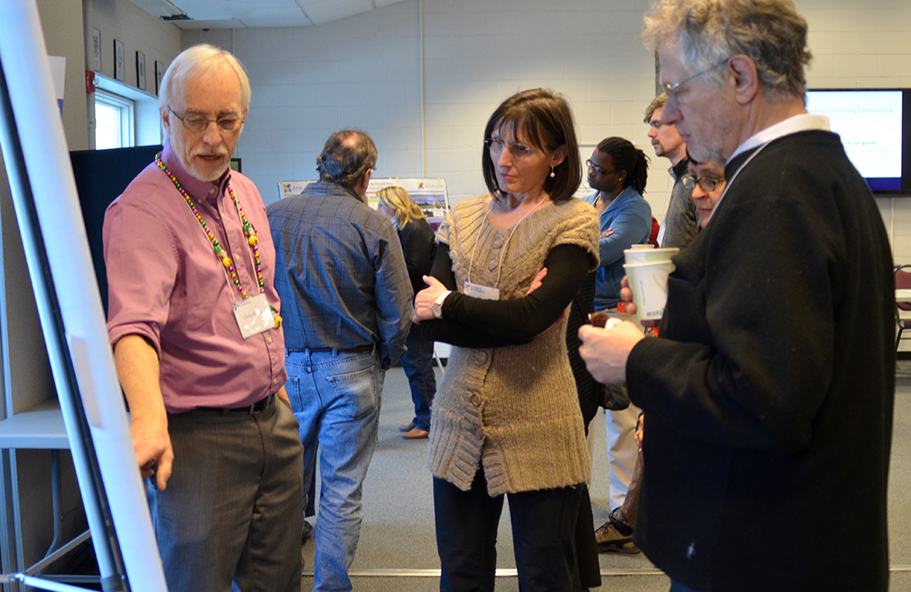
Who We Are
Types of Engagement
So far in FY 2016 the Leitzel Center has reached:
Extended Contact Teacher Professional Development—Since July 1, 2015, we have worked with 82 teachers.
Graduate Student Engagement—over the past year, we have worked directly with 5 graduate students on outreach projects.
STEM Educators Summit—May 2016 Summit was attended by 70 k-12 teachers and informal educators, and 25 presenters and UNH faculty/staff.
KEEPERS Summer Camp – 60 2-5th graders immersed in engineering.
Ruth Varner
Director, Leitzel center
Laura M. Nickerson
Director, STEM TC
Sandy Coit
Program Support Assistant
Lara Gengarelly
Extension Assoc. Professor and
Specialist, science Literacy
Jade Caines Lee
Affiliate Assistant Professor
Erik Froburg
Education & Outreach Specialist
Jennifer Bourgeault
GLOBE US Country Coordinator
Stephen R. Hale
Research Associate
Annette Schloss
Faculty Fellow
Our History
Grant Collaboration
The Joan and James Leitzel Center for Mathematics, Science, and Engineering Education was established through an endowed gift to the University of New Hampshire in June 2002, in honor of UNH President Joan R. Leitzel and her late husband, James R.C. Leitzel
Since July 1, 2015, the Leitzel Center has submitted 26 proposals, requesting a total of $45M.
  9 were led by the LC and 17 were in support of other PIs.
  8 funded, 6 declined, and 12 pending.
“Mathematics, science and engineering education have never been more important to individuals and to the well-being of our nation that at this time.”
Joan R. Leitzel
President Emerita
University of New Hampshire
Recent Reviewer Comments
“Are there adequate resources available? Yes. The PI is teaming with the home institution's center for mathematics, science and engineering education to reach the educational objectives.”
“The plan to use earthquake physics and hazard studies in high school STEM education is very well worked out.“
Steps to Collaboration
Contact the LC at the outset of your planning.
Discuss potentially appropriate forms of outreach.
Develop a budget that meets everyone’s needs, and also the expectations of NSF.
Collaborate on proposal writing.
Implement your funded project!
“The Leitzel Center is pro-active in fostering cross-disciplinary activities among University faculty and other stakeholders, to cultivate relationships and explore creative ideas.”
Leitzel Center Strategic Plan
What We Do
The UNH Joan and James Leitzel Center works to transform education in mathematics, science, and engineering in elementary and secondary schools, and in informal settings through high quality research, carefully examined practice, and interdisciplinary collaboration.
The Leitzel Center worked with K-12 teachers from the following NH communities in 2015-16

