Slide 1


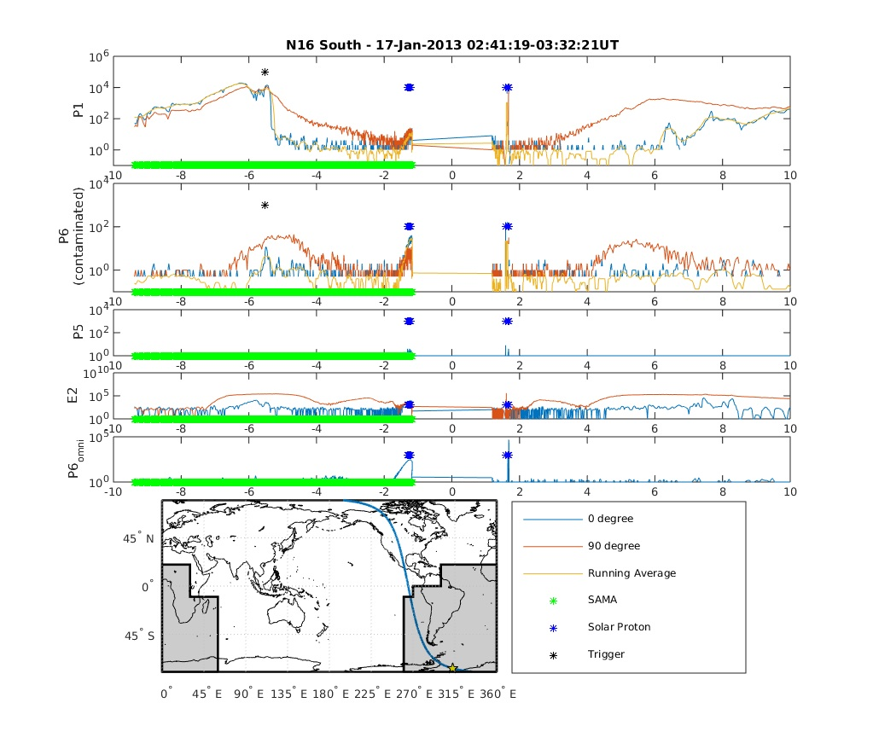
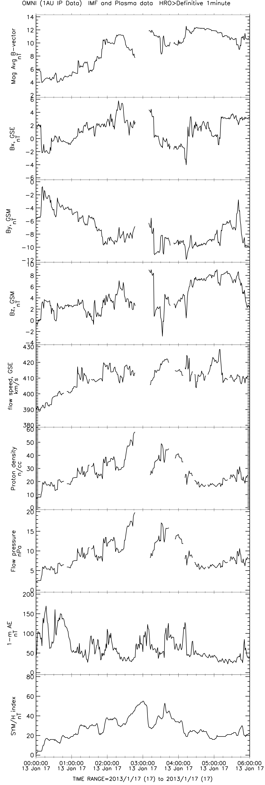
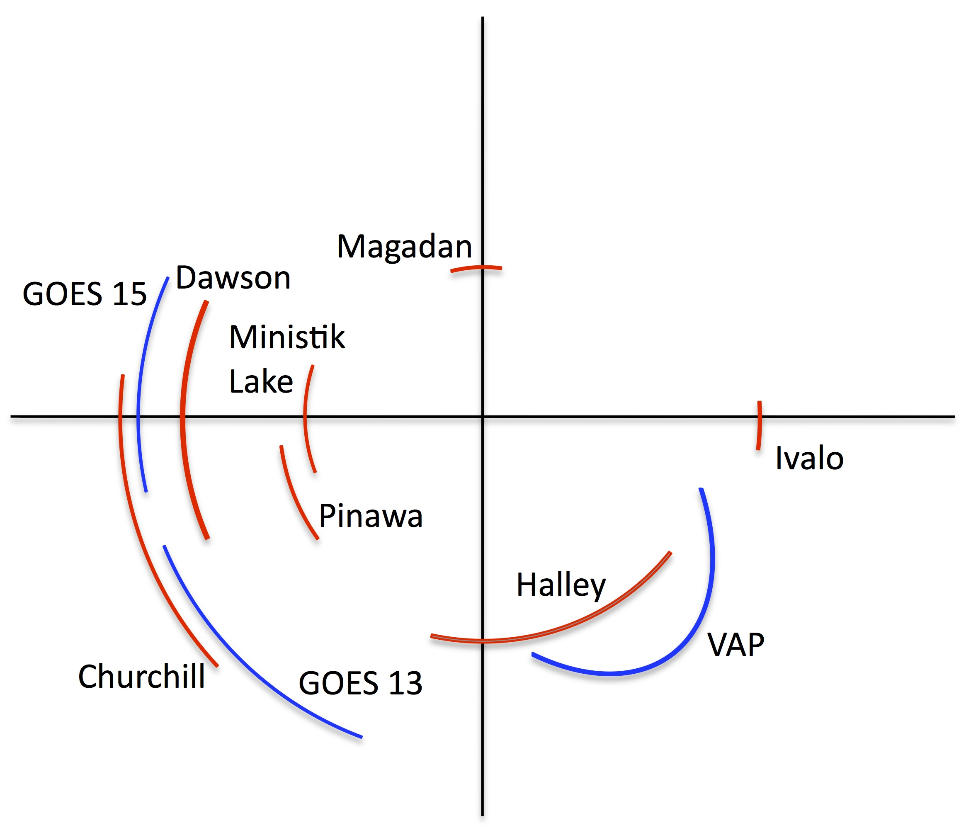
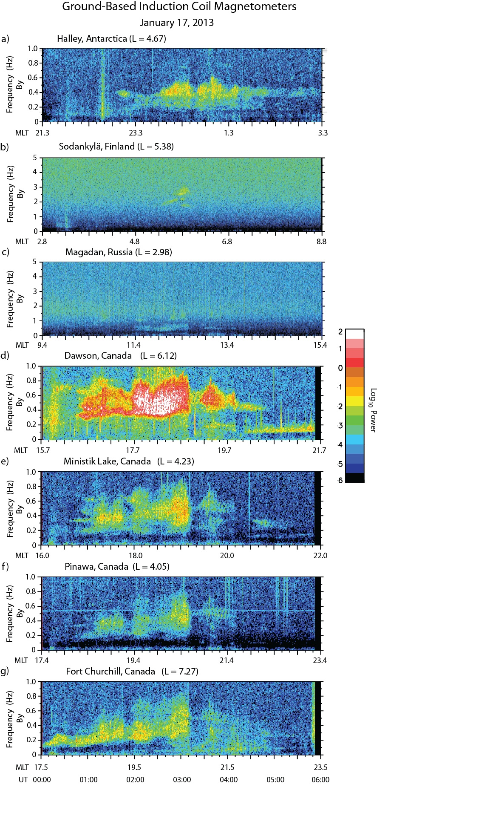
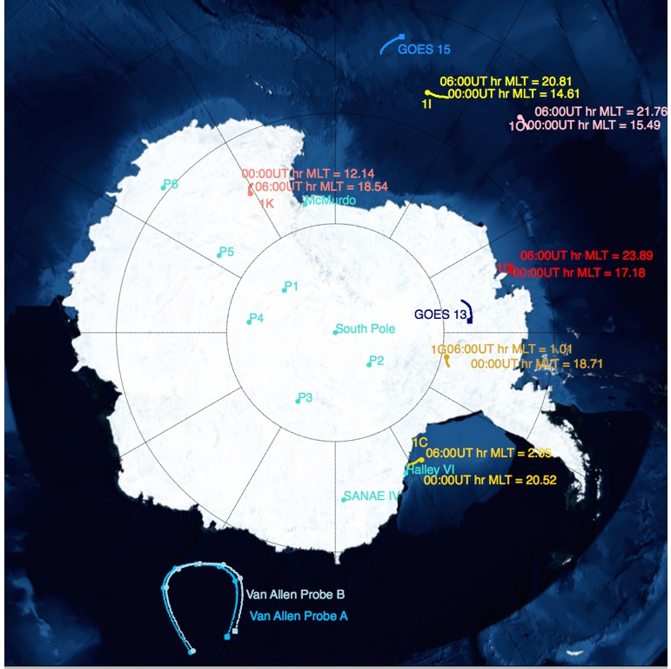
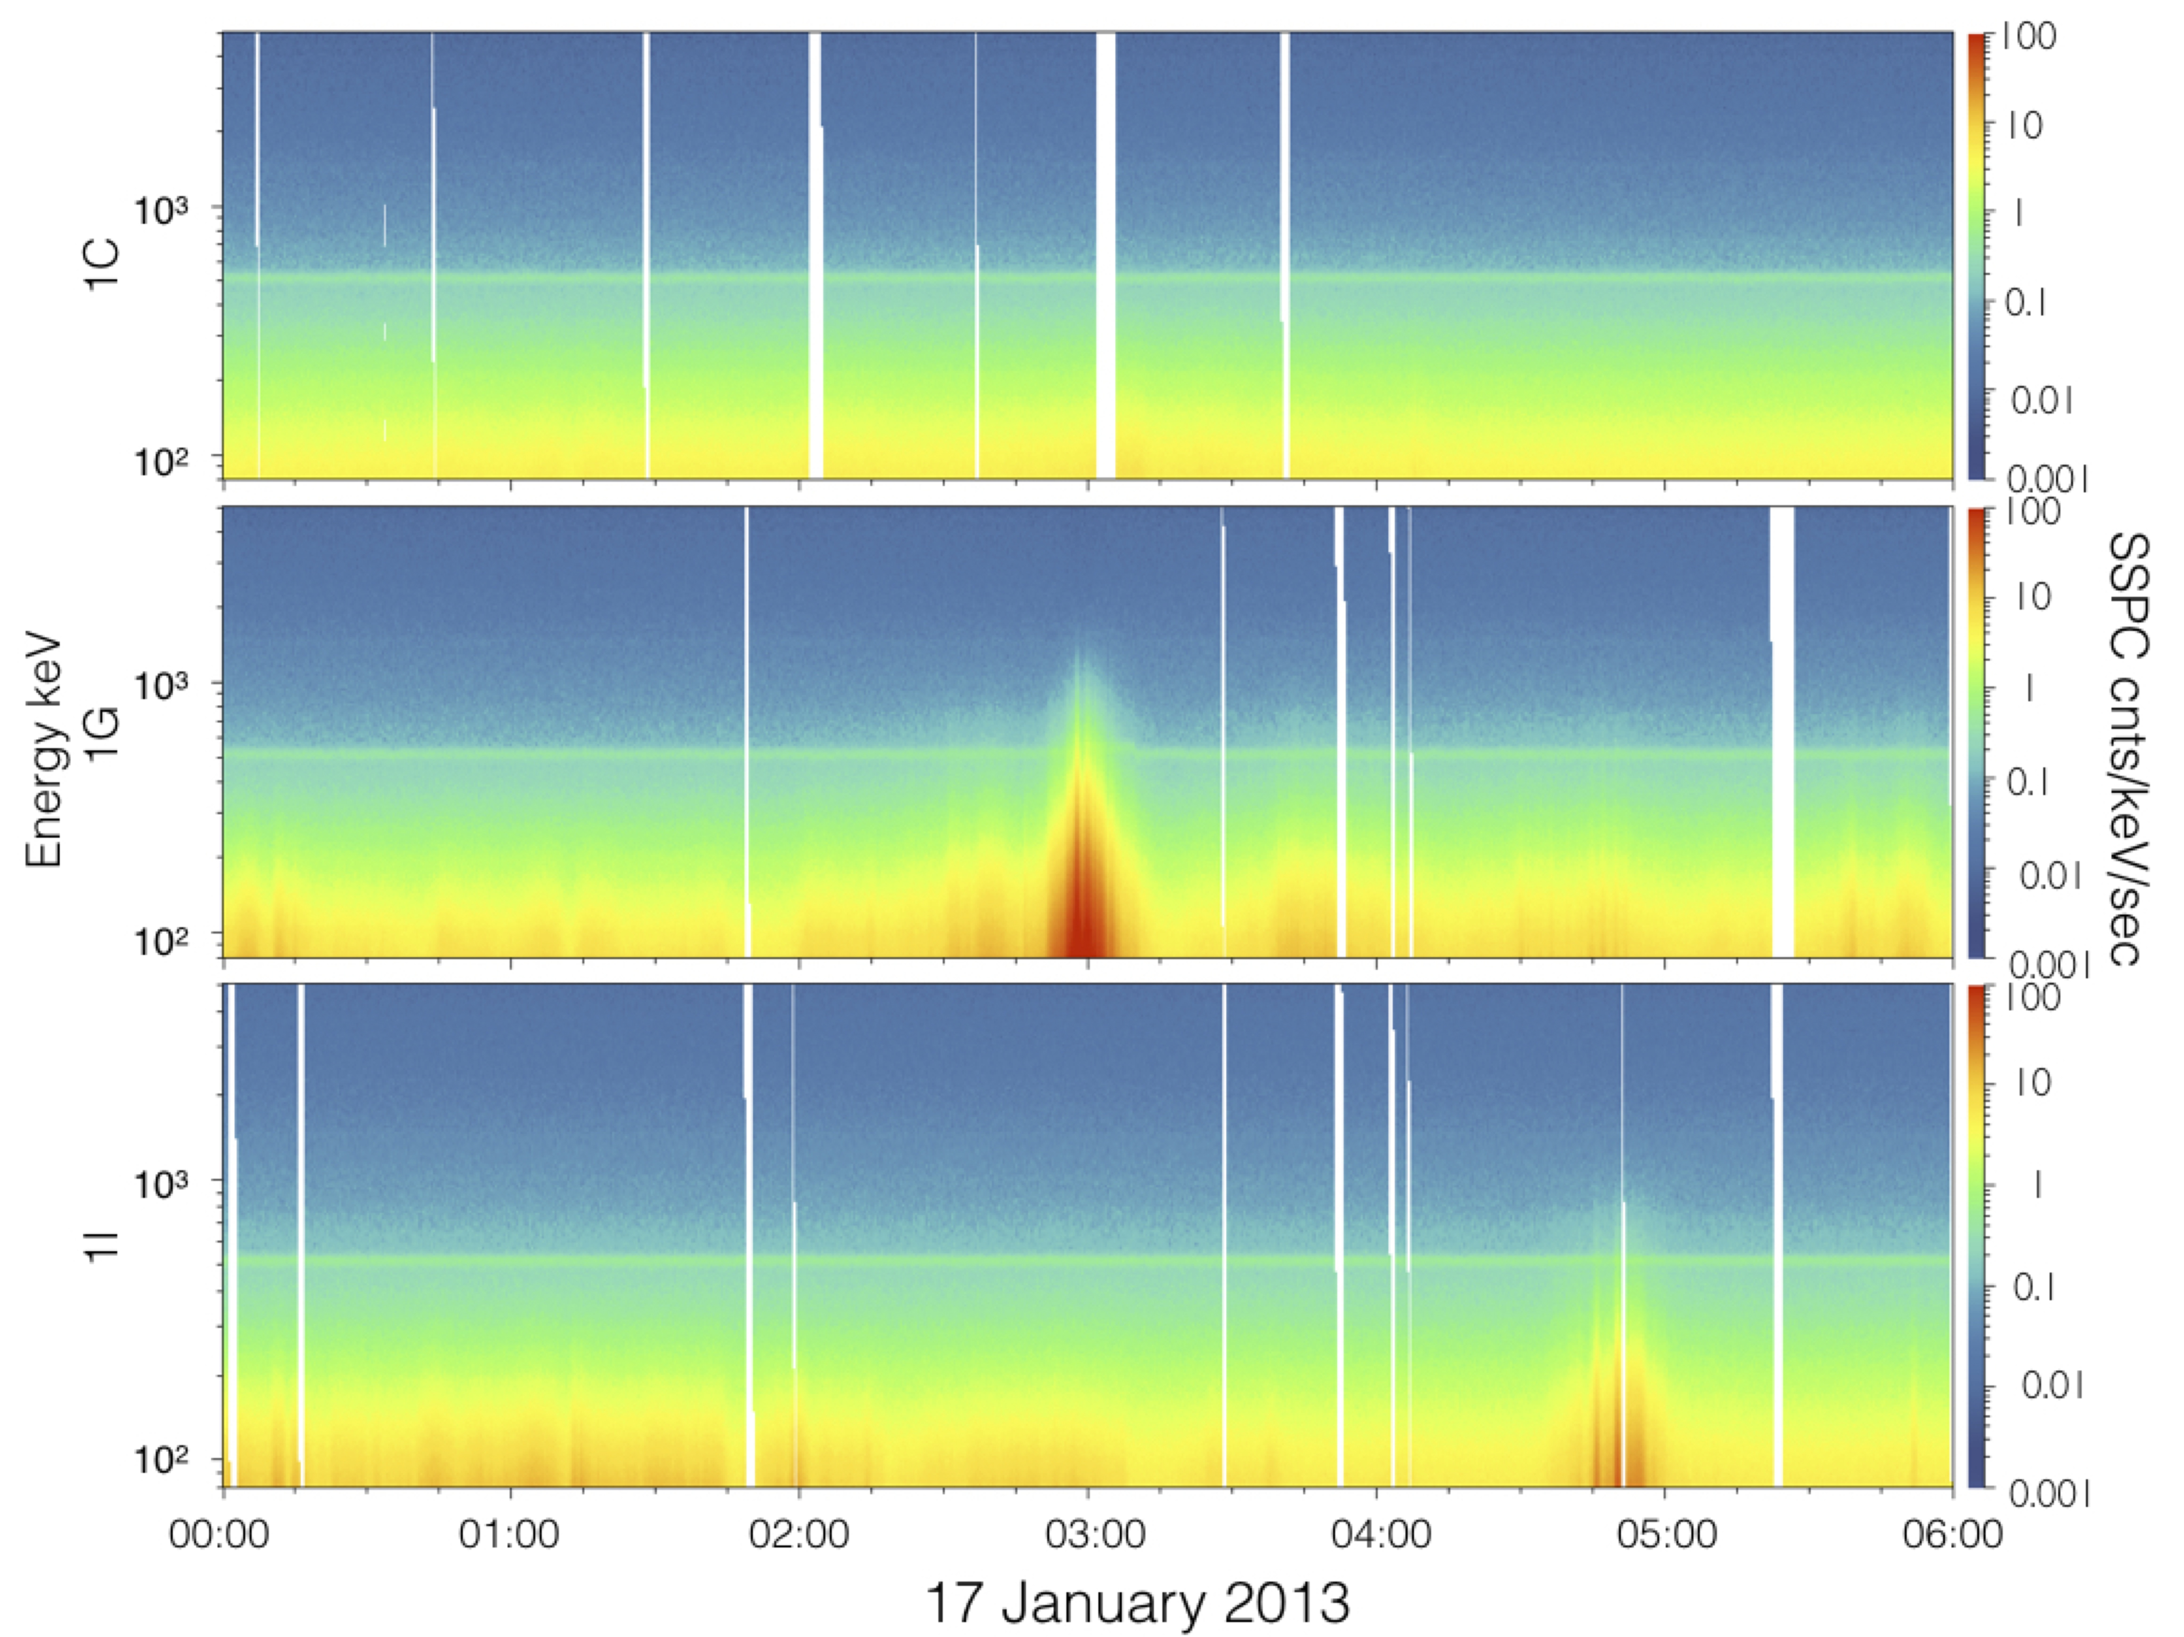
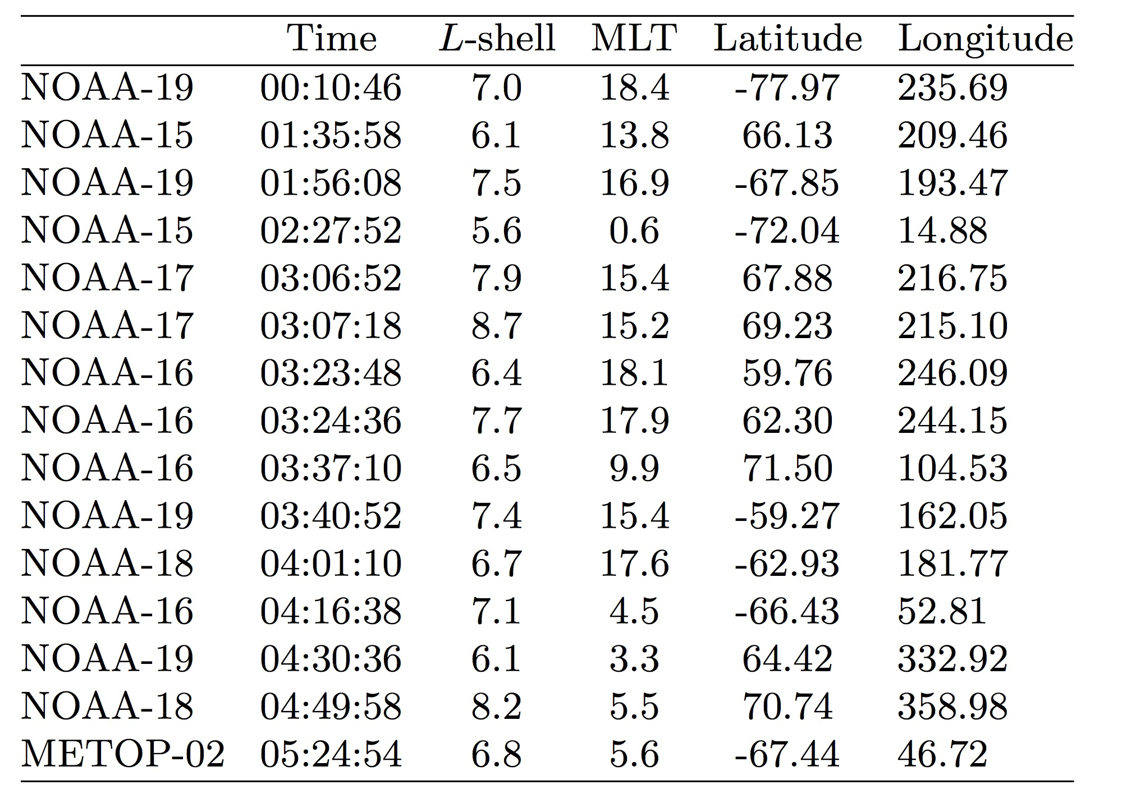
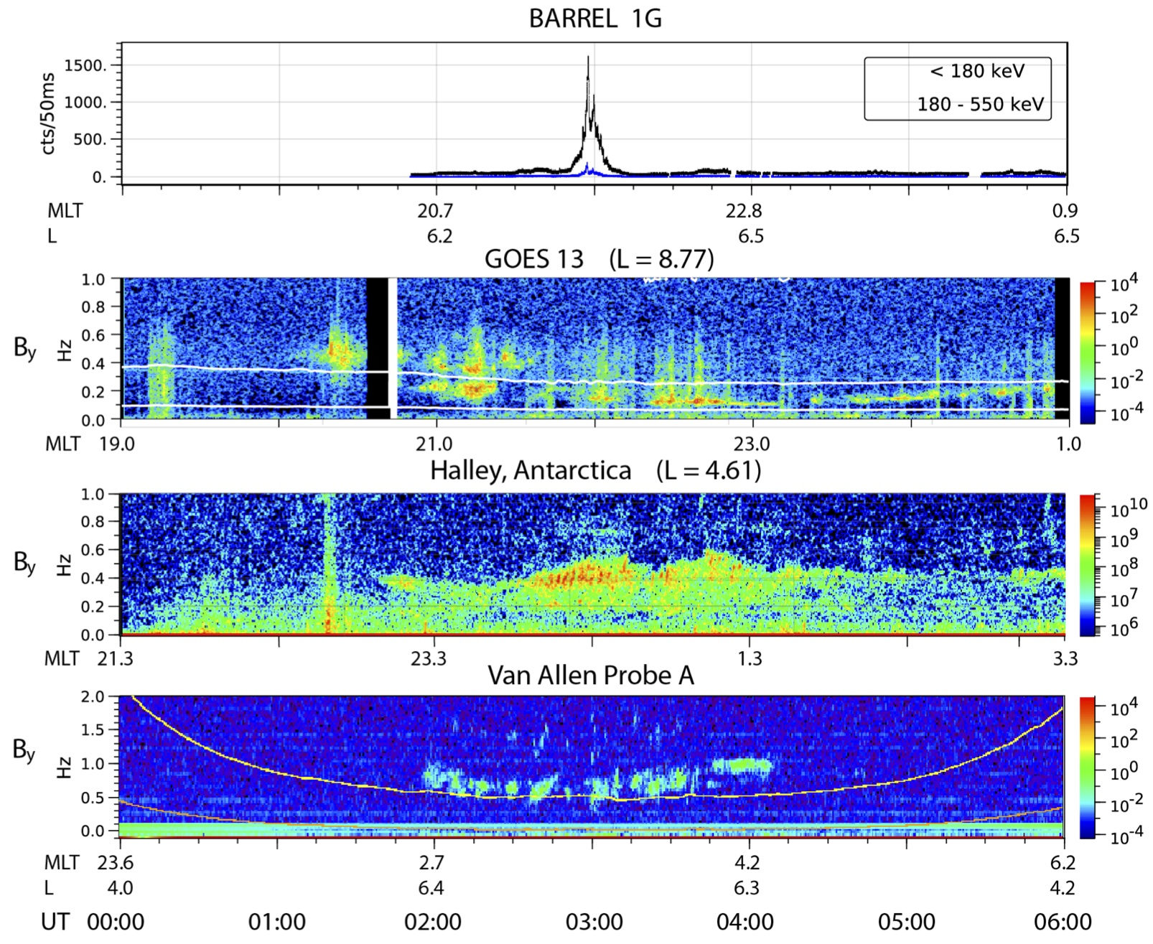
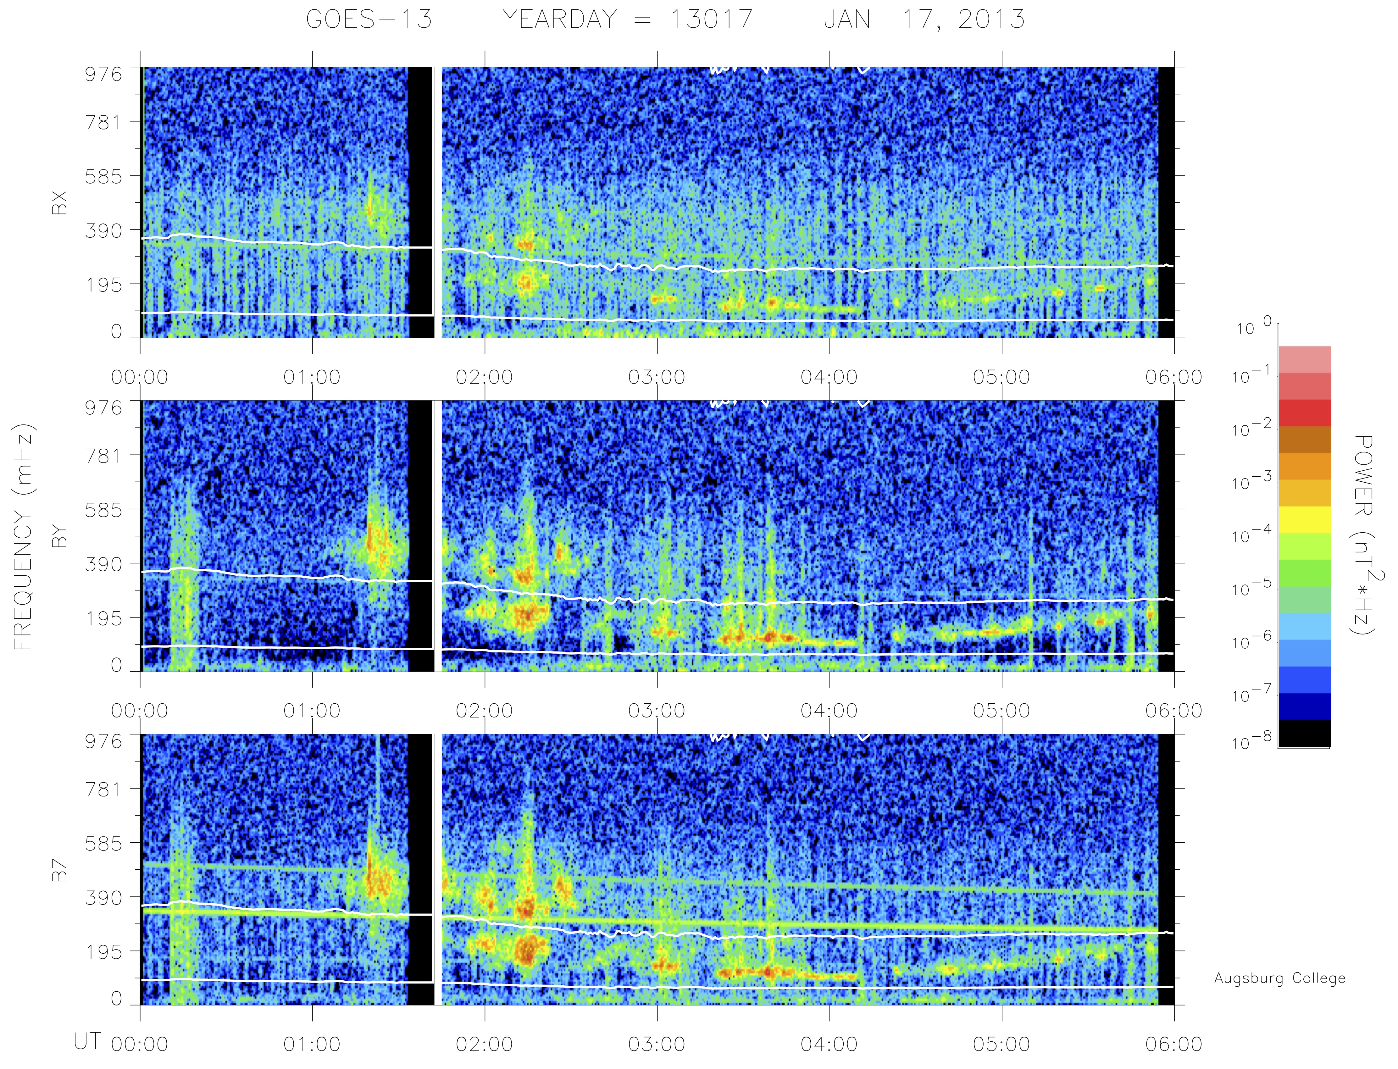
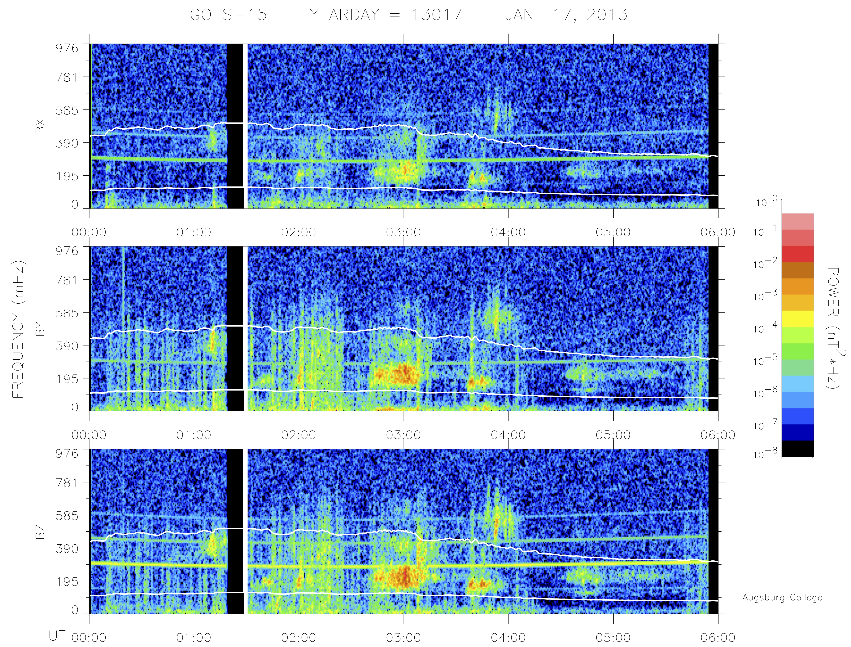
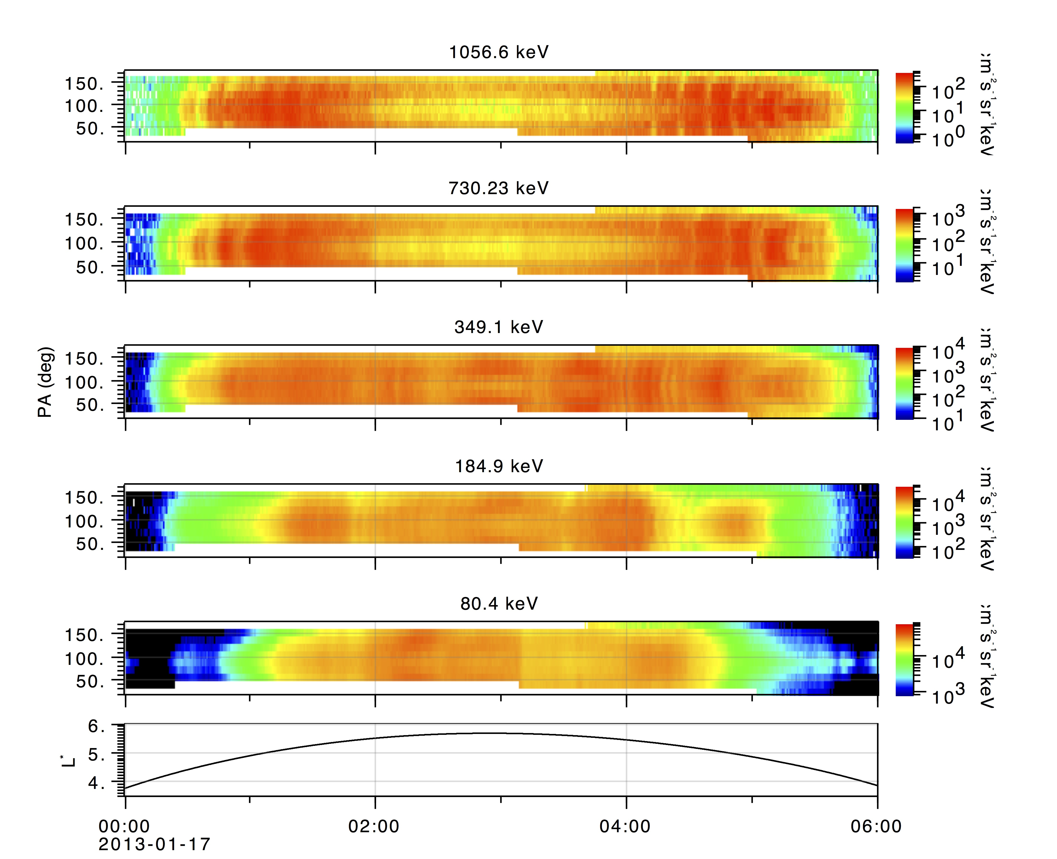
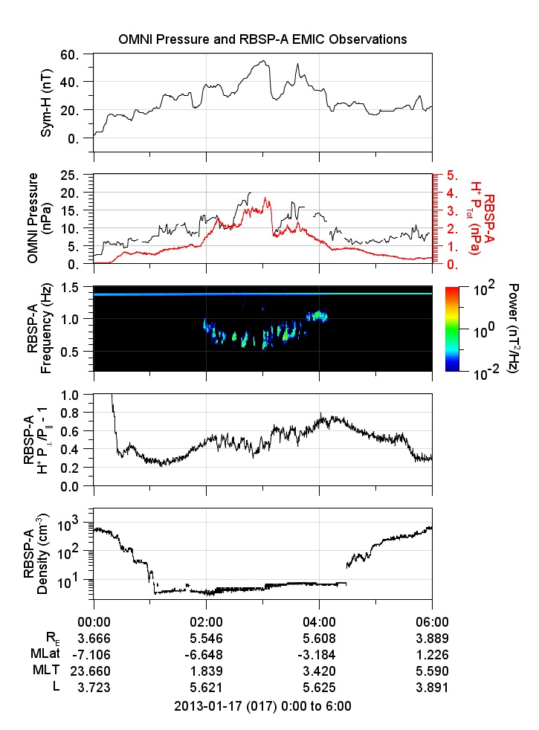
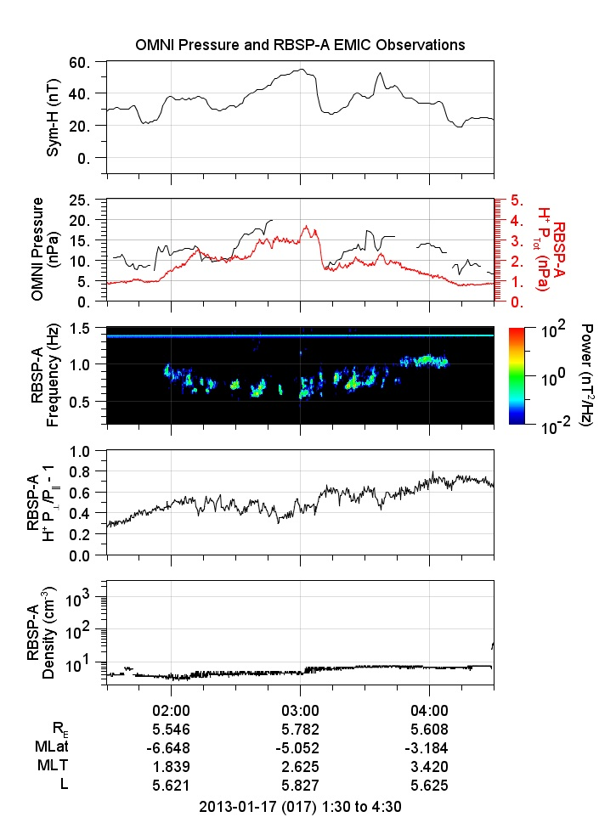
Generation of EMIC Waves and Effects on Particle Precipitation During a Solar Wind Pressure Intensification with Bz > 0
Marc R. Lessard, Mark J. Engebretson, Kristoff Paulson, Harlan E. Spence,
Alexa Halford, Robyn Millan, Craig J. Rodger, Aaron Hendry and Carol Weaver
During geomagnetic storms, some fraction of the solar wind energy is coupled via reconnection at the dayside magnetopause, a process that requires a negative solar wind Bz. Through a complex sequence of events, some of this energy ultimately drives the generation of electromagnetic ion cyclotron (EMIC) waves, which can then scatter energetic electrons and ions from the radiation belts. In the event described in this study, the interplanetary magnetic field remained northward throughout the event, a condition unfavorable for solar wind energy coupling through low latitude reconnection. While this resulted in SYM/H remaining positive throughout the event (so this may not be considered a storm, in spite of the very high solar wind densities), pressure fluctuations were directly transferred into and then propagated throughout the magnetosphere, generating EMIC waves on global scales. The generation mechanism presumably involved the development of temperature anisotropies via perpendicular pressure perturbations, as evidenced by strong correlations between the pressure variations and the intensifications of the waves globally. Electron precipitation was recorded by the BARREL balloons, although it did not have the same widespread signatures as the waves and, in fact, appears to have been quite patchy in character. Observations from Van Allen Probe- A (VAP-A) satellite (at post midnight), showed clear butterfly distributions and it may be possible that the EMIC waves contributed to the development of these distribution functions. Ion precipitation was also recorded by the Polar-orbiting Operational Environmental Satellite (POES) satellites, though tended to be confined to the dawn-dusk meridians.
Electron precipitation
Introduction
NOAA POES data. The top panel (P1) shows the 30–80 keV proton data, with 0◦ pitch angle data (blue), 90◦ data (brown), and a running average of the 0◦ data (amber). The second panel (P6) shows relativistic electron precipitation. The horizontal axis gives the L-shell of the POES spacecraft. The black stars in both of these panels indicate the “trigger” time, where the peak was manually detected in P6. The green line at the bottom is actually a succession of green stars, and indicates the spacecraft was passing through the zone where the particle fluxes are affected by the South Atlantic Magnetic Anomaly, shown by the gray shaded box in the map at the bottom. The star at the bottom right of the map is the location of the POES satellite footprint at the time of the event trigger, which was in fact quite close to Halley.
This figure provides the approximate locations of ground- (red) and space-based (blue) platforms where EMIC waves were observed. The sketch shows coordinates in L and MLT, although signatures at the ground observations are modified by ionospheric ducting. The ducting means that signals will reach the ground stations almost regardless of the latitude at which they were injected into the ionosphere. Thus, assigning an L-shell to the stations maybe not be realistic.
Map of Antarctica, showing the locations of the BARREL balloons (1C, 1D, 1G, 1I, 1K and 1O), Halley Station, the footprints of GOES 13 and 15 and the footprint of the VAP satellites
Observations of X-ray counts by each balloon used in this study, from 00:00 to 06:00 UT. The data presented are “Slow Spectra” (SSPC), which includes energies from 25 keV –10 MeV in 256 energy channels with a time resolution of 32 seconds.
OMNI data showing solar wind parameters associated with this event. The top four panels show total magnetic field strength, followed by Bx, By and Bz. The next three panels show solar wind speed, density and flow pressure. The bottom two panels show the AE and SYM/H indices.
Ground observations from various sites shown in Figure 2, from 00:00 to 06:00 UT, shown in order of increasing L-shell. The simultaneity in EMIC occurrences across all sites is clear in this figure.
Proton precipitation observed by NOAA satellites, ordered by the UT of the observations.
GOES EMIC waves
Composite figure showing simultaneous occurrences of X-ray bursts observed by the 1G balloon in the first panel. Other panels show EMIC signatures from GOES 13, at Halley Station and by VAP-A.
Spectral signatures of EMIC waves from GOES 13 (left) and GOES 15 (right). The white traces show the equatorial gyrofrequency lines for He+ and O+, based on in-situ magnetometer data. Waves at GOES 13 are in both the oxygen and helium bands, while those at GOES 15 are primarily in the oxygen band.
Pressure pulses, bursty waves
MagEIS data from the VAP-A satellite. The plot shows electron pitch angle distribution functions from 80 keV to nearly ∼1 MeV electrons, plotted versus time. As shown in the figures at the bottom left of this poster, EMIC waves occurred in a bursty fashion in the vicinity of the satellite, more or less continuously throughout its apogee pass. These waves may have contributed to the butterfly distributions shown in the figure. During this period, which extends from 01:56 UT to 04:09 UT, the spacecraft moved in its orbit from L = 5.6, out to its apogee of L = 6.2 (not shown) and then back to L = 5.6.
Conclusions
1. With Bz remaining positive for the entire time, reconnection at the dayside subsolar magnetopause was absent or weak, at best. As a result, pressure fluctuations in the solar wind appear to have been directly transferred to the magnetosphere and then propagated throughout the magnetosphere. This conclusion is supported by the strong correlations between temporal variations in the solar wind dynamic pressure, the SYM/H index and pressure variations recorded by VAP-A. We also conclude that the positive excursion in SYM/H resulted from the intensification of magnetopause currents and, perhaps, little or nothing to do with the ring current.
2. The global pressure perturbation appears to have been responsible for the temperature anisotropy needed to generate EMIC waves. Waves with very similar spectral signatures and temporal variations were recorded clearly throughout the dusk to post-midnight sector, with weaker signatures observed near dawn and also near noon. The intensifications of these waves closely tracked SYM/H and also the solar wind pressure, again pointing to the pressure perturbations as the driver for these waves.
3. Electron precipitation was recorded by the BARREL balloons, although it did not have the same widespread signatures as the waves. In fact, the electron precipitation appears to have been quite patchy in character, perhaps corresponding to the presence of localized resonance conditions as explained by Woodger et al. [2016]. Observations from VAP-A (post midnight), showed clear butterfly distributions and it may be possible that the EMIC waves contributed to the development of these distribution functions, though no precipitating electrons were recorded by a NOAA satellite that flew very close to the footprint of VAP-A. Ion precipitation was also recorded by the fleet of POES satellites (which include the NOAA satellites), though tended to be confined to the dawn-dusk meridians.
Data from VAP-A. In each panel, we show the SYM/H index, the OMNI solar wind pressure in black and the pressure at the satellite location in red, calculated from the measured fluxes. The third panel shows magnetic field dynamic spectra, with EMIC wave bursts thoughout the higher L-shells. The fourth panel shows the calculated pressure anisotropy, which is a proxy for the temperature anisotropy if the density is constant, which is shown to be the case in the bottom panel. The plot on the left shows the entire 00:00-06:00 UT interval; the plot on the right provides a closer look, intended to show that although a one-to-one correspondence does not exist between EMIC occurrences and fluctuations in the temperature anisotropy, the temporal variations are similar.
Support for this work was provided at UNH by NSF awards PLR-1341677 and ANT-1141987. Support at Augsburg College was provided by NSF awards PLR- 1341493 and ANT-1142045. A. J. H. was supported by NASA under grant number NNX15AF66G. The research by CJR and ATH leading to these results was supported by the European Communitys Seventh Framework Programme ([FP7/20072013]) under grant agreement number 263218. Support for NASA Van Allen Probes efforts was provided through grant number NAS5- 01072.

