Slide 1
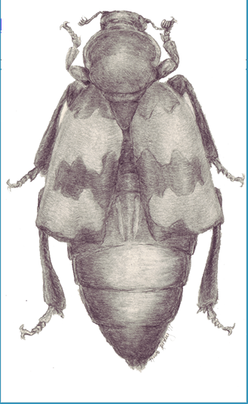
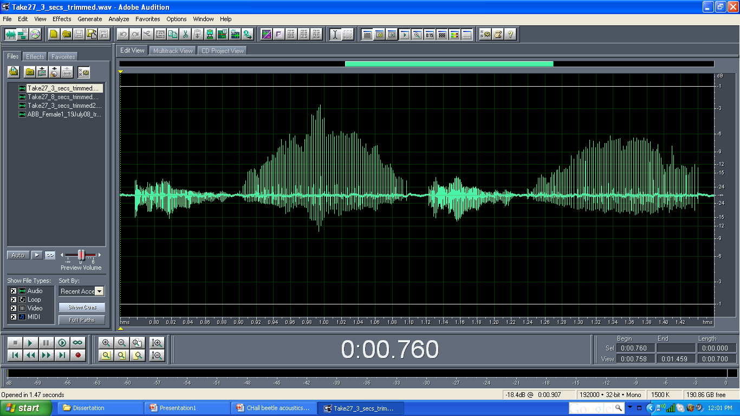
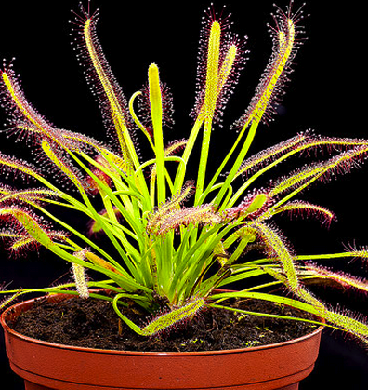
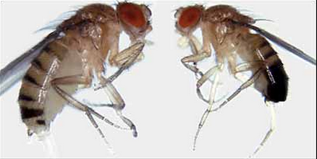
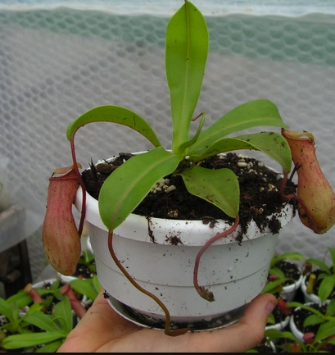
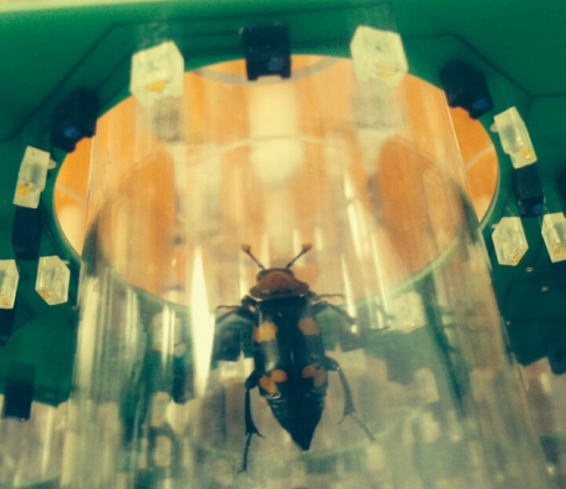
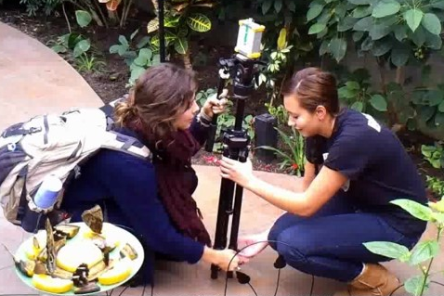
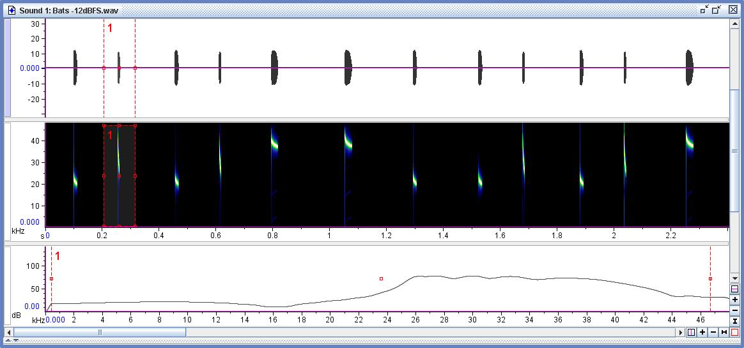
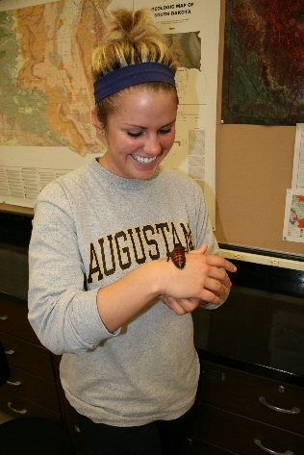
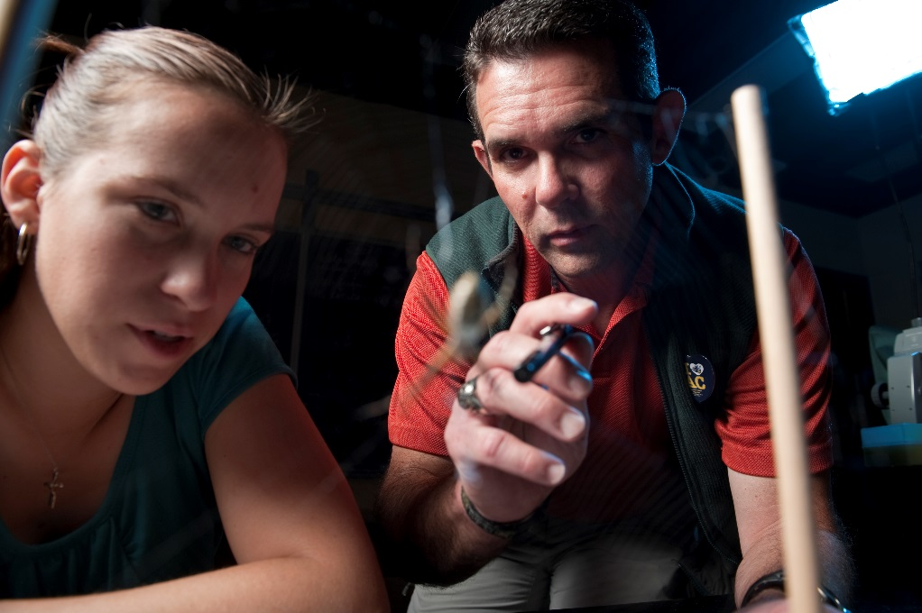



Transforming STEM Education using Innovative Pedagogy:
Integrating Animal Behavior Teaching and Research
¹Carrie L. Hall and ²Daniel R. Howard
The University of New Hampshire: ¹carrie.hall@unh.edu and ²daniel.howard@unh.edu
National call to teach biology
the way we practice biology
Agencies and private organizations (NSF, AAAS, HHMI, NIH, etc), along with faculty scientists, administrators, and other stakeholders have been guiding a national reform movement in undergraduate biology education (Brewer & Smith 2011). As a discipline undergoing this national reform movement, life science faculty have been challenged to teach biology the way we practice biology; to foster in our students an appreciation for the scientific process that can be even more important and informative than any collection of memorized facts (Brewer & Smith 2011). With this challenge as the guidepost, biology educators and researchers have developed pedagogical methods designed to infuse core concepts and competencies into every course, research experience, and learning opportunity that students encounter during their undergraduate career as a major in the biological sciences. This same approach applies to courses in animal behavior.
Three pedagogical methods that have been widely implemented in response to the Vision and Change (Brewer & Smith 2011) movement include:
  Hands-on Learning,
  Project-Based Learning, and
  Course-Based Research.
While the biology education literature describes broad definitions for each of these methodologies, each is an inquiry method that helps develop students’ understanding and application of the scientific method within the framework of their courses. Here, we described how we applied each of these methods across the animal behavior curriculum.
Project-Based Learning
Project-Based Learning (PBL) is a pedagogical method typically used to guide scientific investigations designed and executed by student(s) during the course of a particular class.
Science as Process
Independent Inquiry
Case #1:
Plant-insect interactions project: “Fatal Attraction: Are fruit flies attracted to carnivorous plants through visual or olfactory cues?”
Questions:
1) Are visual or olfactory cues more important for prey capture in carnivorous plants?
2) Is there a difference in capture rates between plant species?
3) How does vision affect the predator-prey relationship?
Case #2:
Visual stimulus response in Lepidopterans
Questions:
1) When presented with equal options, do butterflies exhibit color preferences?
2) Which color is preferred?
Case #3:
Anti-predatory behavior in Lepidopterans
Questions:
1) What behavioral changes do Lepidopterans exhibit when encountering bat echolocation calls?
Course-Based Research
Course-based research projects allow students in a class to contribute directly to the research agenda of the faculty member teaching a particular specialty class.
Case #1:
Acoustic signaling in Nicrophorus: “Description of acoustic characters and stridulatory pars stridens of Nicrophorus (Coleoptera: Silphidae): A comparison of eight North American species
4 Questions regarding evolution, anatomy, behavior, and sound characteristics
Case #2:
Temporal niche segregation
Question:
What are the daily activity patterns of 5 species of Nicrophorus beetles?
Niche segregation to avoid competition?
Interpulse Interval
Major Pulse
Minor Pulse
Transforming YOUR classroom:
…from experimental design through writing
Establish incremental deadlines:
Research question and hypothesis
Introduction with literature review
Appt. to discuss experimental design (Methods and data analysis)
Data analysis
Rough draft
Final paper &/or poster presentation
Publication process will extend beyond semester
Hands-on Learning in Introductory Courses
Novice learner-scientists
Goals: 1) Conceptual engagement
2) Develop observational & descriptive skills
Outcome:
1) Accurate, precise, & concise observation
Not intended to be open-ended discovery research
Citations
Brewer, C. A., and D. Smith. 2011. Vision and change in
undergraduate biology education: a call to action. AAAS,
Washington, DC, USA.
Nersessian, N. J. 1991. Conceptual change in science and in
science education, pp. 133–148. In M. R. Matthews (ed.),
History, Philosophy, and Science Teaching. OISE Press,
Toronto, Canada.
Acknowledgements
Portions of this work have been published in the American Entomologist: Hall, C. L. (2016) Science as Process in the Biology Classroom: Using Insects as Teaching Models. American Entomologist 62(2): 110-111. The authors thank the National Science Foundation (DUE # 1439844) and the Biology Department faculty at Augustana College, for their support of my effort to apply new pedagogical methods to courses across the undergraduate curriculum.
**Lesson plans for Introductory Animal Behavior Hands-On Learning Labs are available upon request.

