Slide 1


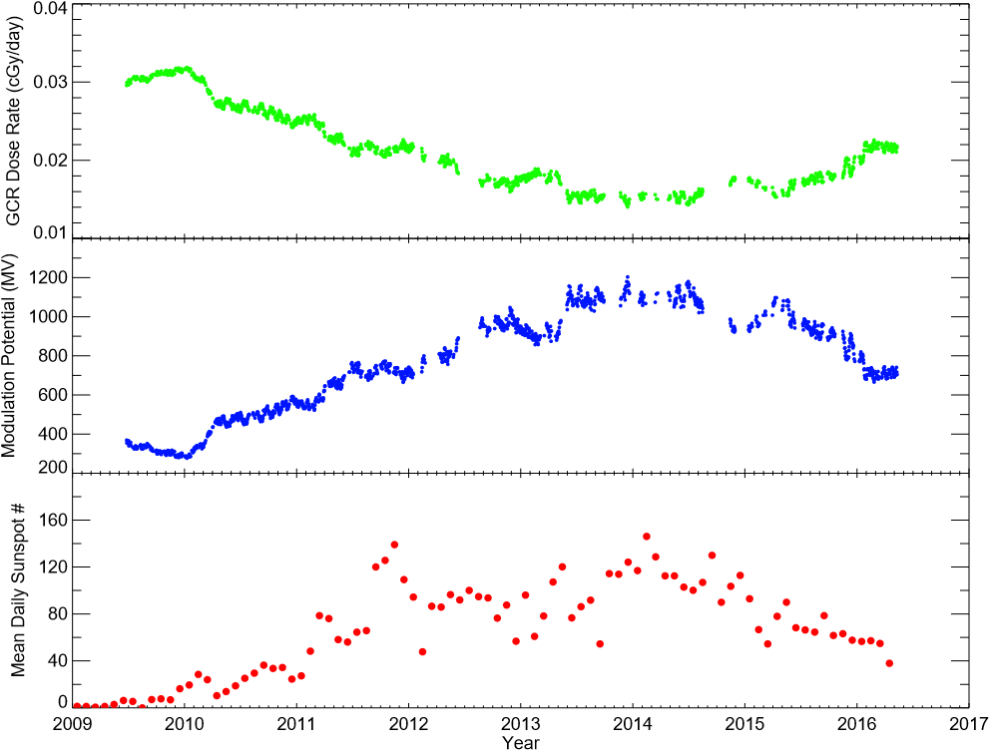
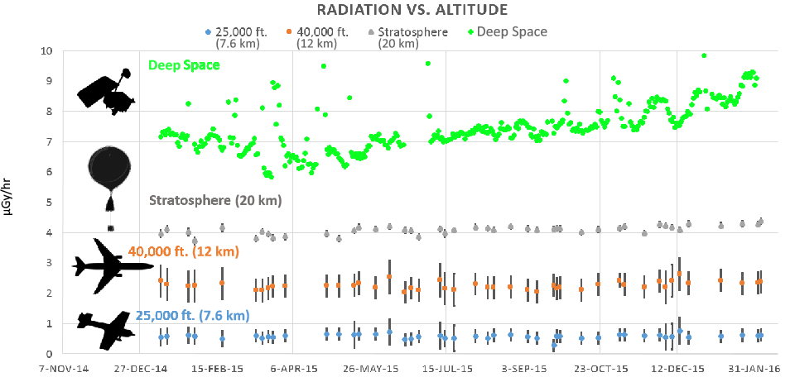
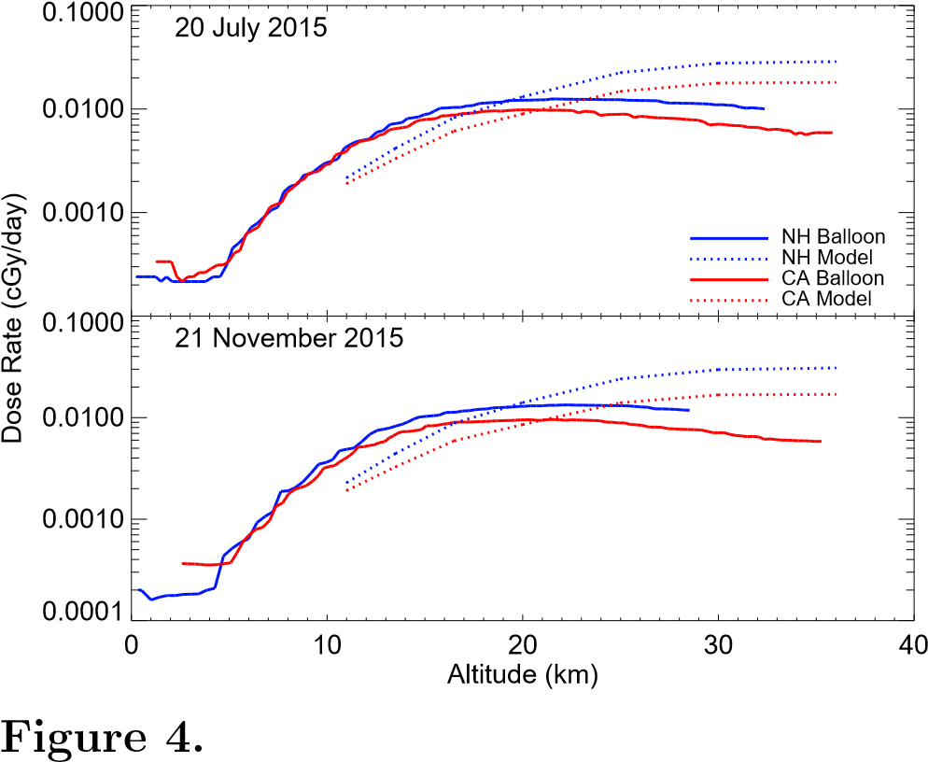
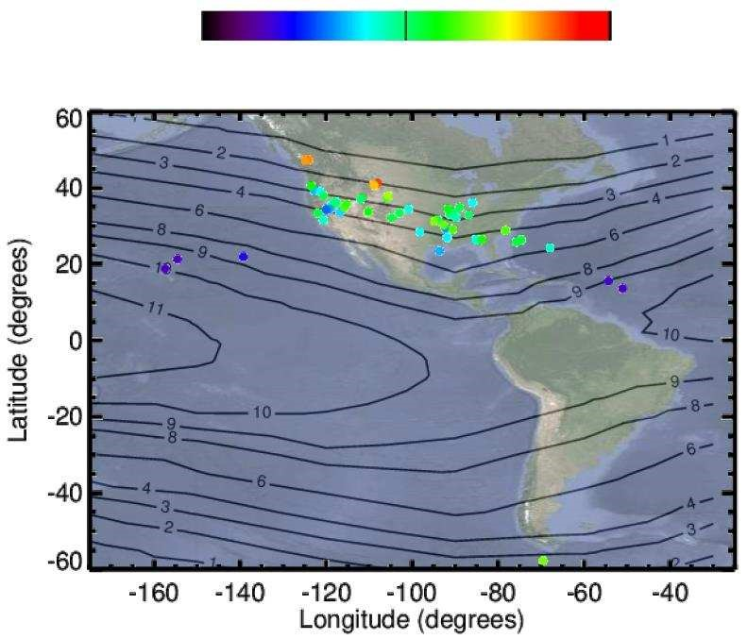
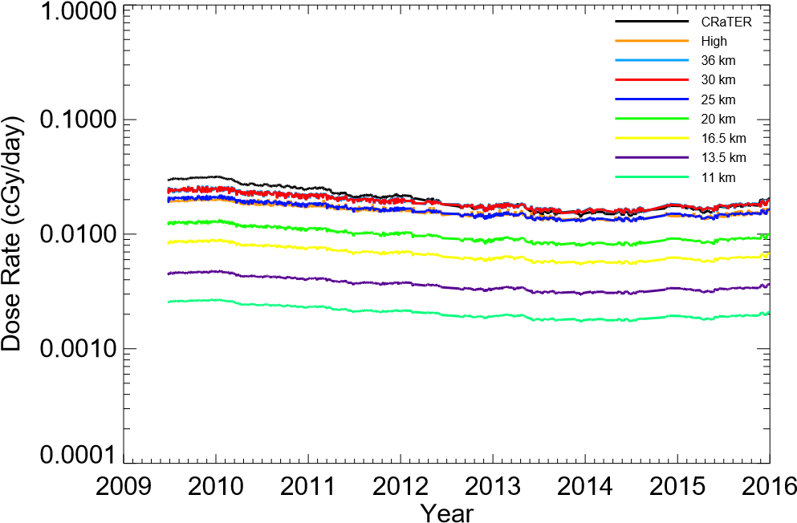
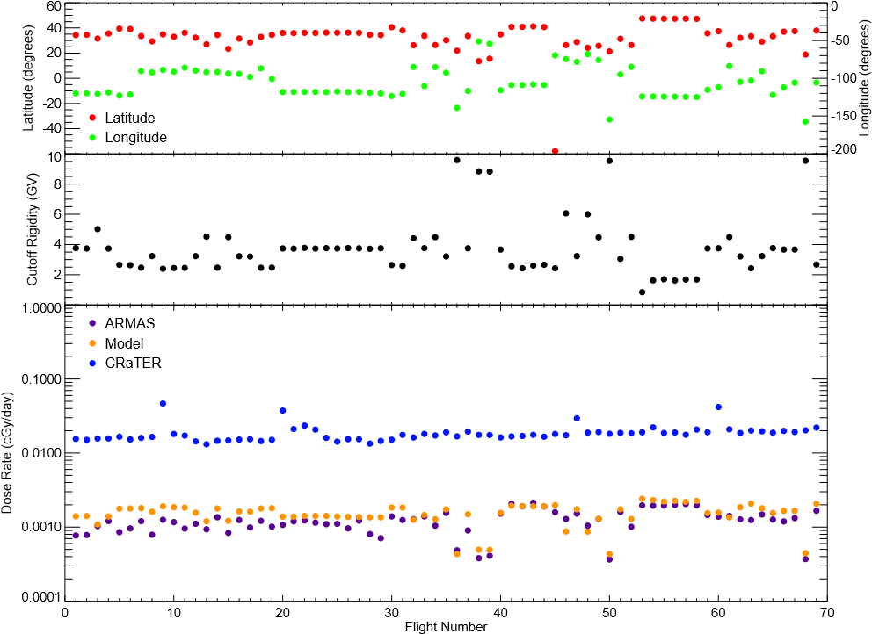
Atmospheric radiation modeling of galactic cosmic rays using LRO/CRaTER and the EMMREM model with comparisons to balloon and airline based measurements
C. J. Joyce,¹ N. A. Schwadron,¹ L. W. Townsend,² W. C. deWet,² J. K. Wilson,¹ H. E. Spence,¹ W. K. Tobiska,³ K. Shelton-Mur,⁴ A. Yarborough,⁵ J. Harvey,⁵ A. Herbst,⁵ A. Koske-Phillips,⁵ F. Molina,⁵ S. Omondi,⁵ C. Reid,⁵ D. Reid,⁵ J. Shultz,⁵ B. Stephenson,⁵ M. McDevitt,⁵ and T. Phillips.⁶ ¹University of New Hampshire, ²University of Tennessee, ³Space Environment Technologies, ⁴Federal Aviation Administration, ⁵Earth to Sky Calculus, ⁶Spaceweather.com.
Email: cjl46@wildcats.unh.edu
Introduction:
We demonstrate the results of a model of galactic cosmic ray (GCR) radiation in the Earth’s atmosphere.
We compare the model output to radiation measurements made by balloon and airline based instruments.
Because it is relatively simple and relies on lookup tables rather than resource intensive computer simulations, the model can easily be adapted for future efforts in risk assessment and atmospheric radiation studies.
Figure 5: Balloon based radiation measurements for 25 flights from Bishop, CA.
Figure 6: Model vs. measurements for 2 simultaneous balloon launches in CA and NH.
The Model:
Dose rates are computed using data products from the EMMREM radiation module together with dose rate measurements made by LRO/CRaTER.
The modulation potential (MP, average energy lost by GCRs in transit through heliosphere) is computed using EMMREM lookup tables with CRaTER GCR dose measurements (Fig. 1).
The MP is then used as input to the 2006 Badhwar-O’Neil model [1], which computes Earth-incident GCR spectra.
The spectra are then attenuated using the Nymmik geomagnetic cutoff model [2], accounting for the effect of the magnetosphere, and atmospheric dose rates are computed using lookup tables from the HETC-HEDS model (Fig. 2).
Figure 1: CRaTER GCR dose rate, computed modulation potential, and sunspot number during LRO mission.
Balloon Comparison:
A newly available and expanding data set of measurements made aboard high-altitude balloons as part of the Earth to Sky Calculus program offers an additional comparison (Fig. 5).
Fig. 6 shows GCR dose rates modelled and measured for two simultaneous launches in 2015 from CA and NH.
Because the balloon instruments measure secondary gamma and X-rays, while model uses primary GCRs and secondary particles such as neutrons, the comparison is not direct, but instead demonstrates which species dominate the dose as a function of altitude.
Conclusion:
We have provided a comparison between an updated atmospheric radiation model and measurements from balloon and airline based instruments.
Validation between the model and comparable airline measurements show the model overestimates dose rates by 30% on average, which falls within the uncertainty limit recommended by the ICRU [3].
We plan to make the modeled atmospheric dose rates shown here available to the community as a tool for risk assessment on the PREDICCS website (http://prediccs.unh.edu), as well as the Community Coordinated Modeling Center (http://ccmc.gsfc.nasa.gov/).
Figure 2: Modelled GCR dose rates at Bishop, California
(lat: 37.5º, long: -118.9º) for altitudes 11-36 km.
Figure 4: ARMAS dose rates during 69 flights with contour plot of geomagnetic cutoff rigidity (GV).
What is the radiation risk for airline travel?
The average equivalent dose rate for the 69 flights used is 0.53 µSv/hr, with an average flight time of 5.9 hrs.
This yields an average eq-dose/flight of 3.12 µSv.
This means that 32 flights are equivalent to one chest X-ray [4] and it would take ~1890 flight hours or ~320 flights to exceed the yearly radiation limit for members of the public recommended by the ICRP [5].
Airline Comparison:
We compare dose rates computed at 11 km to dosimeter measurements made during 69 airline flights as a part of the ARMAS project (Figs. 3,4).
Data below 8 km is ignored in this comparison and flights with latitudes and longitudes ranging more than 5º and 15º respectively were not used.
We find the model overestimates the dose rates at airlines by 30% on average, falling within ICRU limits [3].
References:
[1] O’Neil, P. M. (2006), Advanced Space Research, 37, 1727.
[2] Nymmik, R. A., et al. (2009), Cosmic Research,47,3,191-197.
[3] ICRU, (2010), Journal of the ICRU, Vol. 10, #2, Report 84.
[4] Mettler et al. (2008), Radiology, 248, 25463.
[5] ICRP, (2007), ICRP Publication 103, Ann. ICRP 37 (2-4).
Figure 3: Model vs. ARMAS dose rates for 69 airline flights.

