Slide 1




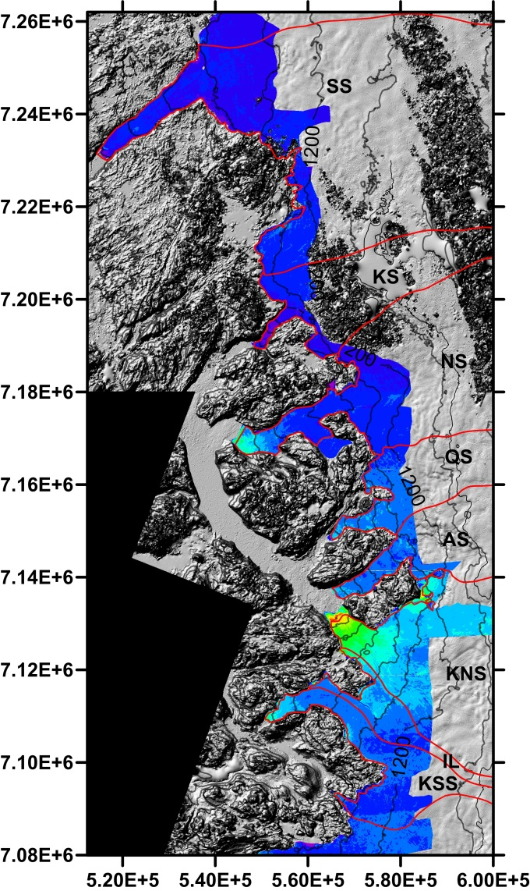
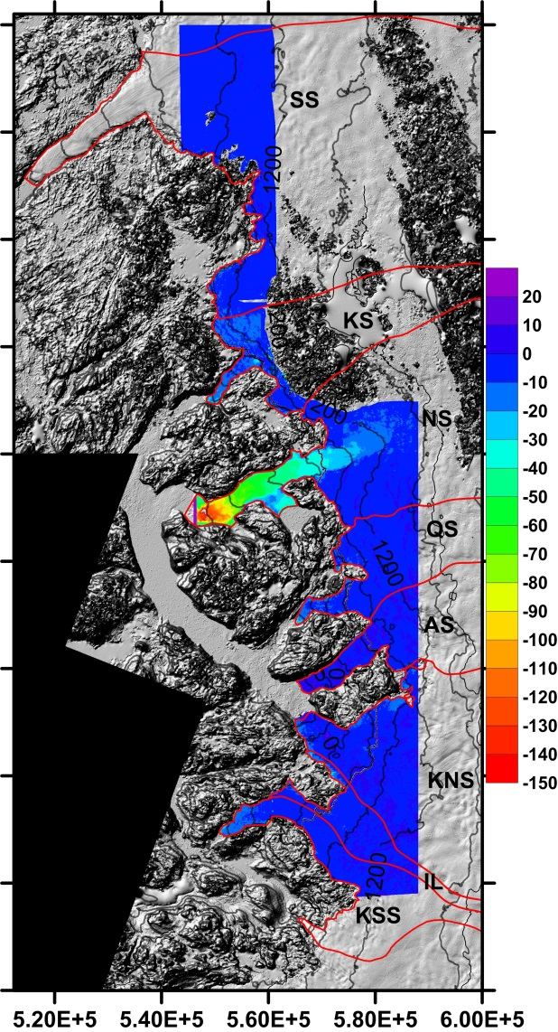
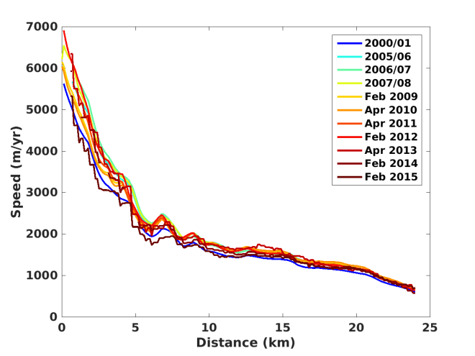
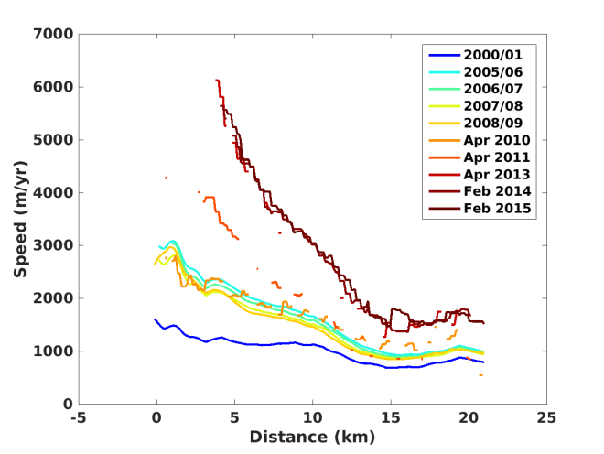
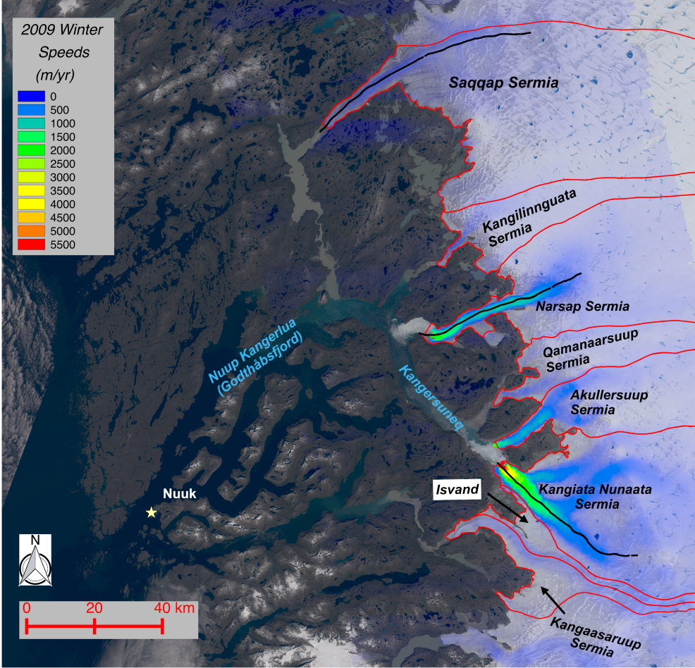
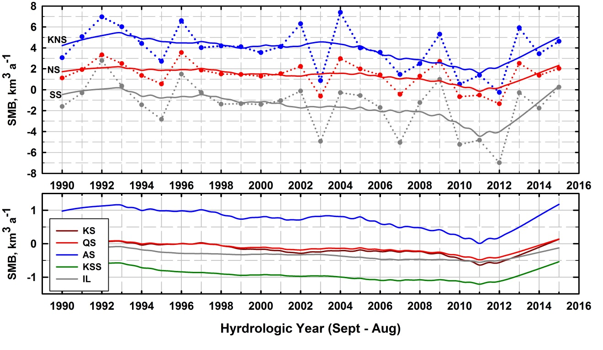
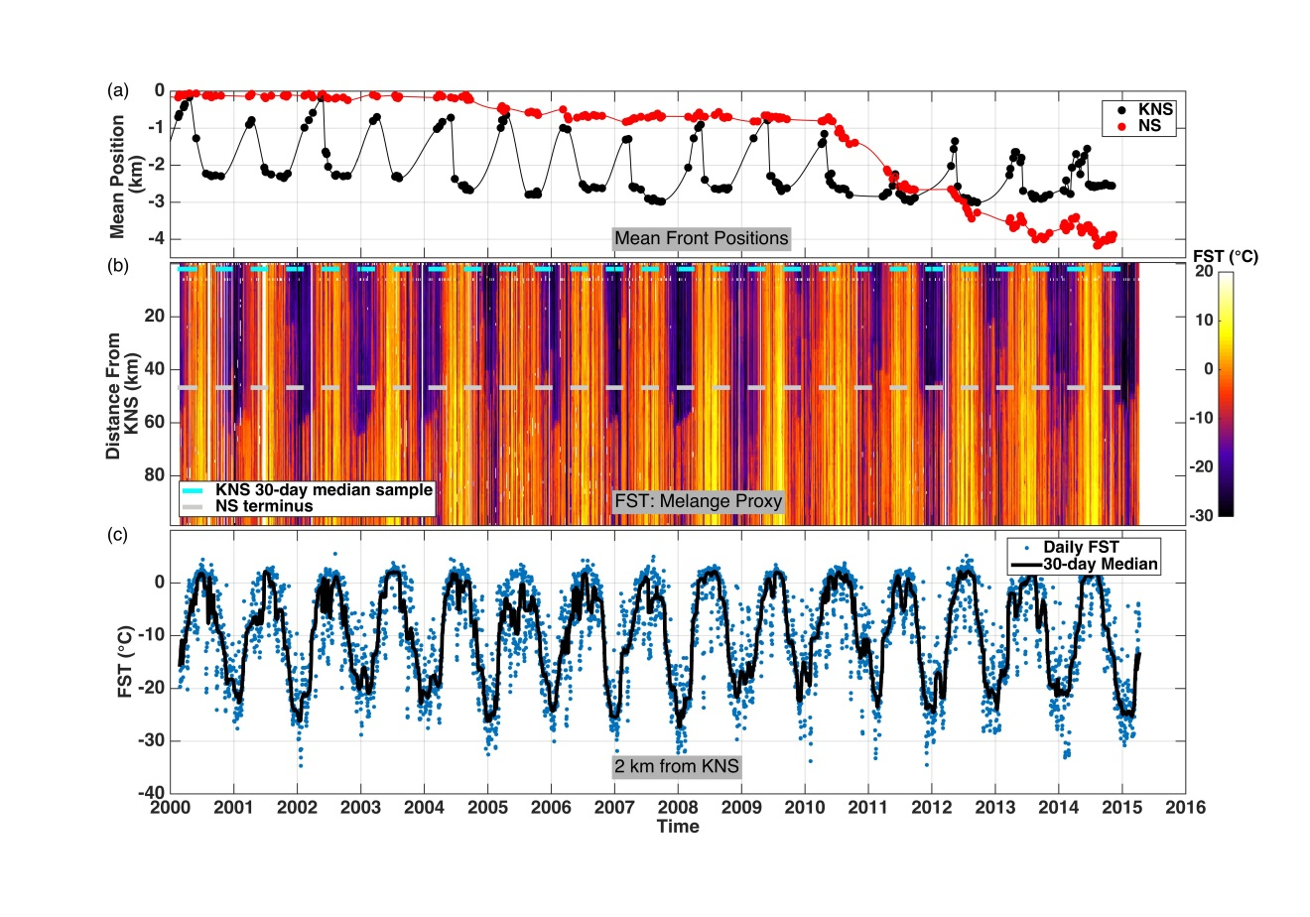
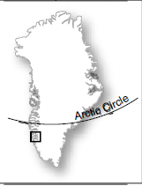
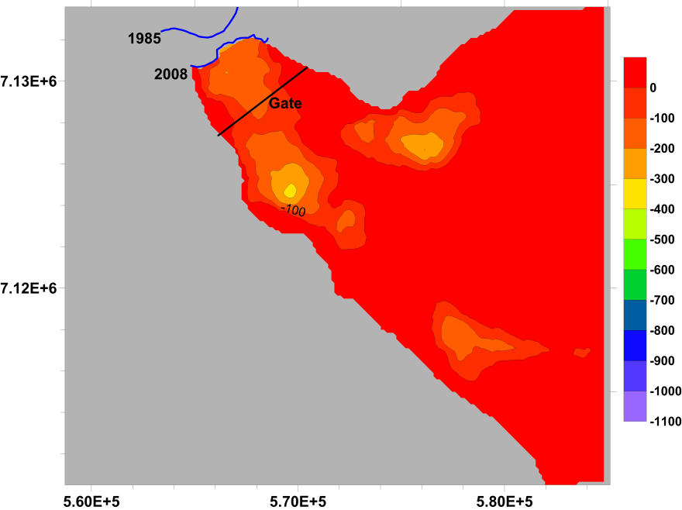
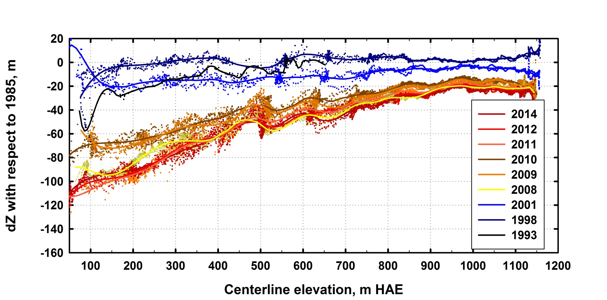
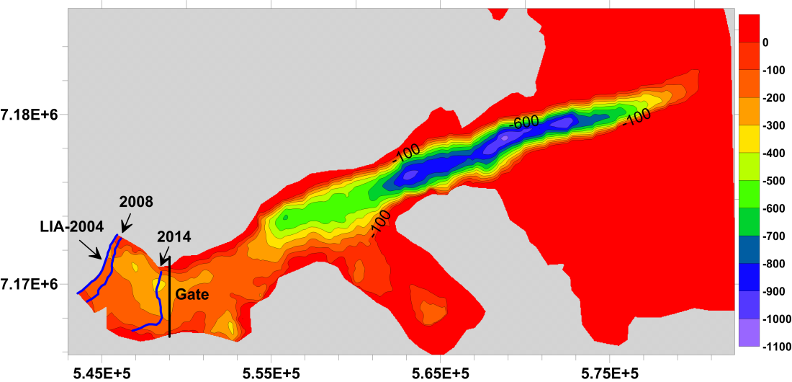
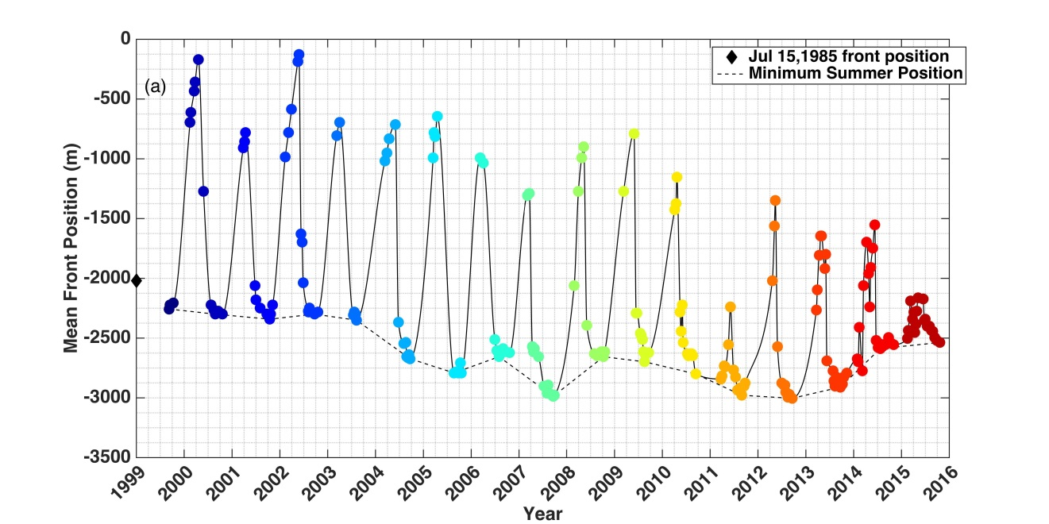
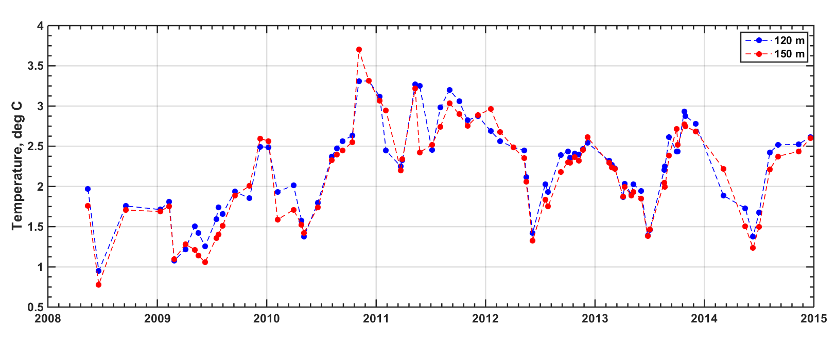
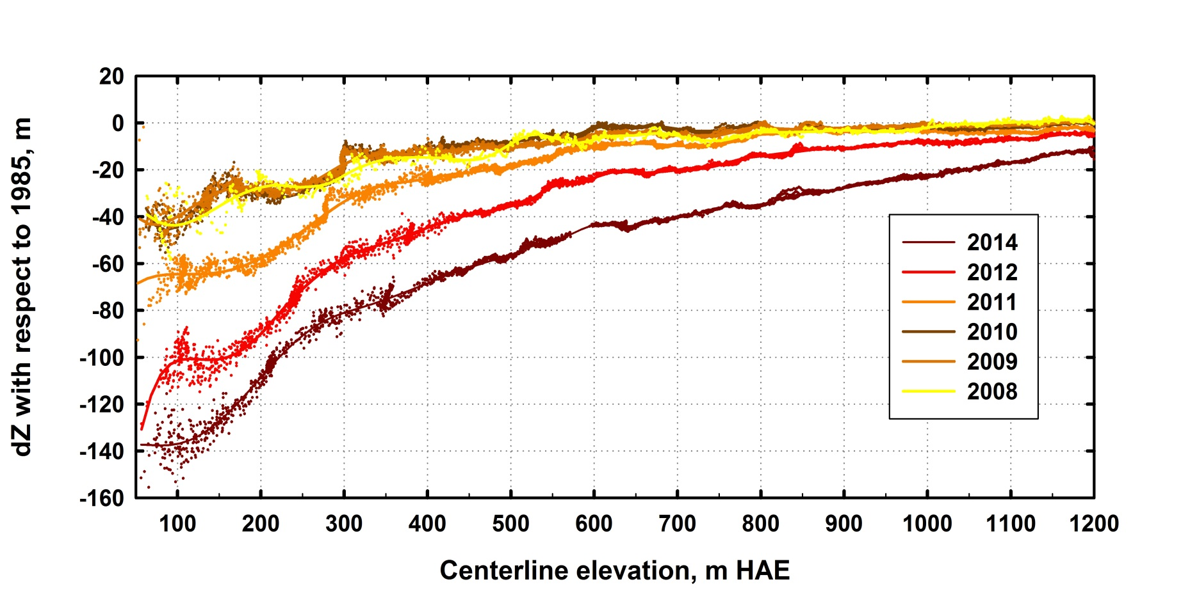
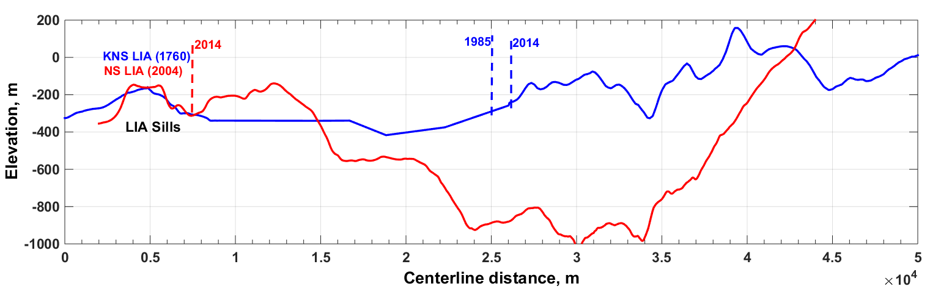
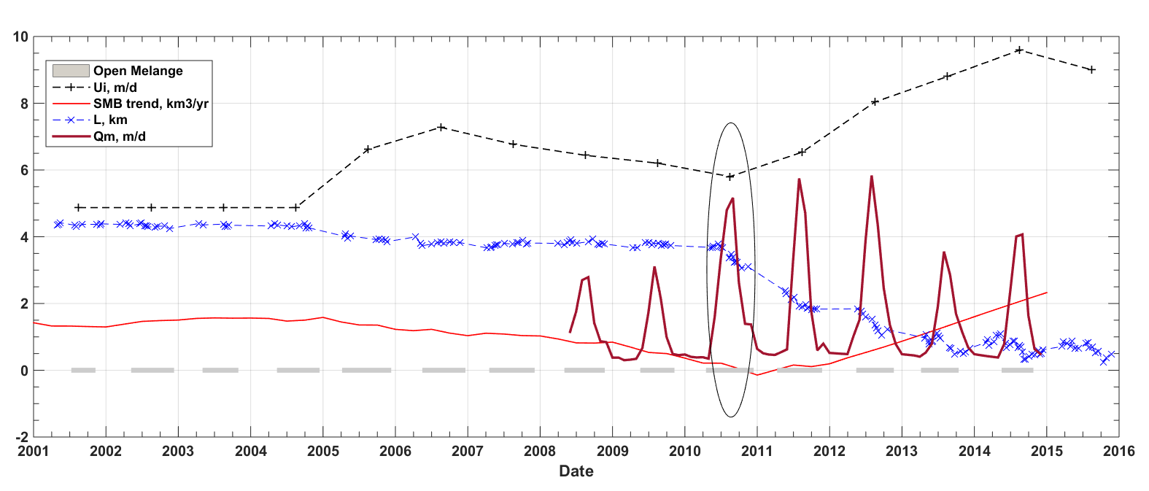
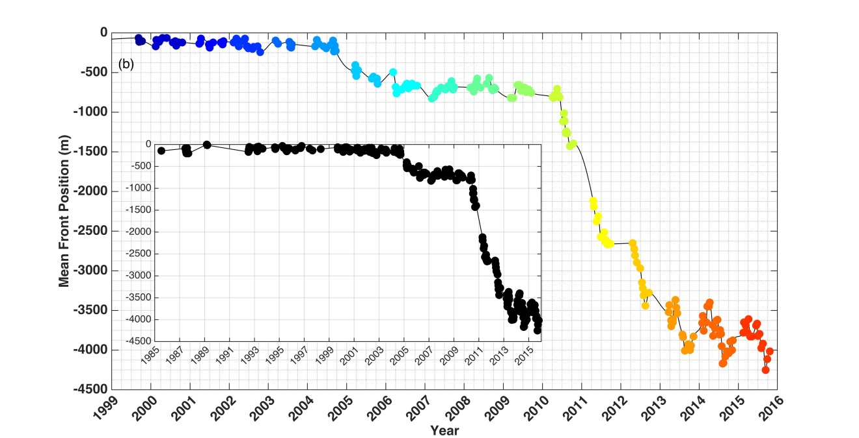
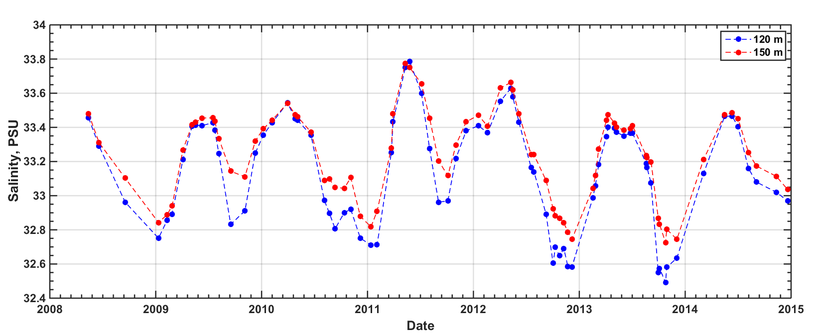
74a2136
Asynchronous Behavior of Outlet Glaciers Feeding Godthåbsfjord (Nuup Kangerlua)
and the Retreat of Narsap Sermia in SW Greenland
1. INTRODUCTION
Our work assesses ice loss and velocity changes of tidewater and land-terminating glaciers that drain into inner Godthåbsfjord (Nuup Kangerlua) in SW Greenland (Fig. 1) using: airborne LIDAR data; digital elevation models; and satellite imagery.
We then focus on the asynchronous behavior of two tidewater glaciers: Kangiata Nunaata Sermia (KNS) and Narsap Sermia (NS).
Lastly, we examine potential drivers of the observed changes including glacier thinning, runoff, surface mass balance, ocean conditions, submarine melting, bed topography, and ice mélange.
Roman J Motyka¹, Ryan Cassotto², Martin Truffer¹, Kristian K Kjeldsen^{3,4}, Dirk Van As⁵, Niels J Korsgaard⁴, Mark Fahnestock¹, Ian Howat⁶, Peter L Langen⁷, John Mortensen⁸, Kunuk Lennert⁸, and Søren Rysgaard⁸
¹Geophysical Institute, University of Alaska Fairbanks; ²Department of Earth Sciences, University of New Hampshire; ³ Department of Earth Sciences, University of Ottawa; ⁴ Natural History Museum, University of Copenhagen; ⁵ Geological Survey of Denmark and Greenland (GEUS); ⁶ School of Earth Sciences and Byrd Polar Research Center, The Ohio State University; ⁷ Danish Meteorological Institute; ⁸ Greenland Climate Research Centre, Greenland Institute of Natural Resources
3. Ice Volume Loss
1985-2008: 29.1 km³ over entire fjord region with KNS accounting for nearly half (Fig. 3a).
2008 - 2014: An additional 14.7 km³ lost with 74% of the loss from NS (Fig. 3b).
Cumulative losses are equivalent to 0.10 mm eustatic sea-level rise.
5. Velocities
KNS terminus velocities averaged 5-6 km a⁻¹ between 2000 and 2015.
In contrast, NS terminus velocities increased from 1.5 km a⁻¹ in 2004 to 5.5 km a⁻¹ in 2015.
7. HIRAM5 Surface Mass Balance
The model indicates that both KNS and NS had a relatively consistent positive balance regime that lasted from at least 1990 until about 2006 with SMB averaging 4.6 km³ a⁻¹ w.e. at KNS and ~1.8 km³ a⁻¹ at NS w.e., although there is considerable interannual variability. SMB declined significantly at both glaciers between 2007 and 2012, averaging 2.3 km³ a⁻¹ w.e. at KNS and 0.6 km³ a⁻¹ w.e. at NS before increasing to pre-2004 levels in 2013-2015.
Land-terminating glaciers all showed negative balance to varying degrees
9. SST and Ice Mélange
The winter ice mélange appears as dark purple or black and during most winters extends past Narsap Sermia’s bay (white dashed line ~48 km) (Fig. 9b). Winter ice mélange was quite pronounced up into 2004. Mélange was at a minimum in 2004 and in 2010, periods when NS initiated retreats (Fig. 9a).
Fig. 9c shows variability 2 km from KNS summer 2000 terminus. The annual changes in KNS terminus position correlate well with the changes in ice mélange in front of KNS.
(a)
(a)
(b)
(b)
Fig. 5. Center line (mostly winter) velocities for KNS (a) and NS (b) derived from RADARSAT and Landsat. Color codes are same as used in Figs. 2. KNS and NS termini lie at the left end of panels (a) and (b).
(a)
(a)
(b)
(c)
6. Glacier Bed
KNS has retreated 22 km from its 160 m deep LIA anchoring moraine and has retreated into a narrower and shallower part of its channel, constricting access to the calving front. KNS appears to have stabilized, now oscillating between small advances and retreats, and between thickening and thinning.
In contrast, NS remained stable at its LIA maximum until 2004 when an initial retreat (~ 0.5 km) led to a doubling in speed to ~3.0 km a⁻¹ . NS retreated a total of 3.6 km between 2004 and 2013 and now terminates in ~300 m deep water.
(b)
Fig. 3. Total elevation change (m) between 1985 and 2008 DEMs (a) and between 2008 and 2014 DEMs (b) super-imposed on shaded relief of 2008 DEM. Terrain contour intervals are 200 m.
Fig. 7. Annual surface mass balance (SMB) for individual drainages as determined from HIRHAM5 (Langen et al, 2015). (a) Results for KNS (blue), NS (red), and SS (grey). Solid lines are 5-year Loess smoothed data to detect long-term trends. (b) Results for remaining glaciers using Loess smoothing. Note difference in Y-axis scale.
Fig. 9. Panel (a) shows average terminus positions for KNS and NS. Panel (b) depicts results of FST data analysis derived from MODIS images. Panel (c) shows FST data (blue dots) for a position about 2 km from the KNS terminus (dashed cyan line in panel b). The FST data were highly filtered in order to bring out temporal trends. The black line in panel (c) is a 30 day running median value.
Fig. 1. Drainage basins and 2009 surface velocities in the Nuuk region of Greenland overlain on July and August 2014 Landsat imagery.
4. Drawdown
KNS thickened by 1998 WRT 1985, then suffered significant drawdown between 2001 and 2008, with terminus elevations dropping 100 m below 1985 level (Fig. 4a). The surface remained nearly constant after 2008, thickening some years and thinning in others.
In contrast, NS sustained drawdowns after 2008, with the 2014 surface dropping 140 m WRT 1985 (Fig. 4b).
8. Seawater Temperature and Salinity
Hydrographic surveys document the incursion of 3° C water beginning in fall of 2010 (Fig. 8a), coincident with the onset of the major retreat at NS and a minor one at KNS. These elevated temperatures prevailed throughout 2011 into the winter 2012. Temperatures then underwent seasonal oscillations, with coldest periods (~1.5° C) in late spring and warmest (~2.5 - 3° C) in late fall. In contrast, a colder regime prevailed prior to 2010, ranging from 0.7° C to 2.5° C.
Salinity fluctuated slightly, ranging from 32.6 to 33.8 PSU, with lower salinity roughly correlating with warmer temperatures (Fig. 8b).
2. RETREAT
KNS has retreated 22 km from its Little Ice Age (LIA) maximum since 1761 AD (Lea et al, 2014). Retreat of the annual minimum positions since 1985 has been relatively minor, ~ 0.8 km (Fig. 2a). However, the glacier exhibited strong seasonal oscillations, often sustaining a ~ 2 km long winter tongue.
In contrast, NS began retreating from its LIA moraine in 2004 (0.6 km), re-stabilized, then retreated 3.3 km between 2010 and 2014 (Fig. 2b).
(a) KNS
10. What Triggered the Retreat of NS?
Several factors can initiate the rapid retreat of a tidewater glacier: 1) thinning of a glacier terminus by a reduction in SMB, 2) changes in submarine melting, via ocean temperature and/or glacier runoff, and consequent enhanced calving; and 3) changes in the proglacial mélange with feedbacks on calving.
From our analyses, it appears that all three processes contributed to the current calving retreat of NS. The ellipse in Fig. 10 encircles various processes coincident with the inception of the 2010 retreat. The year of 2010 saw the largest duration of relatively open water, a significant increase in estimated submarine melting, a continued decline in SMB, and a reduction in Ū_{i}. Thinning would have made the terminus increasingly buoyant, particularly if the 2004 retreat caused the terminus to retract onto a reverse slope, thus increasing its vulnerability to further retreat.
(b) NS
(a) KNS
(a)
(c)
(b)
(b) NS
Fig. 6. Glacier bed topography for KNS (a) and NS (b) modified from Morlighem and others (2014; 2015) . Same color code is used for both panels to accentuate differences in glacier beds. Panel (c) compares centerline bed depths for KNS (blue) vs. NS (red).
Fig. 2. Plot of average terminus position vs. time for KNS (a) and NS (b). Black diamond in (a) marks July 1985 terminus position of KNS, 300 m beyond its 1999 summer position. Dashed line in (a) traces summer retracted position. Inset in (b) extends record for NS back to 1985, which shows terminus was stable until 2005.
Fig. 10. Estimates of submarine melting rates Q_{m} in m d⁻¹ for NS (dark red) using data from Fig. 8. HIRAM5 model runoff results were used as input for subglacial discharge (Q_{sg}). Parameters to obtain Q_{m} estimates were modified from Xu et al. (2013) and Jenkins (2011). Black crosses and dashed line show Ū_{i}, average ice velocity into the terminus for comparison. Grey bars depict periods of open mélange. Red line shows HIRHAM SMB trend (Fig. 10). Blue crosses and dashed line show NS relative terminus position in km. Ellipse demarcates data associated with onset of major retreat
Fig. 4. ATM elevation change time series for a) KNS, b) NS referenced to the 1985 DEM as base. ATM data from (Krabill, 2014). Color codes used to identify dates are similar to those used in Fig. 2.
Fig. 8. Inner fjord water temperature (a) and salinity (b) from Mortensen and others (2013) and Mortensen and others (unpublished data) at depths of 120 m (blue) and 150 m (red). Station locations varied but mostly occur between NS Bay and the KNS LIA sill.
References:
Jenkins A (2011) Convection-Driven Melting near the Grounding Lines of Ice Shelves and Tidewater Glaciers. J. Phys. Oceanogr. 41(12), 2279–2294 (doi:10.1175/JPO-D-11-03.1).
Krabill, William B. 2014, updated current year. IceBridge ATM L2 Icessn Elevation, Slope, and Roughness, Data for 1993 - 2014. Boulder, Colorado USA: NASA Distributed Active Archive Center at the National Snow and Ice Data Center. Digital media. http://nsidc.org/data/ilatm2.html.)
Langen, P. L. and thirteen others (2015), Quantifying Energy and Mass Fluxes Controlling Godthåbsfjord Freshwater Input in a 5-km Simulation (1991–2012). J. Climate, 28, 3694–3713. doi: http://dx.doi.org/10.1175/JCLI-D-14-00271.1
Lea, J. M. and seven others (2014a) Fluctuations of a Greenlandic tidewater glacier driven by changes in atmospheric forcing: observations and modelling of Kangiata Nunaata Sermia, 1859-present. Cryosphere 8(6), 2031-2045.
Morlighem M, Rignot E, Mouginot J, Seroussi H and Larour E (2014) Deeply incised submarine glacial valleys beneath the Greenlandice sheet. Nature Geosci., 7(6), 418eosc (doi: 10.1038/ngeo2167).
Morlighem, M., E. Rignot, J. Mouginot, H. Seroussi and E. Larour (2015) IceBridge BedMachine Greenland, Version 2,. Boulder, Colorado USA: NASA DAAC at the National Snow and Ice Data Center. http://dx.doi.org/10.5067/AD7B0HQNSJ29.
Mortensen, J., J. Bendtsen, R. J. Motyka, K. Lennert, M. Truffer, M. Fahnestock, and S. Rysgaard (2013), On the seasonal freshwater stratification in the proximity of fast-flowing tidewater outlet glaciers in a sub-Arctic sill fjord, J. Geophys. Res. Oceans, 118, 1382-1395, doi:10.1002/jgrc.20134.
Xu, Y., E. Rignot, I. Fenty, D. Menemenlis, and M. Mar Flexas (2013), Subaqueous melting of Store Glacier, west Greenland, from three-dimensional, high-resolution numerical modeling and ocean observations. Geophys. Res. Lett., 40, doi:10.1002/grl.50825.

