Slide 1
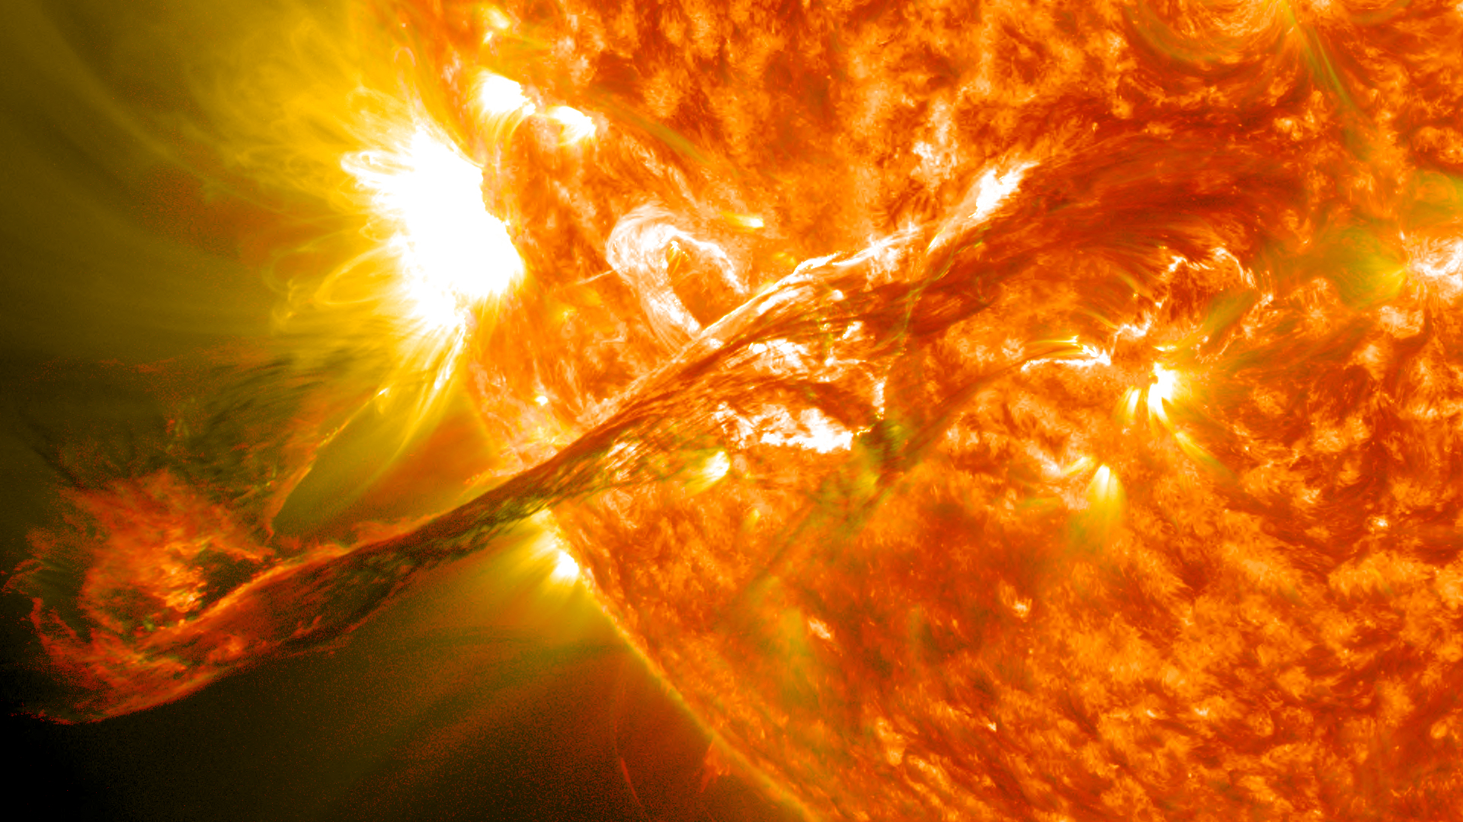


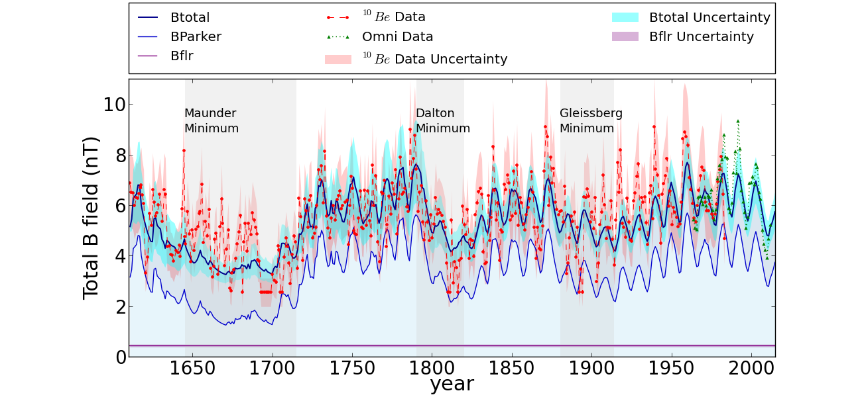
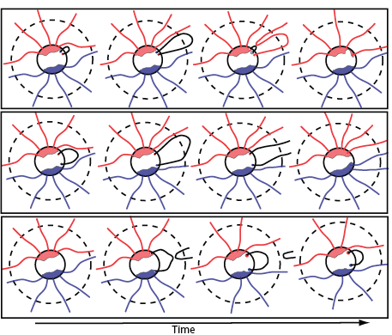
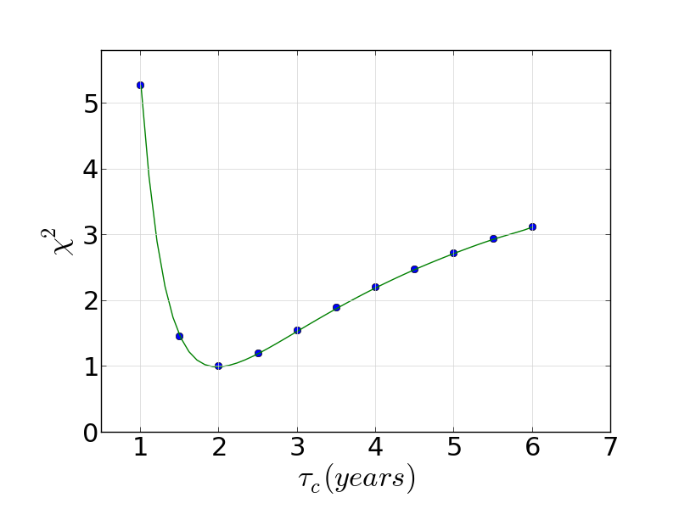
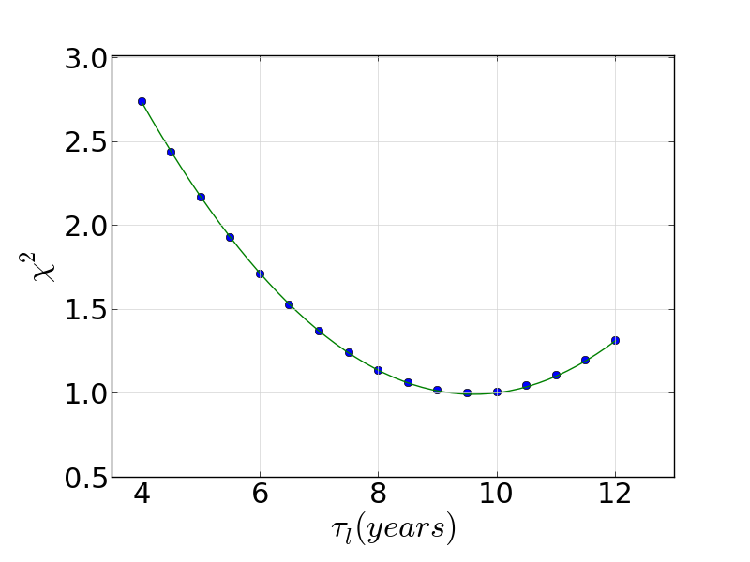
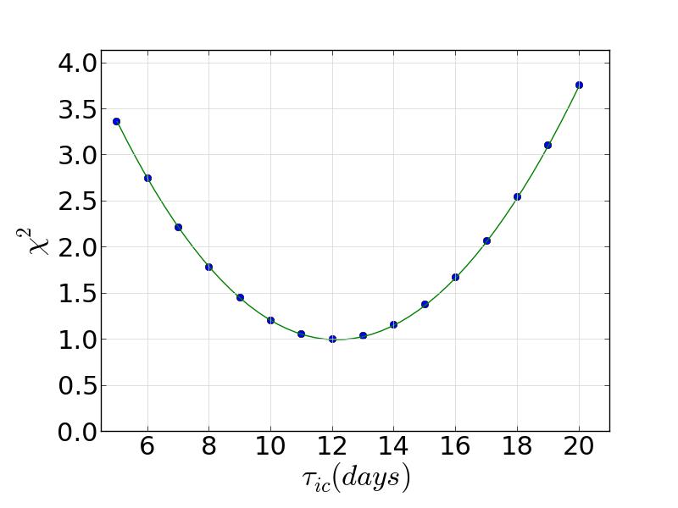
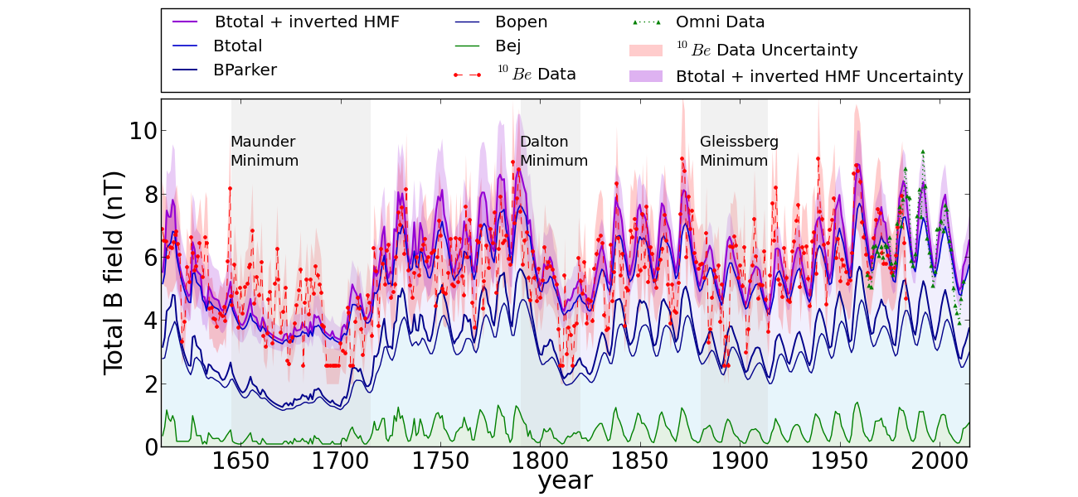
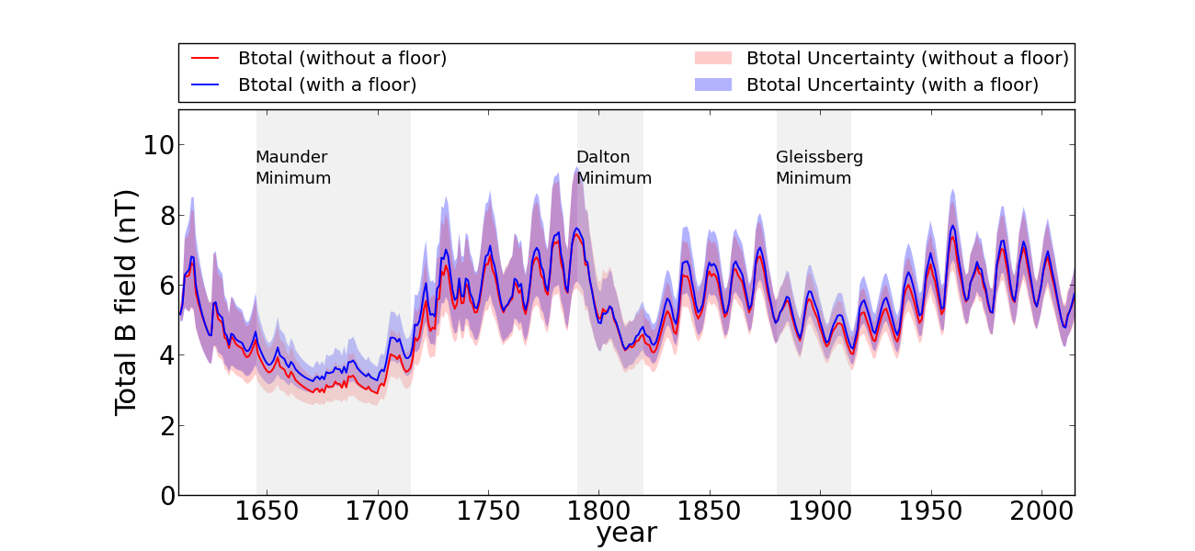
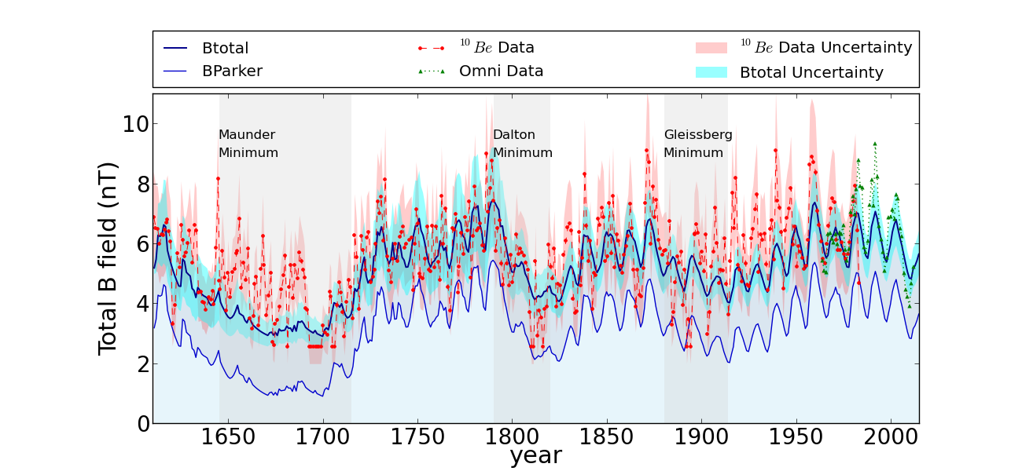
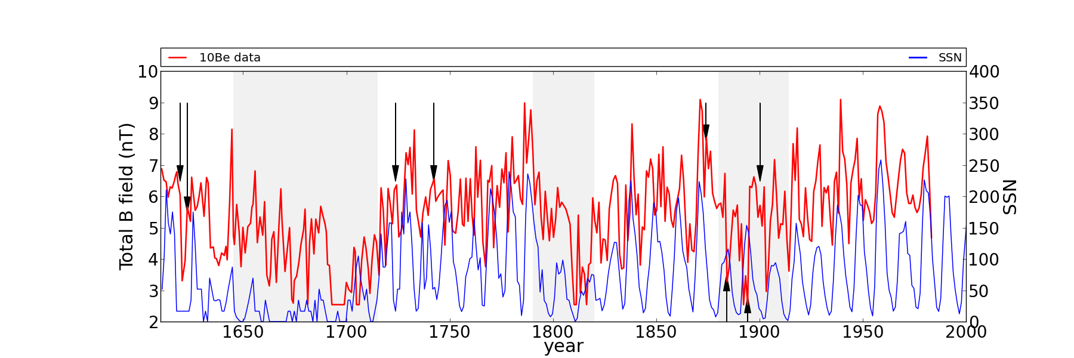
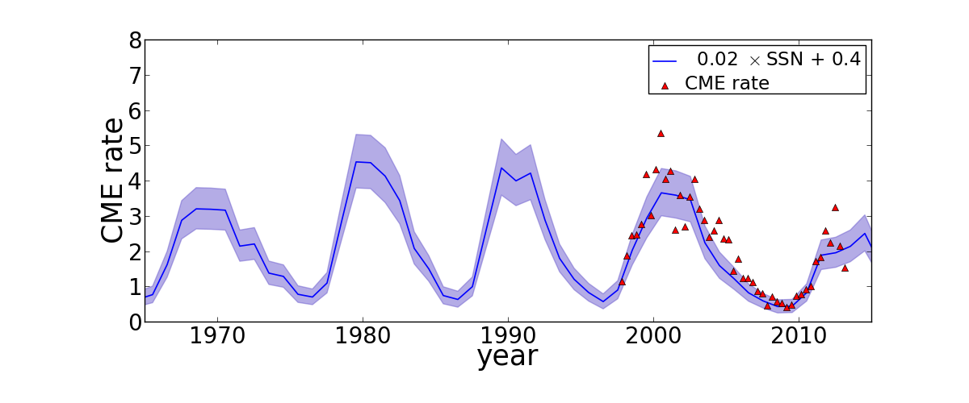
Inferring the Heliospheric Magnetic Field Back to the Maunder Minimum
F. Rahmanifard, N. A. Schwadron, C. W. Smith, K. G. McCracken and K. A. Duderstadt
Theory
Results
Owens et al. (2013) showed that the inverted HMF, created by interchange reconnection close to source surface (shown in Figure 8), can be a source for flux excess at 1 AU in situ observations. They have estimated that the HMF inversions effect can cause an overestimation of in situ measured field no greater than 10% of the observed values for the field. In order to account for such effects we have added a component of HMF inversions, equal to the ejecta associated field, to the total field.
Heliospheric Magnetic Flux system
The Case with No Floor
Coronal Mass Ejections (CMEs) are the source for the transient heliospheric magnetic flux. They harbor substantial amounts of closed magnetic flux, which evolves with time through three processes shown in Figure 1. The top panel shows conversion of transient CME magnetic flux to ambient heliospheric magnetic flux. When the closed flux has the same polarity as the surrounding ambient flux, the magnetic loop is dragged out into the
Figure 4 compares the simulated heliospheric magnetic field with the magnetic field from ¹⁰Be data set (with a relative uncertainty of ~22%) and Omni2 data set. In order to obtain the field simulated in this figure we take φ_{flr}=0 and parameters found by minimizing chi-square, shown in Figure 3. These parameters are τ_{c}=1.97 ± 0.04 years, τ_{l}=9.6 ± 0.2 years and τ_{ic}=12.12 ± 0.23 days. In order to obtain the total heliospheric magnetic field an average value of 2.0 nT has been added to the predicted mean heliospheric field value in order to compensate for the role of the turbulent and toroidal components of the HMF.
solar wind beyond the Alfven surface (shown in dashed line), and eventually becomes a component of the ambient heliospheric magnetic field. The middle panel shows loss of heliospheric and CME magnetic flux which closes heliospheric magnetic flux below the Alfven surface and releases inverted U-shaped field structures. This process is responsible for removing excessive open flux and limits the growth of the heliospheric magnetic field. The bottom panel shows interchange reconnection, which occurs when CME-associated magnetic flux undergoes magnetic reconnection with the ambient heliospheric magnetic field and reconfigures the magnetic fields.
Fig 5: The simulated mean heliospheric field (BParker) is shown in blue. The simulated heliospheric magnetic field (Btotal) is shown in dark blue with cyan uncertainty region. The purple horizontal line a floor field of 0.52 ± 0.05 nT that corresponds to φ_{flr}=(10.3 ±1.1) × 1013 Wb. . ¹⁰Be (Omni2) data points are shown with red circles (green triangles). Uncertainty shaded regions for the data points are obtained from chi-square analysis, which is equivalent to ~%22 relative uncertainty.
Fig 8. HMF inversions can be created when the “switched-back” field segment is dragged out beyond the Alfven surface by the solar wind after magnetic reconnection occurs between an open field line and a closed field line within a CME or a part of a flux rope (Owens et al., 2013).
Fig 3: Normalized χ² vs. timescales (τ_{c}, τ_{l} and τ_{ic}) for the case with no floor. Each plot is made by keeping the two other parameters at their χ² minimum values.
Fig 1: Three processes responsible for transformation of CMEs, conversion (top), loss (middle) and interchange reconnection (bottom). This figure is from Schwadron et al. (2010).
Fig 9. The simulated ejecta associated (open flux associated) field is shown in green (dark blue) line. The simulated heliospheric mean field (heliospheric magnetic field, Btotal) is shown in black (blue). The simulated heliospheric magnetic field plus inverted HMF is shown in dark violet with cyan uncertainty region. This plot is made for the case with a floor.
Schwadron et al. (2010) broke the heliospheric magnetic flux system into two components: the transient CME associated magnetic flux φ_{ej}, and the ambient heliospheric magnetic flux φ_{HMF}.
Fig 6: The simulated heliospheric magnetic field for the case with a floor (blue) is compared to the case without a floor (red). The underestimation of the predicted field during the Maunder Minimum is more significant in the case without a floor.
Conclusion
where f is the frequency of CME ejections, D is the fraction of CME ejecta that reconnects immediately after their release, φ_{CME} is the flux of a typical CME. τ_{c} , τ_{l} and τ_{ic} are timescales associated with the three processes shown in Figure 1 (conversion, loss, and interchange reconnection).
The possible sources for the discrepancy between the predicted heliospheric magnetic field and the observed data include (1) the climate impacts; the production of cosmic rays by the Sun; and the ¹⁰Be data analysis techniques. (2) the uncertainty of the sunspot numbers during the Maunder Minimum. (3) the algorithm to estimate the CME rate from the sunspot number. (4) the flux excess attributed to inverted HMF which leads to an overestimation of the observed heliospheric magnetic field.
Fig 4: The simulated mean heliospheric field (BParker) is shown in blue. The simulated heliospheric magnetic field (Btotal) is shown in dark blue with cyan uncertainty region. ¹⁰Be (Omni2) data points are shown with red circles (green triangles). Uncertainty shaded regions for the data points are obtained from chi-square analysis, which is equivalent to ~%22 relative uncertainty.
 | τ_{c} | τ_{l} | τ_{ic} | φ_{flr} | χ²
The Case with Floor | 1.36 ± 0.03 | 6.58 ± 0.17 | 11.07 ± 0.24 | (10.31 ± 1.06) × 1013 | 1.02_{+0.05(+0.5)}
The Case without Floor | 1.97± 0.04 | 9.6 ± 0.2 | 12.12 ± 0.23 | No Floor | 1.02_{+0.41(+0.65)}
Freqency of CME Ejections
Applying the exact same relative uncertainty estimated using chi-square technique for both cases yields very close values for the normalized reduced chi-square. However, Figure 6 suggests that the case with floor obtains a slightly better HMF specifically during the Maunder Minimum
We have applied chi-square analysis to obtain a linear relationship that gives the best agreement with the CME rate. It obtained f=0.019 ±0.002 × (sunspot number) + 0.37 ± 0.13 to get the best agreement with CME rate observed with the Large Angle and Spectrometric Coronagraph (LASCO) from CACTus.
The Case with Floor
We again apply chi-square minimization, in this case by also varying the floor flux from 0 to 50× 1013 Wb to obtain the minimum value of chi-square at τ_{c}= 1.36 ± 0.03 years, τ_{l}=6.58 ±0.17 years, τ_{ic}=11.07 ±0.24 days, and φ_{flr}=10.31 ±1.06 × 1013 Wb. The value for the magnetic flux floor corresponds to a radial field strength of (0.52 ± 0.05) nT at 1 AU. Using these parameters, the simulated mean field and total heliospheric magnetic field since 1610 are shown in Figure 6 along with the observed 10Be (with a relative uncertainty of ~22%) and Omni2 data.
Acknowledgments
Fig 7: Red line represents the heliospheric magnetic field strength estimated from ¹⁰Be measurements. Blue lines shows sunspot numbers obtained by scaling new sunspot group number released by SILSO. Black arrows show some of the data points where these two data sets are anti-phase. These points cause the resulting simulate heliospheric magnetic field to smooth and deviate from observed data (red line in here) due to lack of variability.
Support this work provided by the NASA Lunar Reconnaissance Orbiter Project (NASA contract NNG11PA03C), as well as various NASA grants (EMMREM, grant NNX07AC14G; C-SWEPA, grant NNX07AC14G; DoSEN, grant NNX13AC89G; DREAM, grant NNX10AB17A; and DREAM2; grant NNX14AG13A) and a NSF grant (Sun-2-Ice, grant AGS1135432). Finally, we thank the International Space Science Institute for supporting the Research Team: Radiation Interactions at Planetary Bodies (http://www.issibern.ch/teams/interactplanetbody/).
Fig 2: CME rate derived from sunspot number (blue curve) is compared to CME rates (red triangles).
Email: fle4@wildcats.unh.edu
Background image is obtained from NASA Goddard Space Flight Center - Flickr: Magnificent CME Erupts on the Sun - August 31, Available on: https://en.wikipedia.org/wiki/Solar_flare#/media/File:Magnificent_CME_ Erupts_ on_the_Sun_-_August_31.jpg

