Slide 1

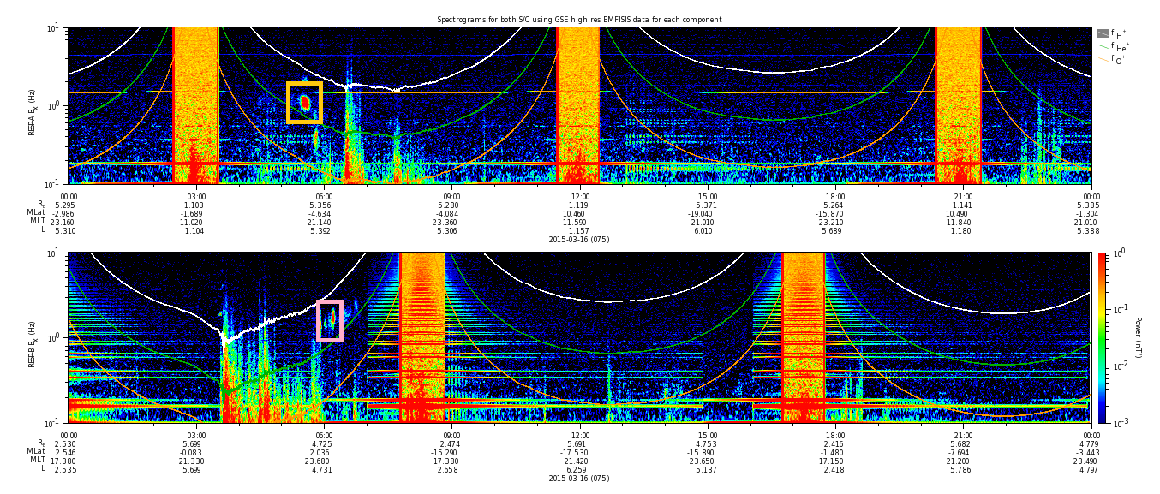
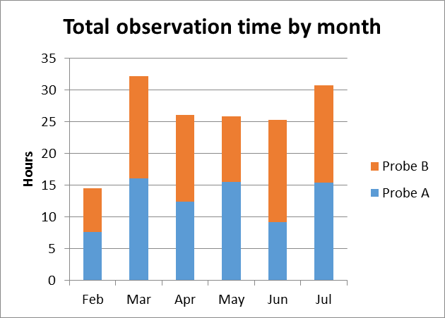
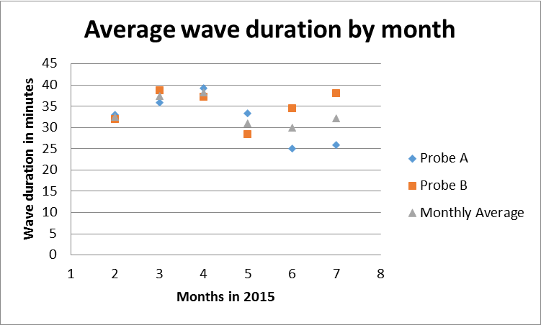
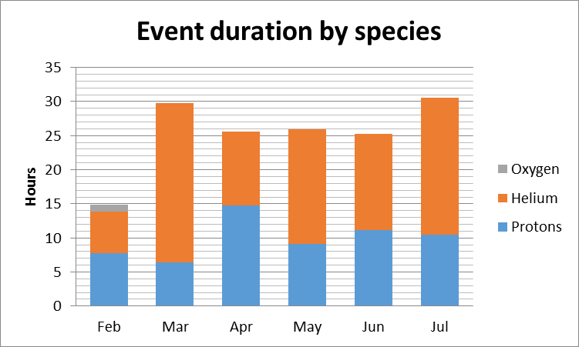
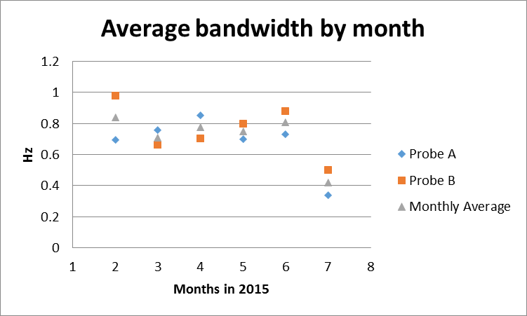
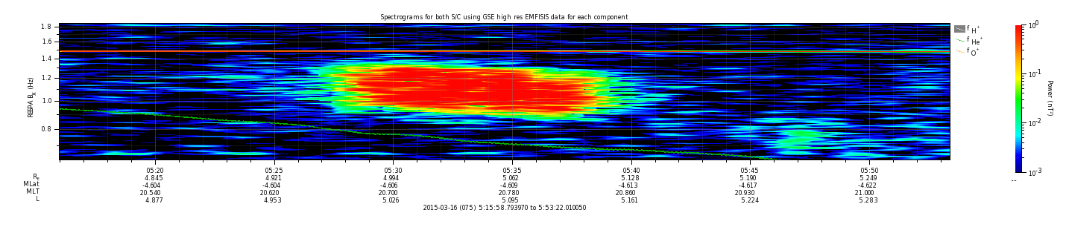
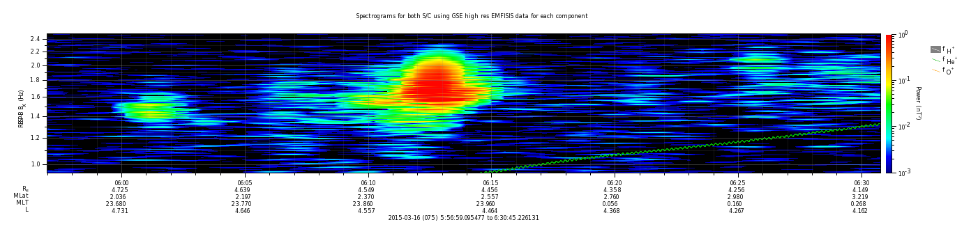
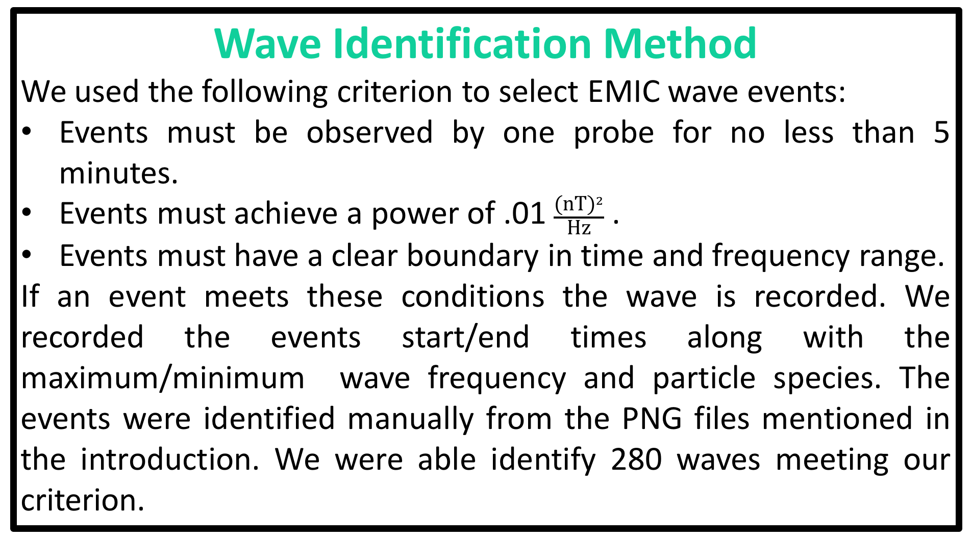
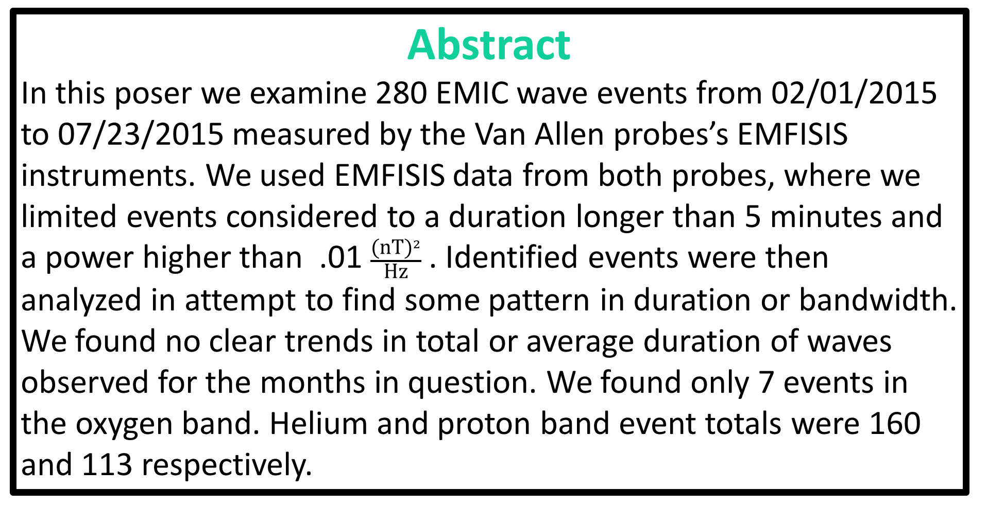
A survey of EMIC waves observed by the Van Allen probes between 02/01/2015 – 07/242015
E. Chapmann², A. R. Aly¹, J. -C. Zhang¹, AA. Saikin¹ , C. W. Smith¹
¹ Space Science Center, University of New Hampshire, Durham, NH 03824, USA
²2015 Project SMART Workshop, UNH, Durham, NH, July 22, 2016.
Abstract
In this poser we examine 280 EMIC wave events from 02/01/2015 to 07/23/2015 measured by the Van Allen probes’s EMFISIS instruments. We used EMFISIS data from both probes, where we limited events considered to a duration longer than 5 minutes and a power higher than .01 $\frac{{\text{(}\text{nT}\text{)}}^{2}}{\text{Hz}}$ . Identified events were then analyzed in attempt to find some pattern in duration or bandwidth. We found no clear trends in total or average duration of waves observed for the months in question. We found only 7 events in the oxygen band. Helium and proton band event totals were 160 and 113 respectively.
Figure 1
Figure 2
Introduction
Electromagnetic Ion Cyclotron Waves (EMIC waves) are charged particle waves. EMIC waves can occur at any location where hot and cold plasma interact with external magnetic fields, Saikin et al., [2016]. These plasma waves are thought to transport high-energy particles from the radiation belts surrounding earth to regions where humans and human technology can be adversely effected by the high-energy particles, Zhang et al., [2014]
. This is the major reason it is practically important to understand EMIC waves.
This study does not offer a new concept but it does use some of the most recent data available, Saikin et al., [2015]. The period used in this survey ranges from February 1st 2015 to July 23rd 2015. In this study we used EMIC wave events observed by the Van Allen probes(VAPs). The VAPs are satellites with highly elliptical orbits housing a suite of instruments designed to study the earth’s radiations belts, or the Van Allen belts. The data used in this study were measured by the EMFISIS instrument onboard the VAPs. The data were then processed by ground teams and finally turned into PNG files using Autoplot by our team (see figure 1). We then used the PNG files for wave identification and analysis.
Summary & Discussion
We identified and recorded 280 EMIC waves using EMFISIS data.
In our analysis we used:
  start and end times
  minimum and maximum frequency
  particle species
We plotted the results of our analysis and found:
  There is no clear trend in the total duration by month.
  There is no clear trend in the average duration or bandwidth by month .
  Event observation in the oxygen band is rare, going months without a single observation in some cases and with a total of only 7 events observed for the entire survey.
  Helium is the most likely band for observing EMIC waves meeting our criterion with 160 events observed.
The figure shows the full day PNG for 3/16/2015 with events observed on both probes. The events are highlighted in different colors on the full day PNG. The bottom figures are enlarged cutouts of the events with the colors of the picture-frames matching the colors assigned in the full day PNG.
Table 1
The total number of events observed by the Van Allen probes. The table also shows the events observed by species.
References
Saikin, A. A., J.-C. Zhang, C. W. Smith, H. E. Spence, R. B. Torbert, and C. A. Kletzing (2016), The dependence on geomagnetic conditions and solar wind dynamic pressure of the spatial distributions of EMIC waves observed by the Van Allen Probes, J. Geophys. Res. Space Physics, 121, 4362–4377, doi:10.1002/2016JA022523.
Saikin, A. A., J.-C. Zhang, R. C. Allen, C. W. Smith, L. M. Kistler, H. E. Spence, R. B. Torbert, C. A. Kletzing, and V. K. Jordanova (2015), The occurrence and wave properties of H+-, He+-, and O+-band EMIC waves observed by the Van Allen Probes, J. Geophys. Res. Space Physics, 120, 7477–7492, doi:10.1002/2015JA021358.
Zhang, X.-J., W. Li, Q. Ma, R. M. Thorne, V. Angelopoulos, J. Bortnik, L. Chen, C. A. Kletzing, W. S. Kurth, G. B. Hospodarsky, et al. (2016), Direct Evidence for EMIC Wave Scattering of Relativistic Electrons in Space, J. Geophys. Res. Space Physics, , doi:10.1002/2016JA022521.
Wave Identification Method
We used the following criterion to select EMIC wave events:
Events must be observed by one probe for no less than 5 minutes.
Events must achieve a power of .01 $\frac{{\text{(}\text{nT}\text{)}}^{2}}{\text{Hz}}$ .
Events must have a clear boundary in time and frequency range.
If an event meets these conditions the wave is recorded. We recorded the events start/end times along with the maximum/minimum wave frequency and particle species. The events were identified manually from the PNG files mentioned in the introduction. We were able identify 280 waves meeting our criterion.
Data Analysis
The EMIC waves recorded were analyzed in Microsoft’s Excel and some of the results were plotted and interpreted. Two histograms and two scatter plots created in excel are shown here. One of the histograms shows the total time waves were observed by the probes each month( Figure 2a), where each column is stacked to show individual contributions from each probe. The other histogram shows the same quantity but with the species contribution highlighted instead of the probes(figure 2b). The first of the two scatter plots shows the average wave duration for each month from both probes and a simple average(figure 2c). The last plot shows the average bandwidth for a wave by month for both probes and the average.
Acknowledgments
This work was greatly supported by Project SMART and the University of New Hampshire. This work was supported by RBSP-ECT funding provided by JHU/APL Contract No. 967399 under NASA's Prime Contract No. NAS5-01072. Work at UNH was also supported by NASA under grant numbers NNX11AO82G and NNX15AF66G.

