Slide 1
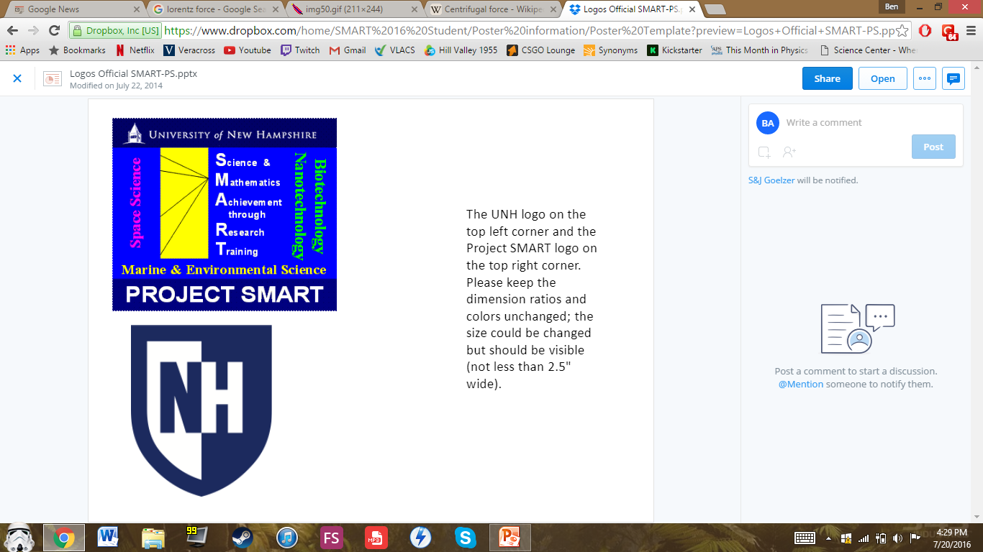
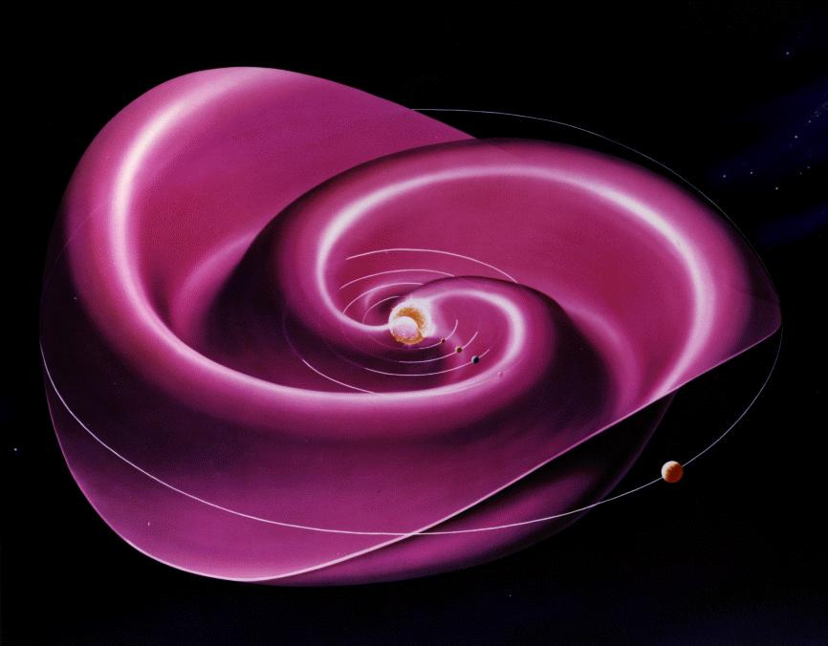
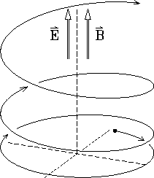
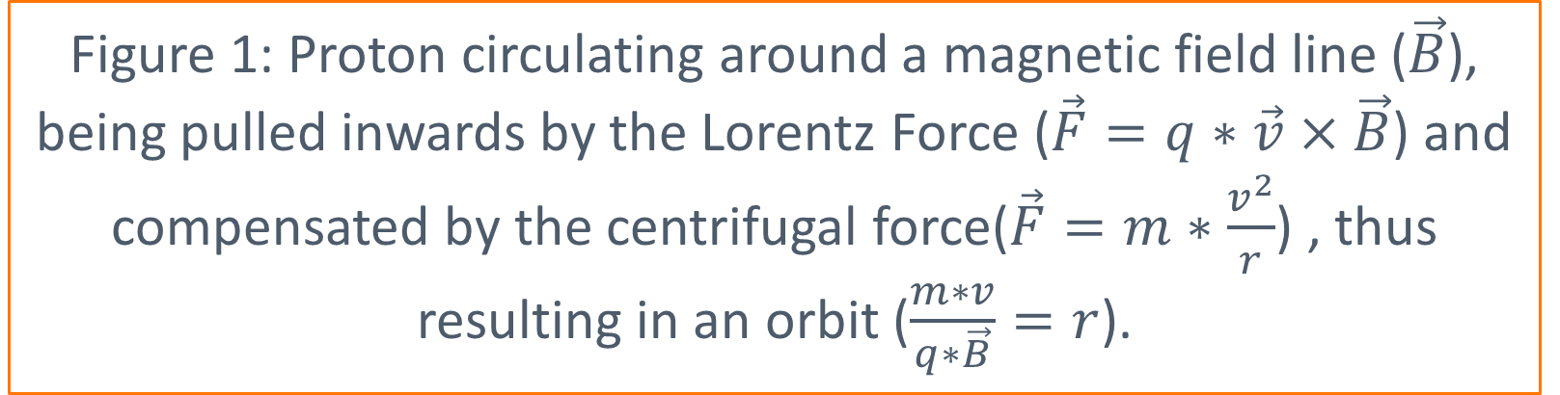
THE CORRELATION BETWEEN PICK-UP IONS CUTOFF SPEED AND THE SPEED OF THE SOLAR WIND
Authors: Paul Weimer, Ben Abraham and Kelly Garcia
Advised by Eberhard S. Möbius¹, Jonathan S. Bower, Philip Quinn
¹Professor, Physics Diploma
The “vacuum” in Outer Space is not a true one; it is filled with the Interstellar medium which consists of gas in ionic, atomic and molecular form, as well as radiation. The Solar Wind, which is a plasma ejected by the sun creates a bubble, named heliosphere, around the solar-system(shields up) which blocks the charged part of the Interstellar medium(plasma). The Solar Wind, which travels at several hundred kilometers a second, contains a magnetic field.
If a neutral particle flies through the heliosphere it can lose an electron to a ion. This ion will now be picked up by the solar wind, thus resulting in the name pick up ions(PUI). Those pick-up ions (or PUI for short) will circulate around the Magnetic field lines at the gyro-radius on which the Lorentz Force is being compensated by the centrifugal force. Those ions are observed by STEREO A, which can then be analyzed.
It was measured that every time the cut-off speed changes drastically, the speed of the solar wind also changes significantly as can be observed in Figure 1. If the cut-off speed changes at a harsh rate, the slope of this incline in the solar wind speed increases or decreases accordingly.
A minor difference in speed can be significant if it occurs over a short period of time, usually around 20 hours, and not vice versa. This contradicts the purpose of a slope, but if the change occurs over a longer time, the speed of the PUIs does not change. In this case, change of the solar wind over a short period of time is what was successfully observed.
The observation that the density of the solar wind also spikes leads to the conclusion that the satellite is observing a shock wave. This shock wave is created by a faster solar wind colliding with the former’s slower solar wind. Because of the sun’s rotation, the plasma at the equator travels faster than the one at the poles. This results in the Ballerina-effect¹.
An additional observation made was that the Magnetic field in the solar wind changes polarity whenever this jump in the cut-off speed occurs.(Figure 4) This observation complicates the situation, because now the orientation of the solar wind and of the satellite have to be taken into consideration.
The progress made during this research period has proven that there are correlations in the behavior of pick-up ions and the solar wind speed.
Figure 2: Observed cut off speed of the PUI assuming that the entire difference from the solar wind is due to the speed of the solar wind in kilometer per second plotted against time in days. Noticeable is the difference between Data point 55 and 56.
If the cutoff speed (the speed in which ions are implanted into the solar wind) of the pickup ions (PUI) change drastically, then there will be a correlation with the speed of the solar wind.
Data recorded from STEREO A and a trend in comparison of the recorded and modeled cut-off speed after correction for the average difference was identified. The expected result was that the graph would show no trends. However, a positive trend was observed. As a next step, a search for anomalies in the PUI cut-off speed was made. (Figure 2) The speed of the solar wind was then observed to gain a better understanding of these anomalies.(Figure 3)
Figure 3: Solar wind speed in kilometer per second plotted against time in 10 minutes intervals at the previously mentioned point. Notice the calm first phase and the following steep incline.
Figure 5: Artist’s depiction of the Ballerina Effect around the sun
Figure 1: Proton circulating around a magnetic field line ($\vec{B}$), being pulled inwards by the Lorentz Force ($\vec{F}=q∗\vec{v}×\vec{B}$) and compensated by the centrifugal force($\vec{F}=m∗\frac{v^{2}}{r}$) , thus resulting in an orbit ($\frac{m∗v}{q∗\vec{B}}=r$).
STEREO A Satellite launched on October 26, 2006- operated by NASA- Mission Type: Solar Observation
https://en.wikipedia.org/wiki/Heliospheric_current_sheet - 7/20/16
http://www.jick.net/~jess/hr/skept/E_M/img50.gif - 7/20/16
Figure 4: Magnetic field of the plasma as observed by the satellite in Nano Tesla plotted against time in 10 minutes intervals. This chart is in the same time frame as figure 2, only zoomed in to the start of the incline. Observable is the flip of the magnetic field’s polarity

