Slide 1


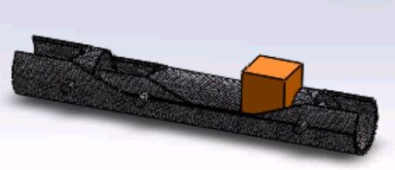
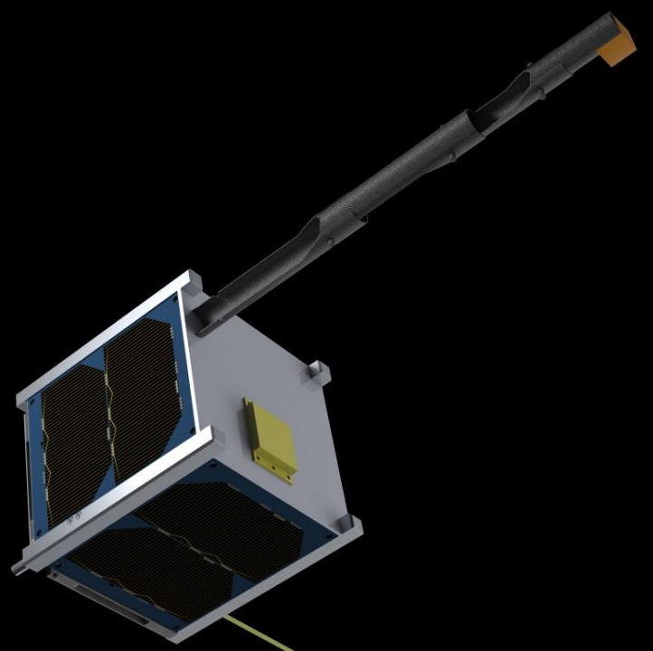
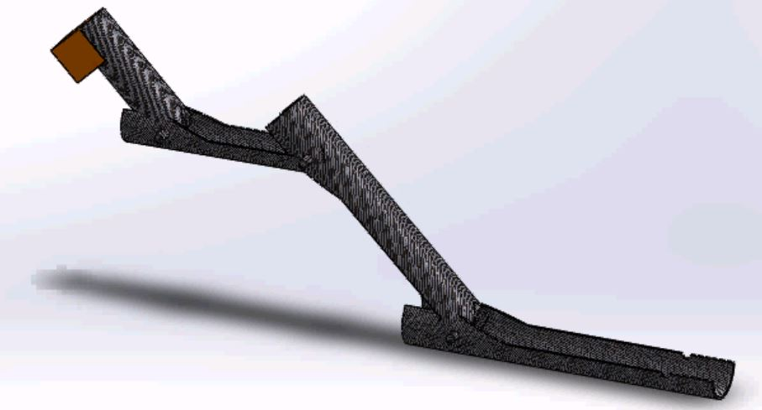
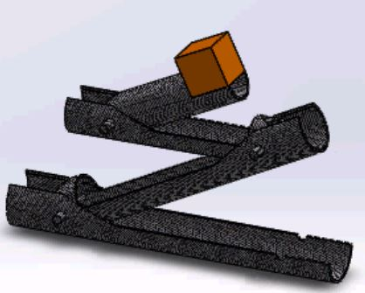
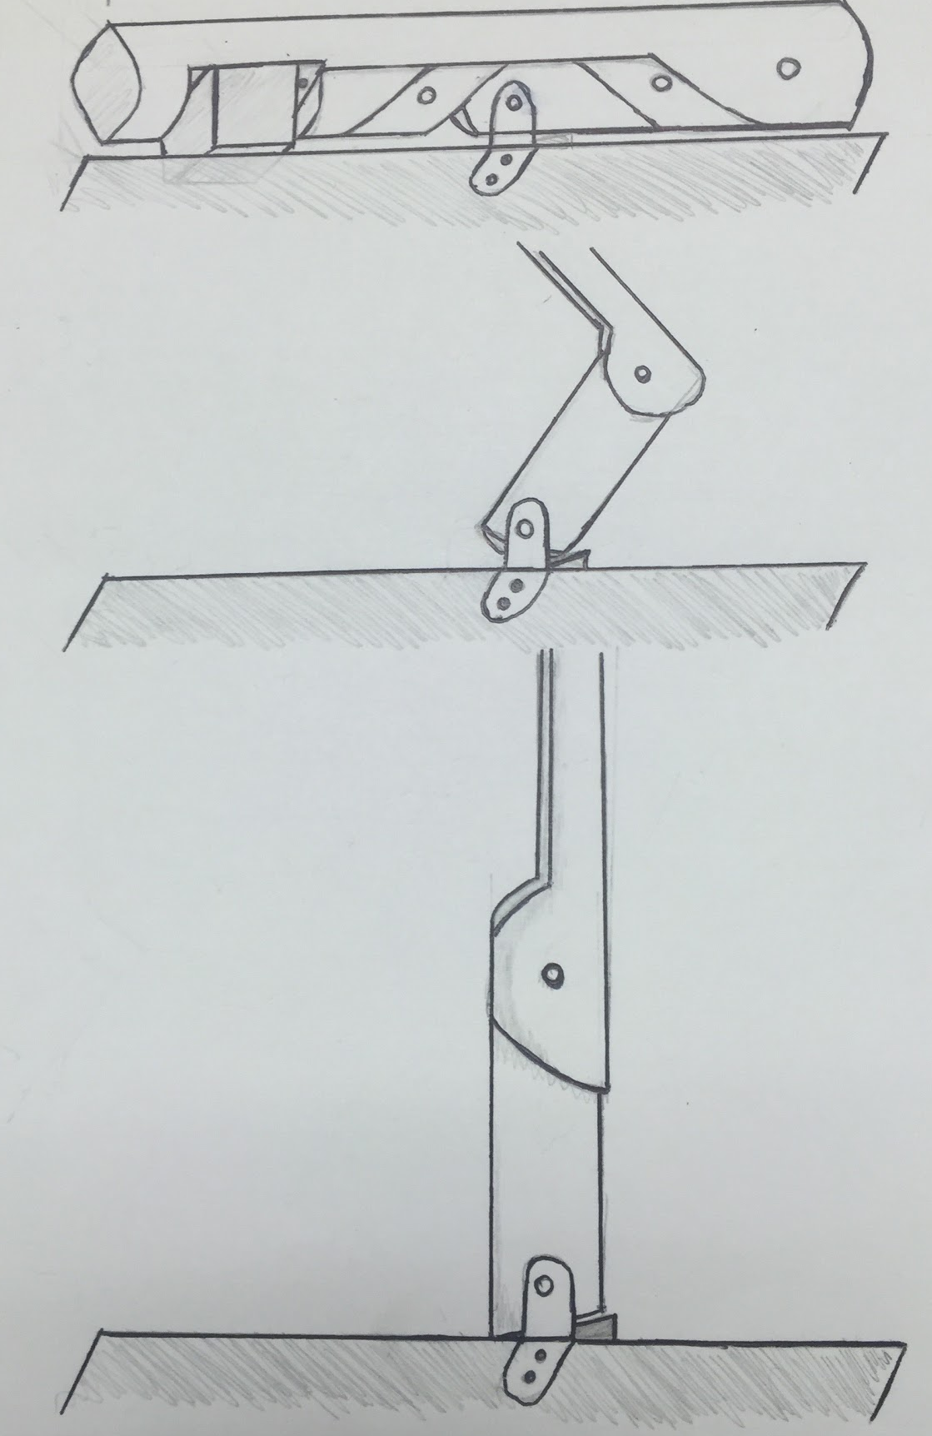
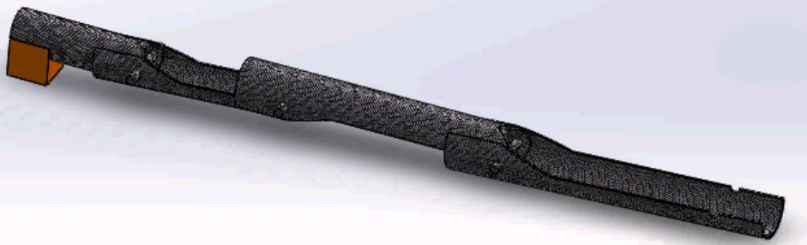
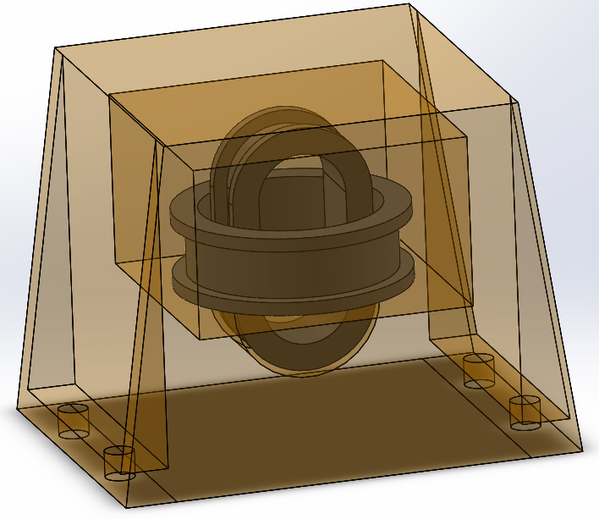
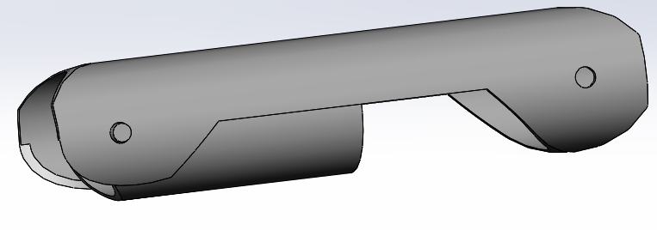
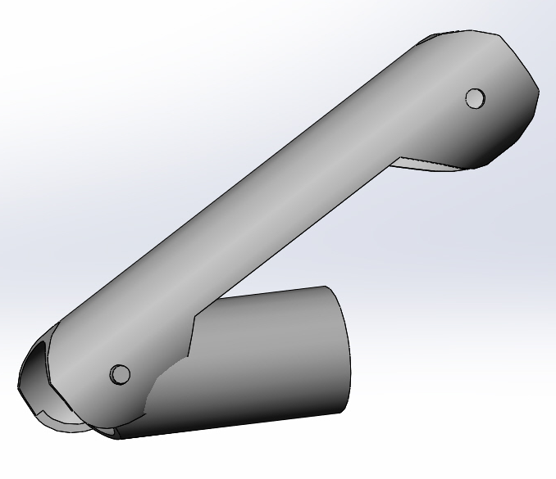
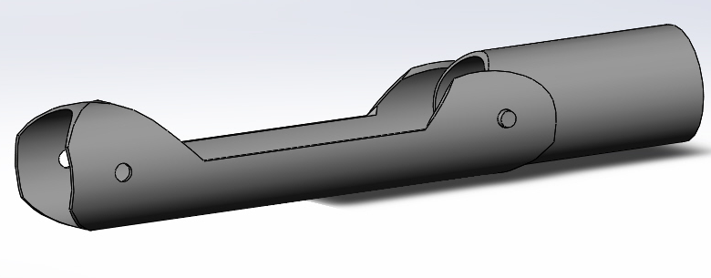
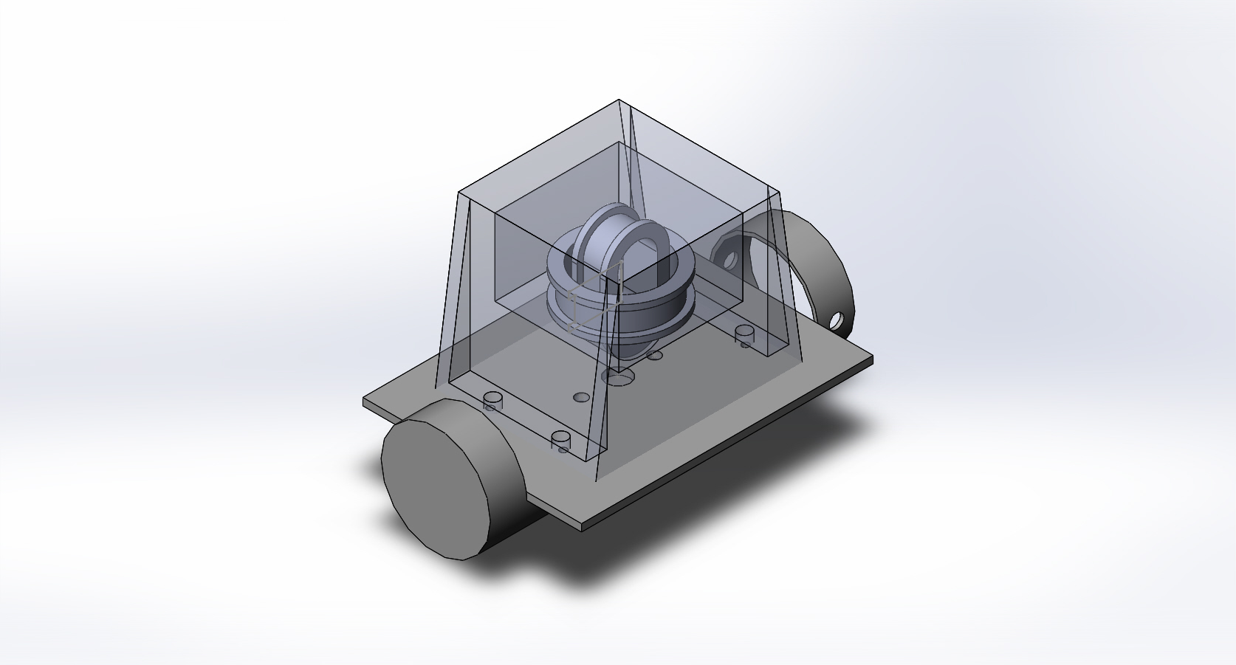
The Process of Designing a BOOM to Deploy a Magnetometer on a CubeSAT
Advised and Aided By:
Dr. Mark Lessard, Tyler Chapman, Maria Panacopoulos and Anthony Velte
Grace Buttrick (Bishop Guertin High School in Nahua, NH) and Jiwan Nepal (West High School in Manchester, NH)
Montana State University and Aerospace Corporation
Background
The Designs
Bracket
Results
CubeSat:
A small satellite that is low cost, small and easy to launch.
The CubeSat Program was started in 1999 to: reduce cost and development time, increase accessibility to space and sustain frequent launches.
The Original Prototype:
This was the first design that is able to both achieve the extended height requirements and compress into a 3 x 5 x 10 cm volume.
This prototype didn’t work because:
it didn’t allow for the size of the magnetometer to fit into the smallest tube.
the SMA (Shape-Memory Alloy) wire couldn’t fit over the tubes from the initial position.
Bracket:
The bracket is a device that joins the boom and CubeSat.
What happened?
The CubeSat BOOM has been in design for over a year and the previous prototypes were not efficient. We got an opportunity to design an efficient boom for the CubeSat.
What comes next?
The proposal will be sent to NASA in hopes of funding. Three identical CubeSats will be built. NASA Launch to ISS with the CubeSats as a secondary payload in a p-pod launcher.
Boom Bracket:
The boom bracket will restrain the boom during launch and will allow the boom to deploy 30 minutes after it has been launched from the p-pod.
Magnetometer:
The Magnetometer is a device that measures the magnetic and direction of magnetic fields.
The Latest Version:
This design is an improvement of the original prototype which is able to achieve the height, width and length requirements for both, extended and compressed configurations. This design shares many of the same basic design concepts as the original prototype. One of the key differences is that instead of a SMA wire system to open the BOOM, a spring system is used. Another key difference is that the tubes have a different shape than the original design (See Photo). The final key difference is the location of the Magnetometer on the BOOM has been moved from the smallest tube to the largest tube.
Design Improvements:
Allowed for the size capacity of the magnetometer to fit into the largest tube.
The springs allow the BOOM to be opened where the SMA wire would not.
Acknowledgements
The Magnetosphere Ionosphere Research Labratory (MIRL), The University of New Hampshire and Project SMART
Magnetometer Bracket:
The magnetometer bracket has to be able to hold the magnetometer in place and isolate the magnetometer frame vibrations and the movement of the CubeSat in space, which would cause disturbances in the data.
Boom:
The BOOM is a device that securely holds the magnetometer away from the cube. The BOOM is needed to hold the magnetometer away from the CubeSat so that the magnetic fields generated by the satellite don’t interfere with the magnetometer.
Advised and Aided By:
Dr. Mark Lessard, Tyler Chapman, Maria Panacopoulos and Anthony Velte
Goal:
To build a lightweight, low cost, low power BOOM, that was far enough away from the Cube, 20 cm, so that no magnetic interferences occurred during normal operations in space.
Thanks To:
Chuck Smith, Rich Messeder, Lou Broad and Scott Goelzer
Notes:
‹#›

