Slide 1

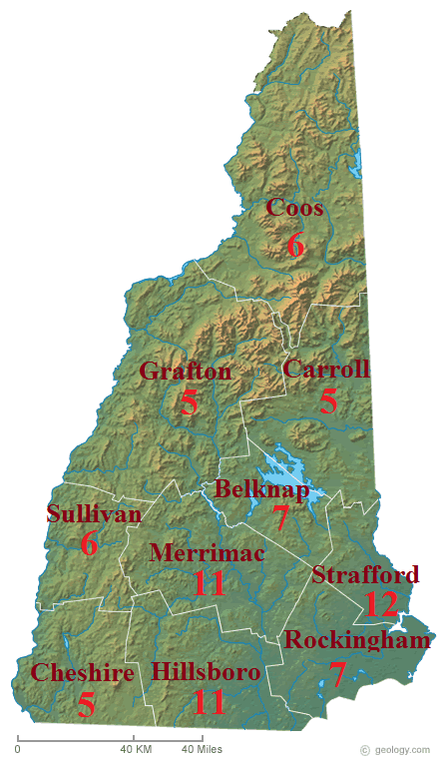
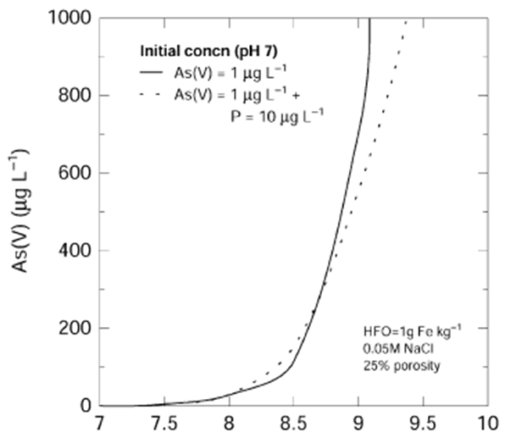
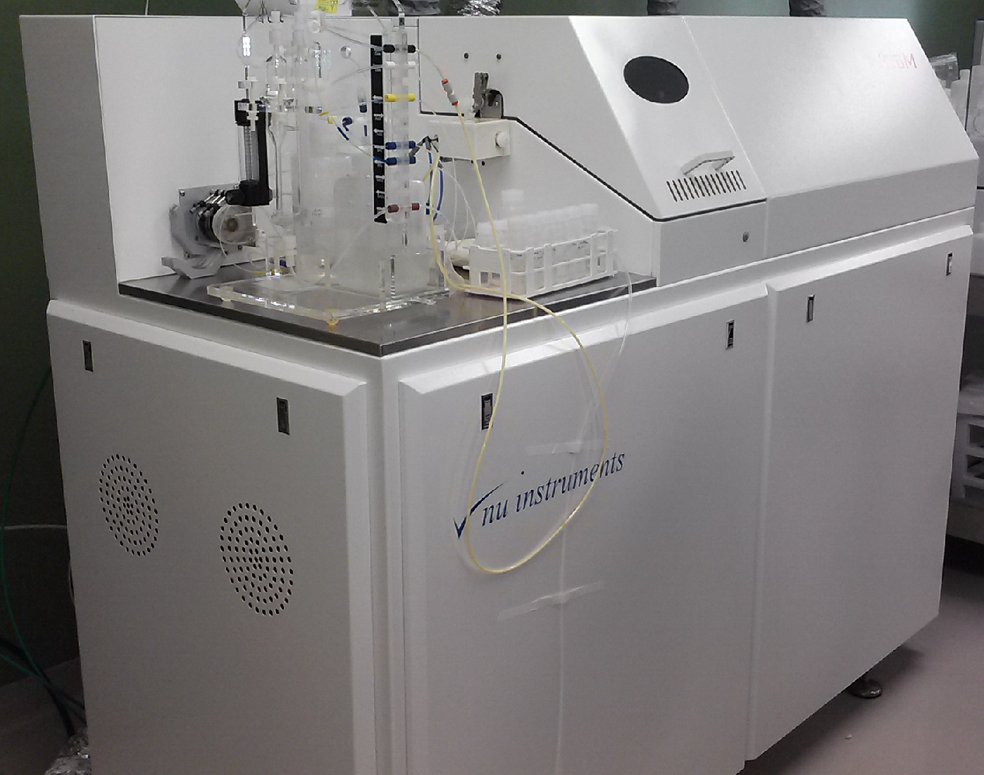
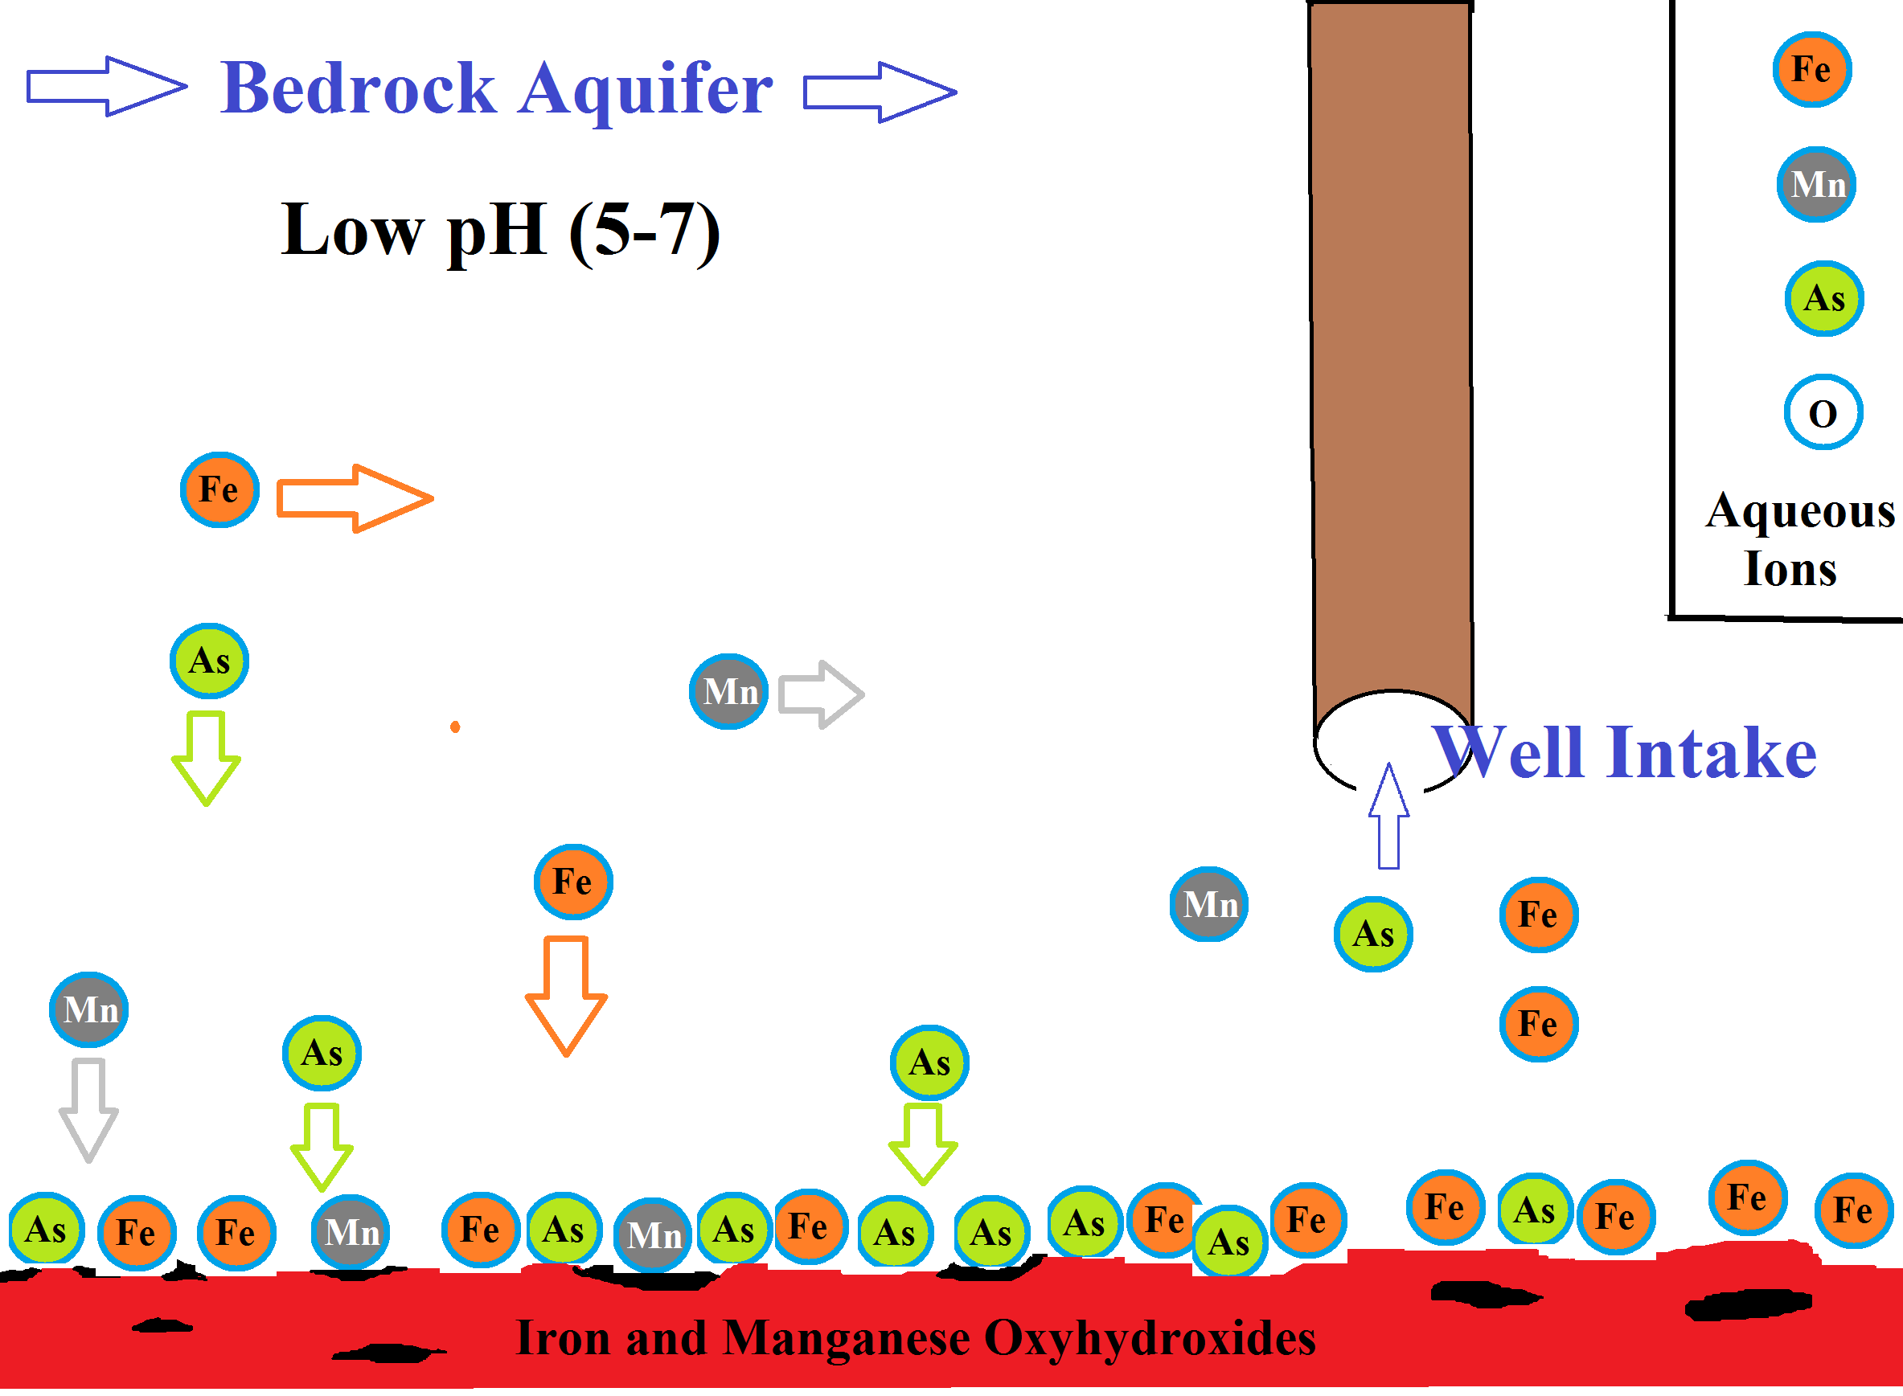
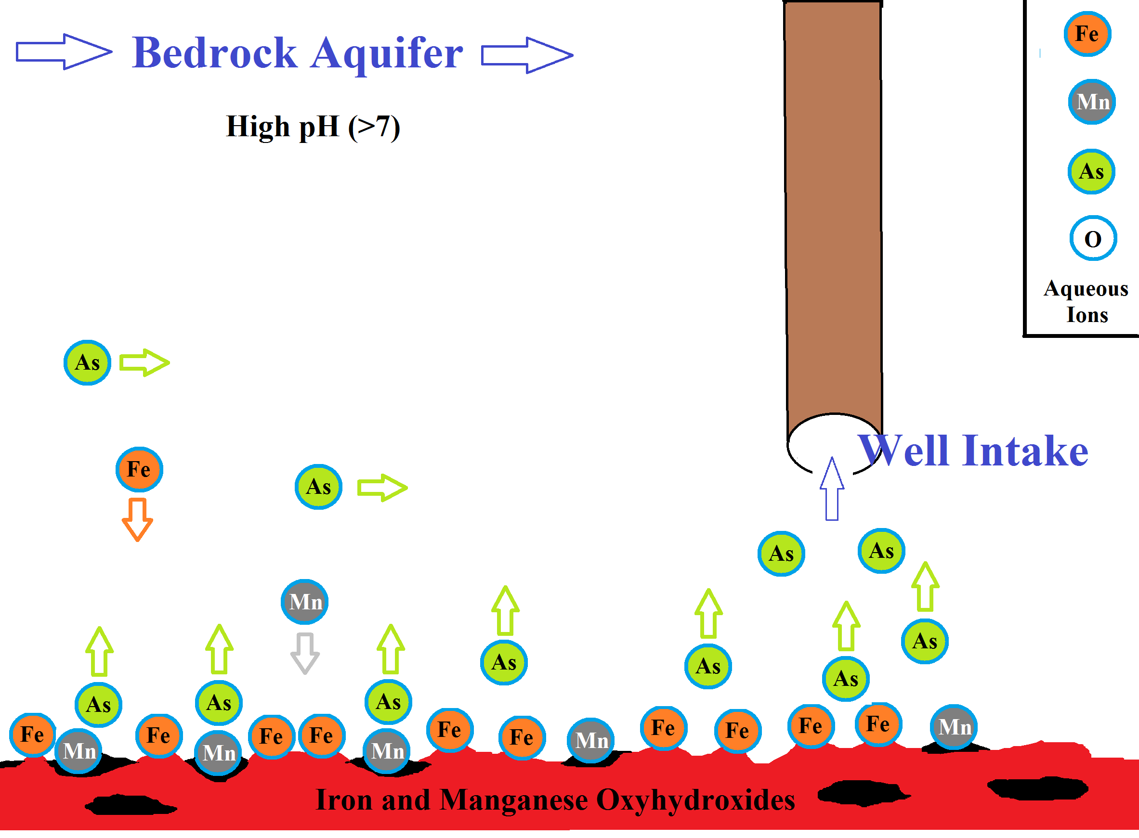

Investigating Linkages between Iron, Manganese and Arsenic Contents in Bedrock-hosted Groundwater Drinking Supplies in New Hampshire
Don Wason¹ Florencia Fahnestock² Julie Bryce² Joseph Ayotte³
¹Dover High School ²Department of Earth Sciences, University of New Hampshire ³USGS: Pembroke, NH
Objectives and Background: Unsafe levels of arsenic (As) (>10ug/L) and other metals in drinking water supplies are a potential problem faced by New Hampshire residents, particularly the ca. 400,000 people who rely on private bedrock-hosted wells (Ayotte and others, 2011). This study will examine the links between iron (Fe), manganese (Mn) and As in a suite of water samples originally collected by the USGS from bedrock-hosted wells throughout New Hampshire. A secondary objective of this work is to evaluate if these private water supplies also exceed Lifetime Health Advisory (LHA) concentrations for Mn (300ug/L).
This Study: Water samples (n=75) were chosen from the >500 water samples collected by the USGS in New Hampshire and previously analyzed by UNH geochemists for As concentration. Samples were chosen from every county (figure 4) reflecting a range in As concentration from very low (<1.0 ppb) to in some cases, very high (>100 ppb). When originally collected by the USGS, the dissolved oxygen, conductivity, temperature, pH, and rock unit for each sample was recorded. All 75 samples were analyzed for Fe and Mn using the Nu Instruments Inductively Coupled Plasma Mass Spectrometer (ICP-MS) at UNH (figure 5). An Indium internal standard as well as a multi-element external standard were used to normalize for instrument drift. USGS Round Robin reference materials were used to asses precision and accuracy
Geochemical Framework: Peters and Blum (2003) and Smedley and Kinniburgh (2002) suggest that dissolved As and Fe concentrations in bedrock aquifers is pH dependent (figure 1). They suggest waters with lower As concentrations (<25 ppb) have variable Fe concentrations and low pH (<7) (figure 2), and that waters with high concentrations of As (>50 ppb) have very low Fe concentrations (<1 ppb) and high pH (>7) (figure 3). Peters and Blum (2003) suggest that pH-dependent (and dissolved oxygen dependent) formation of Fe-oxyhydroxide with corresponding adsorption of Fe can explain the variation of As concentration in New Hampshire groundwater.
a
b
Figure 1. Calculated increase in As concentration as pH increases under closed-system conditions (Smedley and Kinniburgh, 2002).
Figure 4. Map of New Hampshire showing the location of the ten counties and the number of water samples from each county used in this study.( modified from http://geology.com/state-map/maps/new-hampshire-physical-map.gif)
c
d
Figure 5: Nu Instruments Inductively Coupled Plasma Mass Spectrometer (ICP-MS) at UNH
Figure 7. (a) Concentration of Mn vs. Fe (b) Concentration of As vs. Mn at pH = 5-7, (c) Concentration of As vs. Mn at pH = 7-8, and (d) Concentration of As vs. Mn at pH >8.
Manganese-Arsenic Links: Manganese concentrations appear to correlate roughly with Fe, although Mn occurs in much smaller concentrations (figure 7a). Arsenic-manganese concentration links in water samples studied here also do not reflect the simple systematic relationship with pH implied by the experimental data(Peters and Blum, 2003 and Smedley and Kinniburgh , 2002).
- At low pH (<7) Mn concentrations are highly variable (ranging from 0 to 800 ppb) and have no
apparent links with As concentration (figure 7b).
- For pH between 7 and 8 (figure 7c), Mn concentrations, with one exception of [Mn]=4386 ppb)
were generally less than 200 ppb.
- For pH > 8 (figure 7d), both As and Mn concentrations were much lower; all but
one sample had Mn concentrations much less than 200 ppb.
Figure 2. Cartoon depicting arsenic behavior around Fe and Mn in bedrock aquifers at low pH (5-7). As Fe and Mn-oxyhydroxides form and precipitate, As is adsorbed onto the charged surfaces leaving low As concentrations in solution.
Conclusions: This study suggests that multiple factors control links between As, Fe and Mn. While pH clearly influences both Fe and Mn concentrations it seems to have almost no influence on As concentrations, suggesting that groundwater matrices may be more complicated than those studied experimentally. Future studies should consider the role of mixing of waters as well as other aqueous species, including phosphate, sulfate, and even nitrate in the geochemical behavior of As in New Hampshire groundwater.
Elevated concentrations of Mn and Fe as well as As may emerge as water quality problems in New Hampshire. While only 7% (n=4) exceeded the LHA for manganese (300 ppb), almost 40% (n=29) exceeded the Secondary Maximum Contaminant Level (SMCL) for Mn (50 ppb), and 29 others exceeded the SMCL for Fe (300 ppb).
a
b
Figure 3. Bedrock aquifer at high pH (>7). Arsenic less preferentially adsorbs to Fe and Mn-oxyhydroxides (shown experimentally to desorb, resulting in elevated As groundwater concentrations).
References Cited:
Ayotte, J.D., Cahillane, M., Hayes, L. and Robinson, K.W., 2011, Estimated Probability of Arsenic in
Groundwater from Bedrock Aquifers in New Hampshire: U.S. Geological Survey Scientific
Investigations Report 2012-5156, 25p.
Montgomery, D.L., Ayotte, J.D., Caroll, P.R., and Hamlin, P., 2003, Arsenic Concentrations in Private
Bedrock in Southeastern New Hampshire: U.S. Geological Survey Fact Sheet FS-051—03, 8p.
Peters, S.C., and Blum, J.D., 2003, The Source and Transport of Arsenic in a Bedrock Aquifer,
New Hampshire, USA, Applied Geochemistry, v.18, p. 1773-1787.
Peters, S.C., Blum, J.D., Karagas, M.R., Chamberlain, C.P., and Sjostrom, D.J., 2006, Sources and
Exposure of the New Hampshire Population to Arsenic in Public and Private Drinking Water
Supplies: Chemical Geology, v.228, p.72-84.
Smedley, P.L., and Kinniburgh, D.G., 2002, A Review of the Source, Behaviour and Distribution of
Arsenic in Natural Waters, Applied Geochemistry, v.17, p. 517-568.
c
d
Figure 6. (a) Concentration of As vs. pH (b) Concentration of As vs.Fe at pH = 5-7, (c) Concentration of As vs. Fe at pH = 7-8, and (d) Concentration of As vs. Fe at pH >8.
Iron-Arsenic Links: Arsenic-iron concentration links in water samples studied here do not reflect the simple systematic relationship with pH suggested by experimental data (Peters and Blum, 2003 and Smedley and Kinniburgh , 2002).
- Of the 16 samples with low pH (figure 6b), most had As concentrations less than 25 ppb, but
4 had concentrations greater than 25 ppb, one of which contained 77.3 ppb.
- Iron concentrations certainly could be described as variable with 12 of the 16 samples having Fe
abundances less than 2,000 ppb, the other 4 ranged between 4.7 and 12 ppb.
- For pH between 7 and 8 (figure 6c), Fe concentrations were quite variable but fewer than 3 of
the 38 water samples had As concentrations greater than 50 ppb.
- For pH > 8 (figure 6d), both As and Fe concentrations were much lower, all but one sample
had As concentrations less than 25 ppb and most had Fe concentrations less than 500 ppb.
Acknowledgments: Thanks goes to Stephen Hale and the Leitzel Center at UNH for making this research experience a reality. This research was supported with funding from the National Science Foundation’s grant to NH EPSCoR (ENG-1101245).

