Slide 1




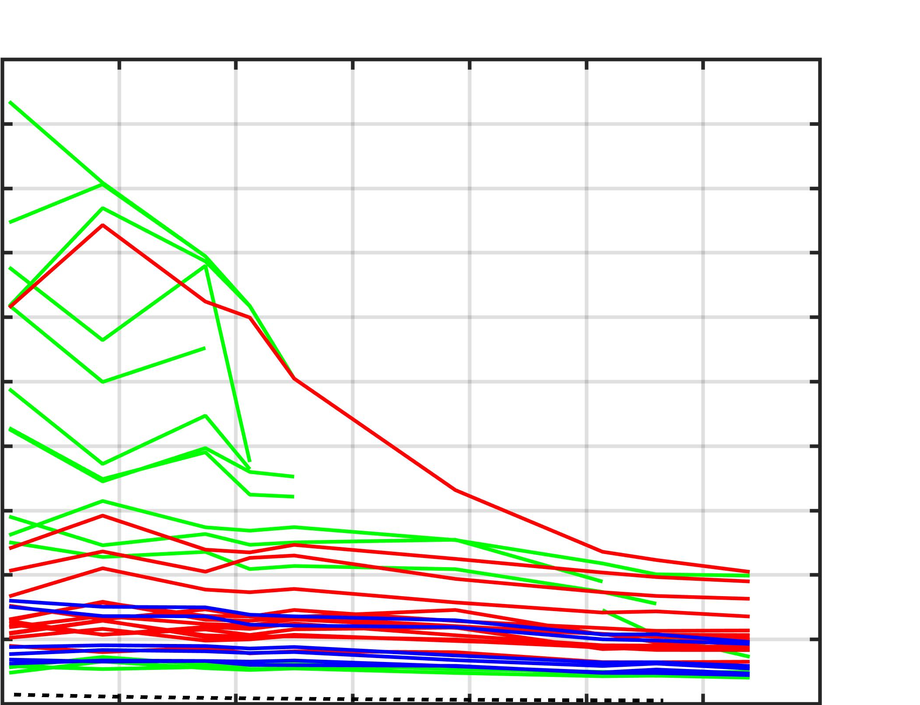
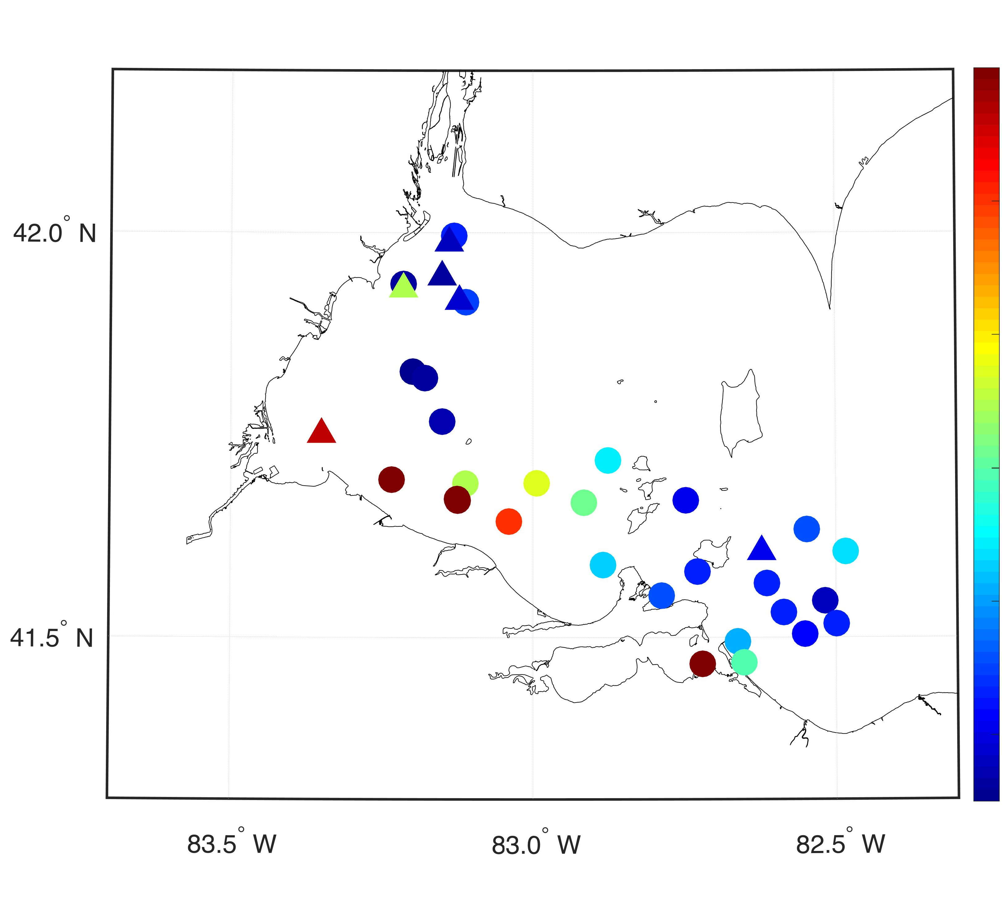
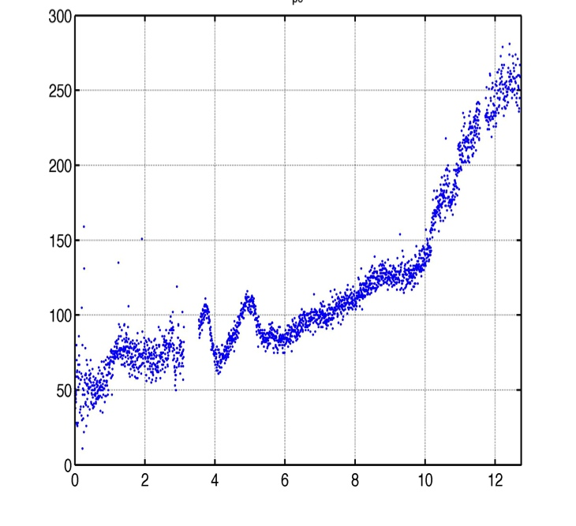
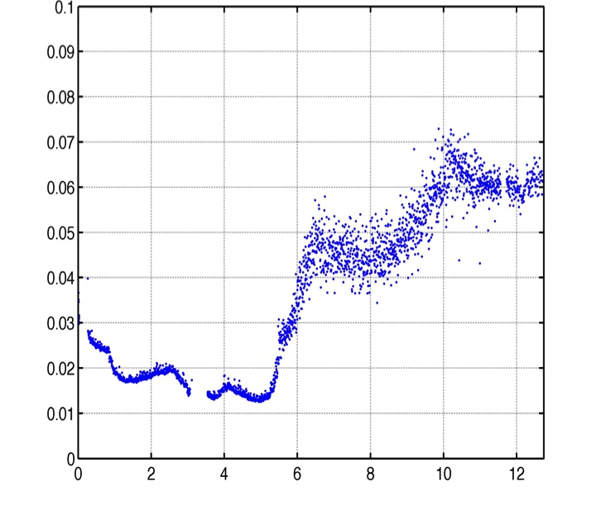
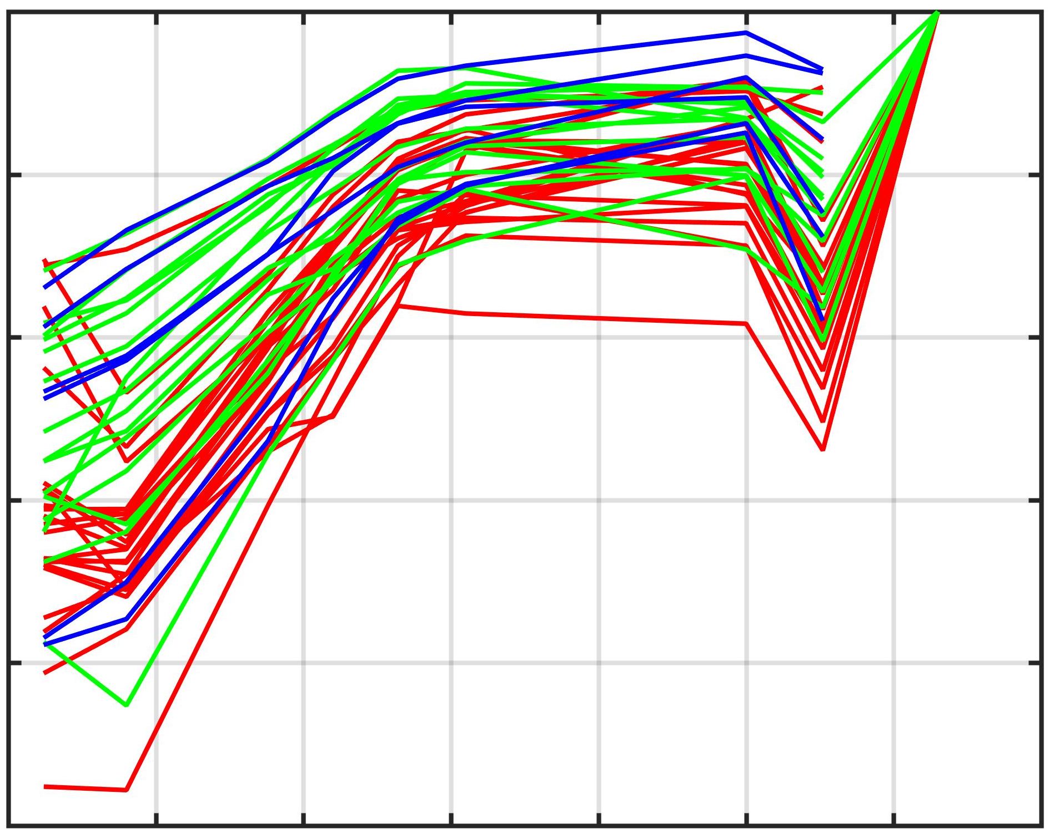
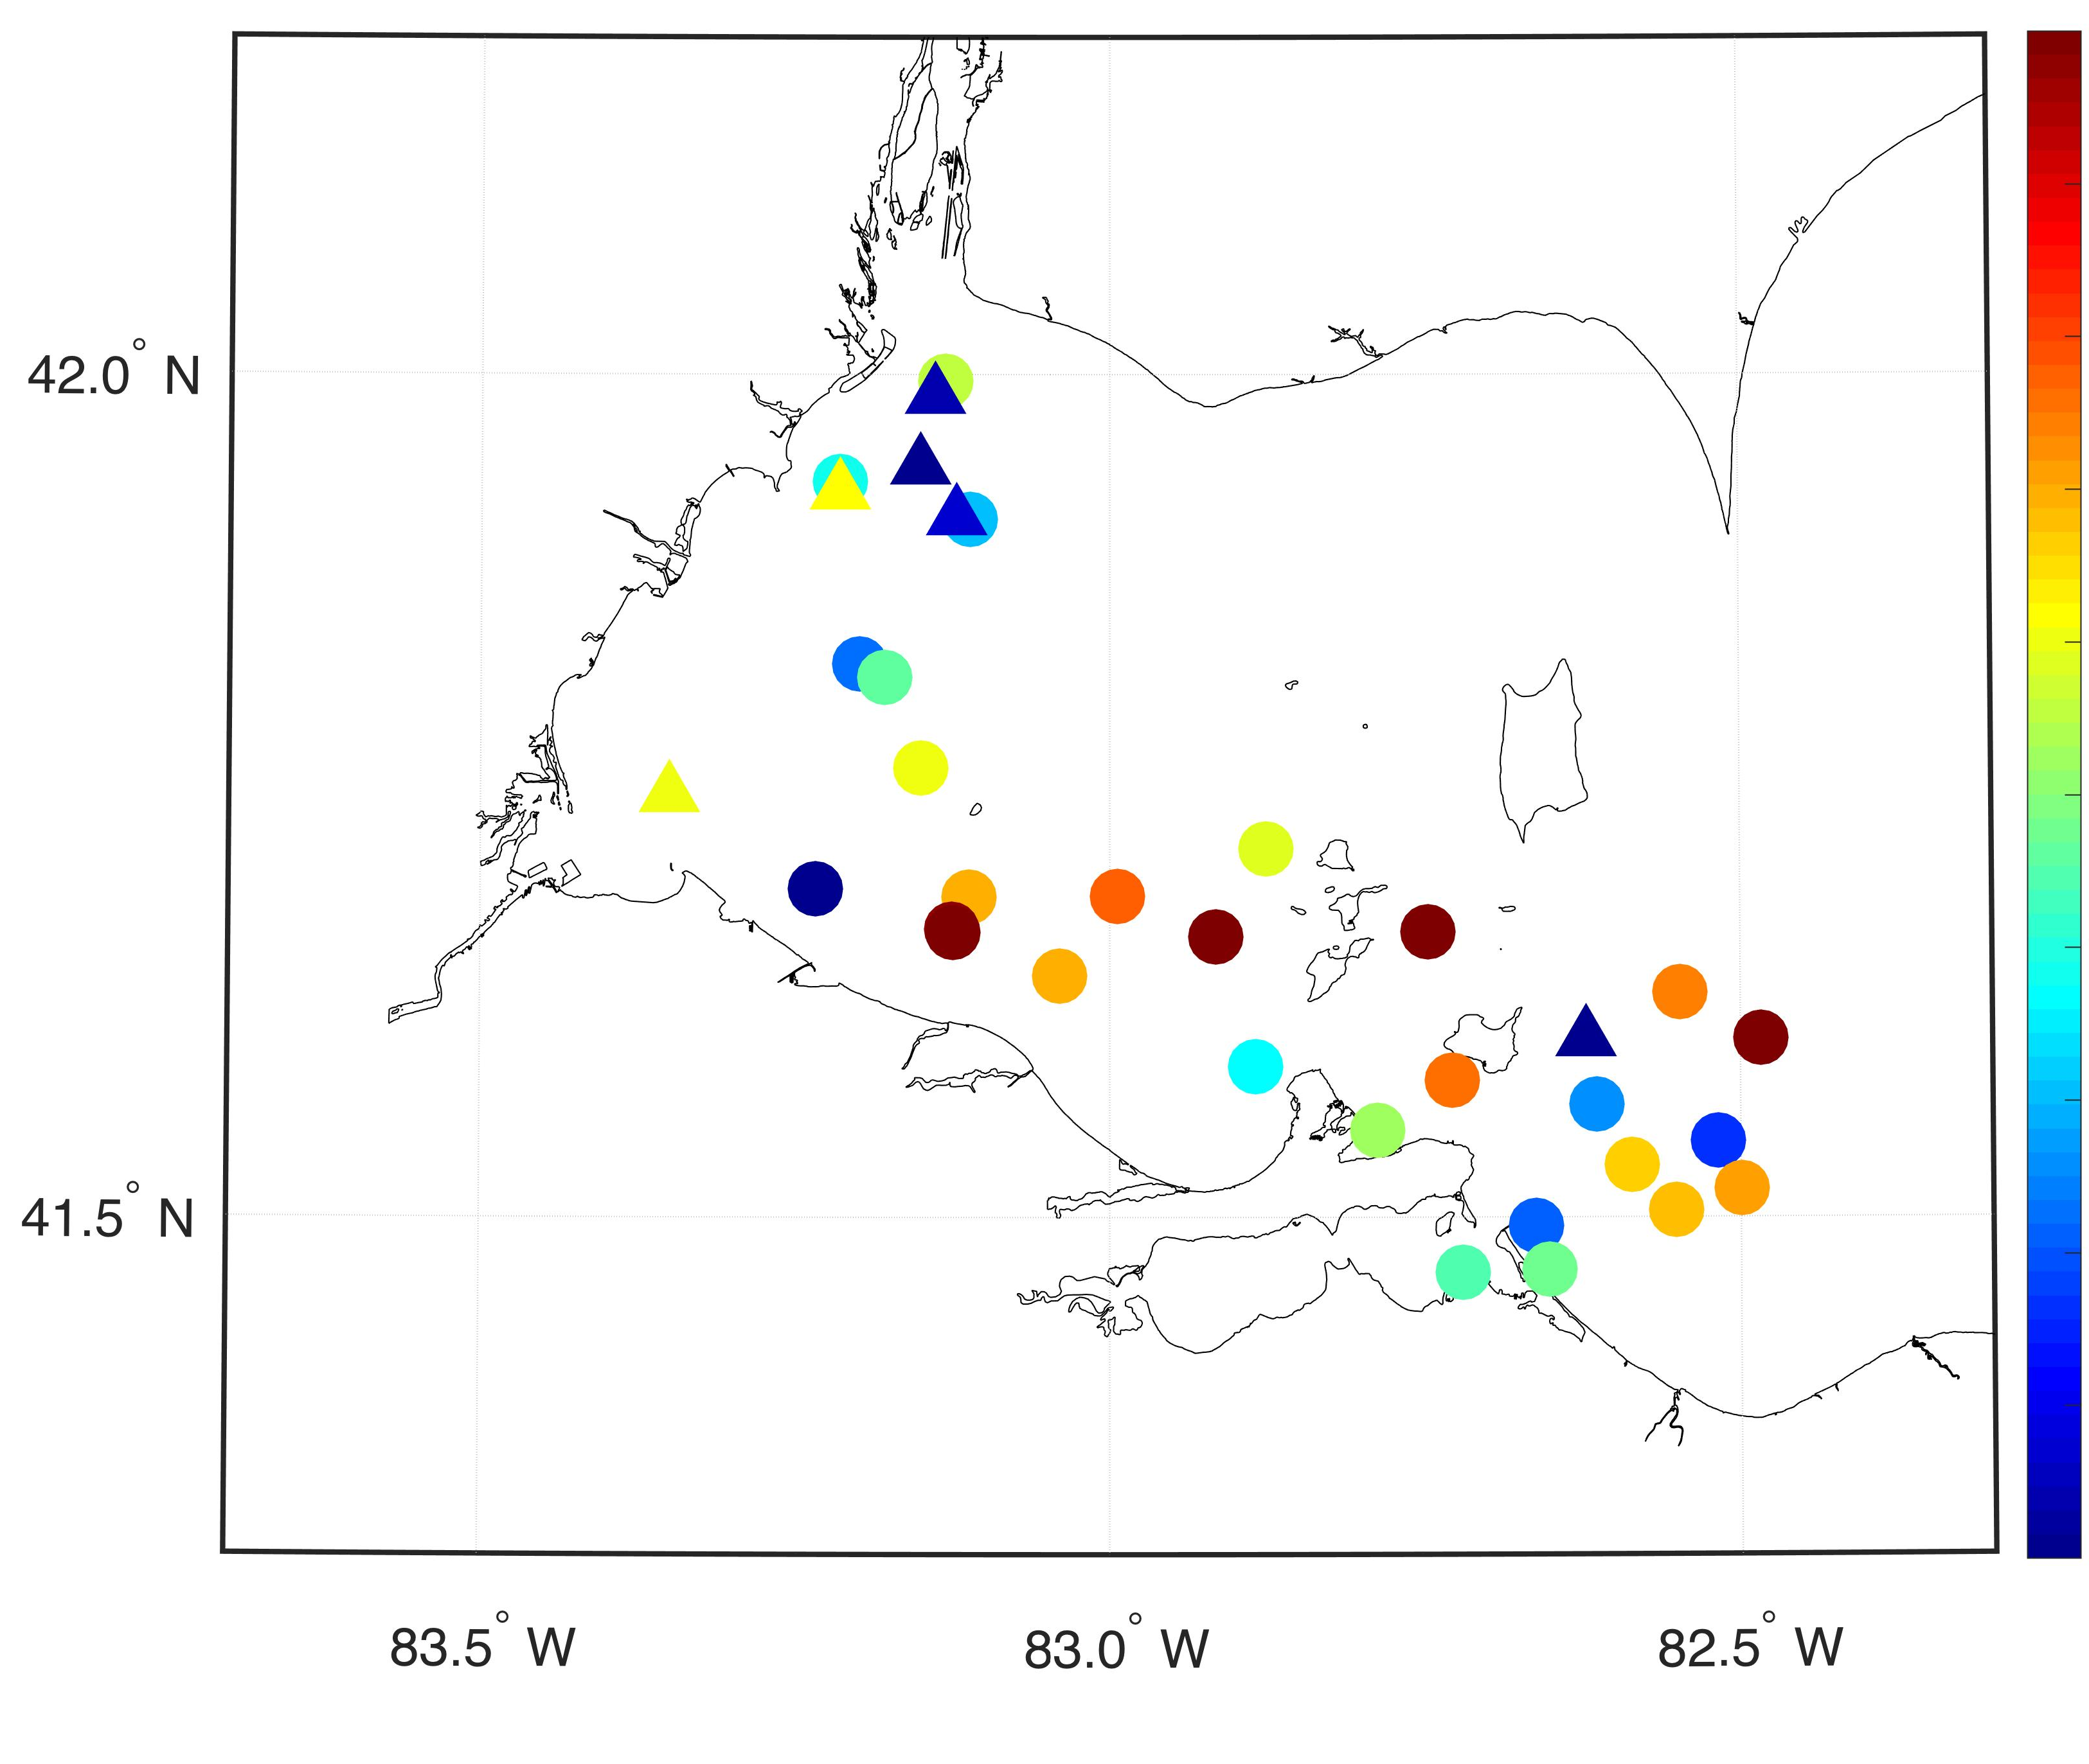
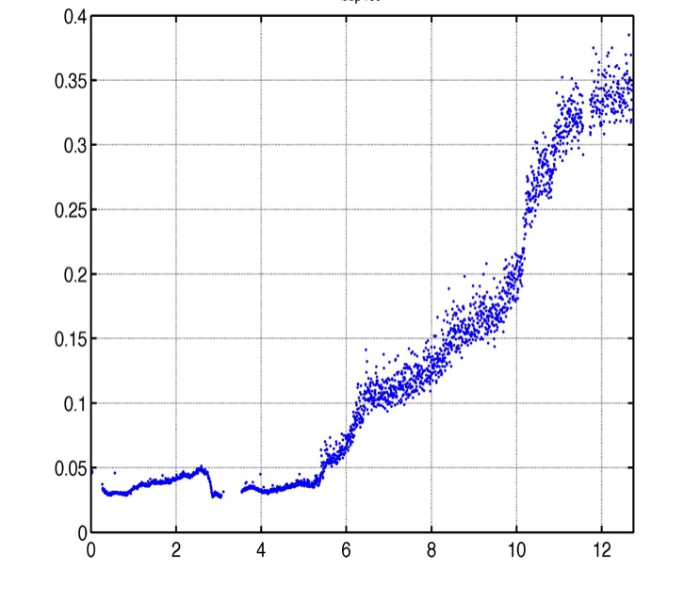
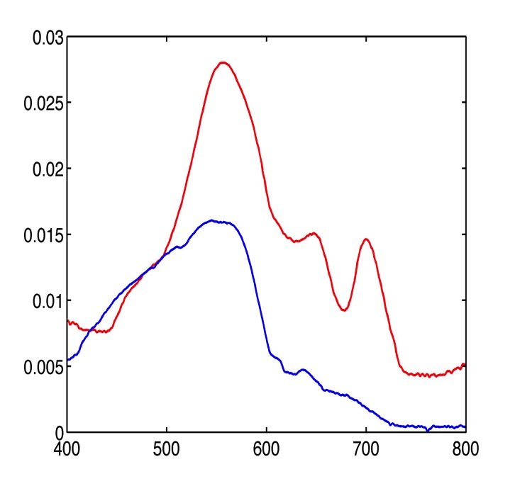
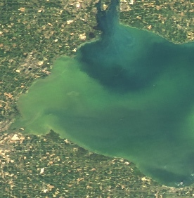
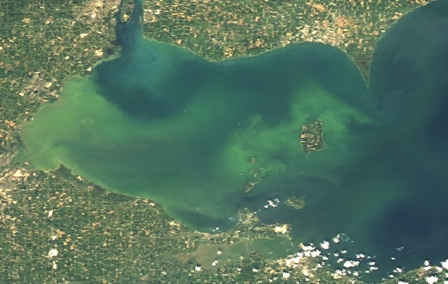
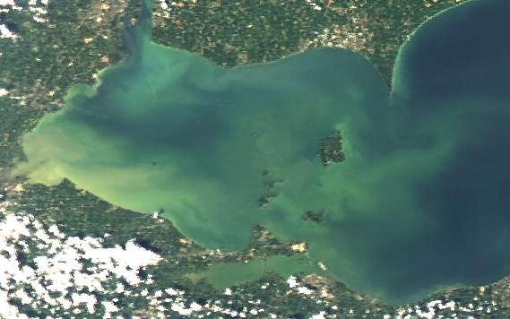
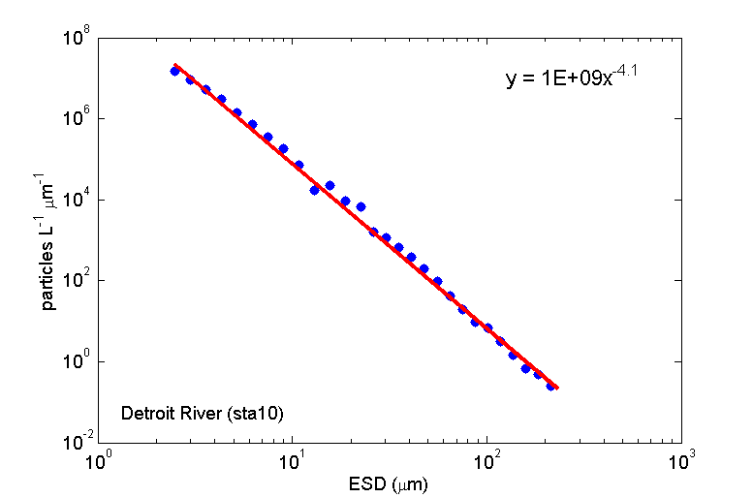
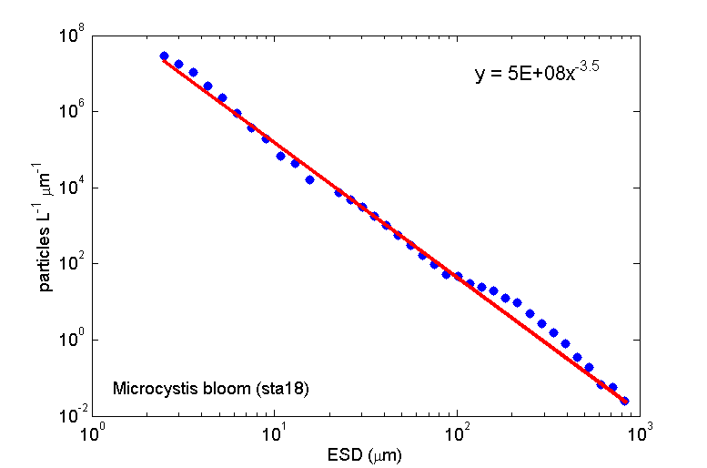
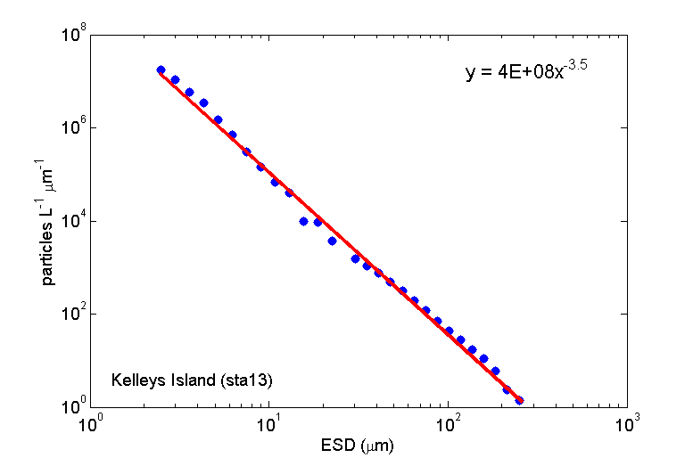
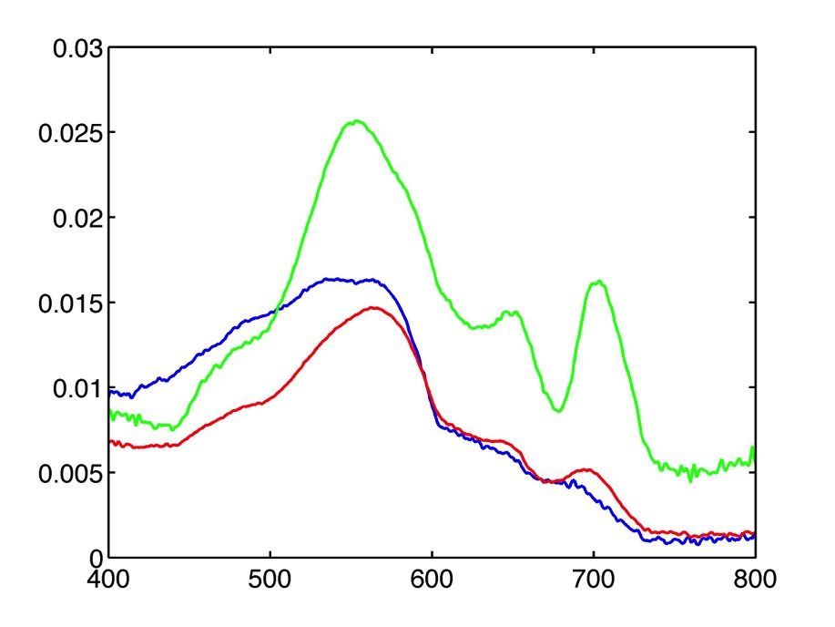
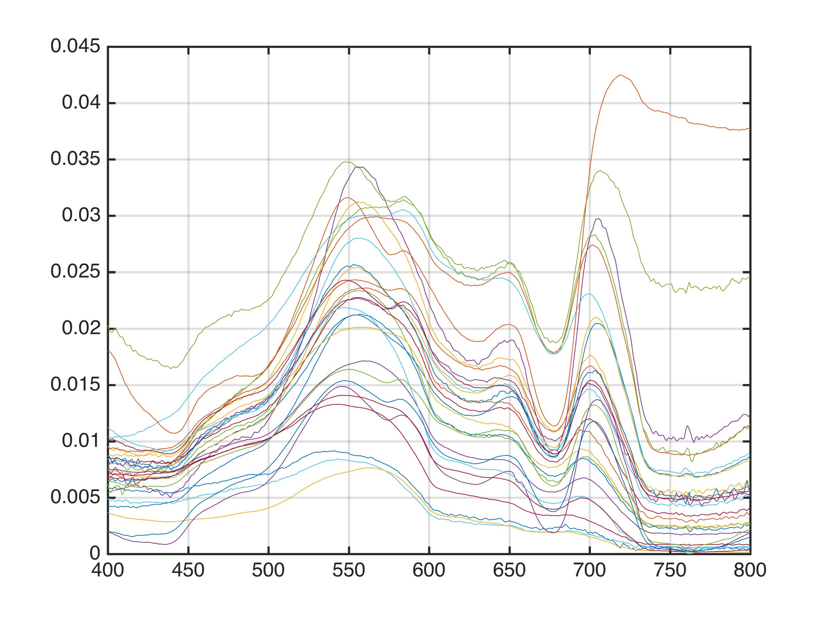
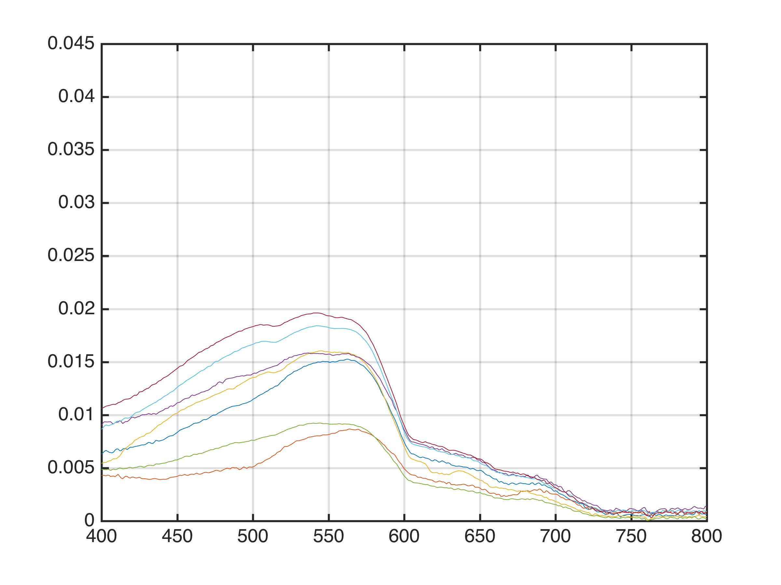
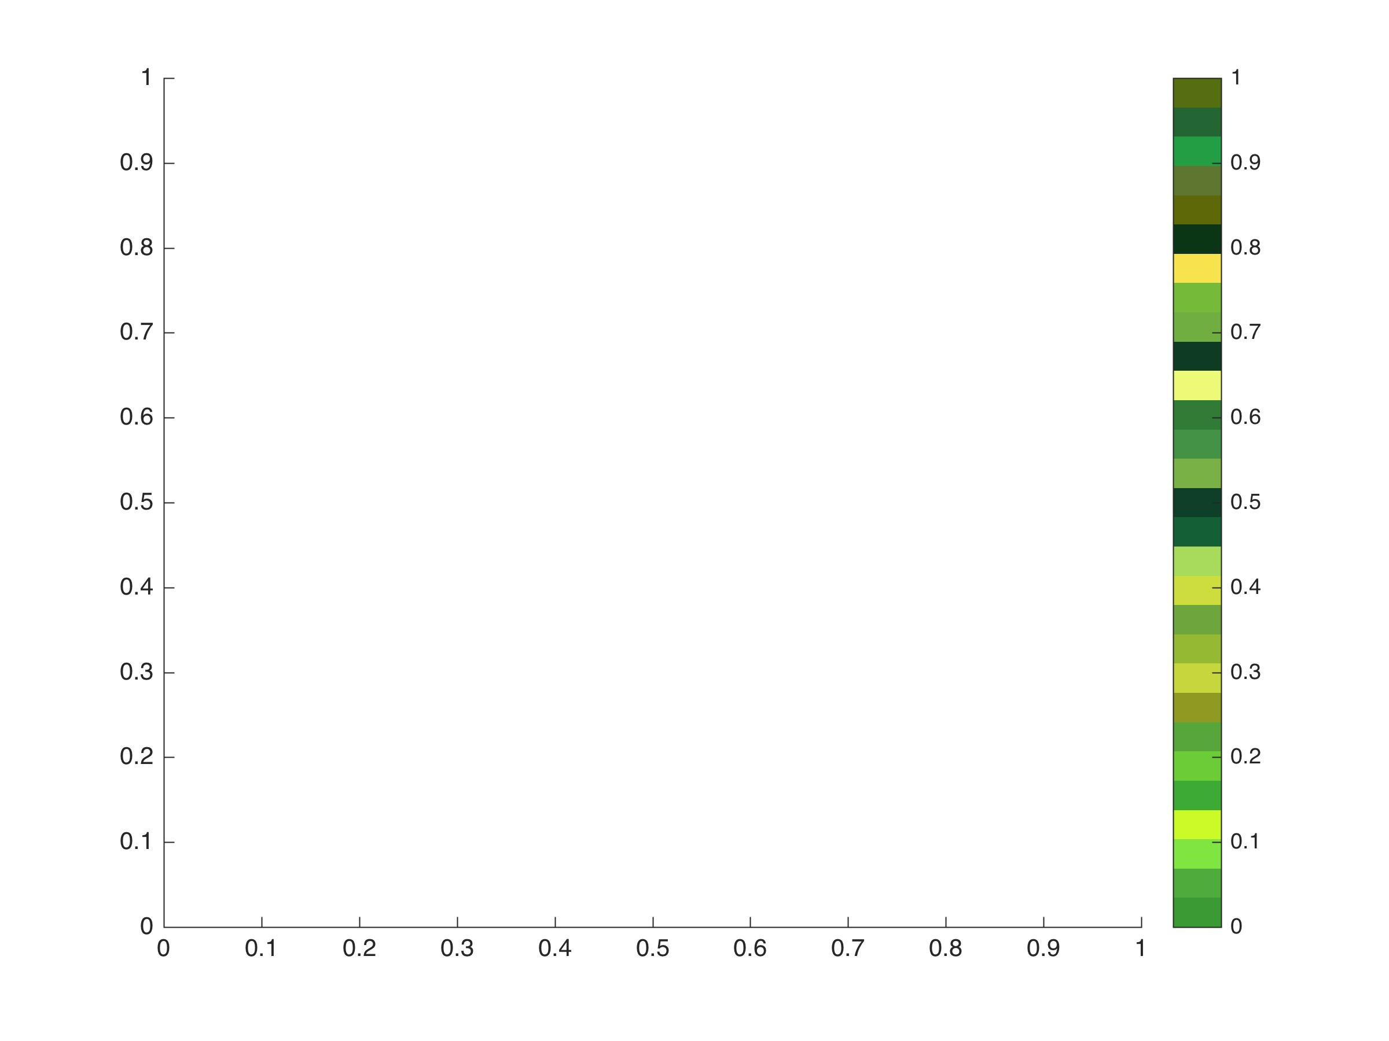
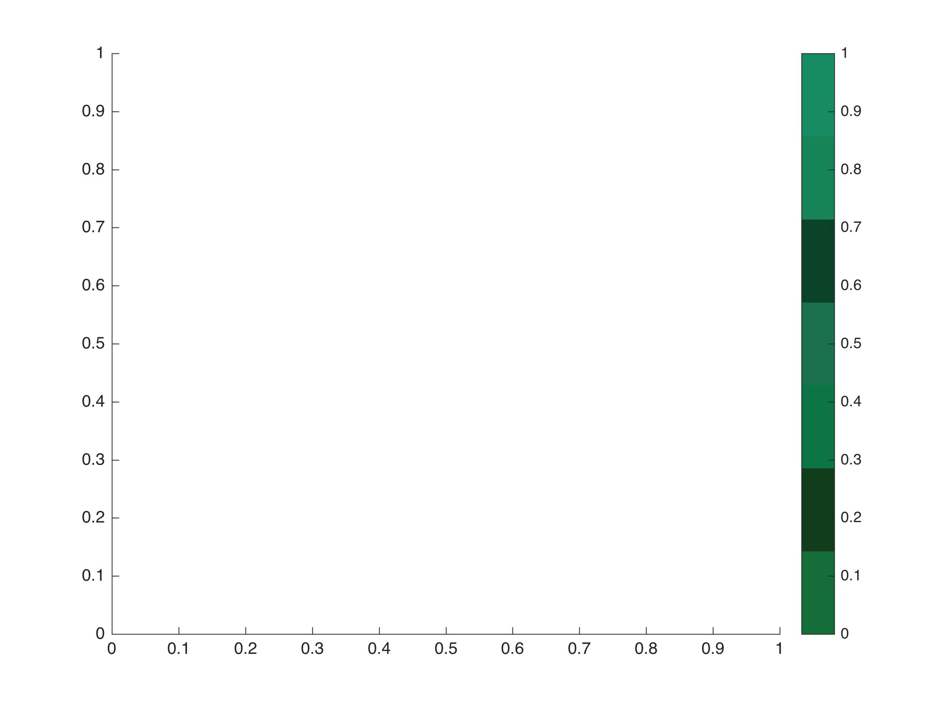
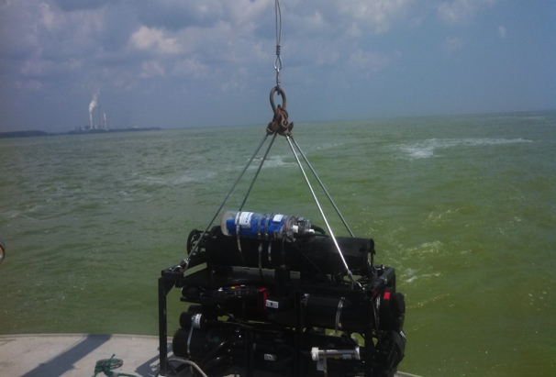
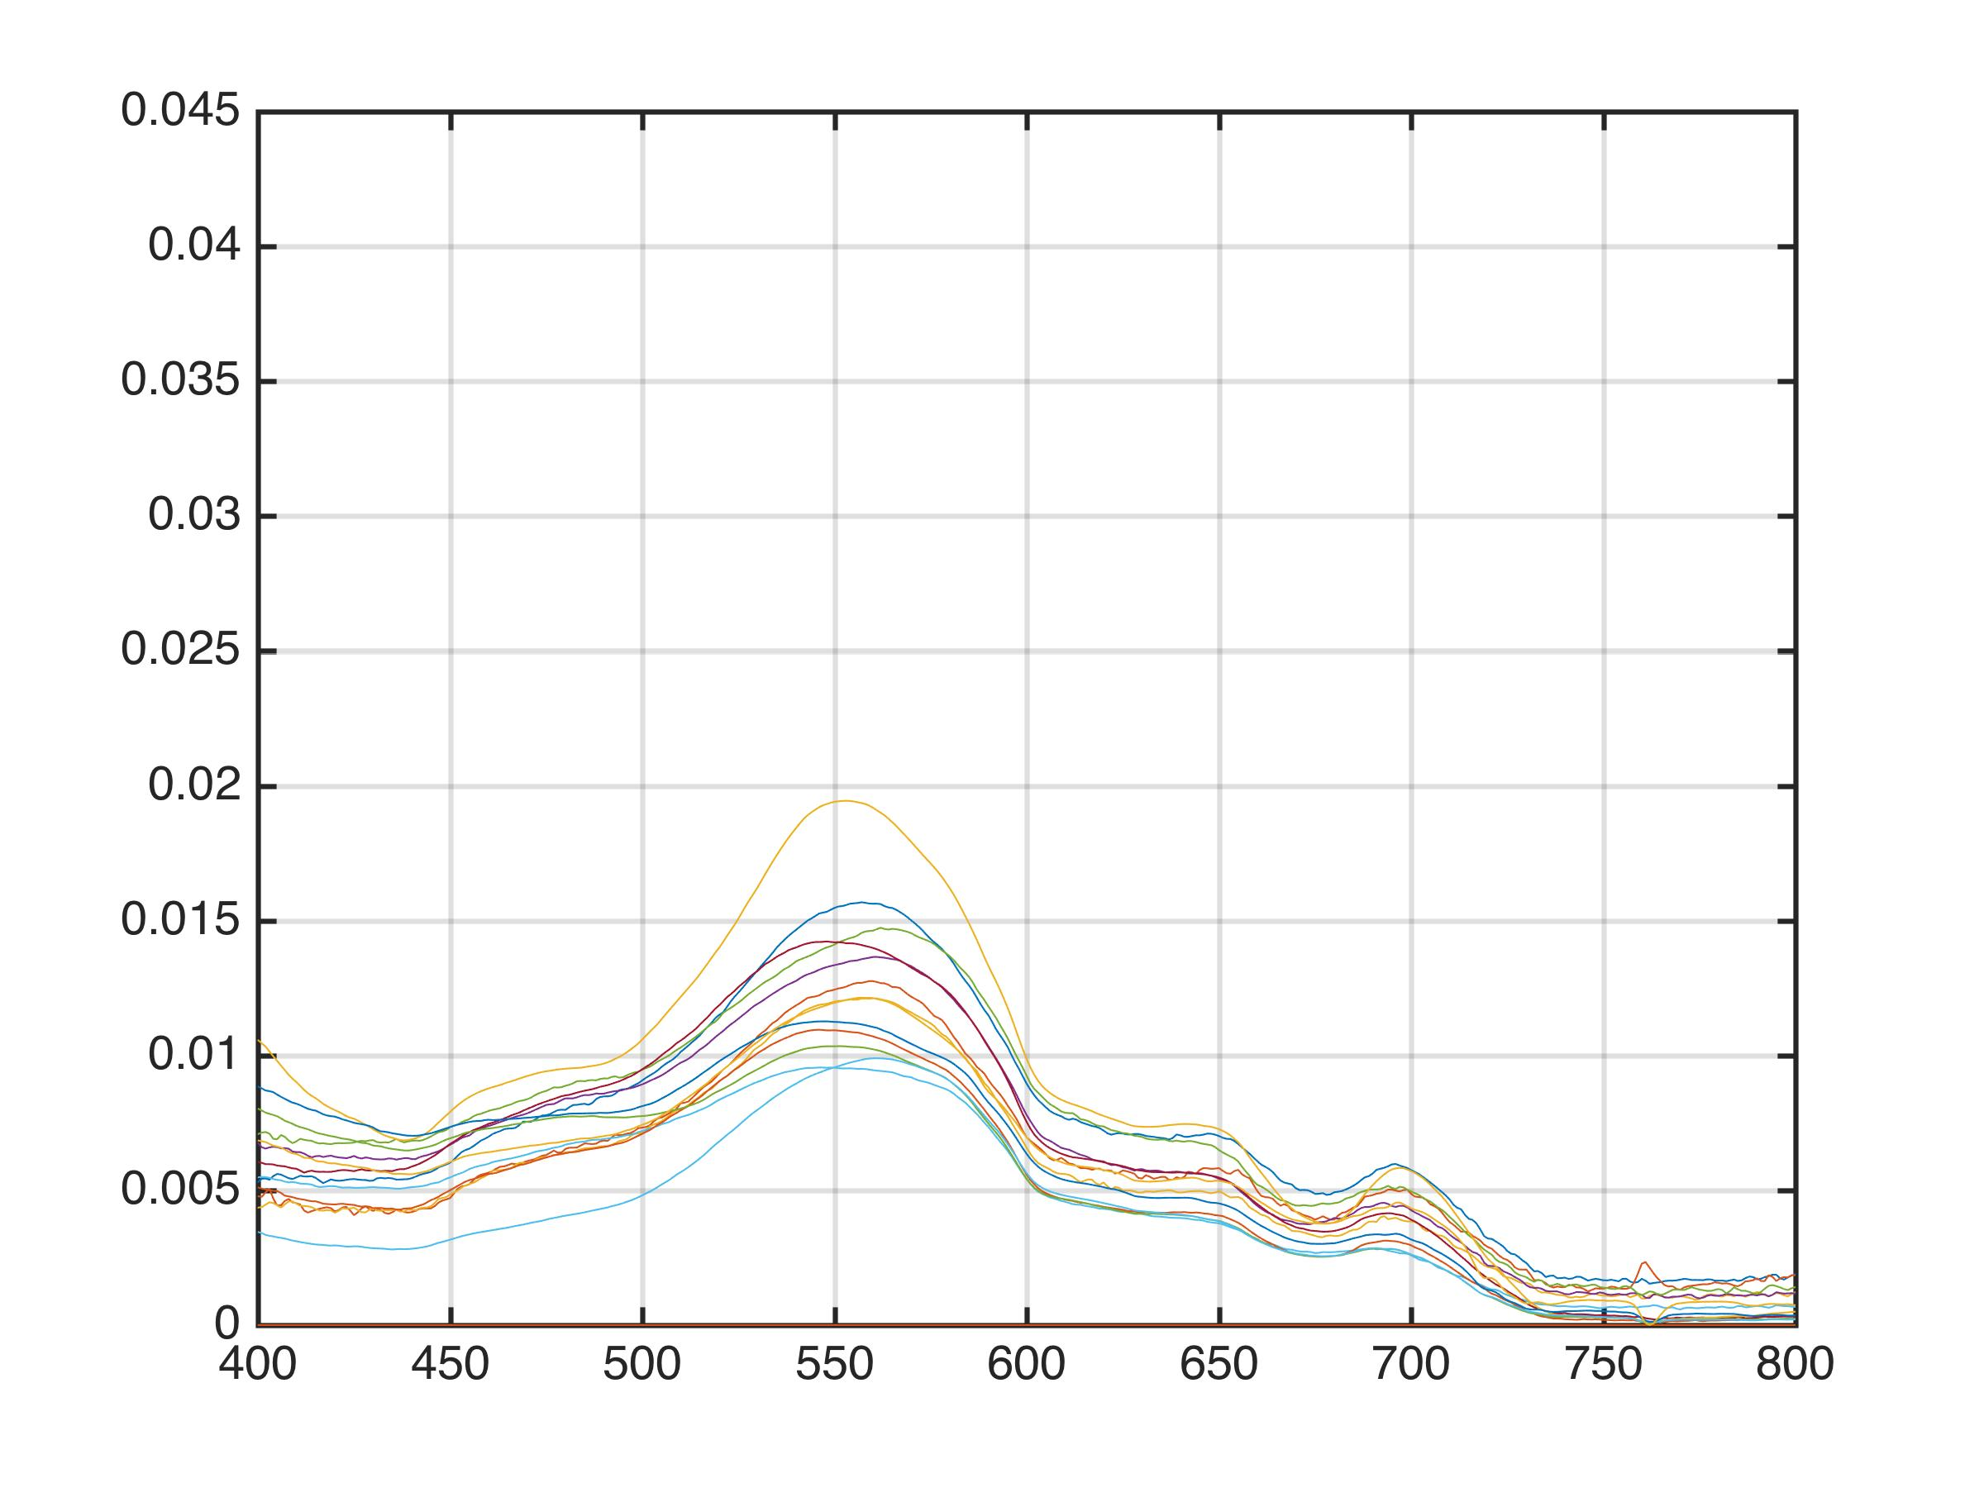
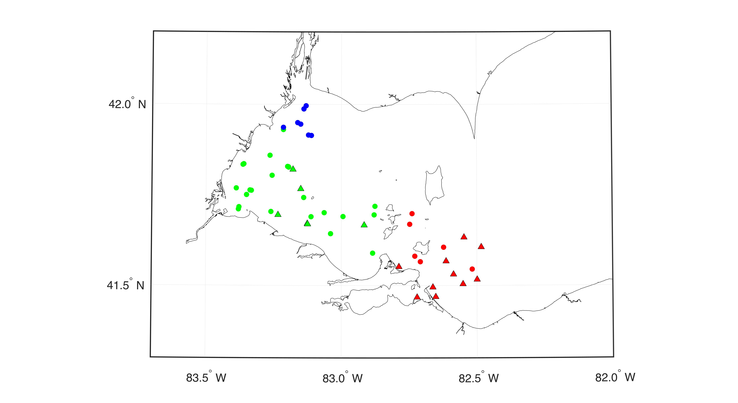
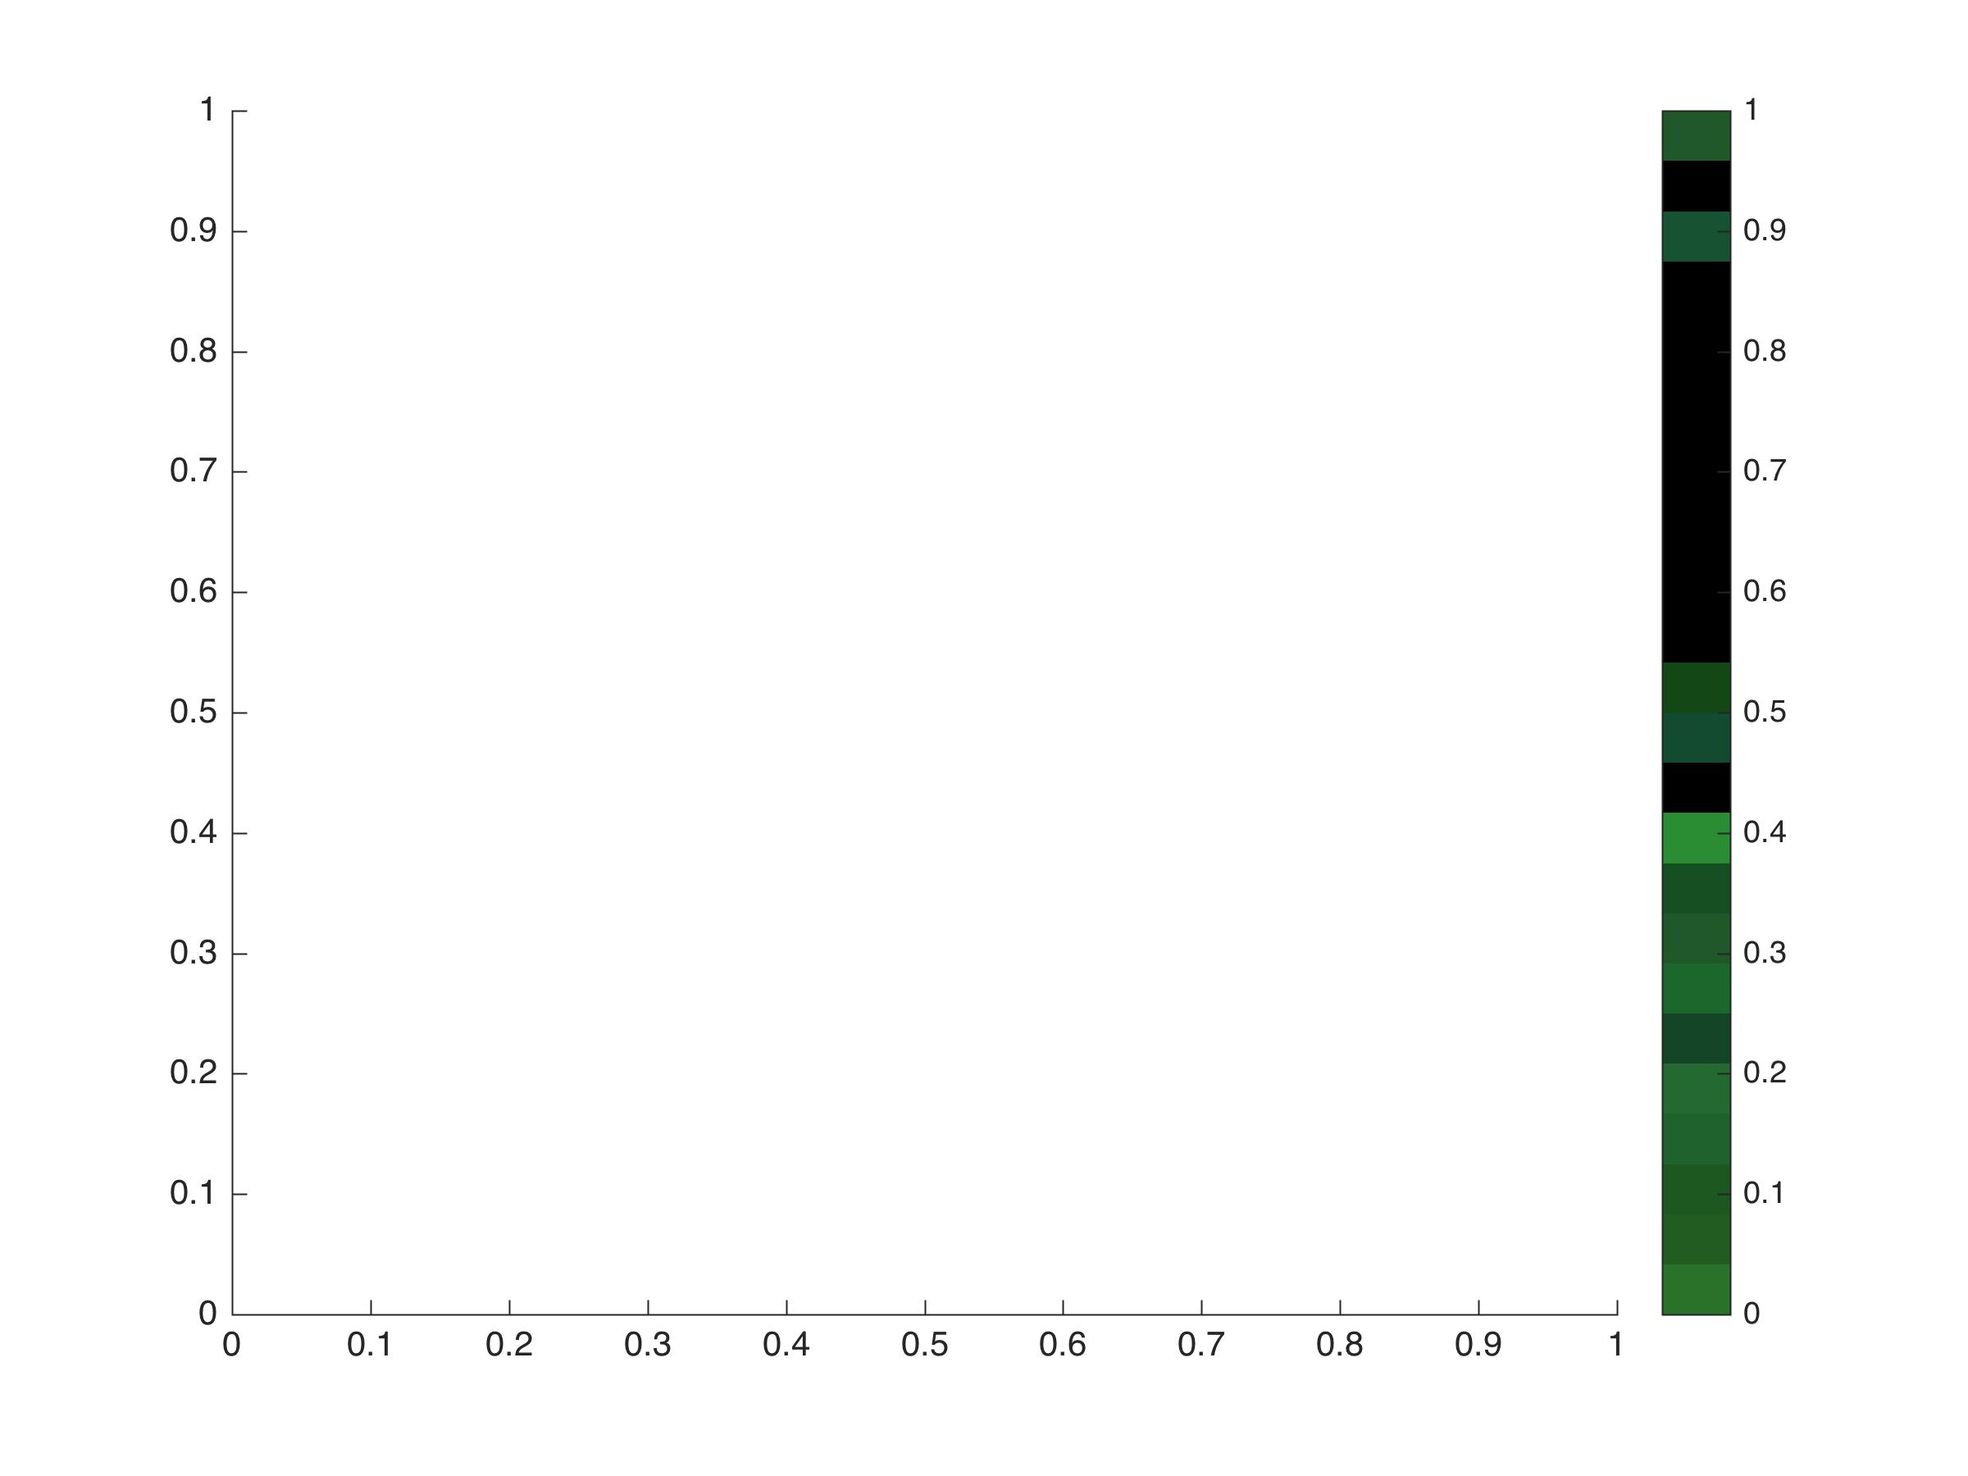
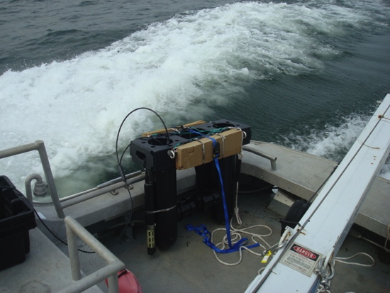
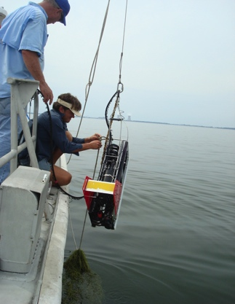
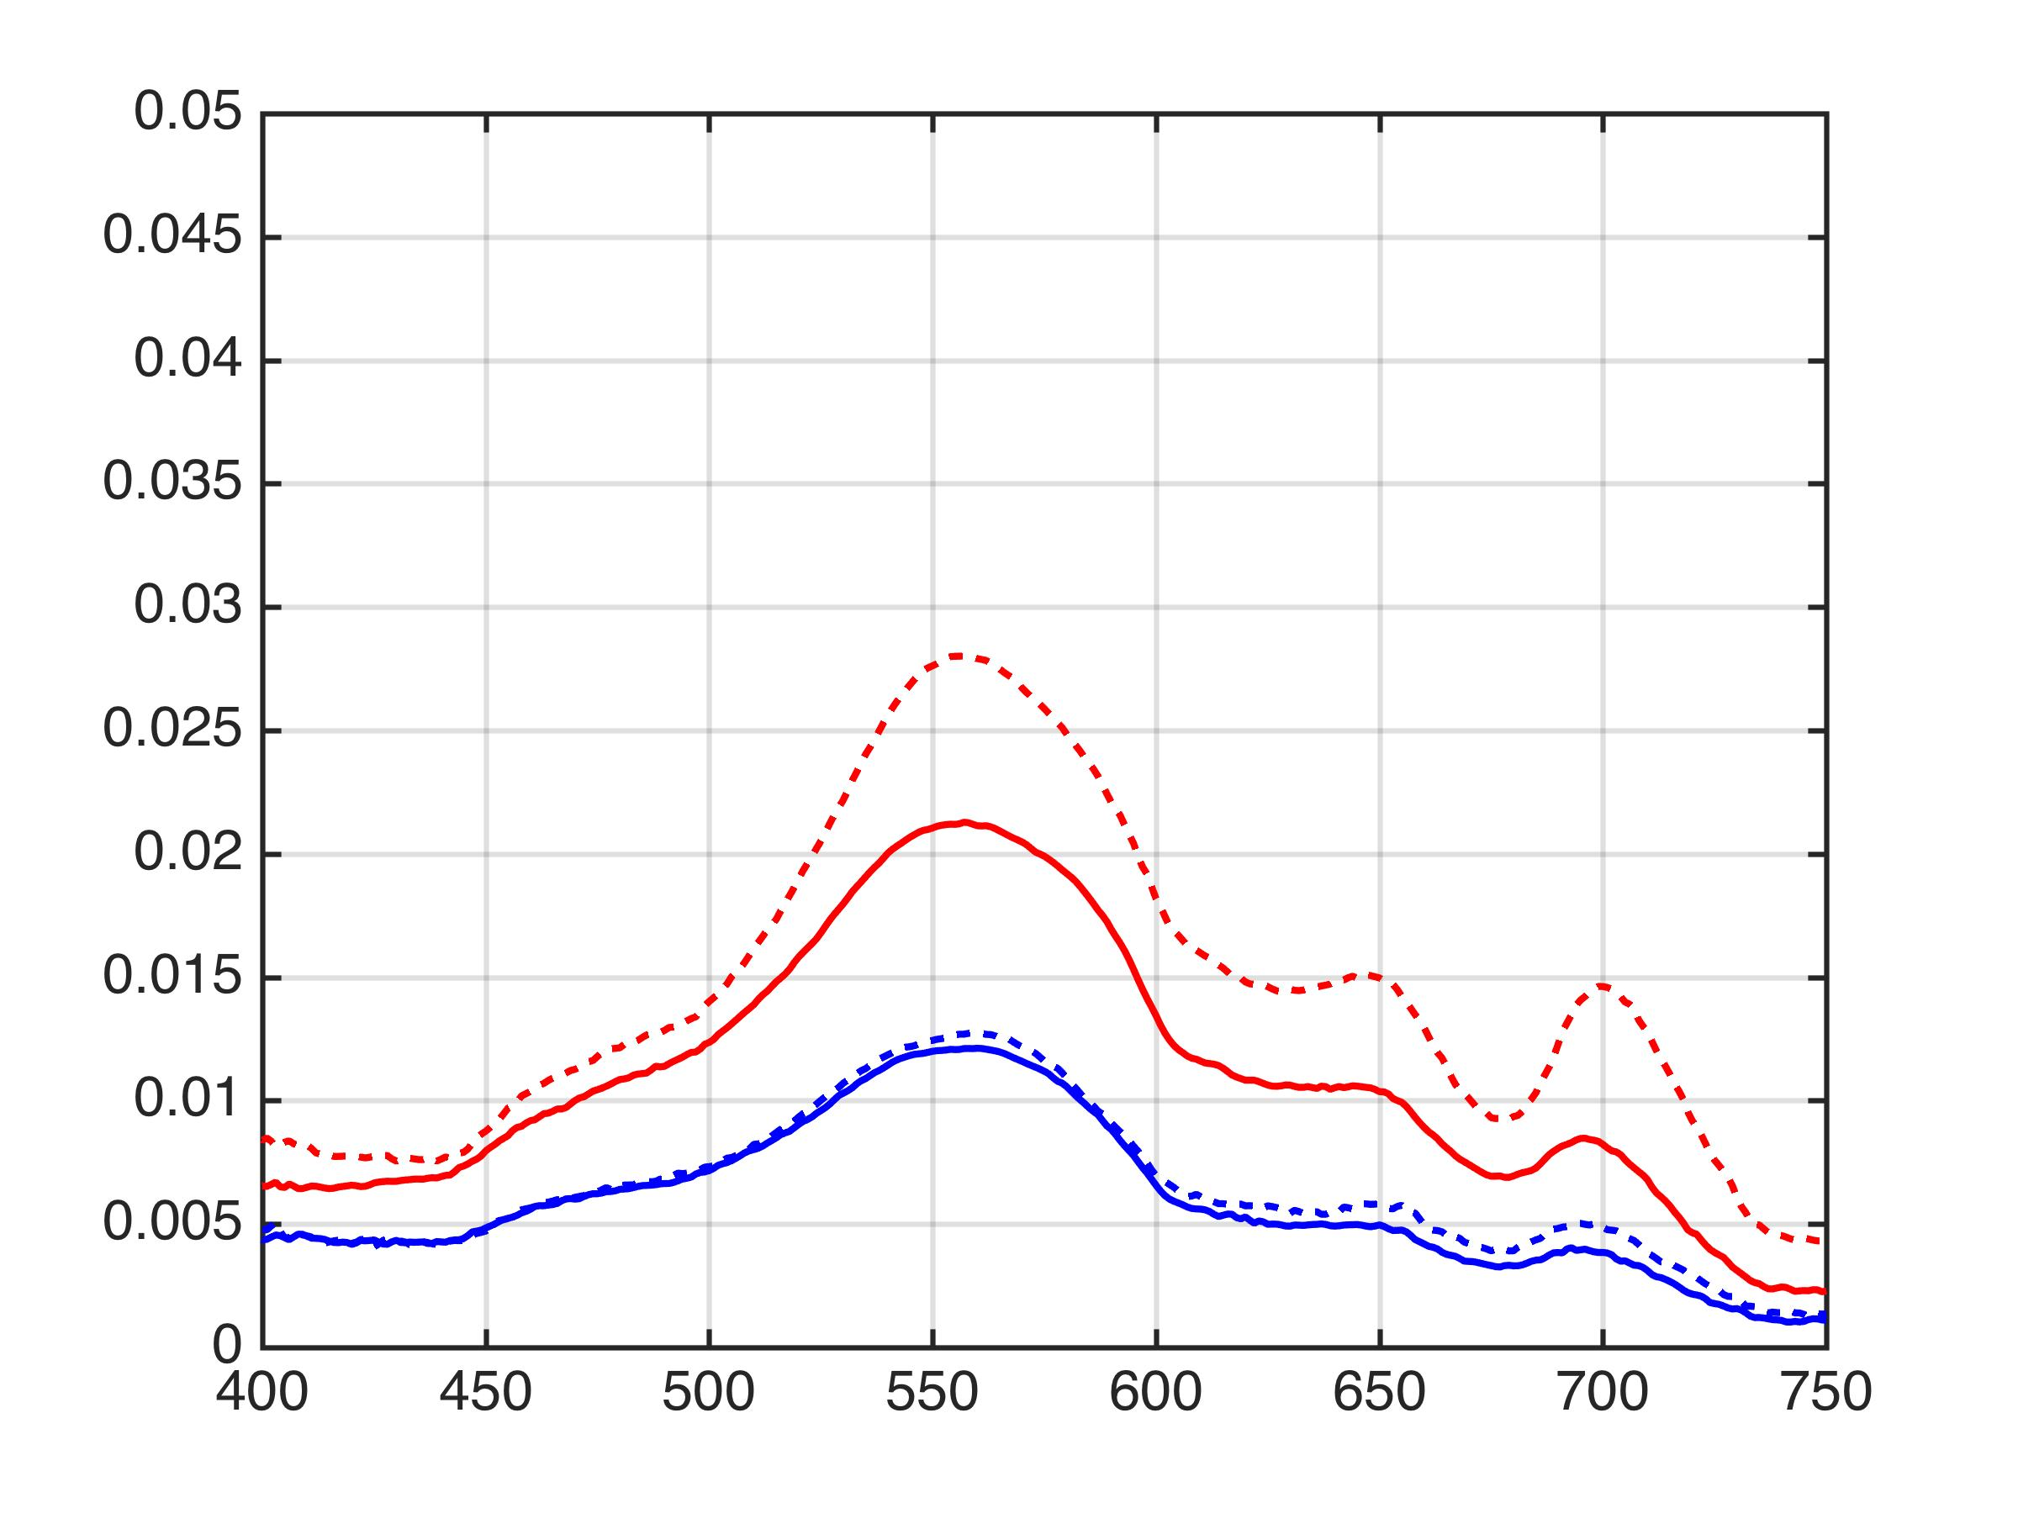
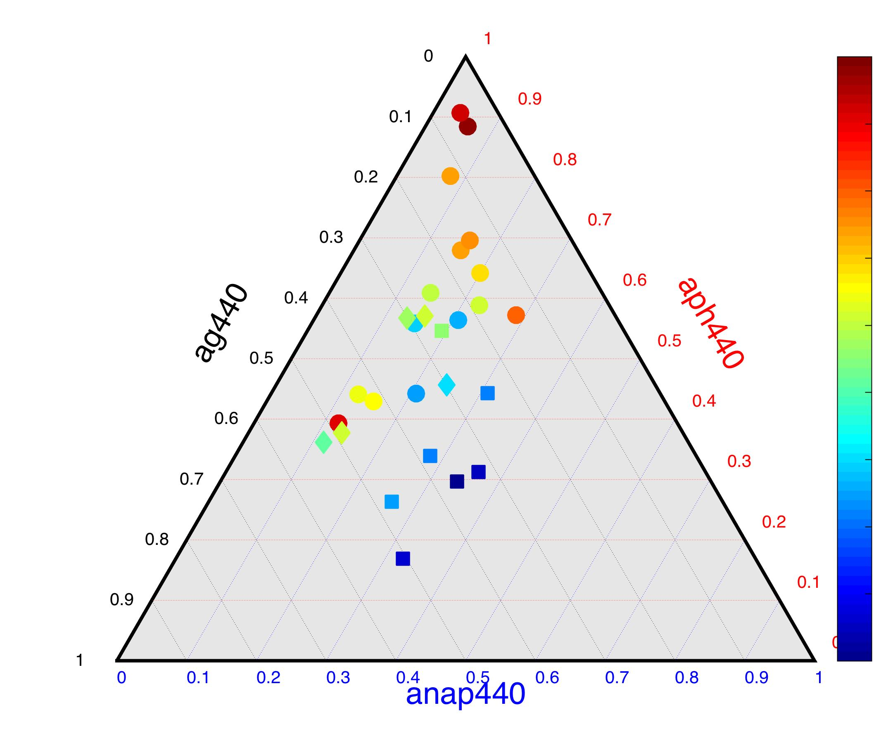
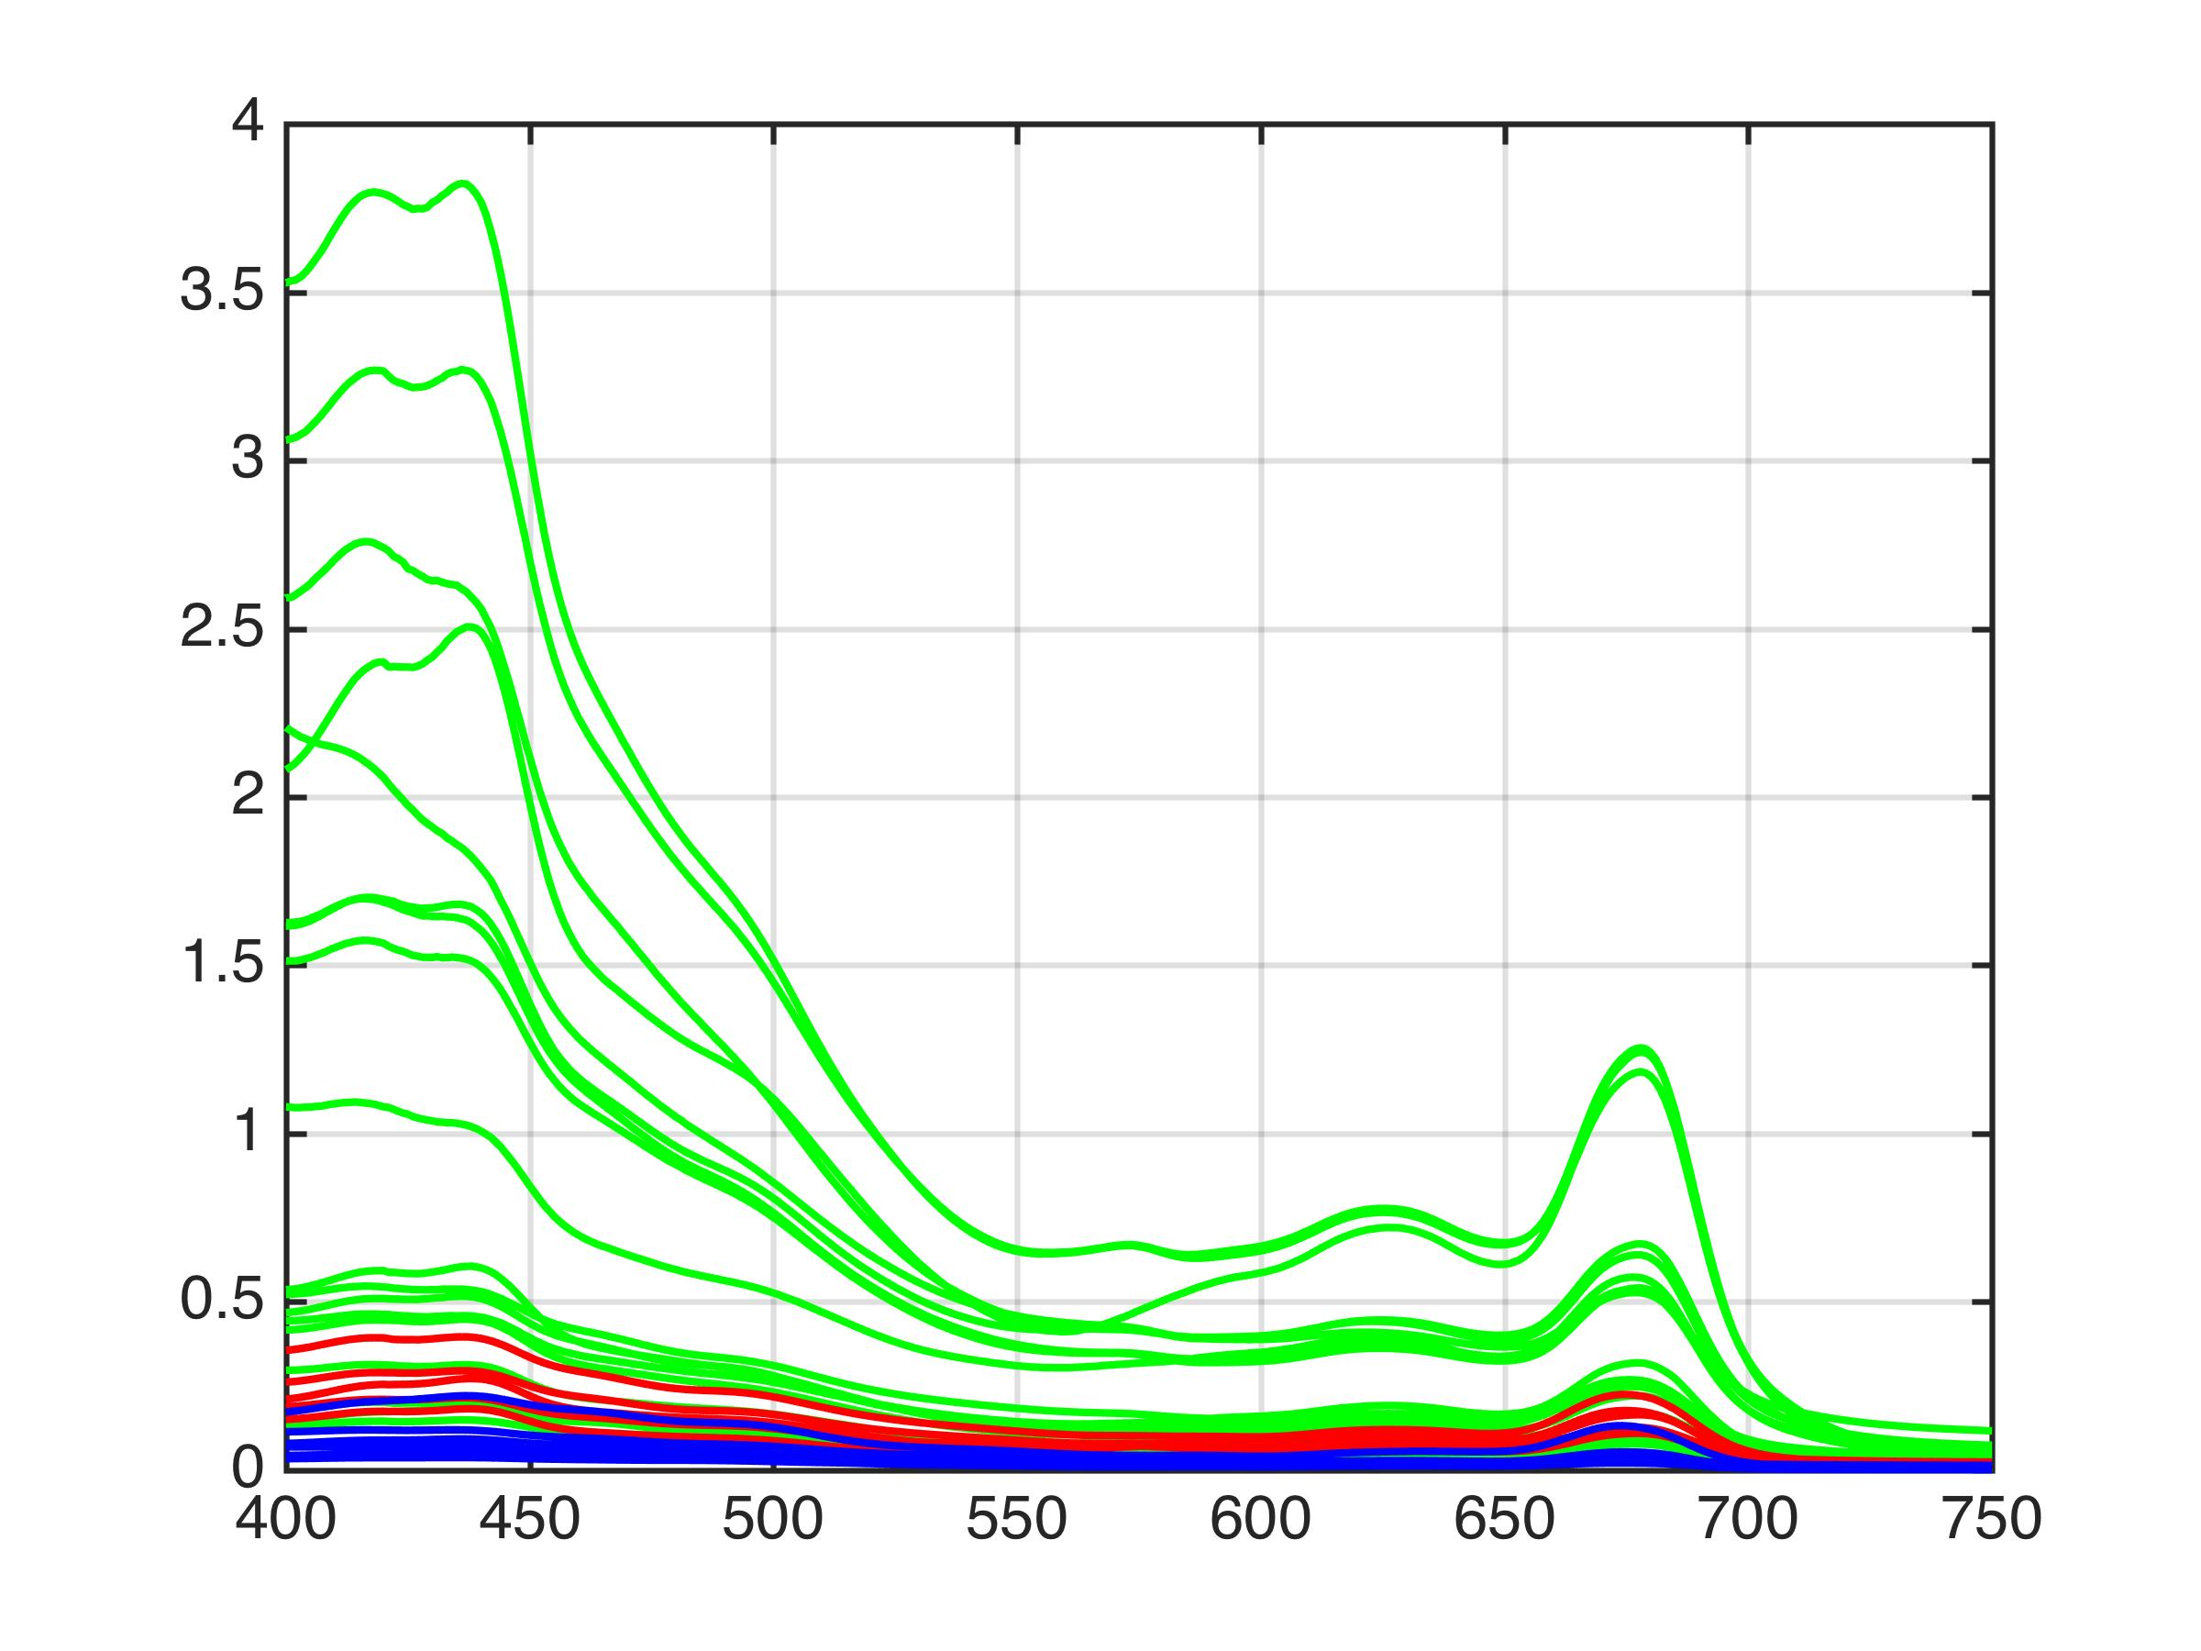
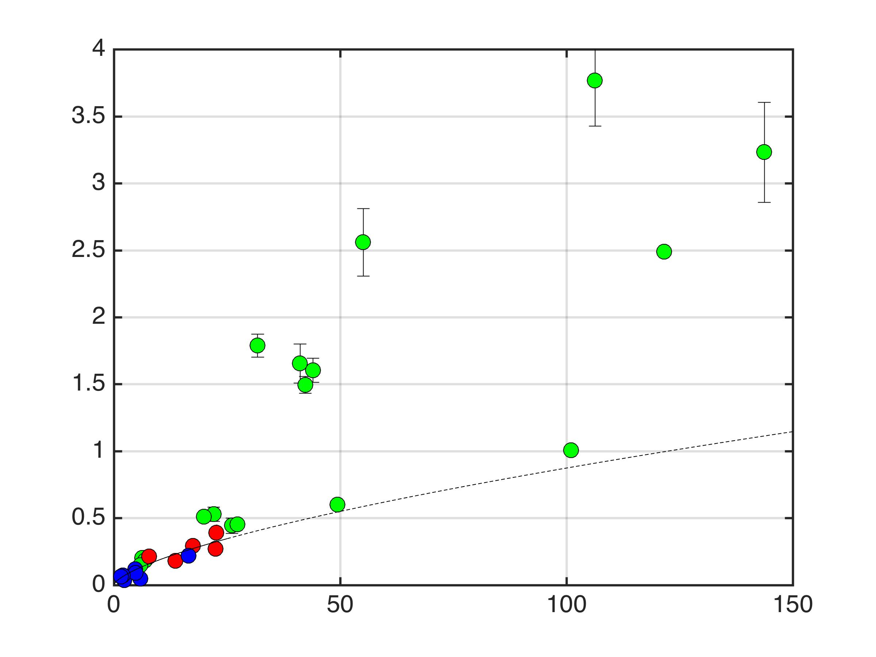
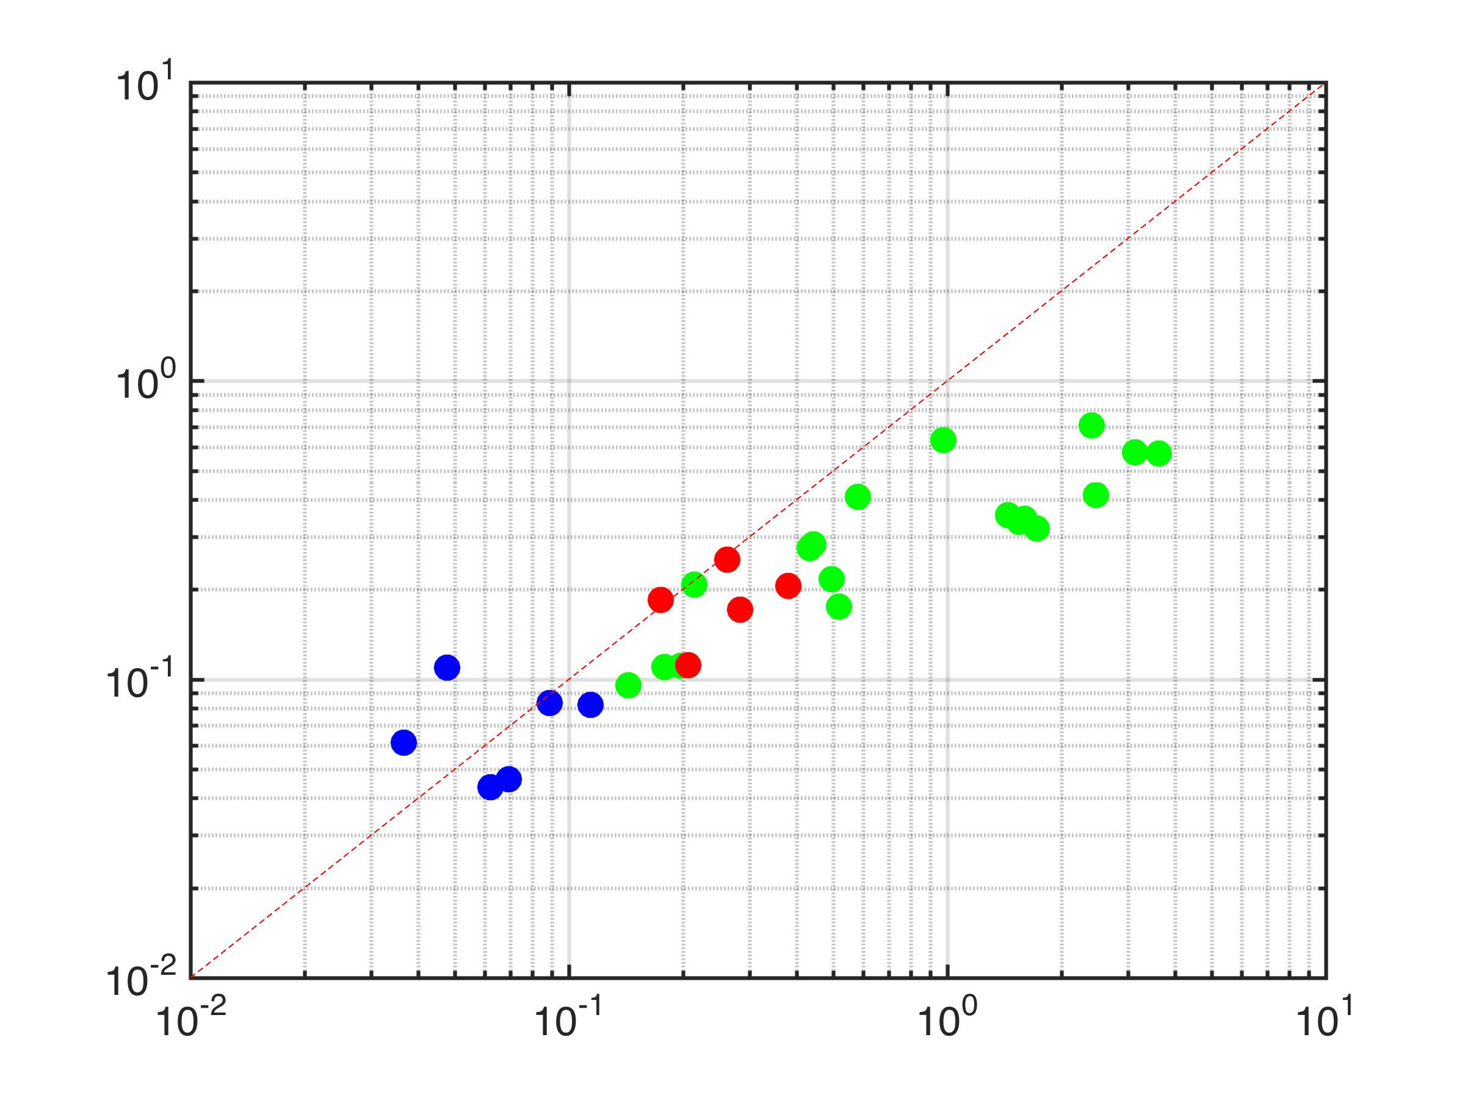
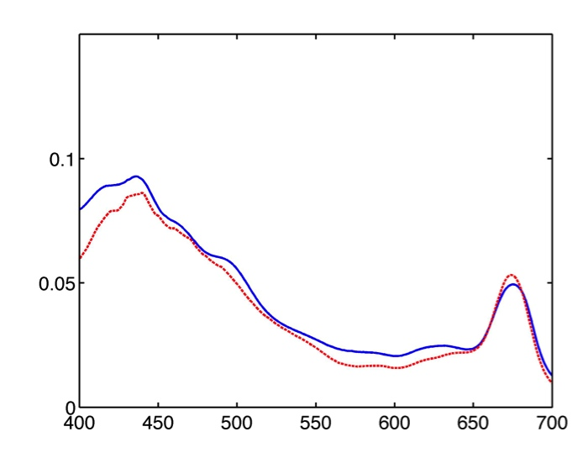
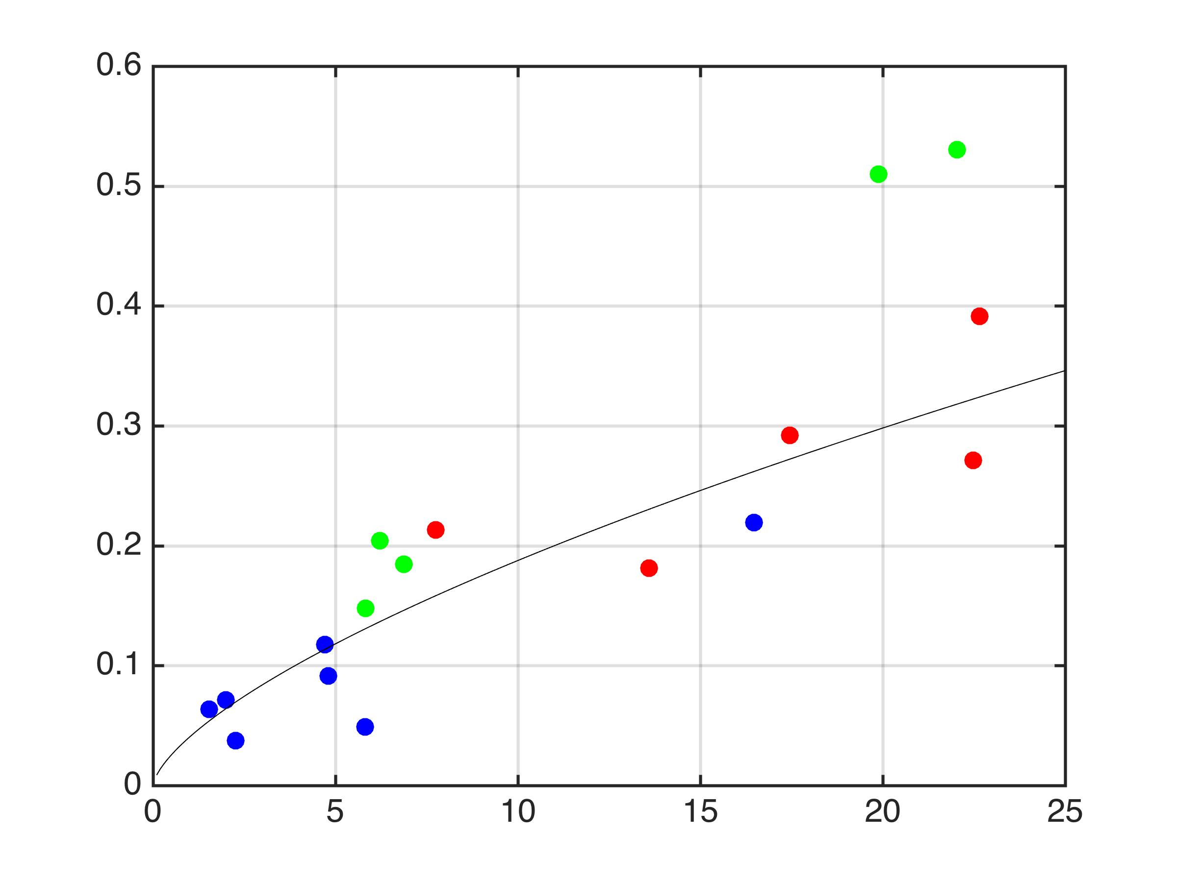
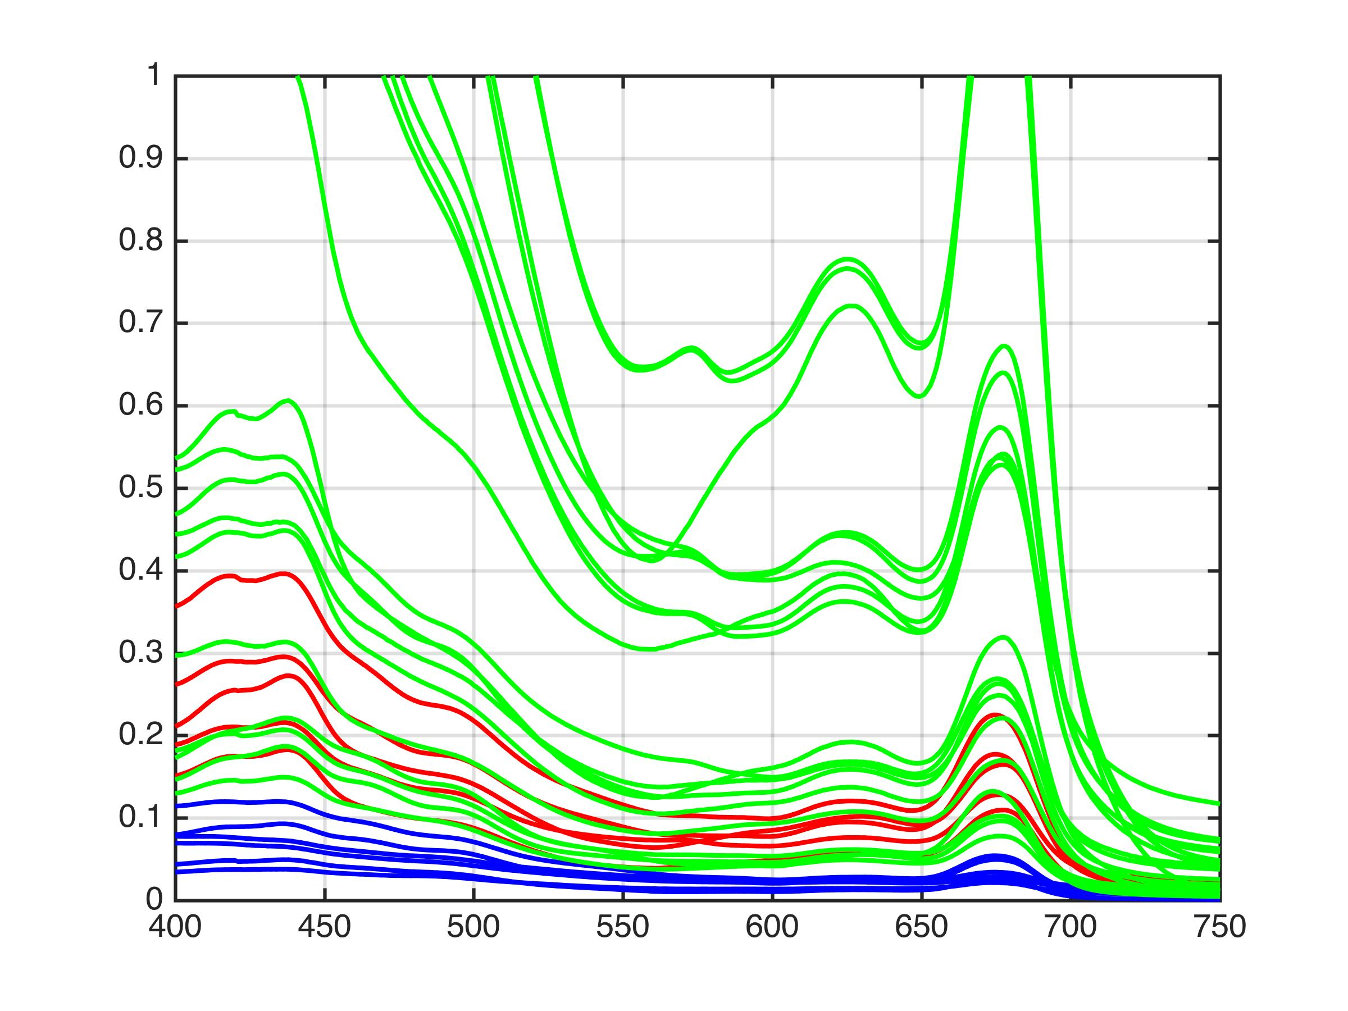
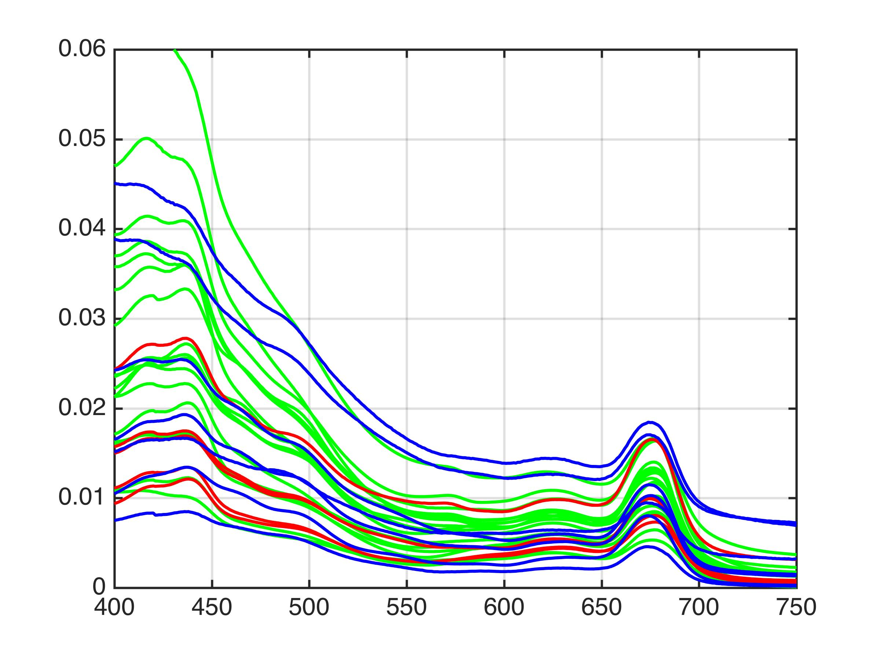
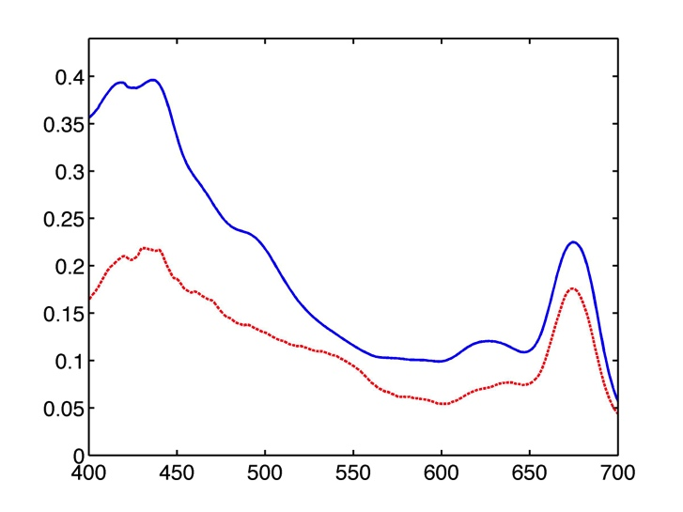
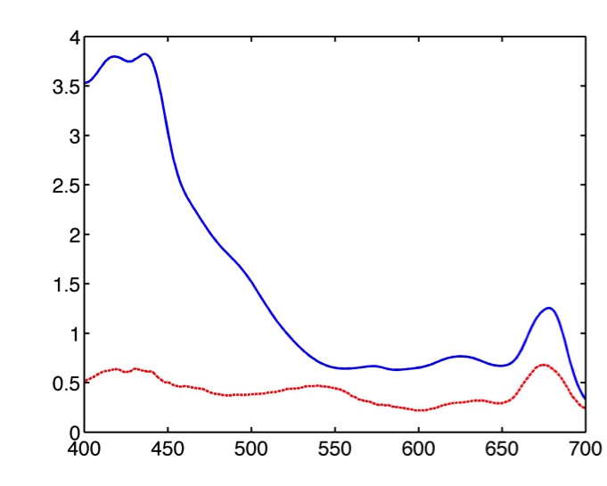
Assessing the optical properties and impacts of cyanobacteria blooms
on ocean color remote sensing
Tim Moore¹, Colleen Mouw², Jim Sullivan³, Mike Twardowski³ and Alan Weidemann⁴
timothy.moore@unh.edu
1 - Ocean Process Analysis Laboratory, University of New Hampshire, Durham, NH USA
2 - Graduate School of Oceanography, University of Rhode Island, RI USA
3 – Harbor Branch Oceanographic Institute, Florida Atlantic University, Fort Pierce FL USA
4 – Naval Research Laboratories, Stennis Space Center, MS USA
Background
Cyanobacteria Harmful algal blooms (cHABs) are a global problem adversely impacting many freshwater systems. In western Lake Erie cHABs initiate in July and are dominated by the colony-forming cyanobacteria Microcystis and last into September/October.
The use of ocean color remote sensing for the detection and quantification of cHABs is subject to a number of special considerations. Microcystis cells can form long, clustered colony chains, and contain gas vacuoles to regulate vertical position. The vacuoles and the vertical distributions of the colonies exert a strong influence on backscattering and remote sensing reflectance properties.
Impacts on Rrs & algorithms
Scattering Characteristics
Dolphin Tow: Aug. 20, 2013
0.5
A
B
0.3
Phycocyanin
bbp/bp (460nm)
0.4
0.25
ppb
0.3
0.2
b_{bp} (443) m⁻¹
b_{bp} (443) m⁻¹
0.2
0.15
0.1
0.1
A
Distance (km)
B
400
500
600
700
0.05
bbp 460
Rrs
A (Detroit R.)
1.0
wavelength (nm)
D
0.04
m-1
Plume
front
B (Bloom)
0.95
0.035
Rrs sr⁻¹
0.90
~
ϖ
0.03
0.85
0.025
0.80
A
Distance (km)
B
Wavelength (nm)
0.75
0.02
Detroit River → LOBO
Transitions of water properties occurred along a 12km transect from Detroit River into HAB-containing waters crossing a front (enhanced phycocyanin and scattering into the WB).
Sharper and earlier shift in backscatter probability (bbprat) than either phycocyanin or backscattering, indicating strong sensitivity to Microcystis for bbprat.
This resulted in significant differences in the remote sensing reflectance.
General Environment
High particle backscattering values for Microcystis waters (WB), moderate for Planktothrix waters (CB), low for Detroit River (DR).
Single scatter albedo high for DR (no cyanos) and WB (Microcystis), low for CB (Planktothrix)
High backscatter probability for Microcystis and Planktothrix waters.
Microcystis and Planktothrix scattering enhanced by gas vacuoles, leading to very high backscattering efficiency.
A
August 17, 2013
Western Lake Erie is > 600 km² with an average water depth of 8m.
It receives freshwater input from the Maumee River (southwest corner) and Detroit River (northwest corner).
Maumee River contributes <10% of water volume input, but >50% of nutrient load.
Mean flow is west to east.
B
August 20, 2014
HOLOCAM Insights
A
A - Detroit River: few particles
B - Western Basin :Microcystis
C - Central Basin: Planktothrix
B
C
Rrs
A
Data Sets
B
We collected field data from:
MASCOT profiles (ac9, CTD, LISST, ECO-VSF, BB9).
Discrete water samples (aph, ad, ap, CDOM, TSM, PC, nutrients, phytoplankton counts).
Dolphin Tow package with ac9, bb3, PC & CDOM fluorescence, CTD.
HOLOCAM profiling imager.
Radiometry with an ASD FieldSpec Pro.
A total of 36 discrete stations and 2 Dolphin Tows in August 2013 and August 2014.
24 additional stations with AOPs and IOPs were contributed by overlapping cruise by NRL (Weidemann).
200um
Rrs
C
a_{w}
Absorption budget
wavelength (nm)
a_{g}
a_{nap}
WB
DR
a_{ph}
Rrs (sr⁻¹)
Rrs (sr⁻¹)
HOLOCAM profiles and records 3-D video of particles undisturbed in the water column down to 1 uM.
Select surface HOLOCAM data from 3 different regions (see Aug. 20, 2014 true color image) revealed aspects of phytoplankton composition and size distributions.
Western Basin (WB) dominated by Microcystis, Central Basin (CB) stations dominated by Planktothrix, Detroit River (DR) had no cyanobacteria.
In the WB, the Microcystis-dominated sample showed a size peak at 200uM, which has been noted as the optimal colony size for maximum vertical velocity (Visser et al., 1997) and suggest that cells were actively migrating.
Wavelength (nm)
CB
Wavelength (nm)
CB
Rrs (sr⁻¹)
WB
MASCOT
DR
Wavelength (nm)
Rrs spectra similar within the 3 sub-regions, but different between them.
Planktothrix (CB) and Microcystis waters (WB) show different spectral shape and magnitude (above) even at similar biomass levels (below).
Stations were grouped by geography/hydrography for comparative analysis reasons: Western Basin (WB), Central Basin (CB), and Detroit River (DR).
HOLOCAM
Chla (ug/L)
13.6
Planktothrix sp.
22.5
Dolphin
16.8
Microcystis sp.
Absorption Characteristics
R_{rs} (sr⁻¹)
26.1
Chl a ug/L
The overall variability of relative absorption was driven by phytoplankton absorption in the study area.
The relative absorption for the DR subgroup was more evenly distributed across phytoplankton, non-algal particles and CDOM.
Strong phytoplankton absorption and package effects occurred in the western basin, impacting aph*.
Based on the Bricaud95 ocean model, the high absorbing Microcystis environments exceeded the model range which couldn’t account for the spectral absorption in the WB, although it worked reasonably well in other areas (DR, CB).
100
Wavelength (nm)
62.2
38.3
23.6
14.5
Conclusions
Western Lake Erie is plagued by summer cyanobacteria blooms, and remote sensing is playing an important role in understanding ecological properties and trends.
Microcystis cHABs have high backscatter probabilities which distinguish them from other particles.
Standard absorption models that include package effects do not capture the the shape of high biomass cHAB waters.
Rrs is strongly impacted by these cHAB properties, and require different IOP models to represent them for algorithm retrieval.
The variety of optical waters and suitable models would be best suited with a scheme accommodating multiple algorithms (see Moore et al., 2014).
These results have global implications, as cHABs are found in many lake systems across all continents.
9.00
5.50
3.40
2.00
1.00
Ternary absorption plot: WB: circles;
DR: squares; CB: diamonds.
4.0
A
4.0
Chla < 25 ug/L
C
A
Bricaud95 aph model
C
3.0
Western Basin
3.0
Central Basin
2.0
Detroit River
a_{ph} 443 (1/m)
a_{ph} (1/m)
2.0
modeled aph 443 m⁻¹
m⁻¹
1.0
1.0
Western Basin
m⁻¹
0
Central Basin
400
500
600
700
0
50
150
150
Detroit River
0.9
wavelength (nm)
B
0.06
Chla ug/L
D
measured aph 443 m⁻¹
wavelength (nm)
0.8
0.05
0.7
aph* m² (mg Chl)⁻¹
B
D
0.6
0.04
0.5
0.03
a_{ph} (1/m)
0.4
0.02
Measured
0.3
m⁻¹
m⁻¹
Bricaud95
0.2
0.01
0.1
600
700
400
500
600
700
400
500
wavelength (nm)
References
Moore, T.S., M.D. Dowell, S. Bradt and A. Ruiz-Verdu. (2014). A framework for selecting and blending ocean color products in coastal zones and lakes, Remote Sensing of Environment, 143:97-111.
Visser, P.M., Passarge, J. and Mur, L.R. (1997). Modelling vertical migration of the cyanobacterium Microcystis, Hydrobiologia, 349: 99-109.
wavelength (nm)
Top left (A): Phytoplankton absorption; bottom left (B): zoom of phytoplankton absorption; top right (C): aph44 vs. Chla; bottom right (D): aph*443 (aph443/Chla) vs. Chla.
wavelength (nm)
wavelength (nm)
Acknowledgment: This work was funded by NIH/NSF Grant R01 ES021929-02.

