Slide 1
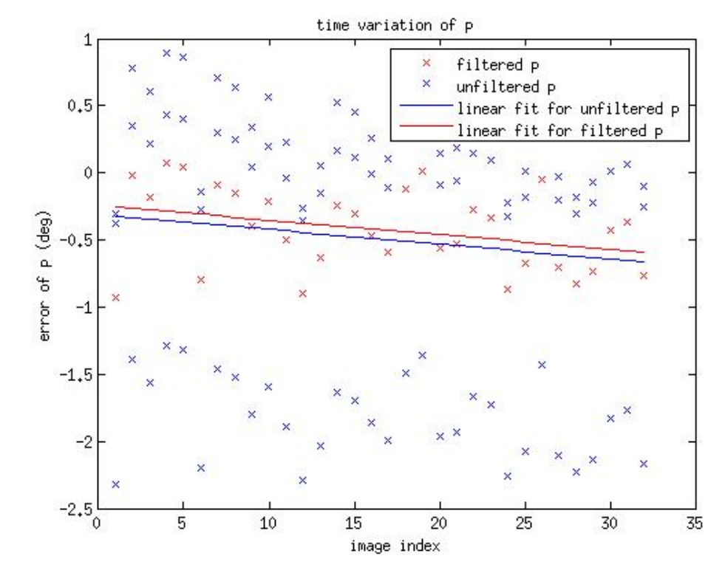
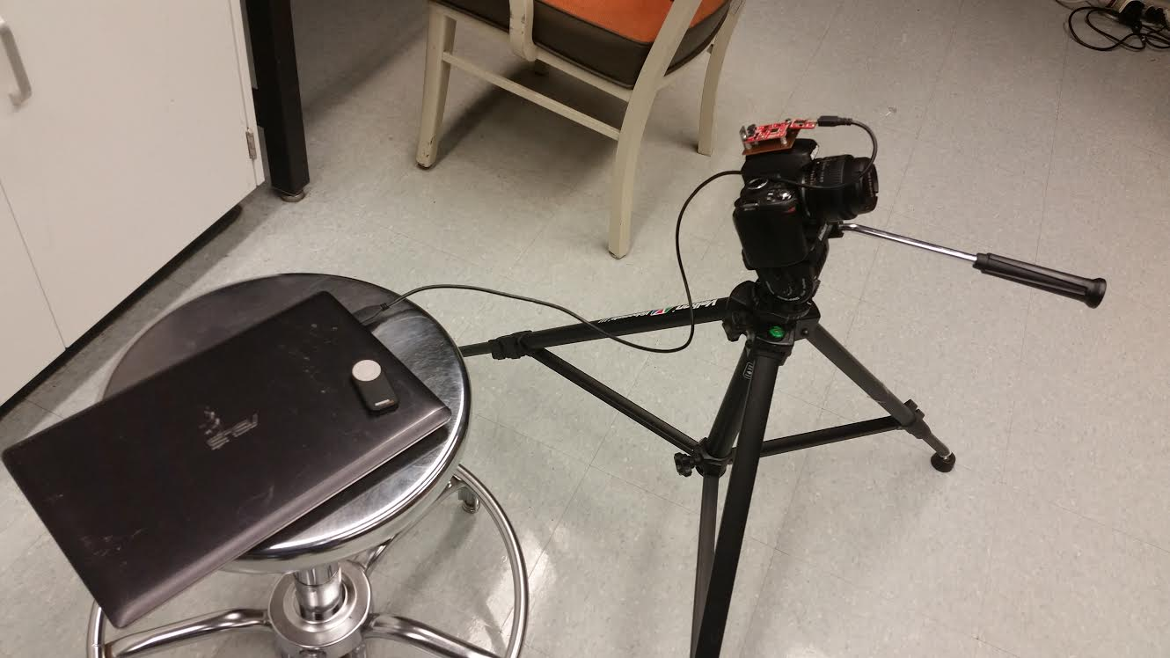
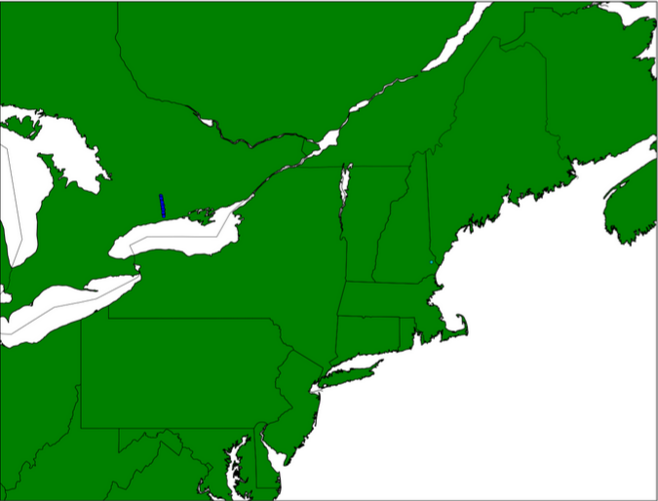
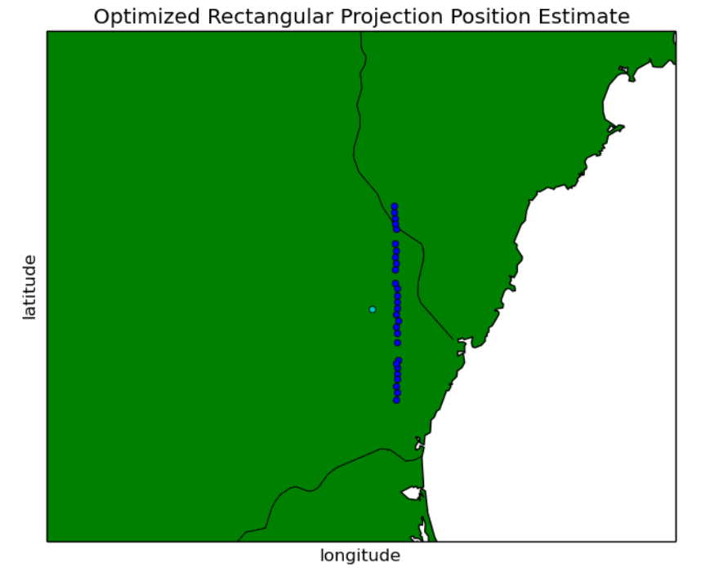
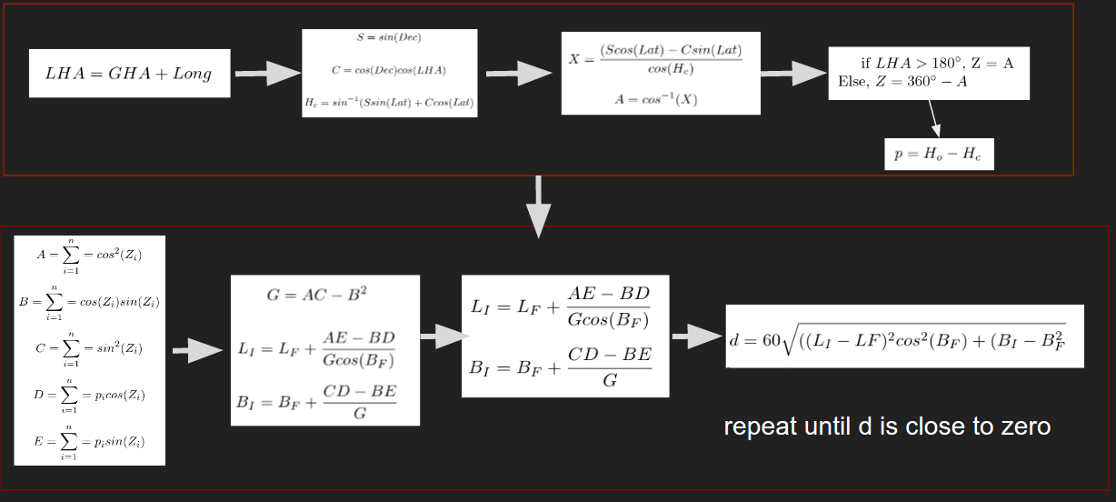
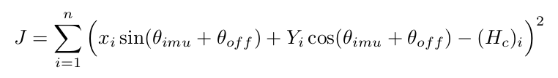
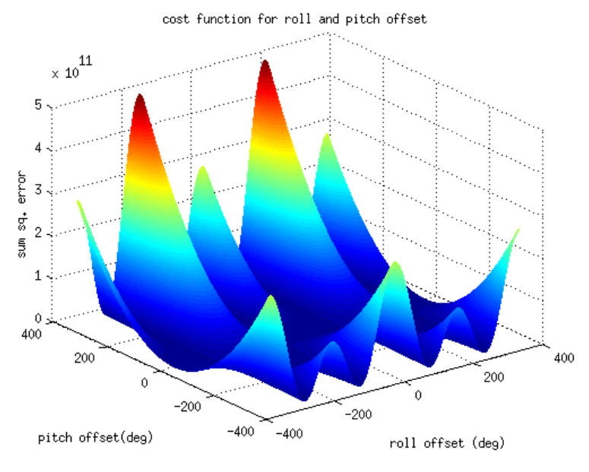
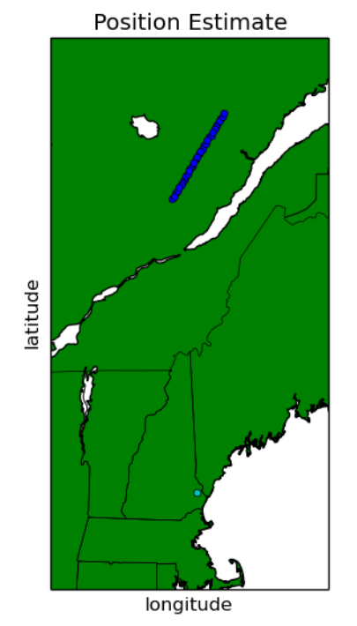
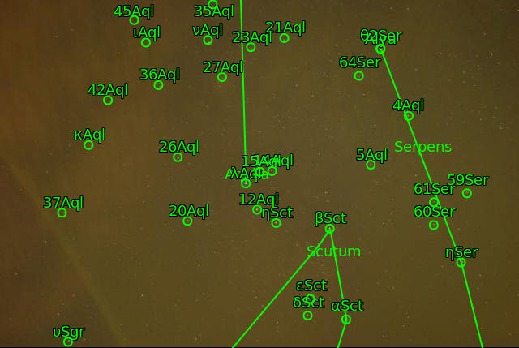
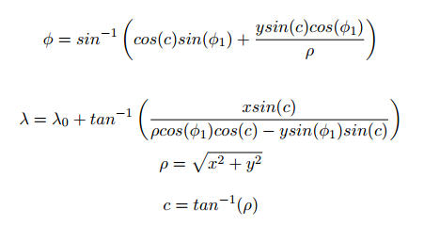
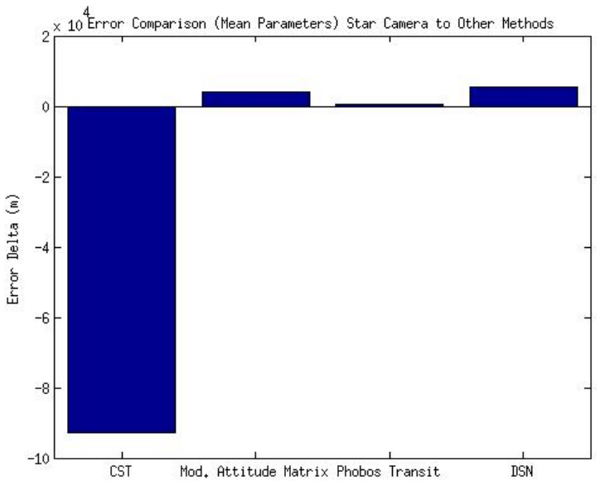
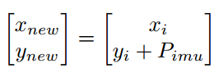
GENERIC CALIBRATION METHOD FOR REDUCTION OF POSITION OUTPUT ERROR IN CELESTIAL BLIND ASTROMETRIC POSITION ESTIMATION DEVICE
Thomas C.K. Fuller and May-Win Thein
University of New Hampshire
Abstract
Experiment Setup
Results
Time Varying Error
Self contained celestial navigation techniques are potential methods for position determination and the exploration of other planets that do not rely on supporting satellites or networks. The authors previously determined that a ground based extraterrestrial mobility solution using a nautical sight reduction, and blind astro-metric calibration based navigation algorithm was demonstrated to be a feasible method for position determination. The presented study examines the use of the
optical gnomonic projection and lumped unmodeled IMU bias to reduce error in the position estimate. Both time varying and time invariant error are considered. Accuracy analysis of the modified celestial navigation system are presented along with a brief comparison to other navigational techniques.
Unmodified Star Tracker
-Treat camera lens as flat
-No optimization performed.
P_{off} = 0°
𝛳_{off} = 0°
Lat. Est=44.241N
Lon. Est=78.293W
Error = ~382.9 n.m.
Introduction
The Nautical Sight Reduction Method equations compare measured altitude, H_{.o} and computed altitude, H_{c} of 3 stars observed in an image to determine location on planetary surface.
The above figure shows the Nikon D60 DSLR Camera, Razor 9DOF IMU, Remote Shutter, Tripod, and Laptop with recording software used to collect experimental data.
The camera was held at an elevation angle of approximately 62 degrees to collect star images of the constellation Libra from 43.1337N, 70.9349W
Rectangular Mean Parameters Method
-Treat camera lens as flat
-Takes mean of optimal points of each image
-Future work includes reducing the GHA based, time varying error in “p” shown above, performing translational error tests, and implementing dynamic navigation.
Error Reduction
Conclusions
For cost function, J, optimization methods are employed to find lumped model parameters 𝛳_{off} and P_{off} corresponding to roll and pitch offset which minimize the value of the intercept, p.
P_{off} = -5.0244°
𝛳_{off} = -2.379°
Lat. Est = 43.142N
Lon. Est = 70.877W
Error = ~3 n.m.
Combining the nautical sight reduction method and blind astrometric calibration was demonstrated to be a viable method for position determination in the Author's previous work. This work used cost function analysis in an attempt to minimize position estimate error. Cost function analysis indicates that the best way to minimize the star camera error is to use the rectangular center pixel method to optimize over the pitch, followed by optimizing over the pitch and roll and taking the mean of the output parameters. These methods led to a minimized error of 0.0586 degrees or approximately 3 nautical miles. This is an improvement of approximately 379 miles of error over the non-optimized star tracker. Compared to other star tracking methods, the presented method has the potential to be comparable or improving on the other self contained navigation methods, namely, the Compass Star Tracker and Phobos transit methods. If access to the DSN is available, then the presented method may not be the best choice for surface navigation. The gnomonic projection appears to be an interesting enrichment problem for star tracking. It was originally expected that the gnomonic projection would reduce estimation error. It can be seen that opposite was achieved by its application. Additionally, time varying error was observed in the system, and a modification to calculation of hour angle may lead to further improvements.
repeat until d is close to zero
‹#›
This research attempts to optimize over p = H_{o} - H_{c} by incorporating the effects of pitch and roll.
Gnomonic Projection Method
-Treat camera lens as sphere
-Uses following equations
P_{off} = -3.769
𝛳_{off} = -12.211
Lat. Est =48.1871N
Lon. Est = 70.911W
Error = ~5.0534°
The image below is an example using the astrometry.net software to locate stars in an image.
Mean Parameters Method Compared to Other Navigation Methods
Error compared to mean parameters method. negative values indicate that mean parameters performed better. Positive values depict mean parameters being out performed.
Selected References
The above cost function represents the sum squared error for approximately 32 images of the Lyra Constellation.
The function domain is restricted to reasonable values and the resulting space is numerically analyzed to determine the minimum value.
Fuller, Thomas, Nitsch, William, and May-Win Thein “Celestial Navigation Device for Future Autonomous Applications.” AAS/AIAA Spaceflight Mechanics Conference. Feb. 2016.
Nautical Almanac 2015 Commercial Edition. N.p.: Paradise Cay Pubns, 2014. Print.
Lang, Dustin. "Blind astrometric calibration of arbitrary astronomical images."Astrometry. net (2009): 1-55.
"A Short Guide to Celestial Navigation." A Short Guide to Celestial Navigation. N.p., n.d. Web. 11 Feb. 2016.
Blewitt, Mary, and Thomas C. Bergel. Celestial Navigation for Yachtsmen. Camden, Me.: International Marine, 1995. Print.
Basic Formulation for finding H_{o} using IMU pitch measurement, P_{IMU} initial pixel locations x_{i} and y_{i}, y_{new} is then converted to degrees to output H_{o}.

