Slide 1


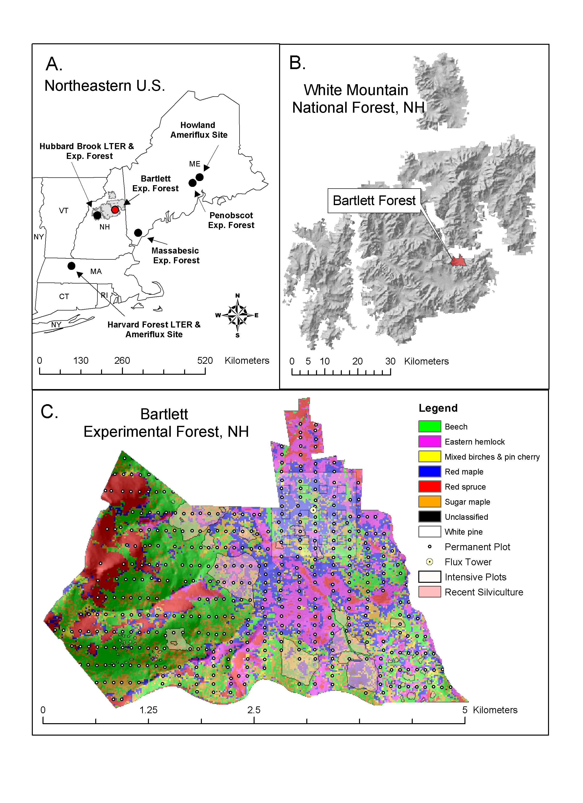
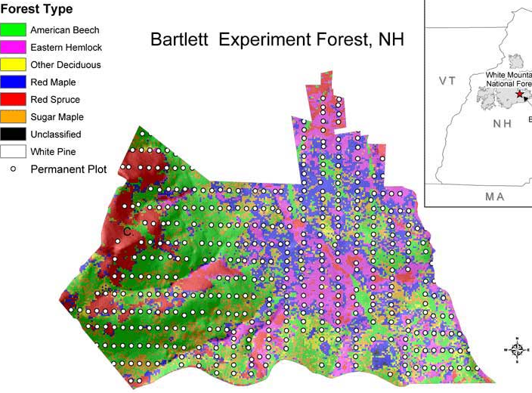





Comparison of carbon flux estimates using 10 years of eddy covariance data and plot-level biometric measurements from the Bartlett Experimental Forest, New Hampshire
Andrew Ouimette*, Scott Ollinger, Andrew Richardson, Dave Hollinger, Trevor Keenan, Lucie Lepine, Zaixing Zhou
Earth Systems Research Center
Institute for the Study of Earth, Oceans, and Space
*Andrew.Ouimette@unh.edu Earth Systems Research Center, University of New Hampshire, Durham, NH 03824, USA
Ameriflux Spet 21-24, 2016
Abstract
Carbon Fluxes: 10 year mean
Interannual Variation in Carbon Fluxes
In the northeastern United States, forest regrowth following 19th and 20th century agricultural abandonment represents an important carbon (C) sink. The ability of these secondary forests to continue sequestering C as they mature is unclear. Given uncertainties in eddy covariance estimates and forest inventory measurements, efforts to derive C budgets using multiple approaches are needed. Thus far, the number of forested sites reporting enough information to compare top down and bottom up approaches of C flux estimates has been limited and often lack a complete assessment of the uncertainties associated with each approach.
Here we compare estimates of ecosystem C fluxes from a 100-125 year old forest at the Bartlett Experimental Forest, NH using 3 approaches: (1) eddy covariance, (2) biometric estimates of net primary production (NPP) and heterotrophic respiration, and (3) a carbon inventory approach for 10 years (2004-2014) of plot-level data. We include estimates of uncertainty for all three approaches.
Ten year mean estimates of net ecosystem production (NEP) compared well among all three methods (ranging from 133-141 g C/m²/yr), and indicate that this aging deciduous stand is still acting as a moderate C sink. The largest uncertainty in eddy covariance C flux estimates was associated with the selection of an appropriate ustar filter, while uncertainties in biometric approaches were dominated by belowground C fluxes (fine root and mycorrhizal production). Comparisons of interannual variations in biometric and eddy covariance C fluxes highlight a lack of correlation between wood growth and NEP or GPP, suggesting that source limitation (C supply) may not be controlling rates of wood production. The application of all 3 approaches helped place constraints on difficult to measure C fluxes and provided a comprehensive C budget for future model-data comparisons.
NEP
(a)
(b)
EC: 136 ± 50
Bio: 141 ± 149
∆C: 136 ± 34
GPP
Ecosystem Respiration
EC: 1250 ± 75
Bio: 1325 ± 149
EC: 1114 ± 75
Bio: 1184 ± 149
(c)
Figure 6: Time series of (a) biometric wood NPP and eddy covariance (EC) NEP, (b) wood NPP and EC GPP, and (c) wood NPP and annual air temperature. Wood growth is uncorrelated to either current or previous year NEP and GPP, but more strongly correlated to climate variables such as early season (winter through early summer) temperatures. The lack of correlation with C supply suggests wood growth may be more “sink” than “source” driven. Interannual variations in wood growth can be nearly 100% between years, but are much smaller than the observed range of NEP (a).
30% of Re
54% of NPP
Aboveground Respiration
Site: Bartlett Experimental Forest
Aboveground NPP
J) CWD: 5 ± 5
K) Standing Dead: 56 ± 15
L) Live Wood: 146 ± 75
M) Live Foliage: 152 ± 50
(a)
(b)
A) Wood
i) Large trees: 150 ± 20
ii) Small trees: 30 ± 5
iii) Branchfall: 31 ± 21
B) Foliage/Fruit: 123 ± 11
C) Understory/herbiv: 20 ± 10
Hubbar Brook
LTER & Exp. Forest
Bartlett Exp. Forest & Ameriflux Site
Data Model Comparison
70% of Re
Model over estimates
46% of NPP
Durham Flux
Tower Cluster
Belowground NPP
Soil Respiration
Model underestimates
D) Coarse Roots: 34 ± 7
E) Fine Roots: 110 ± 64
F) Myco Fungi: 158 ± 119
N) Heterotrophic: 454 ± 50
O) Autotrophic: 372 ± 50
0
2.5
5
km
Model sensitive to water stress?
Figure 1: (a) Map of New England showing location of Bartlett Experimental Forest in relation to other eddy flux towers. (b) Species composition map of Bartlett Exp. Forest showing location of flux tower. Square outline indicates location of biometric plots in this study.
r
Figure 5: Mean annual carbon fluxes for Bartlett Experimental Forest from 10 years of eddy covariance (EC), biometric (Bio), and inventory (∆C) data. There is generally good agreement between the different approaches for estimating NEP, GPP, and RE. Soil respiration and aboveground respiration contribute approximately 70% and 30% to total ecosystem respiration, respectively. Aboveground NPP is allocated roughly equally among 4 sinks: wood, foliage, fine roots, and mycorrhizal fungi.
Figure 7: (a) The difference in C fluxes between predictions from an uncalibrated ecosystem model (PnET-SOM) and biometric data (PnET – data). Compared to the biometric data, PnET overestimates C allocation aboveground (wood, foliage, respiration), and underestimates belowground C allocation to fine roots/mycorrhizal fungi and soil respiration. (b) Time series of annual NEP from PnET and the EC tower. The model performs well at capturing interannual variations in NEP but may be too sensitive to water stress .
Biometric Measurements
10 m radius subplots
Bartlett Tower Site:
12 plots (100 x 100 m)
48 subplots (10 m rad.)
96 litter baskets
96 soil respiration collars
48 branchfall tarps
1000+ trees for DBH
150+ trees for foliar %N
90+ year long ingrowth root cores
36+ pairs (open/closed) fungal ingrowth cores
Flux tower
Correlations of C fluxes with climate and phenology
Conclusions and Future Directions
1000 m
120 m
We present 10 years of eddy covariance (EC) and biometric carbon flux data with uncertainties including belowground C fluxes
10 year mean estimates of NEP, GPP, and Re agree reasonably well between top down (EC) and bottom up (biometric) approaches.
Largest uncertainty in EC data was choice of ustar filter.
Belowground allocation to fine roots and mycorrhizal fungi dominate the uncertainty in biometric measurements and have similar C fluxes to aboveground foliage and wood
Wood growth was not correlated to GPP or NEP but more strongly correlated to climate (temperature). Suggests “sink” driven rather than “source” driven.
NEP and GPP are weakly or negatively correlated to temperature and more strongly related to phenology?
An ecosystem model, PnET-SOM, does well at predicting C fluxes but underestimates belowground allocation to fine roots/mycorrhizae and soil respiration while overestimating aboveground NPP and autotrophic respiration
PnET-SOM captures interannual variations well but may be too sensitive to dry conditions (2007 and 2011) and not sensitive enough to cooler growing season temperatures (2009).
200 m
Wood Growth
Annual
Growing Season
Winter
Spring
Early Summer
Late Summer
GPP
NEP
PAR
D_{PAR}
T_{Air}
T_{Soil}
VWC
VPD
Phenology
Fall
1000 m
Figure 2: Layout of the biometric plots around the eddy flux tower at Bartlett Experimental Forest. The plots were established in 2004 as part of the North American Carbon Program following the FIA nested plot design.
NEP
Uncertainty in C Fluxes
GPP
Re
PAR
D_{PAR}
T_{Air}
T_{Soil}
VWC
VPD
Phenology
(a)
(b)
GPP
Acknowledgements
Re
NEP
PAR
D_{PAR}
T_{Air}
T_{Soil}
VWC
VPD
Phenology
Figure 5: Correlation coefficients for linear regressions of annual Wood growth, NEP, and GPP during different times of the year (seasons) using data from 2004 – 2014. Colors denote the season for the explanatory variables. For example (see arrow), wood growth is positively correlated with annual, growing season, winter, spring, and early summer air temperature, but uncorrelated to late summer or fall air temperature. More sophisticated statistical models are being used to analyze these data but this simplistic approach is helpful for highlighting that 1) the independent variables most strongly positively correlated with wood growth (temperature, vpd) tend to be negatively or weakly correlated to NEP and GPP. It also highlights the complexity of identifying drivers of C fluxes and the need for longer term datasets to provide more robust analyses of these relationships. Additionally, comparison with predictions from ecosystem models is ongoing and should provide further insight.
Figure 3: (a) Percent of nighttime data available after ustar filtering (primary vertical axis) and annual ecosystem respiration, Re, (secondary vertical axis) versus ustar. Choice of ustar has a strong effect both on Re and the percent of available data. (b) Comparison of 3 approaches to estimate annual NEP: (-NEE = eddy flux tower; NEP = biometric approach; C = inventory approach). 10 year mean NEP for the 3 approaches show good agreement. The large error bars for the NEP approach are due to uncertainties in belowground NPP.
This study is supported by Northeastern States Research Cooperative (NSRC) (award numbers #15DG11242307053, #12DG11242307065) and the NH EPSCoR Program. Support for the NH EPSCoR Program is provided by the National Science Foundation's Research Infrastructure Improvement Award # EPS 1101245.

