Slide 1
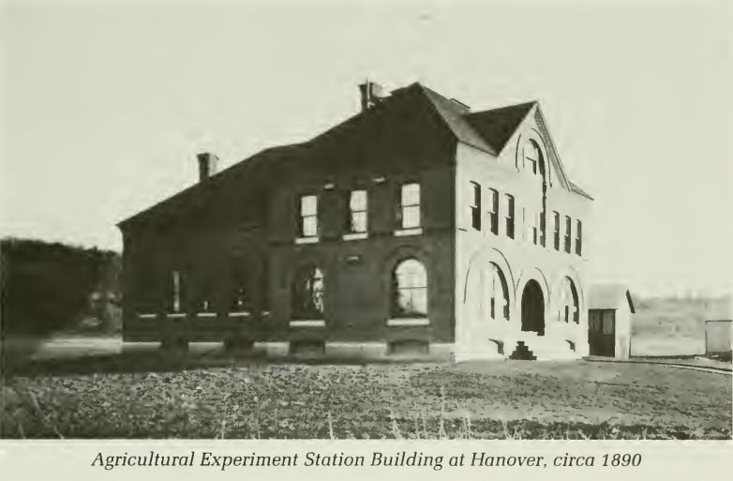
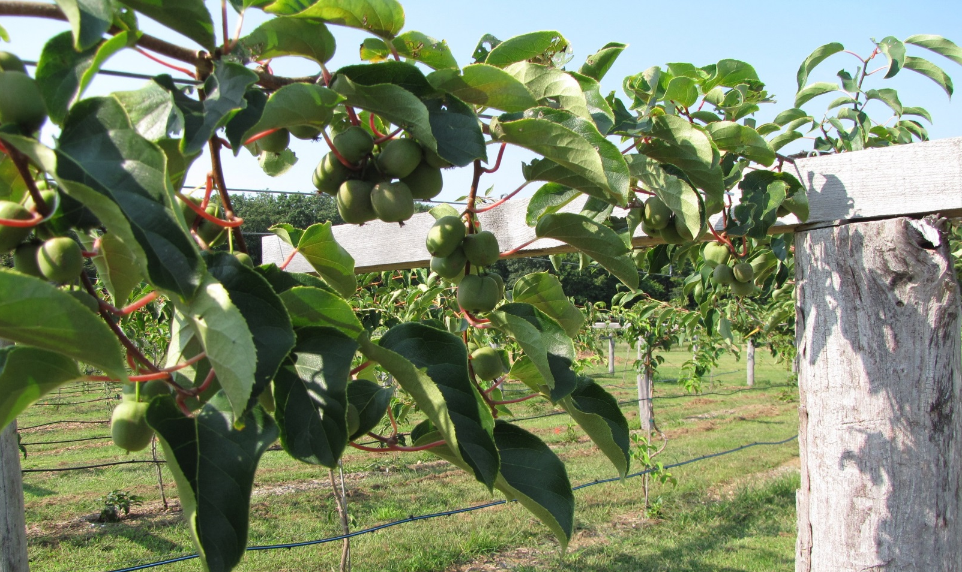
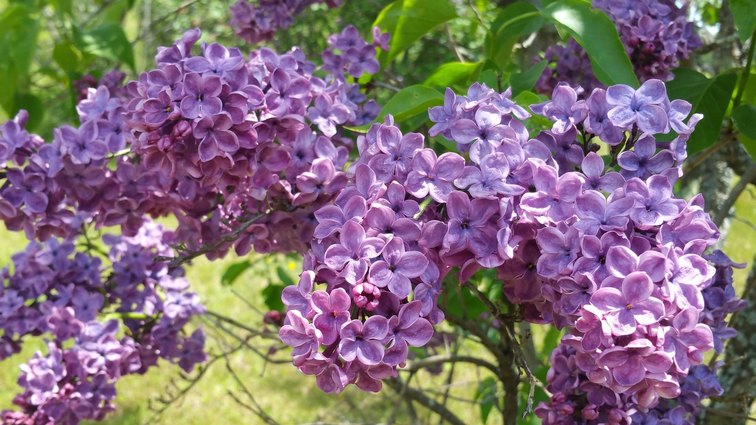
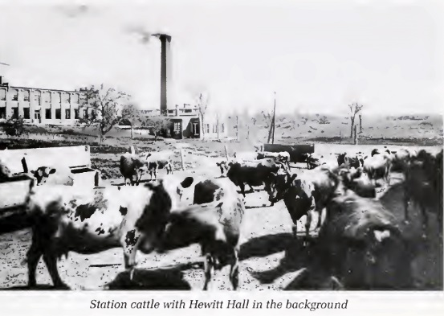
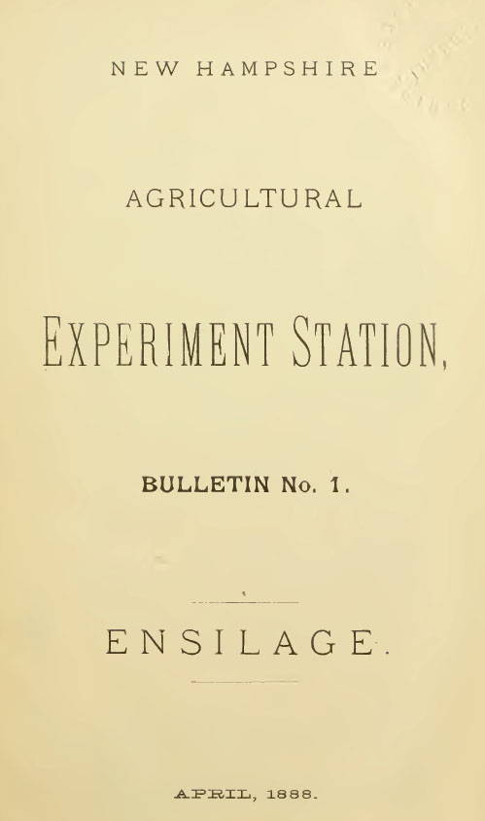
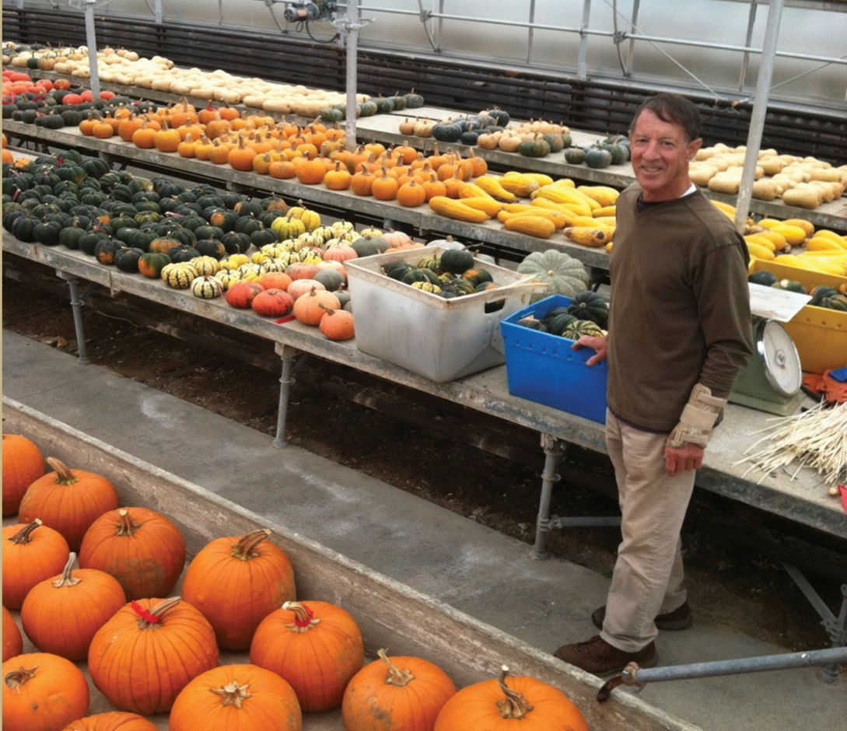
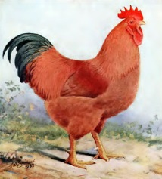
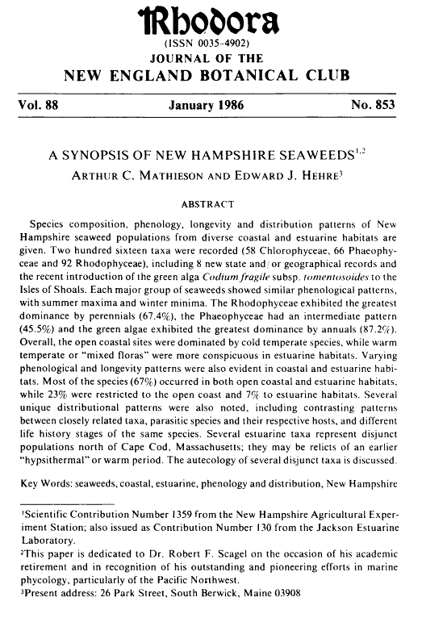
History of Agricultural Research and Innovation at UNH
1900: C.W. Burkett, agriculturalist, is the first PhD on staff at the experiment station.
1941: Importance of soil loss from erosion and value of cover crops to reduce the loss is studied.
1987: Experiment station celebrates 100 years of research and innovation at UNH.
1921: NH Legislature makes first appropriation in support of agricultural research conducted at the experiment station.
2012: Station scientists launch first ever cold-hardy kiwiberry research project. Public tastes UNH kiwiberries for the first time at fall 2016 farmers markets across the state.
1887: NH Agricultural Experiment Station is established after passage of the Hatch Act, providing federal funding for agricultural research at land-grant institutions.
1940s: UNH begins lilac breeding program that will last for five decades and become the most prolific lilac breeding program in the nation.
1907: “Practicality” of milking cows by machine investigated.
1989: Thomas P. Fairchild Dairy Teaching and Research Center opens.
1888: First bulletin of NH Agricultural Experiment Station,” Ensilage,” is published.
1923: NH College of Agriculture and Mechanical Arts becomes the University of New Hampshire.
1978: One hundred new varieties of plants introduced by experiment station since 1938.
2005: UNH establishes Organic Dairy Research Farm, the first of its kind at a land-grant university.
1912: C.A. Black becomes the first woman PhD and first woman scientist on experiment station staff.
1893: NH Agricultural Experiment Station moves to Durham, anchoring what is now the University of New Hampshire.
1956: Station scientists make the first conclusions regarding land-use trends using aerial photos.
1999 to present: Sales of seeds developed by Brent Loy represent 35% of UNH’s total intellectual property revenue.
1903: E.M. Davis, purchasing agent, and M.E. Townsend, stenographer, become first women on staff at experiment station.
1986: Experiment station releases groundbreaking “A Synopsis of New Hampshire Seaweeds,” a report based on 18 years of research on algal flora, in Rhodora, the journal of the New England Botanical Club.
1866: First agricultural research begins shortly after NH College of Agriculture and Mechanical Arts established at Dartmouth.
1903: First nursery inspection law enacted; station entomologist appointed inspector.
1916: UNH Poultry Department is established.

