Slide 1

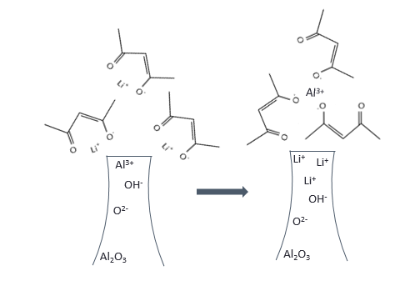
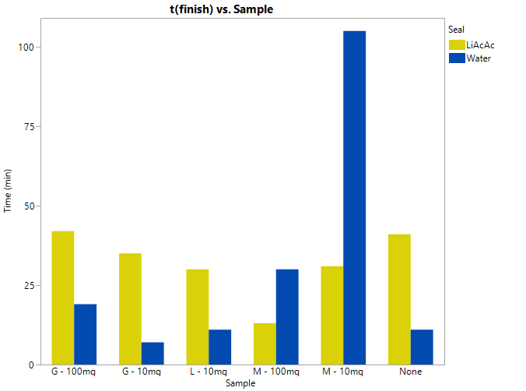
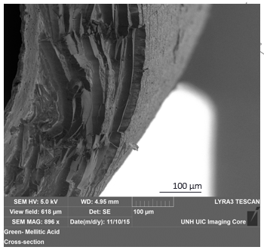
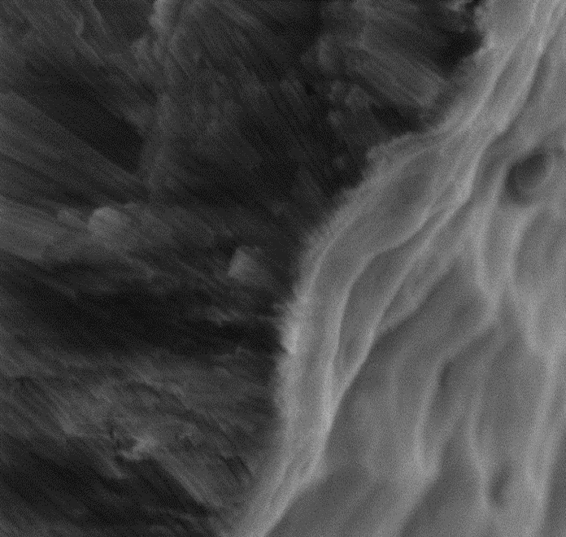
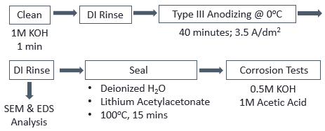
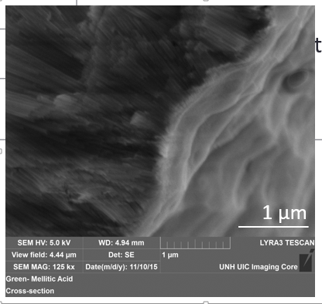
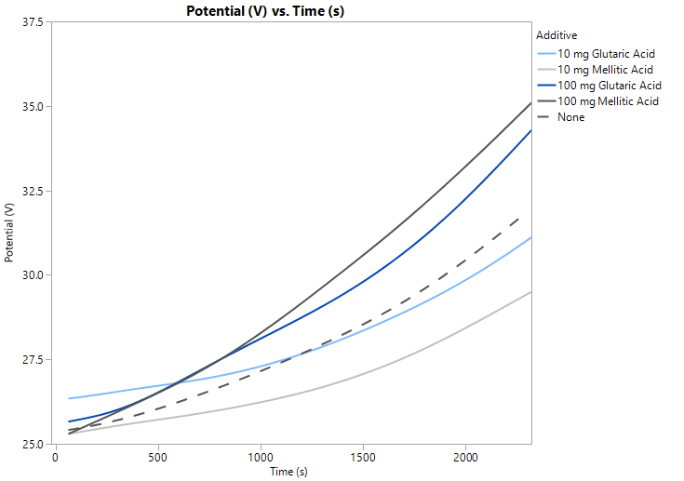
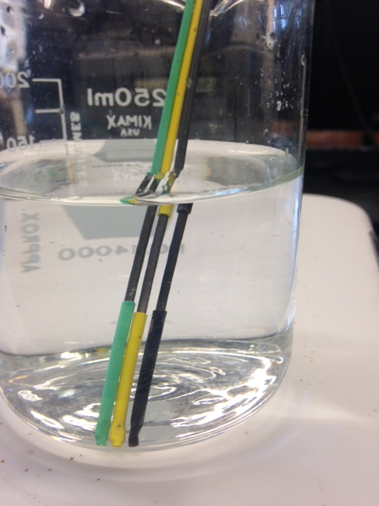
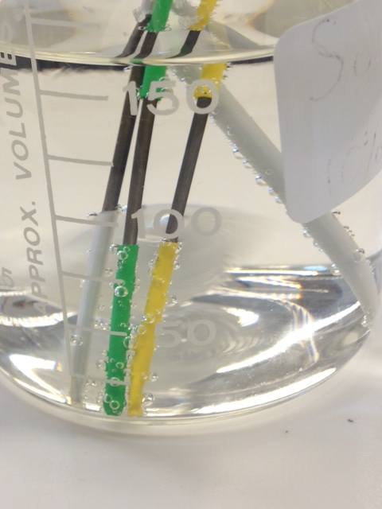
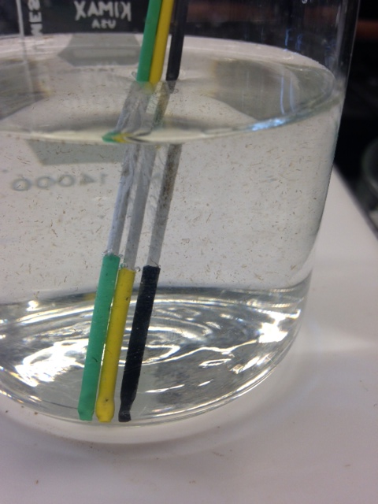
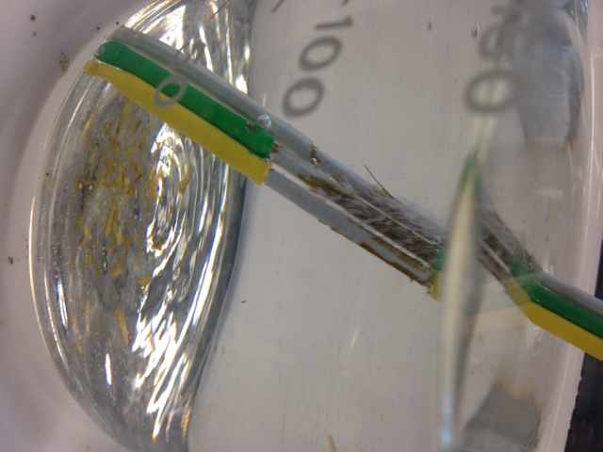
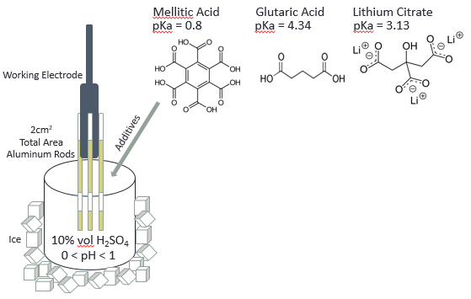
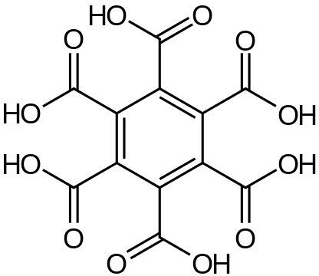
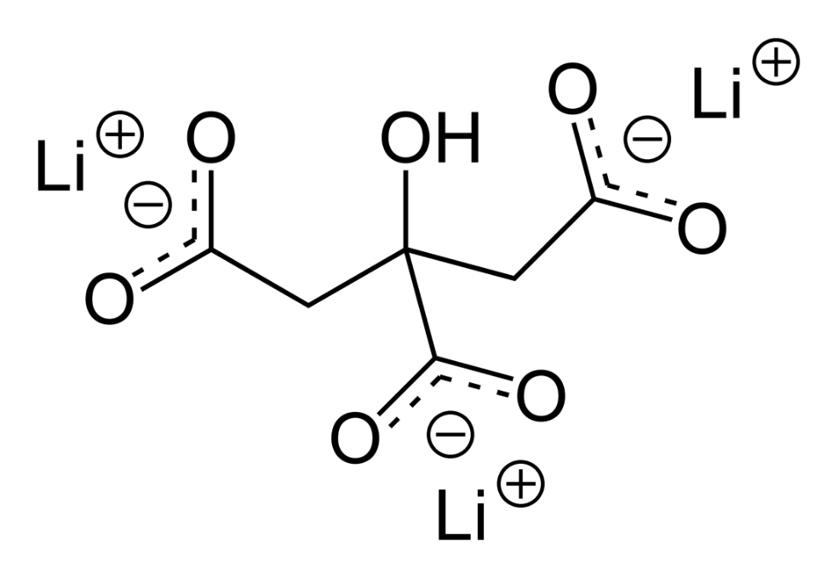
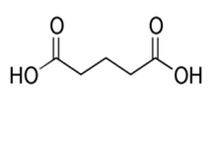
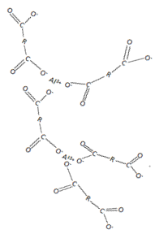
The effect of carboxylic acid additives on the structure and corrosion resistance of alumina coatings
Abby Koczera
Chemical Engineering 2017, University of New Hampshire
Background & Theory
Experimental matrix
Corrosion results
In the aerospace, appliances, and computer industries, hardcoat anodizing is used to increase corrosion and abrasion resistance, improve surface cosmetics, and provide electrical insulation. Alumina is resistant at neutral pH, but is extremely vulnerable in acidic and basic environments such as household consumption and cleaning mediums. Varying anodizing bath additives and sealing chemistries are ways to improve the corrosion resistance of the coatings.
Complexing organic compounds in the form of carboxylates were added to the sulfuric acid anodizing bath to improve the stability of the coating.
Hard-ion carboxylates readily form complexes with Al³⁺ to form insoluble metal soaps that are incorporated onto the surface of the anodic coating. Ideally, this thin film promotes protection of the metal, and even more so when coupled with a finishing seal.¹ Lithium acetylacetonate seal was chosen due to its ability to induce formation of a dual salt with good chemical resistance at the surface (Fig. 4).
Table 1. Consequential additive configurations, including concentration in the anodizing bath followed by three types of seals and corrosion tests.
Additive | Mass (mg) | Seal Types | Corrosion Tests
Mellitic Acid | 10 | None Boiling Water Boiling Lithium Acetylacetonate | 0.5M KOH 1M Acetic Acid
 | 100
Glutaric Acid | 10
 | 30
 | 100
Lithium Citrate | 10
Coating properties
Figure 4. Lithium acetylacetonate sealing mechanism and its reaction with alumina.
Seal
LiAcAc
Water
G: Glutaric Acid
L: Lithium Citrate
M: Mellitic Acid
Time (min)
Methods & Materials
Clean
DI Rinse
Type III Anodizing @ 0ºC
1 μm
1M KOH
1min
40 minutes; 3.5 A/dm²
Figure 2. SEM cross-section image of anodized aluminum with 100mg Mellitic acid additive. Coating thickness: 27.7 μm.
Sample
Potential vs. Time
Figure 5. 0.5M KOH corrosion completion times for samples of different seals. Lithium acetylacetonate seal proved better than the hot water seal for all samples except Mellitic acid.
DI Rinse
Seal
Corrosion Tests
Additive
Deionized H₂O
Lithium Acetylacetonate
100ºC, 15 mins
0.5M KOH
1M Acetic Acid
10mg Glutaric Acid
10mg Mellitic Acid
100mg Glutaric Acid
100mg Mellitic Acid
None
27.7μm
SEM & EDS
Analysis
33.1μm
Mellitic Acid
Glutaric Acid
Lithium Citrate
Increasing coating thickness
pKa = 0.8
pKa = 4.34
pKa = 3.13
Potential (V)
26.3μm
(a)
(b)
Working Electrode
25.1μm
Figure 6. Corrosion behavior in 0.5M KOH for samples sealed in (a) boiling water and
(b) boiling lithium acetylacetonate. Sample (left to right in each photo): no additives, 10mg glutaric acid and 10mg lithium citrate.
23.2μm
conclusions
2cm²
Total Area
Aluminum Rods
Additives
Time (s)
Higher concentrations of carboxylic additives in the anodizing bath yield thicker coatings
Additives create protective films composed of insoluble metal soaps
Lithium acetylacetonate seal provides protection against corrosion, specifically for glutaric acid configurations
Mellitic acid anodized samples performed best in KOH corrosion tests when sealed with boiling water
Figure 3. Potential with respect to time of additives anodized at various concentrations, includes measured coating thickness values.
Ice
10% vol H₂SO₄
Acknowledgements
0 < pH < 1
The author acknowledges the guidance and expertise of Professor Dale P. Barkey, as well as the support of the University of New Hampshire College of Engineering and Physical Sciences.
Metal Soap Complex
Figure 1. Schematic of the flow process and experimental set up.

