Slide 1

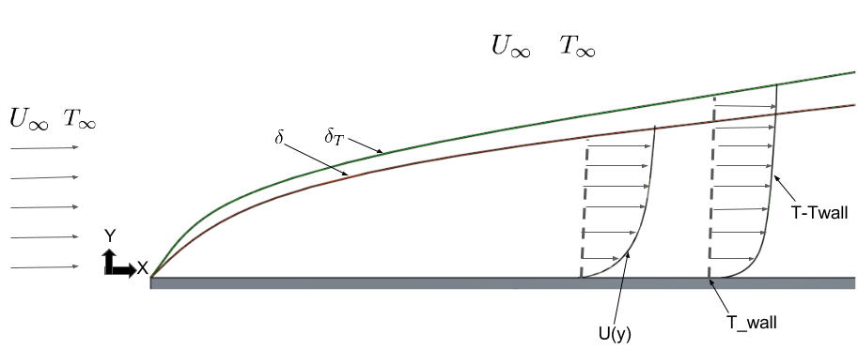
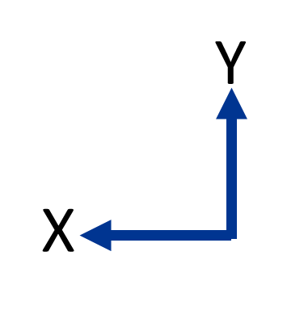
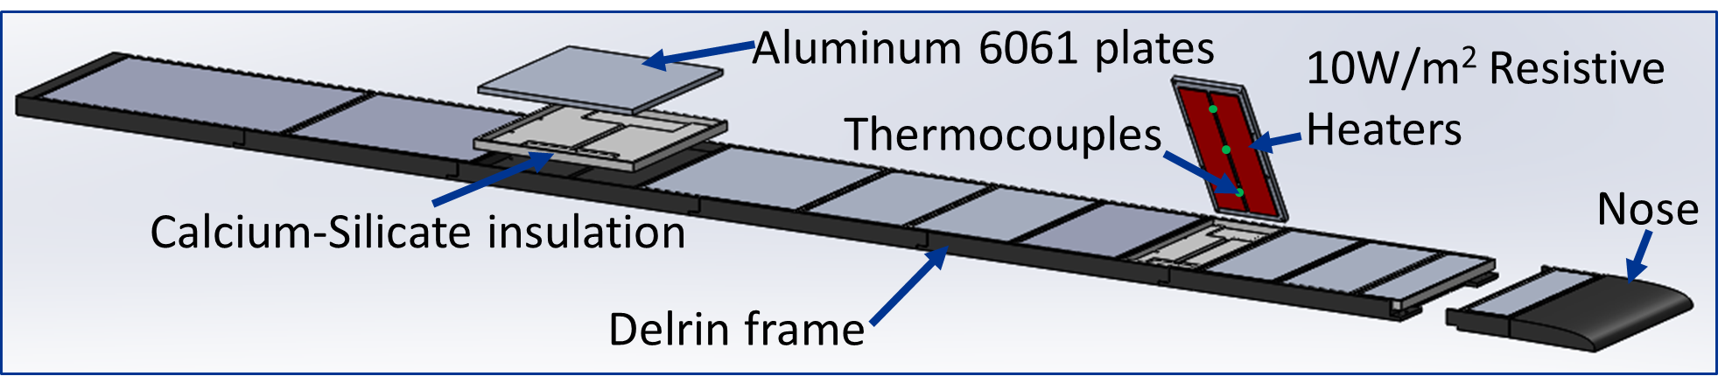
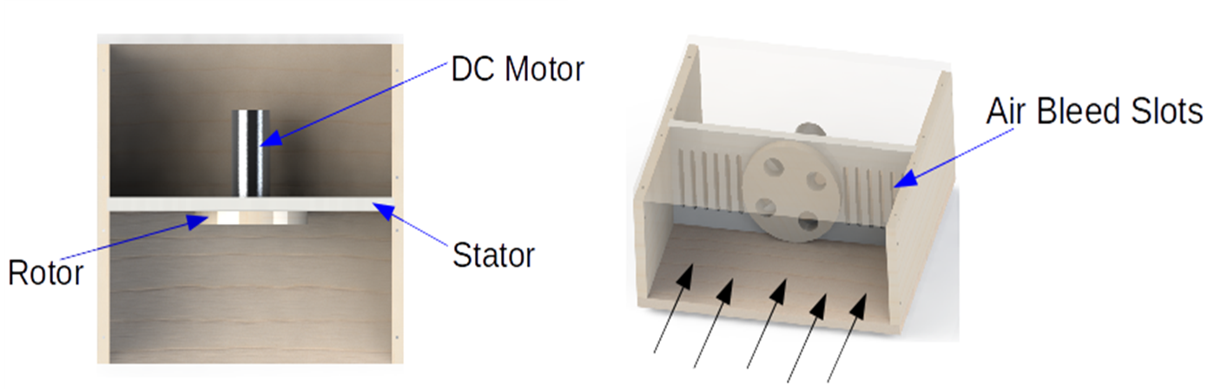
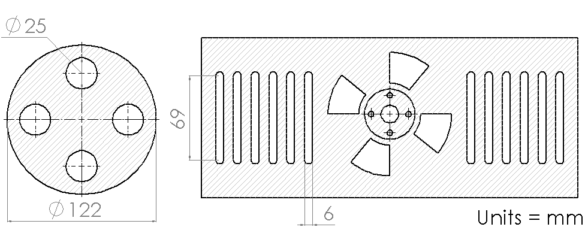
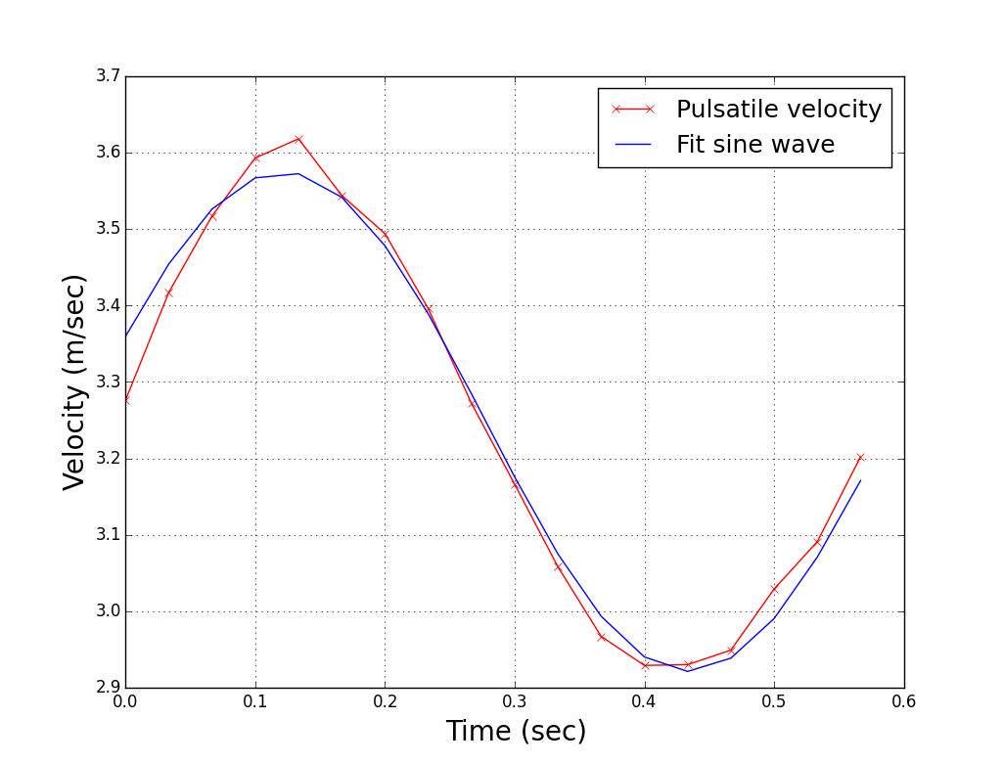
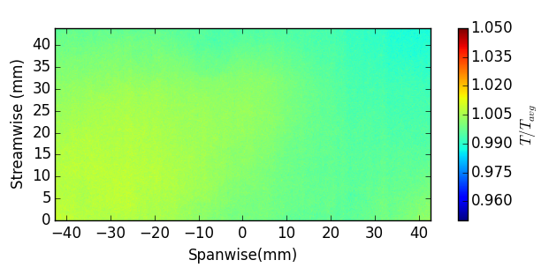
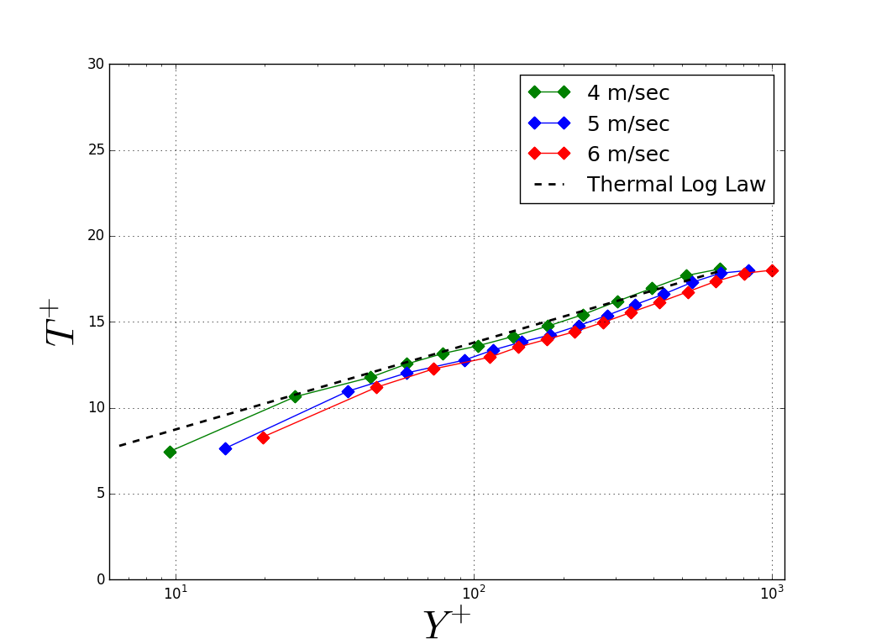
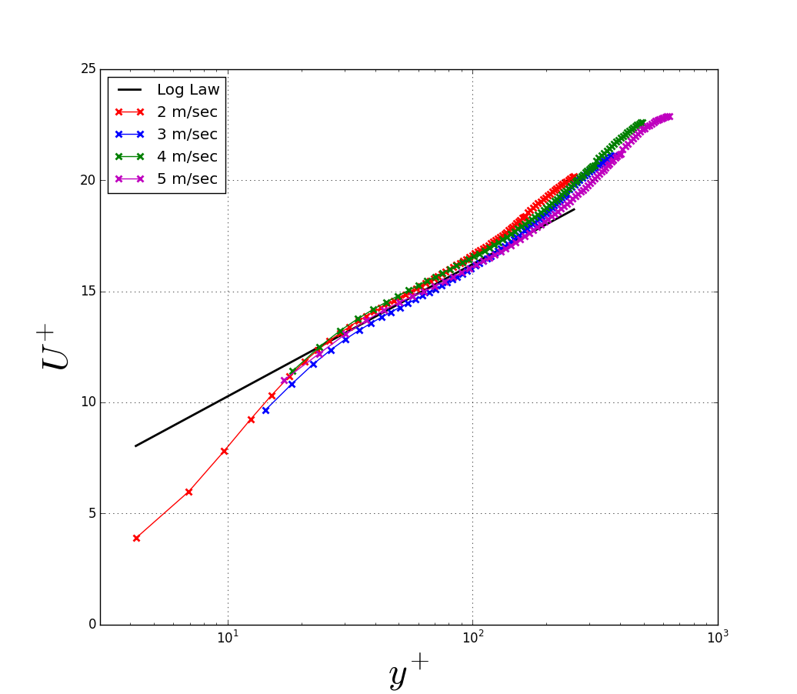
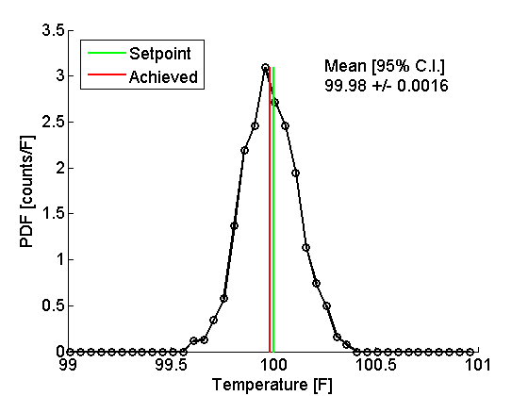


Development of the N.E.A.T Boundary Layer Wind Tunnel
D. Biles, A. Ebadi, M. Allard, and C. White
(Non-Equilibrium And Thermal)
What in the world is a Boundary Layer?
Why is it important?
Boundary layers are omnipresent from our atmosphere to our oceans. They provide the dominant method for mixing of temperature, nutrients, pollution and other passive fields. Boundary layers also control important engineering parameters such as drag and heat transfer.
Test Section
Development length of 2.74m with a cross section of 303mm by 111mm
Resistive Heater
Resistive finned heaters controlled with an SCR for heating/controlling the incoming air temperature.
Fan
Centrifugal fan capable of achieve speeds of 0.5 – 10 m/sec
Diffuser
Rectangle – to – Round diffuser
Contraction
¼ reduction in cross-sectional area using a 5th order polynomial
Rotor-Stator (R-S) Mechanism
The R-S mechanism can be used to modulated the pressure gradient within the tunnel and create sinusoidally varying mean velocity.
Thermal Wall Plate
Sets the temperature of the floor of the wind tunnel.
Turbulent Management Section
A series of honeycomb screens to straighten and condition the incoming air flow.
Seeding Manifold
Manifold for introducing oil droplets into the flow for velocity measurements
Validation
Mean velocity time series
Spatial temperature distribution as measured by an IR camera
Thermocouple temperature profile
Particle image velocimetry velocity profiles
Air temperature probability density function
(normalized mean temperature)
(normalized mean velocity)
So Now What?
(normalized wall normal position)
(normalized wall normal position)
With the validation of the N.E.A.T. boundary layer tunnel complete, experimental investigations can now be performed, tackling two large areas of interest:
Non-equilibrium Fluid Flow 2) Near Wall Heat Transfer
Little experimental data exists for analyzing the above two important areas of research. This data will help inform physics based models to be implemented in the engineering design process. Systems such as gas turbines or internal combustion engines will increase in efficiency because of more informed models.
This work is supported by an NSF/DOE partnership, award’s: 1258702, 1258594, 1258697

