Slide 1


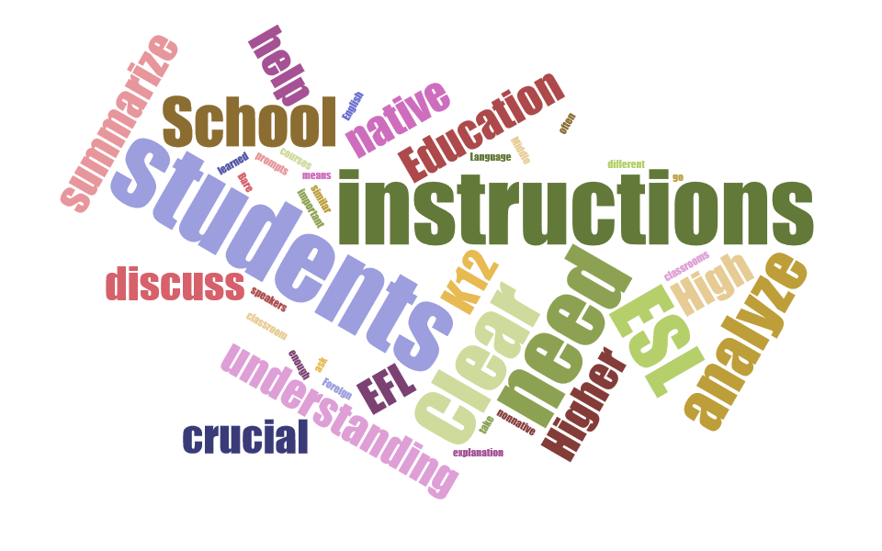
Mechanical Engineering Graduate Students’ Understanding of Writing Assignment Instructions
Jovana Milosavljevic Ardeljan
University of New Hampshire
ABSTRACT
RESULTS
DISCUSION
While there is extensive research on second language (L2) writing examining the process and the final product of writing, few studies look at what happens before students start writing. This paper describes the findings of a mixed-methods research study designed to find out whether students interpret writing assignment instructions in the way their professors expect them to. Furthermore, the study identifies the differences between professors’ and students’ understanding of expectations of a writing assignment at hand. International students in the Mechanical Engineering Department at UNH were asked to explain their interpretation of instructions received for a writing assignment. Additionally, two professors were interviewed and asked to explicitly state their expectations from students’ writing for the given writing assignment. The differences between students understanding of instructions and expectations, and that of professors’ were then explored.
RQ1 How do mechanical engineering students interpret writing assignment instructions, such as “summarize X”?
Based on students’ answers the results show that all the participants expressed concern that they didn’t have enough information to be confident about undertaking the writing assignment that asked them to summarize a scientific paper. Students’ concerns were related to the content requirements, that is how detailed the summary should be, what they should focus on, and whether they were expected to include equations and pictures from the paper, as well as what the page number requirement was. Their understanding of “summarize” varied, and for one of the students it meant that they were expected to provide in depth report on the article. The understanding of another student was that they should find what the main points were and explain those. There was inconsistency among students opinion about what the main points of the article were since they weren’t sure what they were supposed to focus on in the article.
RQ2 What are students’ understanding of the expectations of their writing assignments?
The findings for this question confirm the researchers’ hypothesis that students often don’t know what instructors’ expectations are. From an assignment that asked students to “List any questions that you may have with regard to Fracture Mechanics as of now”, the researcher found that the three students had three different interpretations of the assignment. One student’s understanding was that he needed to come up with questions after he had done the summary (previous assignment). Another student’s interpretation was that he was supposed to look for questions in the text book for the course. Finally, the third student taught that the questions were supposed to come from everything she had learned. She also taught the questions were supposed to be “creative” and to invoke new questions. However, the instructor’s expectation did not match any of the students’ interpretations. These answers imply that students need a little bit more specific guidance in order to minimize misinterpretation. However, on the students’ part there should be more initiative and responsibility as well. None of the student participants confirmed that they asked their instructor for clarification on what the requirements of the assignment were even though they admitted having difficulties understanding them..
Writing assignments expectations: Professor’s vs. students’ understanding
RQ3 What are teachers’ perceptions of ESL students’ understanding of writing assignments?
The interviews with instructors confirmed that there were discrepancies between their perception and that of the students. Even though many of the assignments were carefully designed in terms of giving steps that students should take in order to carry out the assignments, some of the word choices made it difficult for students to interpret them. The syllabi analysis showed that the instructors were not always sensitive to the use of ambiguous vocabulary such as “analyze X”. One of the instructors’ explanations of each assignment that asked for analysis showed that the expectations were inconsistent, meaning that they differed from assignment to assignment even though the tasks were very similar.
Category | Sample student explanation
Vague instructions | It just says “Write summary”
Knowing what professor’s expectations are | The problem is only one statement… I mean it's not actually clear what I think is right is actually what he wants.
More specific instructions needed | [I need] outline of how the thing would look like. But also like that whole process of creating that. Like steps of that procedure.
Show vs. Prove | [I]n the statement it was, two words (…) “show” and “prove”. And when I translated those words into [L1] they have their own meaning, but the thing is that in English they actually have, so what you actually have to do is the opposite
Meaning of “summarize” | I understand what summarize means, but I don’t know, in my head there like maybe several types of how you could summarize (...), so is it like to summarize. I don't know how (…) in depth that summary has to be.
RESEARCH QUESTIONS
How do mechanical engineering students interpret writing assignment instructions, such as “summarize”?
What are students’ understanding of the expectations of their writing assignments?
What are teachers’ perceptions of ESL students’ understanding of writing assignments?
Metacognition is
“awareness of the requirements and processes involved in undertaking the task”
Task Knowledge
“What learners need to know about the tasks”
A key to successful interpretation of a task is metacognitive awareness and task knowledge as it’s crucial part for understanding requirements of an assignment.
(Wenden, 1991)
PEDAGOGICAL IMPLICATIONS
Professor
Organized writing
Students
Organized
2-3 pages
“see key equations from the paper, explanations”
“Own opinion on the subject or if there was something they would do differently”
Recognize main points
Specific vs general points
Not sure about the length
Rethinking and redesigning writing assignments in any subject and at any level.
“Write summary of the paper by Hutchinson”- instructions of the assignment used in the study
Write a summary of the paper by Hutchinson.
Length
Purpose
Guidelines (e.g. Provide main points, organize chronologically, give a personal conclusion)
(Victori, 1999)
REFERENCES
Victori, M. (1999). An analysis of writing knowledge in EFL composing: A case study of two effective and two less effective writers. System, 27, 537-555.
Wenden, A (1991). Metacognitive strategies in L2 writing: A case for task knowledge. In A James (Ed.), Georgetown university round table on languages and linguistics (pp. 303-322). Washington, DC: Georgetown University Press.
(Victori, 1999)
In many cases there are no instructions given at all. In the first place, this refers to writing research papers.
Writing assignments that students receive are designed using bare prompts that ask students to summarize without giving further explanation of expectations or examples of what needs to be done.

