Slide 1
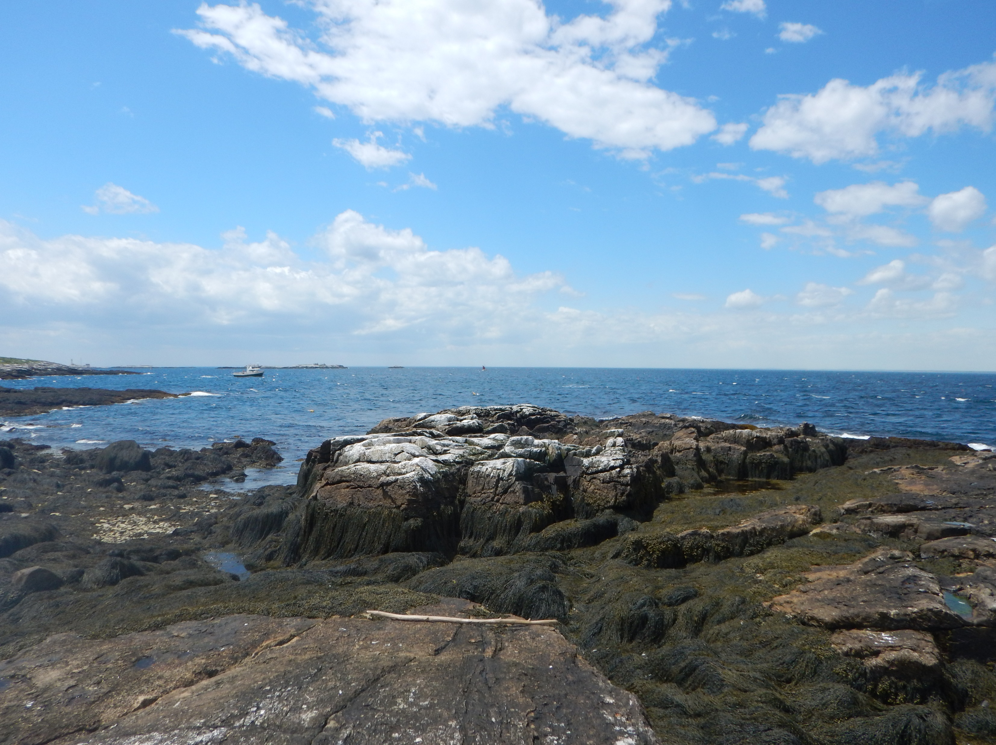



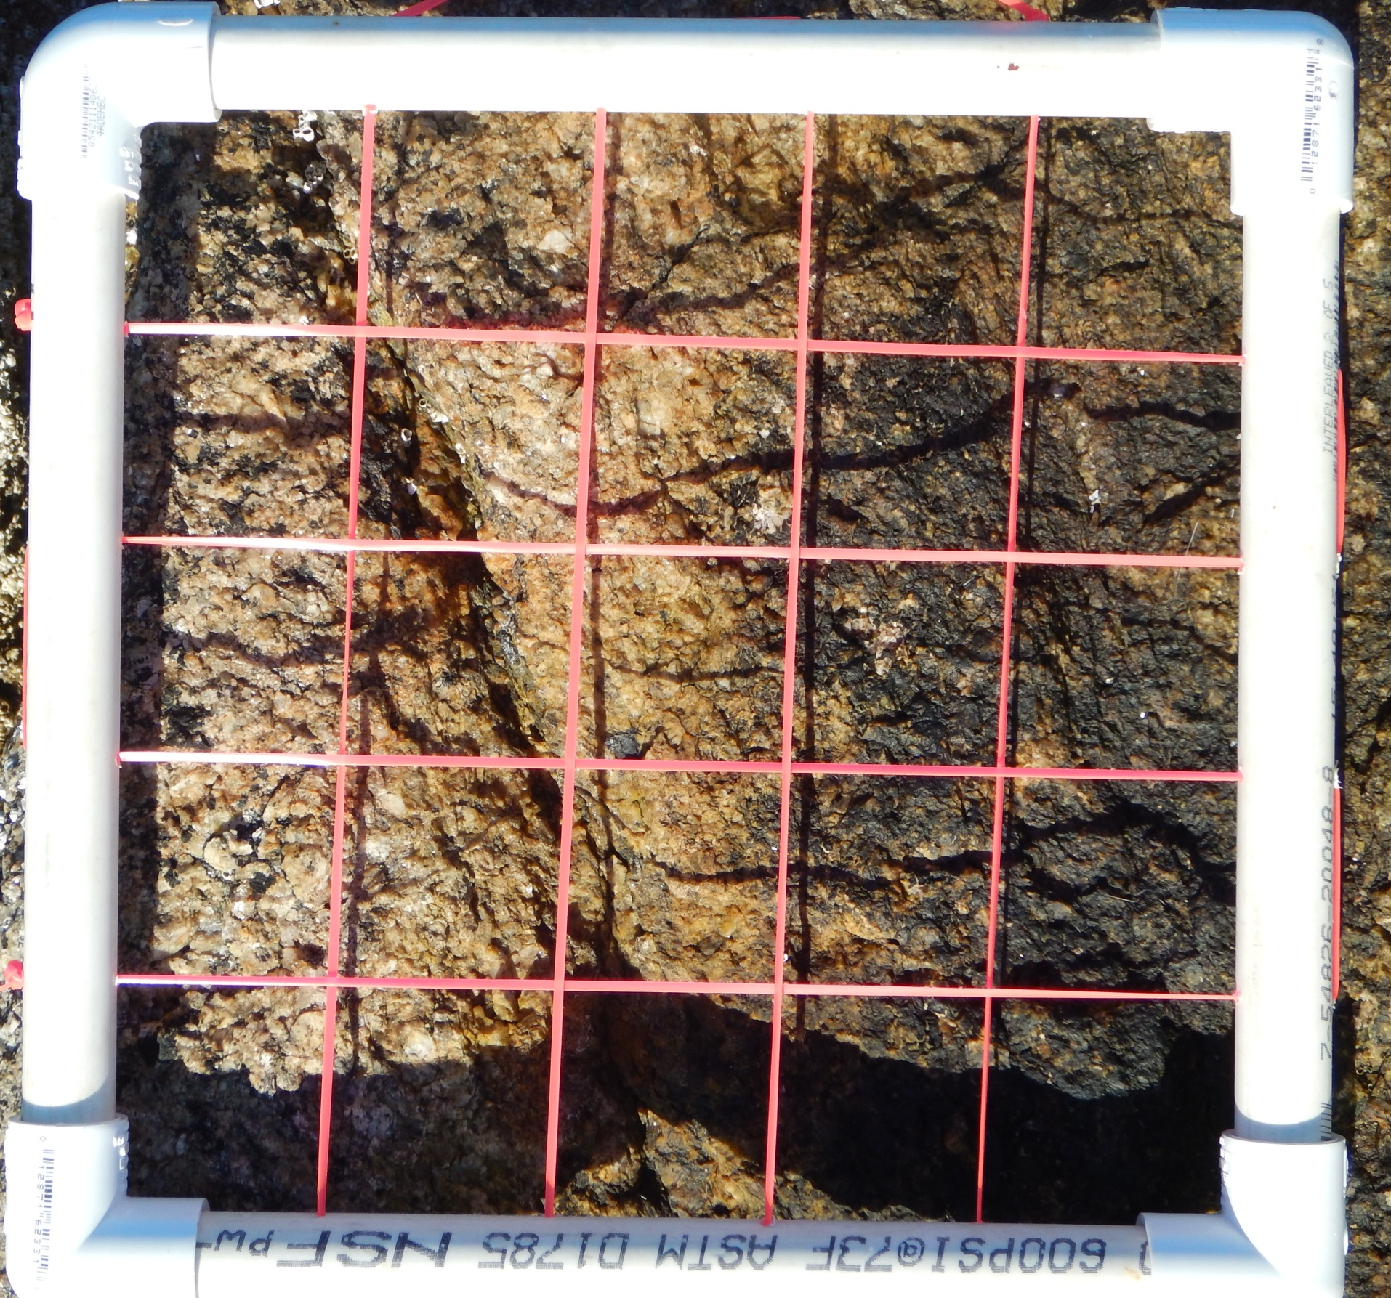
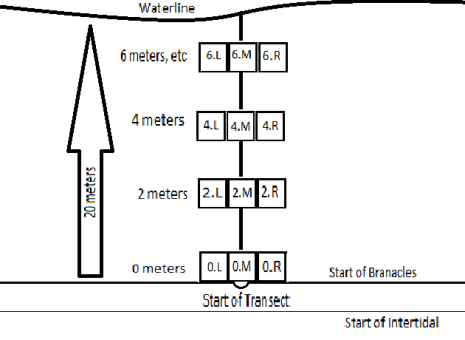
Citizen Intertidal Ecologists Project
Mary Caffrey¹, Addison Jones², Mark Wiley¹
University of New Hampshire
Keene State College
Blog: https://citeproject.wordpress.com/
Introduction
Quadrats
Data Manipulation
The Gulf of Maine has an intertidal that is changing rapidly due to human impacts, but no one has done any comprehensive studies for the entirety of the Gulf of Maine.
Quadrats required in protocol are 25cm X25cm.
Species with lower abundance are counted on an individual basis.
Species with high abundance are counted using percent cover, calculated by determining how many grid squares are occupied by the species.
Barnacles are unique in that they can be both very numerous or absent. These are counted by averaging 5 random squares in the quadrat, even those in which they are absent
Once the data are collected, there will be many ways it can be manipulated and applied:
Different sites will be compared based on environmental differences:
  Wave action
  Nearby human factors
  Wind exposure
  Region within the Gulf of Maine
Weather and time of year will also be taken into account:
  Air temperature
  Water temperature
  Sun exposure
Specific Species distribution can also be examined based on biotic and abiotc factors.
Requests could be taken for data or specific factors or species outside the base list.
Approach
Our approach is to use citizen science to collect data on a number of species throughout the Gulf of Maine. This will allow us to collect more data from the intertidal, over a broader range. A comprehensive database where these data can be stored will allow scientists to access and observe long term trends.
Goals
Species List
Create a unified protocol for collecting species abundance data in the Gulf of Maine intertidal.
Create a species list that is indicative of the health of the intertidal ecosystem.
Train and qualify citizen scientists to collect intertidal ecology data.
Apply these methods internationally.
Create a database where citizens can enter the data for global access.
Design a website that will detail methodology for citizen scientists to initiate permanent transects.
Species | Criteria
Green Crab | Invasive, Predator
Asian Shore Crab | Invasive, Predator, Abundance
Jonah Crab | Predator
Rock Crab | Predator
Tortoiseshell Limpet | Bioindicator, Grazer
Common Periwinkle | Invasive, Abundance, Grazer
Rough Periwinkle | Grazer
Smooth Periwinkle | Grazer
Dog Whelk | Predator
Blue Mussel | Bioindicator, Filter feeder
European Oyster | Invasive
Twelve Scaled Worm | Bioindicator, Predator
Golden Star Tunicate | Bioindicator, Filter feeder
North Atlantic Sea Star | Predator
Green Urchin | Grazer
Lined Anemone | Bioindicator, Filter feeder
Northern Rock Barnacle | Filter feeder, Abundance
Knotted Wrack | Producer, Abundance
Bladder Wrack | Producer, Abundance
Sugar Kelp | Producer
Irish Moss | Producer
Gutweed | Producer
Sea Lettuce | Bioindicator, Producer
Sample Data Trends
Sample data were collected on Star Island. Two transects were examined with the help of citizens, one on the protected side of the island and one on the exposed side of the island.
Data were used to test how future data could be manipulated to determine deviations from the ‘right’ answer due to citizen involvement.
Data were not numerous enough to establish any concrete tends, however they were useful in examining how to manipulate data in the future.
More citizen scientists will be able to create a much larger picture and potentially find more trends within the Gulf of Maine
Protocol
Acknowledgements
Thanks to Jennifer Seavey and James Coyer of the Shoals Marine Laboratory; Arthur Eaves and Joe Watts from the Star Island Corporation; and colleagues and staff of Shoals Marine Laboratory.

