Slide 1



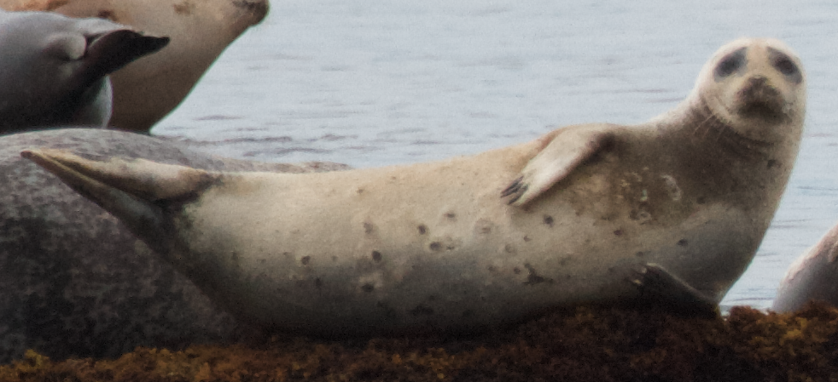
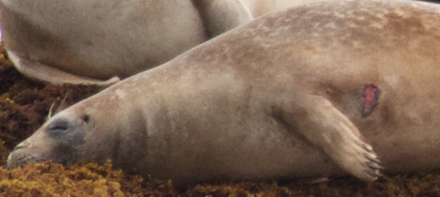
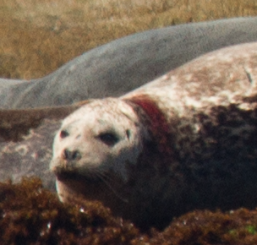
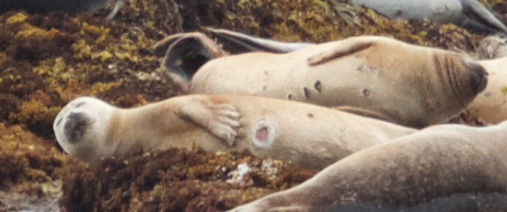
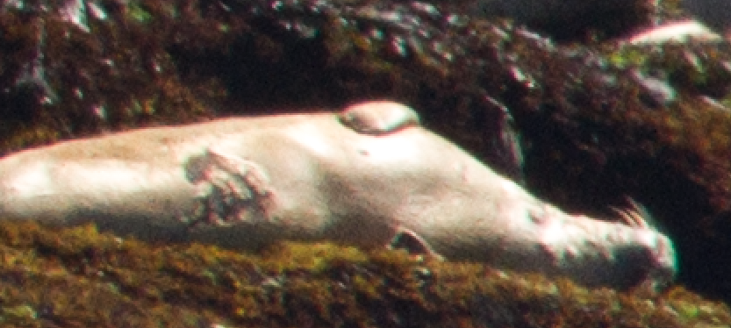
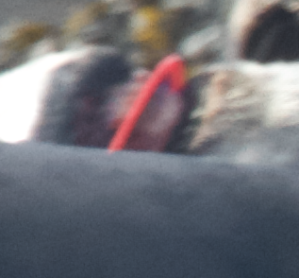
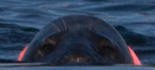
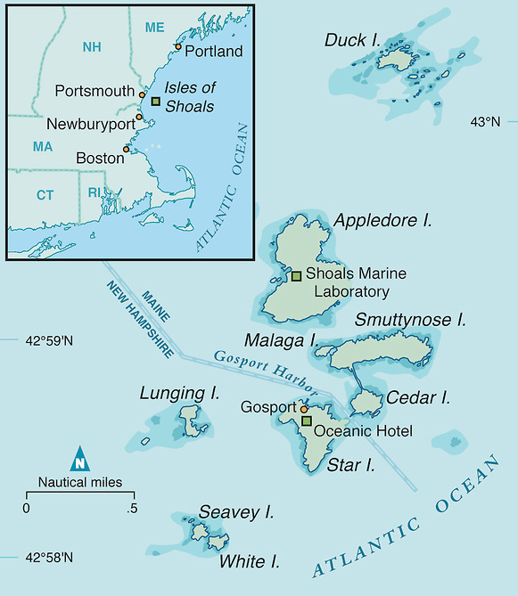
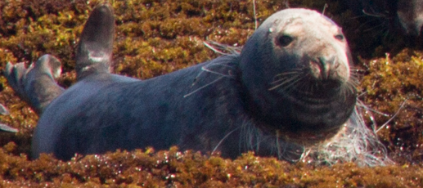
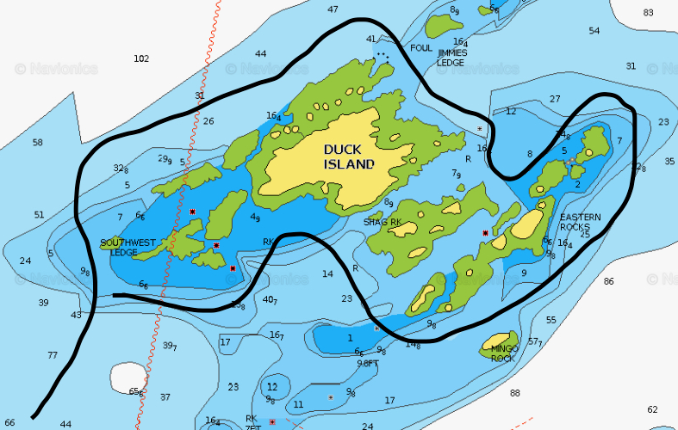
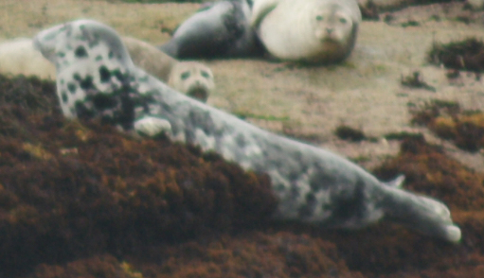
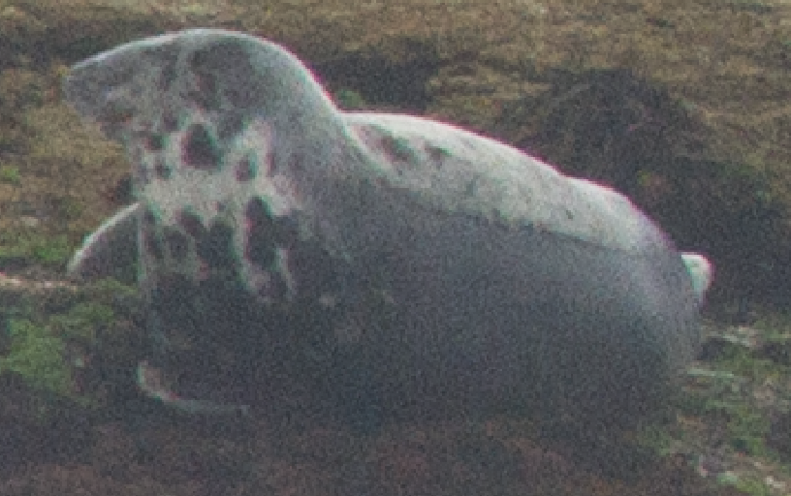
Population assessment of Harbor (Phoca vitulina) and Grey seals (Halichoerus grypus) at Duck Island ledges, ME
Bogomolni¹, G. Calandrino², M. Carr³, N. Lysiak⁴, G. Tsourounakis⁵
¹Woods Hole Oceanographic Institute, Woods Hole, MA
²Department of Natural Resource Conservation, UMASS Amherst, Amherst, MA
³Department of Biological Sciences, University of New Hampshire , Durham, NH
⁴Department of Biology, UMass Boston, Boston, MA
⁵Department of Biology, Cornell University, Ithaca, NY
Introduction
Results and Discussion
F
G
The abundance of pinnipeds in the Gulf of Maine has been increasing since the Marine Mammal Protection Act went into effect in 1972.¹ Prior to the MMPA, two species of phocids, Halichoerus grypus (Grey seal) and Phoca vitulina (Harbor seal), were hunted for bounty and experienced a significant population decline.²​
Duck Island and its surrounding ledges are a part of the Isles of Shoals in the Gulf of Maine. This area acts as a central resting point along the seasonal migratory route of harbor and grey seals, making it a highly relevant study site for population assessment.
Abundance
Minimum abundance increased for both species
Harbor linear regression
y=24.7 + 210.8
R²=0.80
Grey lin. reg.
y=30.4 + 33.7
R²=0.98
Entanglement by Year
Entanglement rates varied by year
Increase in Grey seal entanglement since 2013
2016 Entanglements
24 Grey seals
18 Harbor seals
A Grey seal entangled in a red plastic disc was sighted five times (C, D)
Other types of entangling gear included monofilament line and gillnet (E) in addition to multifilament line, rope, trawl net and a hook
Resights
20+ individuals resighted from previous years
“Granite” sighted for the first time since named in 2011 (see left)
H
Observations
11+ cases of seal pox (F)
30 injuries of varying severity (G, H)
Unique findings (I, J)
One harbor seal was sighted with a green tag on its right hind flipper
I
J
Objectives
Assess temporal changes in abundance
Monitor population health by recording instances of disease, injury, entanglement and human interaction
Identify individuals seals using photographic mark-recapture
Conclusion
Duck Island and the surrounding ledges serve as an important habitat for both Halichoerus grypus and Phoca vitulina
Harbor and Grey seal minimum abundances are increasing at this site
The continuation of this study is imperative, as creating long-term datasets will enable human interactions and population health to be better monitored
Methods
Shipboard photographic surveys conducted at low tide during summers 2011-2016
Minimum abundance assessed
Incidence of disease, entanglement, pathological abnormalities, and presence of tagged or branded individuals noted
Database used to identify resighted individuals based on unique patterns
C
D
Future Research
E
Study behavior of seals that are hauled out and in the water
More thorough analysis of diseases, pathology, injuries
Charts
Location of Duck Island ledges in the Isles of Shoals (A)
Survey route around the ledges (B)
Acknowledgements
We express our deepest gratitude toward B. Carver, J. Coyer, O. Foley, and T. Klodenski. We also thank Cornell University, the University of New Hampshire and SHOALS Marine Laboratory for funding this project.
References
¹Waring, G., Gilbert, J., Loftin, J. 2006. Short-term movements of radio-tagged harbor seals in New England. Northeast. Nat. 13: 1-14
²Lelli, B. and Harris, D. 2006. Seal bounty and protection laws in Maine, 1872-1972: Historic perspectives on a current controversy. Nat. Resour. J. 46: 881-924
Nautical charts: Mirto Art Studio, Navionics
*photos were taken under Level B NOAA NMFS LOC permit 20412.
A
B
2011
2016

