Slide 1



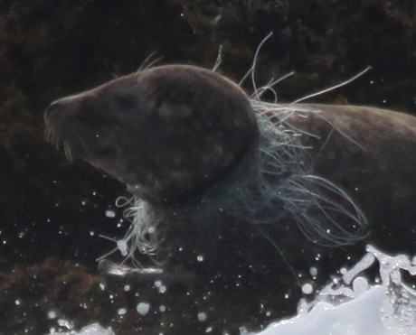
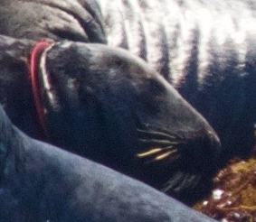
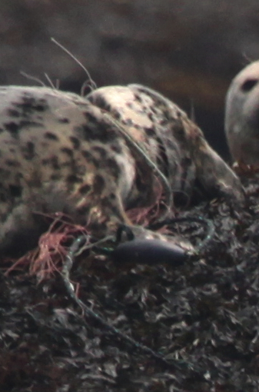
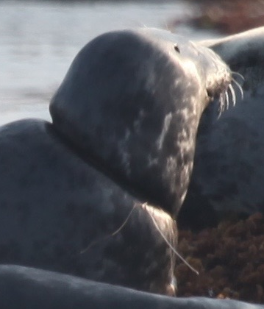
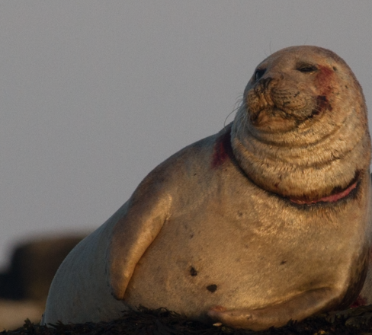
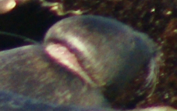
Entanglement of Grey (Halichoerus grypus) and Harbor seals (Phoca vitulina) at Duck Island ledges, ME
M. Carr¹, A. Bogomolni², N. Lysiak³
¹ Department of Biological Sciences, University of New Hampshire , Durham, NH
² Woods Hole Oceanographic Institute, Woods Hole, MA
³ Department of Biology, UMass Boston, Boston, MA
Introduction
Results and Discussion
Fig 4. 2016 Gear Type
Gear Type
Most common entangling gear: monofilament
Other gear types included rope, multifilament line, a hook, and a red plastic ring
Marine debris is at an all time high¹
Marine mammals are severely impacted by entanglement²
Phocid seals are curious and often interact with fishing gear²
Entanglement results in:
  Increased mortality^{2,3}
  Increased metabolic costs^{2,3}
  Decreased mobility^{2,3}
  Increased predation^{2,3}
Entangling gear often representative of local fishery activity⁴
No assessment of entanglement at Duck Island ledges
Shipboard photographic surveys conducted at low tide during summers 2011-2016
Minimum abundance, health and entanglement of Harbor (Phoca vitulina) and Grey seals (Halichoerus grypus) were assessed
Categorization
Location of entanglement gear on body
  neck, flipper, body, multiple locations
Gear type
Severity Score*
*A score of 1 (loose) has never been observed at Duck Island
Fig 1. Normalized Yearly Entanglement Rates
Entanglement Rate
Accounted for changes in survey effort and proportion of the two species
Variation by species and year
Average value was higher for Harbors (14.7) than Greys (11.7)
Probability of Resight
Higher for nonentangled seals than harbor seals
Probability was artificially high for grey seals as one 2016 individual was resighted many times
Severity Scores
Little variation between species
Average Harbor seal score was 3.00
Average Grey seal score was 3.05
The majority of wounds were severe and could be life-threatening
Significance
Inform marine policy decisions
Evaluate fishery interactions
As marine debris is a global problem, this research holds important implications for many other species
Methods
Future Work
Fig 2. Probability of Resight (Annual)
Identify sources of fishery-related entanglement gear
Compare to other entanglement studies of Phoca vitulina and Halichoerus grypus in the Gulf of Maine and worldwide
Estimate mortality rates of entangled individuals
Compare to entanglement of other pinnipeds and marine mammal species
Identify ways to mitigate entanglement
  Degradable plastics
  Deterrent systems
  Proper plastic disposal
Acknowledgements
Fig 3. Distribution of Severity Scores
We express our deepest gratitude toward M. Calandrino, B. Carver, J. Coyer, O. Foley, T. Klodenski and G. Tsourounakis. We also thank Cornell University, the University of New Hampshire and SHOALS Marine Laboratory for funding this project.
Monofilament Net
Plastic (aerobic frisbee)
Rope with Floats
References
¹Gregory, M. 2009. Environmental implications of plastic debris in marine settings-entanglement, ingestion, smothering, hangers-on, hitch-hiking and alien invasions. Phil. Trans. R. Soc. B. 2013-2025.
²Laist. D. W. 1997. Impacts of Marine Debris: Entanglement of Marine Life in Marine Debris Including a Comprehensive List of Species With Entanglement and Ingestion Records, p. 99-139. In J. Coe and D. Rogers [eds.], Marine Debris. Academic.
³Fowler, C., Merrick R., Baker, J. 1990. Studies of the population level effects on entanglement on Northern fur seals. Mar. Mam. Sci. 453-474.
⁴Page, B., McKenzie, J., McIntosh, R. et al. 2004. Entanglement of Australian seal lions and New Zealand fur seals in lost fishing gear and other marine debris before and after Government and industry attempts to reduce the problem. Mar. Pollut. Bull. 49: 33-42.
*All photos were taken under level B NOAA NMFS LOC permits 16260-01, 16260-02 and 20412.
2: Tight
3: Severe
4: Extremely Severe

