Slide 1
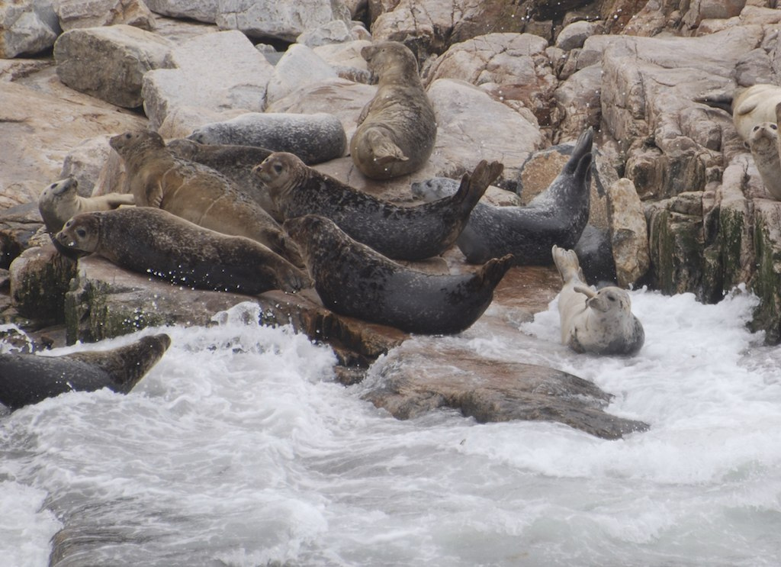


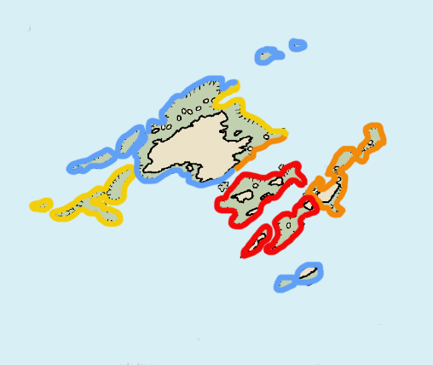
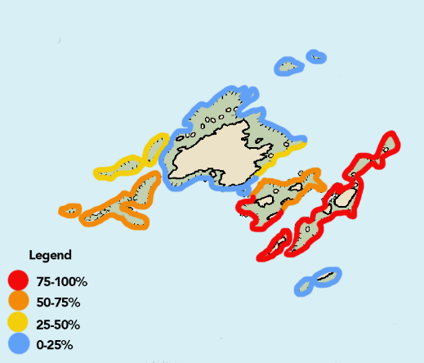
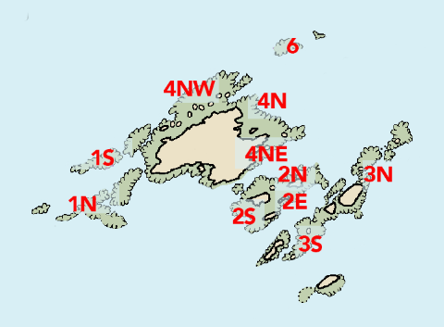
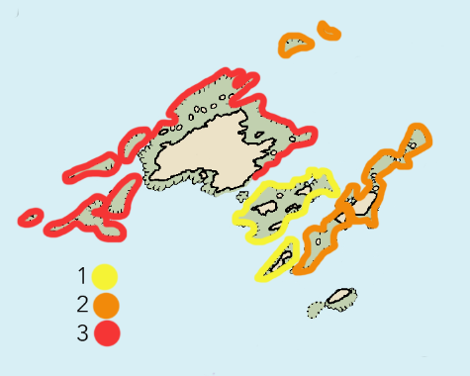
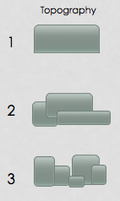
Fine-scale Haul-out Preferences of Harbor Seals and Gray Seals at Duck Island, ME
George Tsourounakis¹ Andrea Bogomolni² Nadine Lysiak³
¹Department of Animal Science, Cornell University
²Woods Hole Oceanographic Institution, Woods Hole, MA
³Deptartment of Biology, UMass Boston, Boston, MA
Introduction
Harbor (Phoca vitulina) and Gray Seals (Halichoerus grypus) haul out at Duck Island, ME, and most arrive from other locations along the eastern coast of the US where they haul out on beaches, rocky areas, and ice. Duck Island is unique as a middle ground between major populations but, it is not known why Duck Island is an attractive haul out site.
Results & Discussion
33% of Harbor Seal minimum count at 2S
37% of Gray Seal minimum count at 3S
Questions
What are the haul-out preferences of Harbor and Gray Seals?
How can these parameters be incorporated into a predictive model?
Fig. 2. Proportional minimum count with standard error bars of Harbor and Gray Seals 2012-2016
Fig. 6. Proportional count at each ledge with standard error bars with assigned topography score for Harbor Seals and Gray Seals
Topography has a clear influence on Harbor Seals hauling out with a preference for flatter areas
Gray Seals prefer an intermediate relief
Slope, ledge size, and depth have little to no effect on haul-out preferences for either species
While there is clear preference, it is not feasible to put these variables into a predictive model at this time
Methods
Mark/ recapture surveys from 2012-2015
Minimum count data analyzed for species- specific haul out sites
Photos, shipboard surveys, and nautical maps used to assess qualitative and quantitative factors of each ledge
Fig. 3. Probability of sighting based on presence at ledge for each survey for Harbor Seals (left) and Gray Seals (right) on Duck Island and the ledges
Future Research
More detailed characterization of rocky ledges
Create more accurate topographic maps for better haul-out assessment
Correlate habitat change due to rising sea levels
Gray seal sighting most likely at 3N and 3S
Harbor seal sighitng most likely at 3N, 3S, and 2
Fig 4. Key for topography judgment, depicting rockiness of ledges
Acknowledgments
We thank Shoals Marine Laboratory. Thank you to Dr. Jim Coyer, the captains (Ossian Foley, Tom Klodenski, Ben Carver, and Mike Rosen), Dr. Jennifer Seavey, the kitchen staff, coordinators, and managers. We would also like to thank Mila Calandrino and Meg Carr for their contributions. We thank University of New Hampshire and Cornell University for support.
Permit No. NOAA NMFS LOC 20412
Fig 5. Map illustrating the topography of each ledge, 1 being the most flat to 3 being rocky
Fig 1. Identification of census location on Duck Island and surrounding ledges

