Slide 1


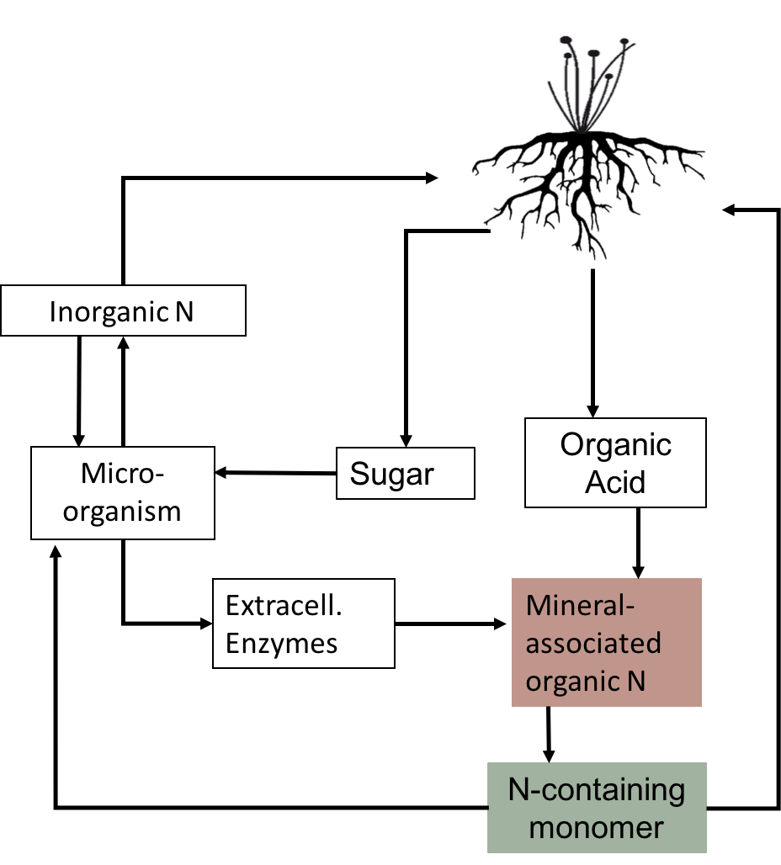
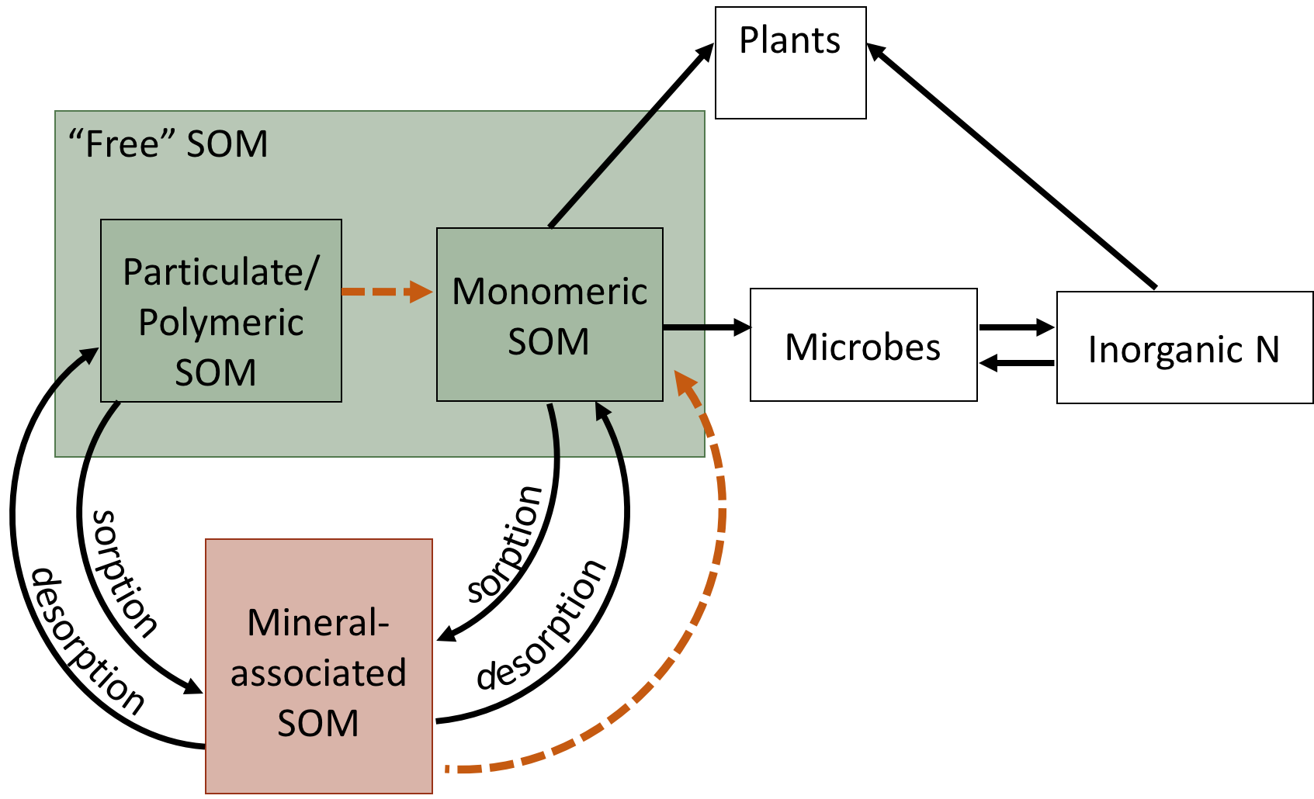
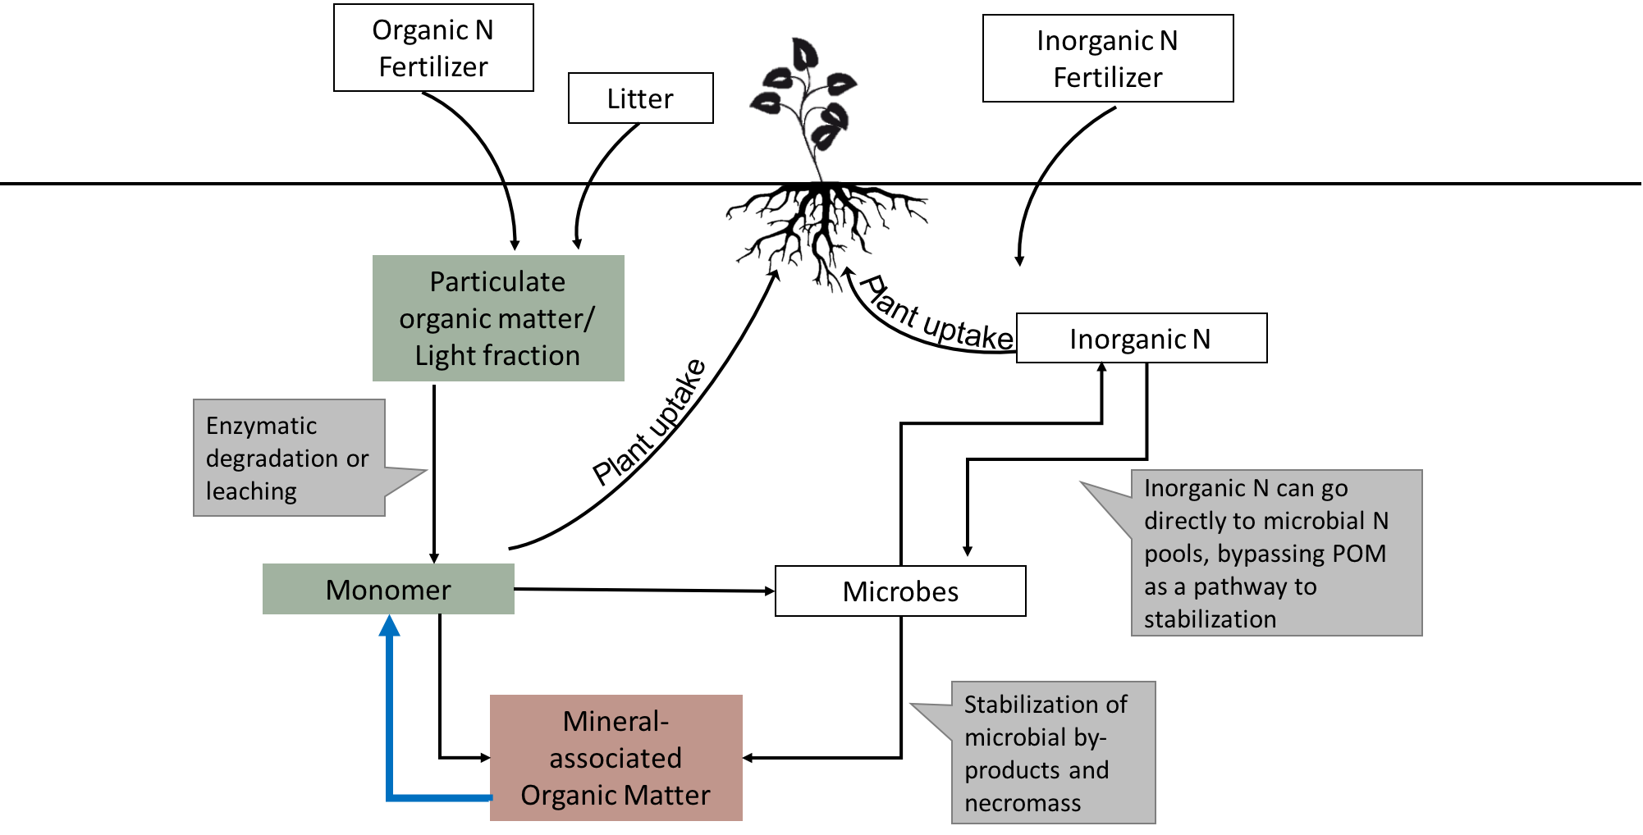
Soil minerals as mediators of nitrogen transformations in the rhizosphere
Andrea Jilling¹ and A. Stuart Grandy¹
¹Department of Natural Resources and the Environment, University of New Hampshire, Durham, NH, United States
Introduction
Proposed conceptual model
Biotic and abiotic pathways to MAOM-N destabilization
Recent research on soil N dynamics has shifted in focus from net mineralization to soil organic matter (SOM) depolymerization as being the rate limiting step for N availability. To that end, Schimel and Bennett (2004) argued that depolymerization and subsequent plant-microbial competition for N-containing organic monomers regulates N availability. Building upon this model, we present a new conceptual framework arguing that along with depolymerization, mineral-organic associations may proximally regulate the provisioning of bioavailable organic N monomers especially in the rhizosphere.
Background
Conceptual diagram illustrating proposed model wherein minerals mediate organic nitrogen availability. Green box: particulate/polymeric and monomeric forms of SOM that are designated “free” in that they are not associated with mineral particles – thus, more physically accessible in the soil solution; Pink box: mineral-bound polymeric and monomeric SOM; Black arrows: physical mobilization or movement of N between pools; Orange hashed arrows: biologically-driven flows that require extracellular transformations
Mineral-associated organic matter (MAOM) is a significant and often overlooked reservoir for N. In cultivated soils, MAOM stores 5-20x more N than particulate or physically accessible fractions. Fine fractions also preferentially accumulate N compounds such as proteins, amino acids, and nucleic acids. As such, MAOM has a low and energetically favorable C:N relative to other components of SOM (Sollins et al., 2006). While largely protected from degradation, a portion of these mineral-associated compounds can undergo rapid exchange with the soil solution (Balabane, 1996). The conditions that allow for this turnover are poorly understood despite its potential to supply such N-rich compounds to the soluble N and plant-available pool.
Plant roots continuously deposit low molecular weight compounds via exudation and can significantly influence SOM mineralization. Known as the “priming effect”, root exudates can stimulate the associated microbial community and modify the chemical environment. As the strength and form of mineral-organic associations are highly sensitive to their microenvironment, it is possible that biochemical modifications in the rhizosphere could significantly enhance MAOM stabilization and destabilization processes. Alternatively, mineral surfaces vary considerably in physical and electrochemical properties and these differences may mediate how strongly or loosely organic matter is held. Mineral surface properties may thus influence how MAOM responds to rhizosphere processes.
Hypotheses
Mineral-associated organic matter (MAOM) is a potentially mineralizable and important source of nitrogen in the rhizosphere of agricultural soils
Root-deposited low-molecular weight inputs facilitate the biotic and abiotic destabilization and subsequent bioavailability of MAOM
Biotic:
Energy-rich rhizodeposits, such as glucose, stimulate microbial activity and the spatially concentrated production of extracellular enzymes. Labile carbon consumption induces a microbial N- limitation and N mining response that targets the N-rich compounds of MAOM.
Abiotic:
Organic acids released on or near mineral particles can destabilize bound organic matter by directly interfering with metal- organic bonds
3. Following labile C inputs , the competitive balance between the
potential fates of N-containing monomers—stabilized on mineral
surfaces or dissolved and available for assimilation—depends on the
specific influence of clay composition on the mineral-bound organic
matter, soil solution and the microbial community.
Minerals interactions with SOM, the soil solution, and microbial communities
Microbial community
Soil solution
Soil organic matter
Mineralogy can drive the establishment and development of microbial communities and influence their specific activities.
Clay composition
Mineral identity (i.e., 2:1 clays, 1:1 clays, and Fe and Al-oxides) will determine how SON binds and how vulnerable to destabilization
Localized changes in pH can influence the charge characteristics of clays and dissolved organics; changes in soil solution can modify the form and strength of mineral-ON interactions.
N-containing compounds are more soluble than C-rich compounds and are more susceptible to desorption and solubilization than the latter. The chemistry of mineral-bound SOM will control exchange dynamics.
Acknowledgements and references
Conceptual diagram highlighting the pathways to N stabilization and destabilization in agricultural soils. N inputs contribute to the mineral-associated pool via biotic and abiotic pathways. In turn, the MAOM pool can release organic N back into the soluble and potentially plant-available pool (blue arrow) — we focus on this particular pathway throughout the proposed conceptual framework.
This work was funded by the USDA-NIFA-Grant #2014­67019­21716.
References: Balabane, M., 1996. Turnover of clay-associated organic nitrogen in the different aggregate-size classes of a cultivated silty loam. European Journal of Soil Science 47, 285–291. doi:10.1111/j.1365-2389.1996.tb01402.x ; Schimel, J.P., Bennett, J., 2004. Nitrogen Mineralization: Challenges Of a Changing Paradigm. Ecology 85, 591–602. doi:10.1890/03-8002
Sollins, P., Swanston, C., Kleber, M., Filley, T., Kramer, M., Crow, S., Caldwell, B.A., Lajtha, K., Bowden, R., 2006. Organic C and N stabilization in a forest soil:; Evidence from sequential density fractionation. Soil Biology and Biochemistry 38, 3313–3324. doi:10.1016/j.soilbio.2006.04.014
Notes:
The vast majority of a plant’s nitrogen needs are supplied by a pool that is physically unprotected and chemically labile. Often defined operationally as the light- or particulate organic fraction, this pool is in general considered distinct from mineral associated organic matter. We propose that the fine fraction and rapidly cycling nitrogen pools are not mutually exclusive across all agricultural soils.
These measures included soil total nitrogen content (TN), particulate organic matter nitrogen content (POM-N), the ratio of POM-N to total N (POM:TN), soil texture and potential N mineralization. Mineralogical classifications—specifically, the relative abundances of specific clay minerals—were also determined for each soil using the Natural Resources Conservation Service soil characterization. Due to the limited dataset and the degree of multicollinearity between explanatory variables, we applied partial least squares regression (PLSR) to assess the relationships between soil mineralogical and textural classifications and all N-related variables. PLSR distills the information in dependent and independent variables into linear combinations, or latent variables, such that the covariance between the latent x variables maximally explains the variation in the response variable. The contribution of specific variables is assessed based on the variable importance in projection (VIP) and its calculated weight.

