Slide 1

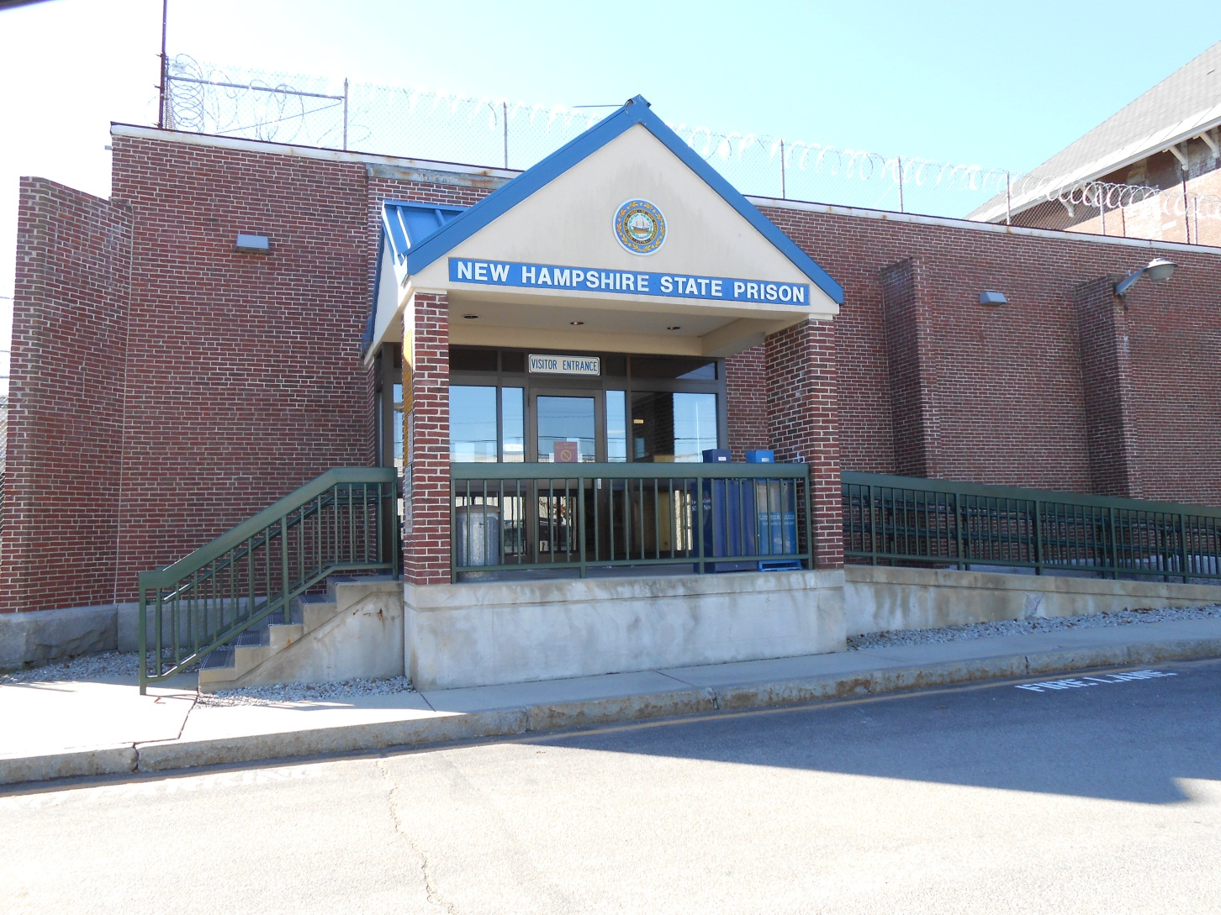
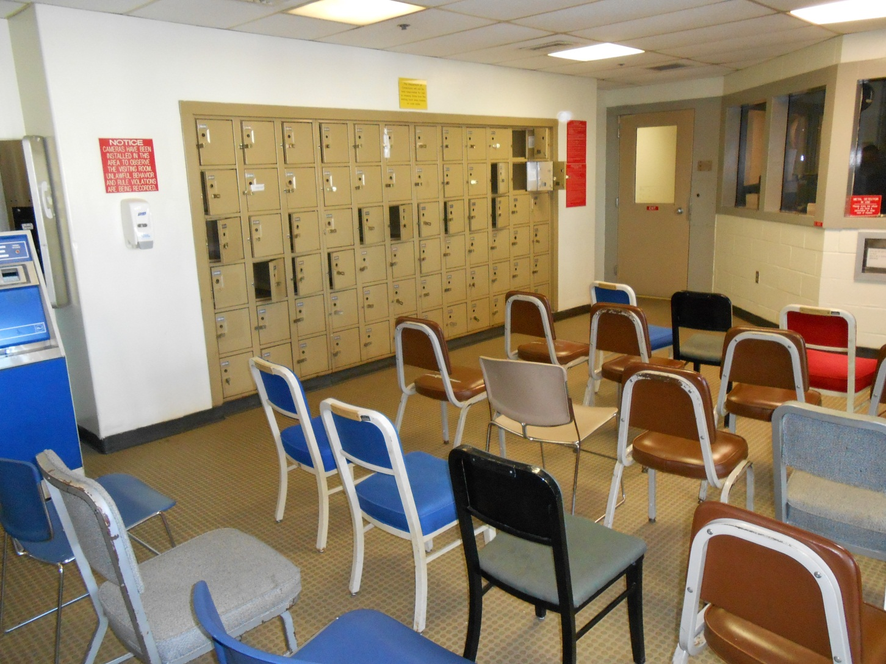

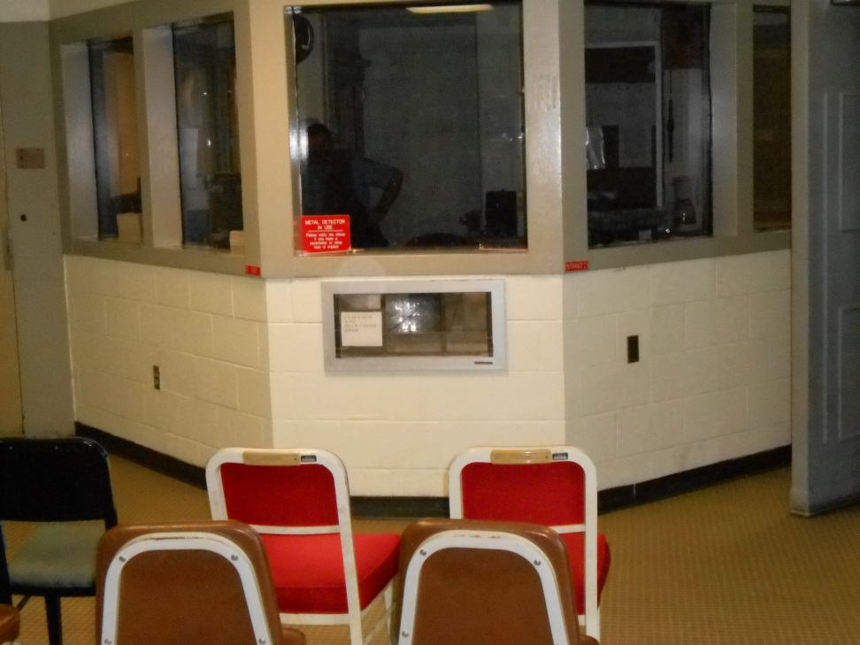
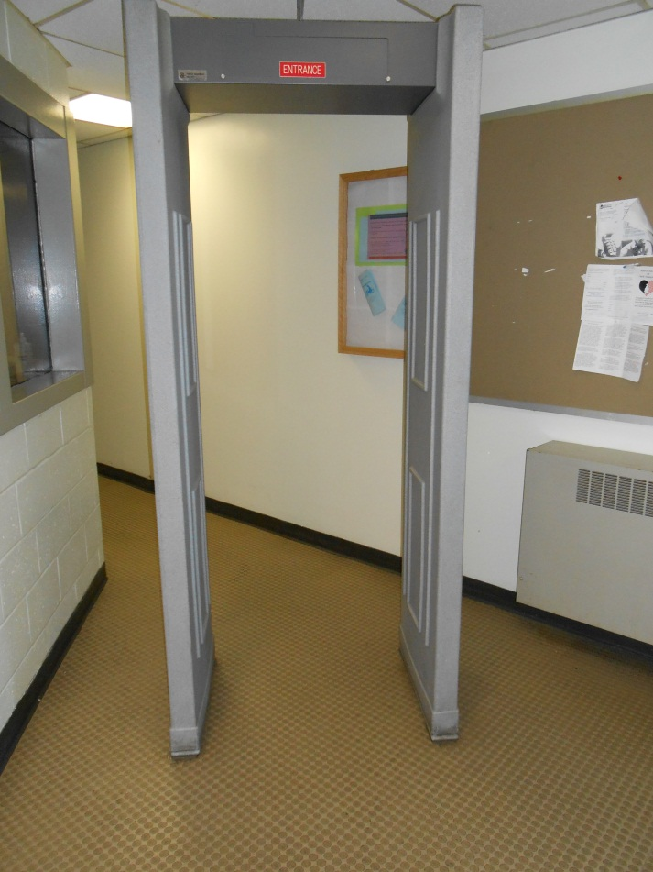
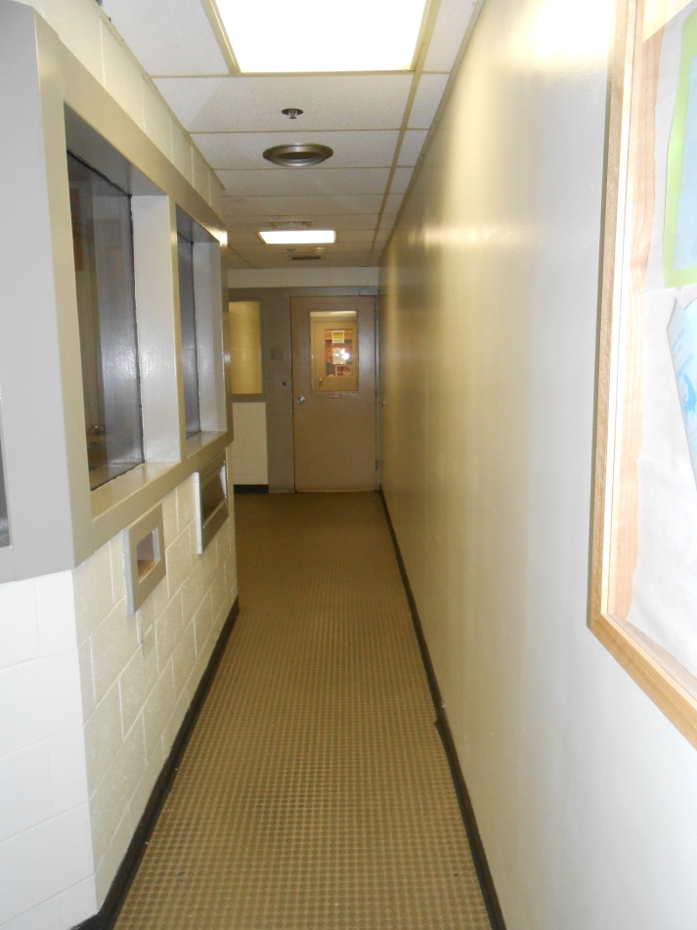
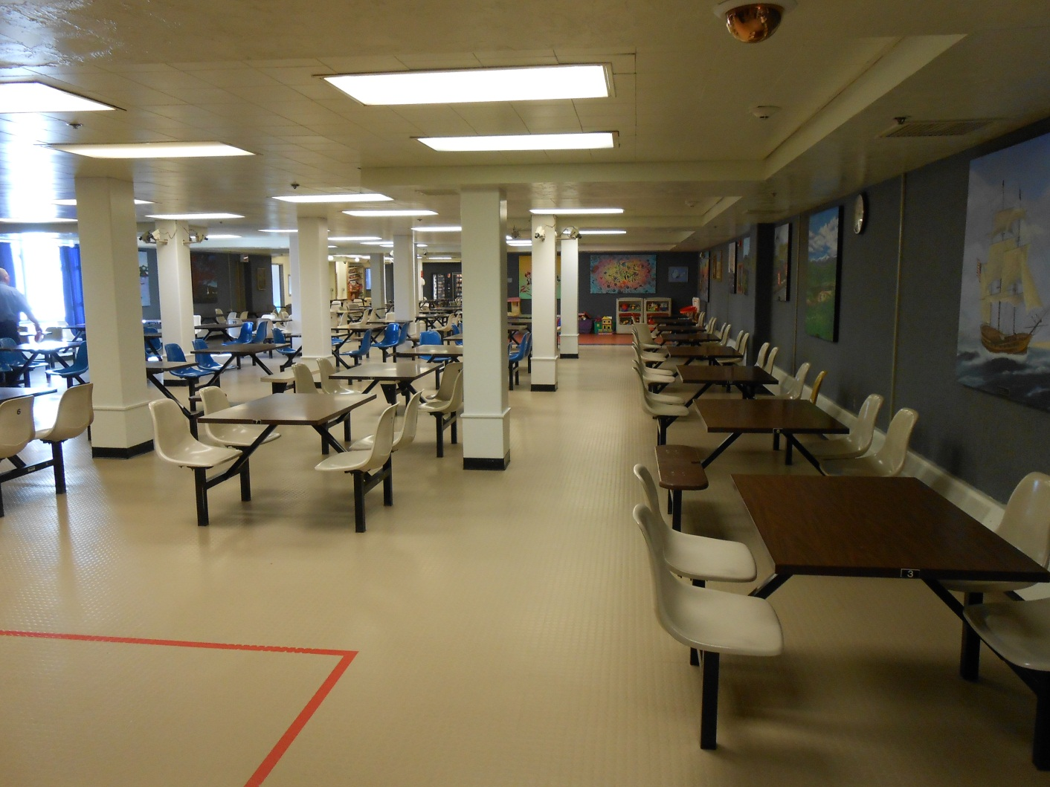
Incarcerated Men and Their Partners: A Relationship Intervention Study
Kerry Kazura, Ph.D.
Associate Professor & Chair
Human Development and Family Studies
University of New Hampshire
Participants
The following analyses were conducted using data from 40 incarcerated men and 40 female partners who completed the PREP© program.
All couples were in a committed relationship with the relationship length averaging 6.29 years (sd=5.33) and ranged from 1-28 years.
Participants’ Age
42.3% between the ages of 18-35
50.9% between the ages of 36-55
6.8% over 65 years old
Ethnicity
0.3% Asian
7.9% Black
9.3% Hispanic
11.6% Other
Prison Waiting Room
Results
The results suggest improvement for both inmates and their partners was similar in the areas of positive interactions and relationship confidence, with scores significantly increasing for both groups.
There were different trends between inmates and their partners for relationship satisfaction and negative interactions. Men’s marital satisfaction was not significantly different from time-1 to time-2. The men may have felt a level of constraint due to their incarceration and physical separation from their partner. While their female partners did report a significant increase in relationship satisfaction.
The second difference was in negative interactions while both groups scores decreased over time, only the men’s scores were significantly different. Men’s scores were slightly higher than women’s at time-1 and combined with the impact of their incarceration, they may have had more room for improvement.
The posttest intervention questions reveals that both men and women found the PREP program useful for learning effective communication skills, increasing positive attitude about their relationship and learning the key risk factors in relationship failure. However, listening techniques and setting ground rules during discussions were still issues both groups struggled with at time 2.
Conclusion
Evidence-based relationship programs designed specifically for this population are critical for successful re-entry into society. The huge cost associated with incarceration and recidivism can be reduced with more reentry programs that address the special needs of inmates’ family systems.
Introduction
• The Family Connections Center (FCC) was founded in 1998 from a partnership created among the New Hampshire’s Department of Corrections, University of New Hampshire’s (UNH) Department of Human Development & Family Studies.
• Male offenders who maintain strong connections to their family during incarceration have higher rates of post release success than those who do not.
• Few rehabilitation programs address the needs of establishing healthy family relationships.
•Programs that have focused on improving family functioning have adopted a wide range of formats which have been delivered by a variety of agencies: family support providers, state agencies, and community and faith based organizations. However, few have provided these programs to both partners at the same time.
Purpose of Study
•The purpose of this study was to examine pre- and post-test data from inmates and their partners who participated in the Prevention and Relationship Enhancement Program (PREP©) while in prison.
Identification card to be filled out and
handed to correctional officer behind glass.
Visitors must walk through metal detector,
then get their hand stamped with invisible ink.
Measures and Analyses
Relationship Satisfaction
Relationship Confidence
Negative Interactions
Positive Interactions
PREP© Pre and post test questionnaire
A series for 2 (time) x 2 (gender) analysis of variance were conducted to examine changes from pre- to post- intervention among inmates and their partners. Time was treated as a within-subjects factor and gender as a between-subjects factor. The time factor represented the pre and post intervention scores on each of the measures.
Prison Visitation Room

